Slide 1
Workshop 1: Semester projects & R projects in R studio
BIOL90041
Week 2

Slide 2
Todays learning objectives
Assign group projects (10 min)
What is an R project and set up (15 min)
Practice data components of data cleaning in R using msleep data and your project data (1hr)
one table verbs and group summaries
using pipes
grouping, mutating, and filtering
Quiz (30 min)

Slide 3
Semester Group Projects

Slide 4


A basic R project set up
Getting organised : Root Folder
Your Project Name
.Rproj (R Project File)
Data
Script
Output
Notes:
One of the biggest hurdles for beginners in R is managing files—figuring out where your data is and why your script suddenly can’t find it.
This is where project organization makes a huge difference.
1st, it promotes reproducibility. If someone else—or future you—wants to rerun your analysis,
they can do so easily if everything’s structured properly.
2nd, it enhances portability. You can move your project across computers or share with collaborators without breaking paths or scripts.
3rd, it brings clarity to your workflow. Having a dedicated folder for data, scripts, and outputs helps you stay on track.
And finally, it’s just more efficient. You save time and avoid frustration by not constantly fixing file paths or wondering where that CSV went.
The figure here shows a clean directory structure using folders like Data, Scripts, and Outputs. This is what we’re aiming for

Slide 5
A basic R project set up
Getting organised : Data
Your Project Name
.Rproj (R Project File)
Reproducibility: Ensures analyses can be reliably repeated and verified.
Portability: Facilitates seamless collaboration and transition across different systems.
Clarity: Maintains a clean separation between raw data, scripts, and outputs.
Efficiency: Simplifies navigation and reduces errors in file handling.
Data
Script
Functions
Analysis A
Analysis B
Output
Tables
Plots
Notes:
One of the biggest hurdles for beginners in R is managing files—figuring out where your data is and why your script suddenly can’t find it.
This is where project organization makes a huge difference.
1st, it promotes reproducibility. If someone else—or future you—wants to rerun your analysis,
they can do so easily if everything’s structured properly.
2nd, it enhances portability. You can move your project across computers or share with collaborators without breaking paths or scripts.
3rd, it brings clarity to your workflow. Having a dedicated folder for data, scripts, and outputs helps you stay on track.
And finally, it’s just more efficient. You save time and avoid frustration by not constantly fixing file paths or wondering where that CSV went.
The figure here shows a clean directory structure using folders like Data, Scripts, and Outputs. This is what we’re aiming for

Slide 6
A basic R project set up
Now lets get organised : Data
Purpose: Store all raw datasets required for analysis.
Best Practices:
Keep original data unaltered to maintain integrity.
Use subfolders like Data/Raw/ for original data and Data/Processed/ for cleaned versions.
Example:
read.csv("Data/dataset.csv")
Notes:
Let’s start with the data folder. This is where all your input files go—CSV files, Excel sheets, or even RDS files.
You should separate raw data from processed data. Why? Because you want a clean record of your starting point.
In R, we’ll use relative paths like this: read.csv("Data/Raw/dataset.csv").
Notice that there’s no full path. This only works if we’re inside an RStudio Project—more on that soon.
Think of the data folder as the foundation of your analysis—don’t overwrite or edit files here manually.
Always write scripts to do any cleaning or transformations.

Slide 7
A basic R project set up
Now lets get organised : Script
Purpose: Contain all R scripts files for data processing and analysis.
Best Practices:
Organize scripts logically, e.g., Scripts/Data_Cleaning.R, Scripts/Analysis.R.
Use relative paths to reference data and outputs.
Example:
source("Scripts/Data_Cleaning.R")
Notes:
Next is the Scripts folder. This is where all your code lives: from data cleaning to statistical analysis to visualizations.
It's a good habit to name scripts clearly, like 01_data_cleaning.R, 02_analysis.R, and so on.
This helps you and your collaborators follow your logic.
When sourcing scripts or loading files, always use relative paths. For example: source("Scripts/01_data_cleaning.R")
And when you're working in an RStudio Project, R automatically knows to treat your project folder as the root directory.
This means you never need to hard-code full file paths—just stay consistent and organized.

Slide 8
A basic R project set up
Now lets get organised : Output
Purpose: Store results such as figures, tables, and reports generated from analyses.
Best Practices:
Separate outputs into folders like Outputs/Figures/, Outputs/Tables/
Ensure outputs are reproducible by generating them through scripts
Example:
ggsave("Outputs/Figures/plot.png")
Notes:
Outputs include everything you generate from your analysis—figures, tables, and maybe even model summaries.
A good practice is to separate these into subfolders, like Outputs/Figures/ or Outputs/Reports/.
That way, when you're writing papers or giving talks, everything you need is easy to find.
Here’s an example: ggsave("Outputs/Figures/plot.png")
You should always generate outputs through scripts,
so they can be reproduced by anyone running the code.
Never copy/paste files manually into this folder.

Slide 9
A basic R project set up
Now lets get organised : Project
Purpose: Define the root of the project, enabling consistent relative paths.
Benefits:
Automatically sets the working directory to the project root.
Enhances collaboration by avoiding hard-coded paths.
Notes:
Now for the glue that holds it all together—the RStudio Project file, or .Rproj.
This tiny file sets the working directory to your project root automatically.
That means when you write read.csv("Data/Raw/dataset.csv"),
it’ll work no matter where your project is located,
because it’s relative to the .Rproj file.
This makes your code portable and removes the guesswork about where R is looking for files.
When you open the .Rproj, RStudio knows where to start. This is crucial for collaboration and for preventing those dreaded ‘file not found’ errors.
Bottom line: Always start your projects with File > New Project in RStudio.
Then use that .Rproj file every time.”

Slide 10

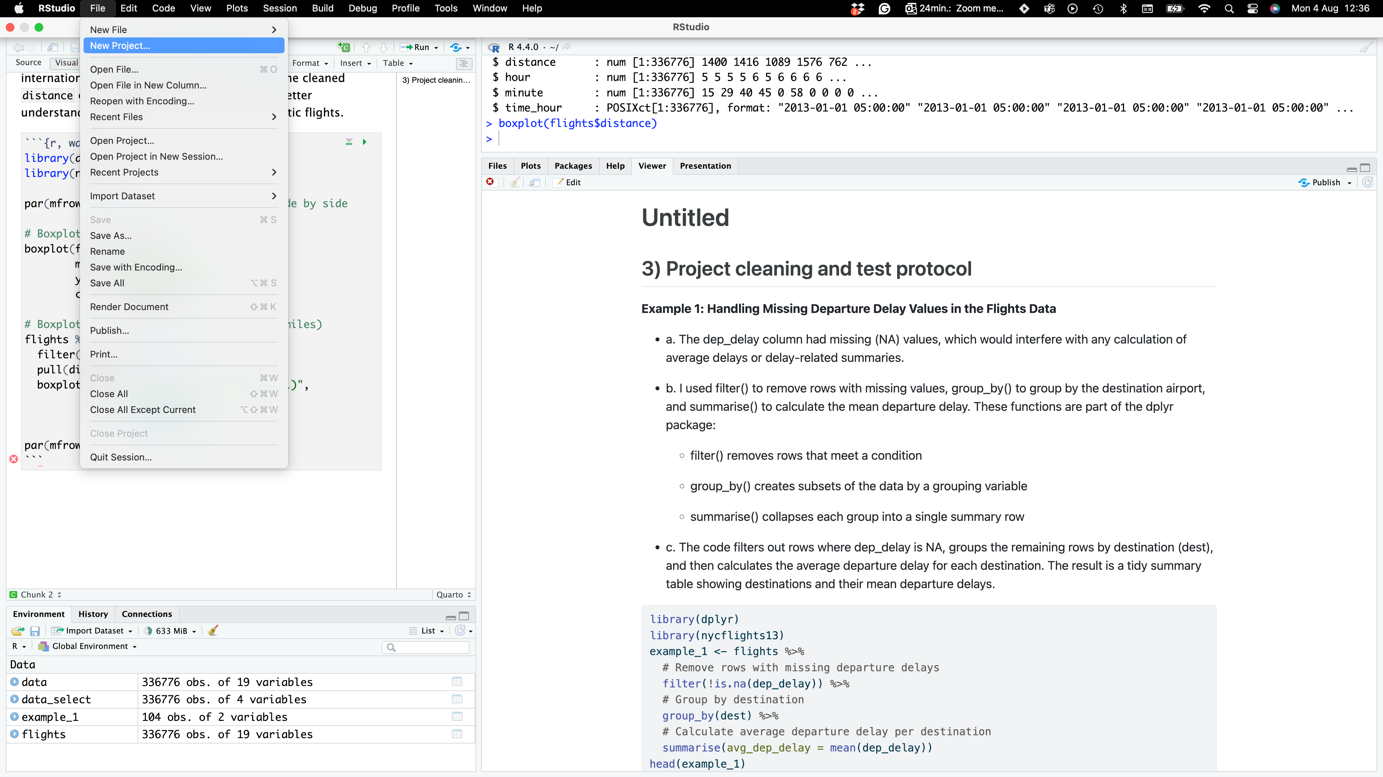
Stop and Code (3 mins)
A basic R project set up
Data_Science_for_Biologists
Data_Science_for_Biologists.Rproj
Create a project ON YOUR DESKTOP using the following structure
Add in your lecture script
Add in your group project data
Data
Project_data
data1.csv
data2.csv
Lecture_script.R
Output
Plots
Powerpoints

Slide 11
Data manipulation practice with dplyr

Slide 12
Today’s learning objectives
msleep data
One table verbs & grouped summaries
Data pipelines
Grouped mutate/ﬁlter & window functions
Apply to your group data

Slide 13

The bad news: It’s going to be frustrating
© Allie Brosh

Slide 14
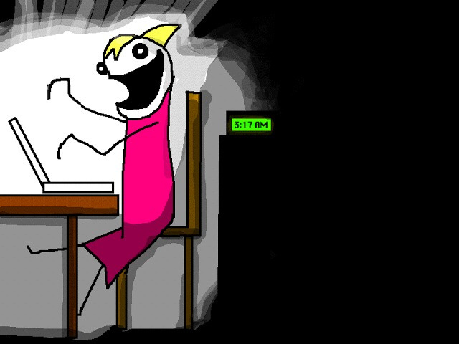
The good news: Frustration is typical and temporary
© Allie Brosh

