Slide 1





Kristoffer_Wild_S007341
Kristoffer_Wild_S007341.proj
Kristoffer_Wild_S007341.qmd
Kristoffer_Wild_S007341.doc
Data
data1.csv
data2.csv

Slide 2

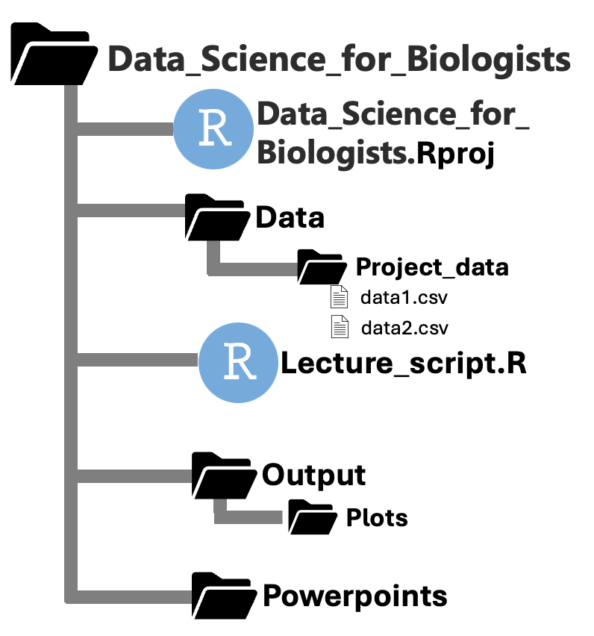

Slide 3
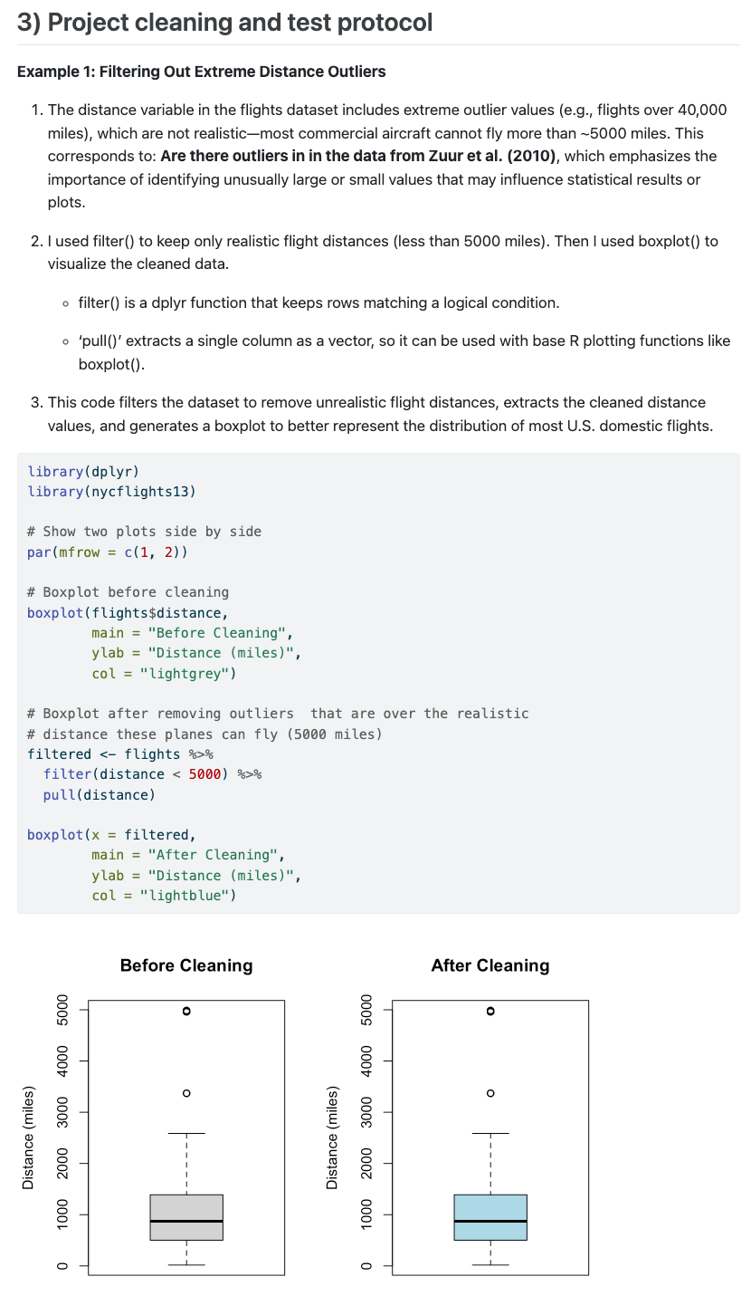
The data problem
& what you did to it
The code you used
The final comparison

