Slide 1





Kristoffer_Wild_S007341
Kristoffer_Wild_S007341.proj
Kristoffer_Wild_S007341.qmd
Kristoffer_Wild_S007341.doc
Data
data1.csv
data2.csv

Slide 2

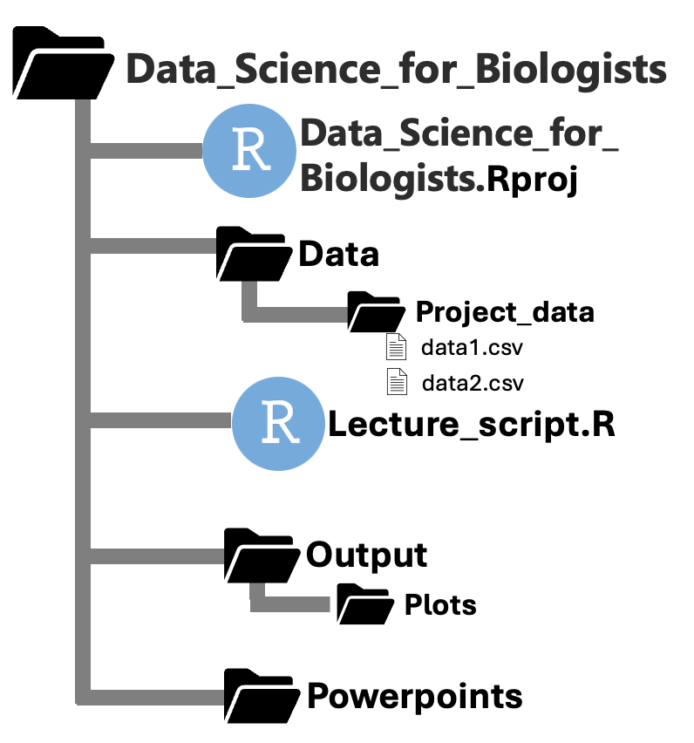

Slide 3
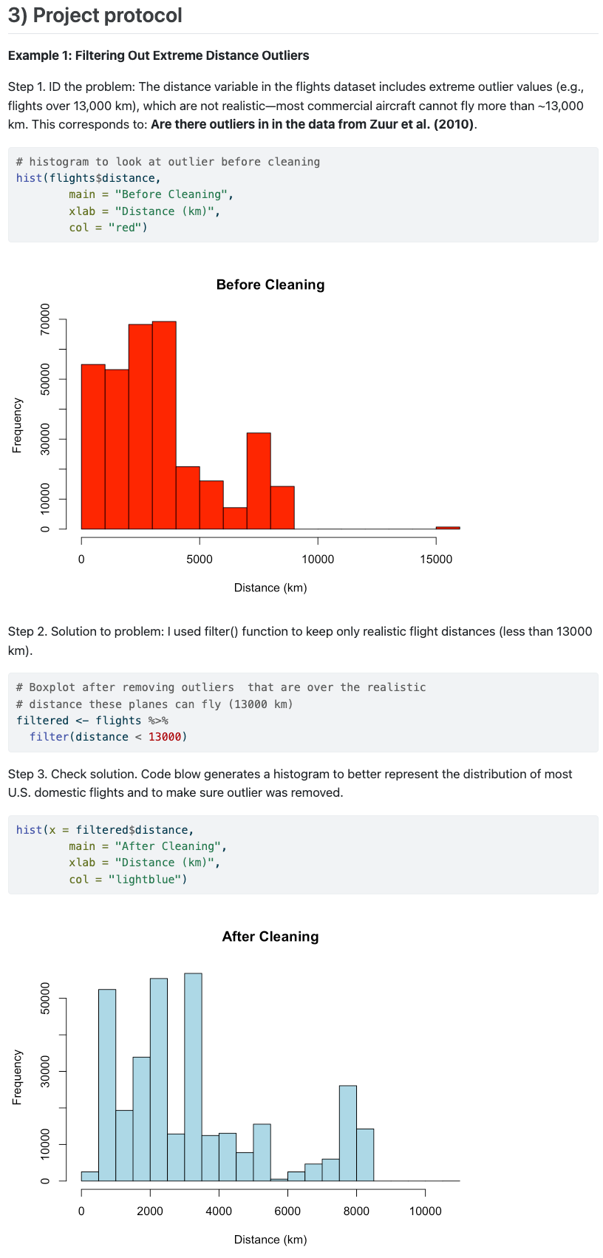
Step 1. ID the problem
Step 2. Solution to the problem
Step 3. Check that solution
resolved problem

