Slide 1
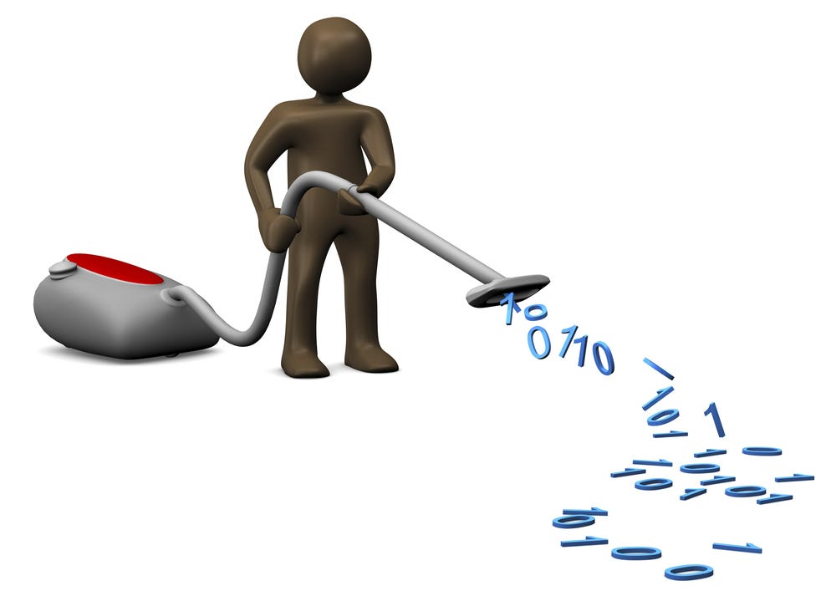

Data cleaning and exploration 1
BIOL90041
Week 3
Dr. Kristoffer Wild
kristofferw@unimelb.edu.au

Slide 2
Todays Learning objectives
Finding your data…
How do we do it?
Then how do we save it?
Viewing and inspecting your data
functions to look at data once imported
Protocol for data exploration from from Zuur et al., 2010
What is quarto and it’s functionality

Slide 3
So you want to be a data scientist…

Slide 4
How will you spend your time?

Slide 5
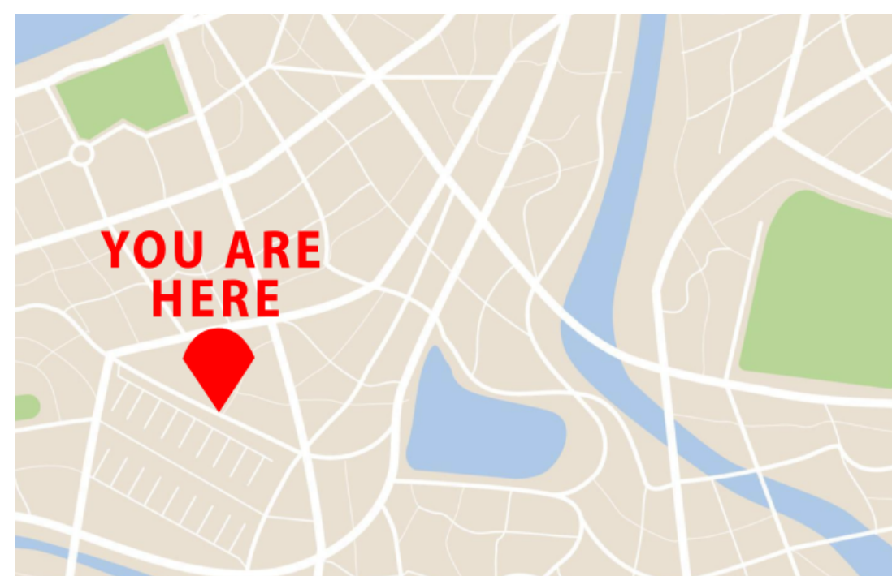
Working Directory
Most of the time, you won’t generate data in R — you’ll import it from external files
Before importing data, you need to understand where R is “looking” from
This location is called your working directory
The working directory is your R console’s current vantage point on your files
Notes:
Most of the time in R, we don’t create datasets from scratch—we’re bringing them in from elsewhere, like CSV or Excel files.
Before R can read those files, it needs to know where to look.
This “starting location” for R is called the working directory.
Think of it like the “You Are Here” marker on a map—it’s the folder R considers “home” right now.
Any time you try to read or save a file without giving a full file path,
R will use the working directory as the default location.
If R can’t find your file, the first thing to check is whether your working directory is set to the right folder.

Slide 6
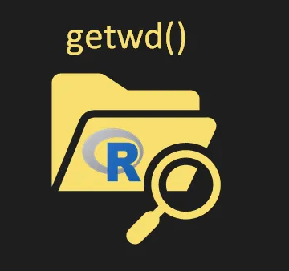
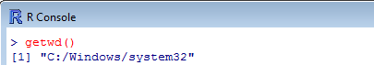
Working Directory
You can check your working directory using the getwd() function
In a R project it will be the root folder!
Notes:
If you’re ever unsure where R is “looking” for files, you can check using the getwd() function.
getwd() stands for “get working directory” and returns the path to your current working directory as a character string.
In the example here, the working directory is set to C:/Windows/system32—
which is not where you’d usually store data files.
When you’re working inside an R Project, the working directory will automatically be the root folder of that project.
This is why R Projects are so handy—they keep everything self-contained,
and you don’t have to keep resetting your working directory every time you open R.
A quick tip: if your script can’t find a file, running getwd() is the first troubleshooting step to make sure you’re in the right place.

Slide 7
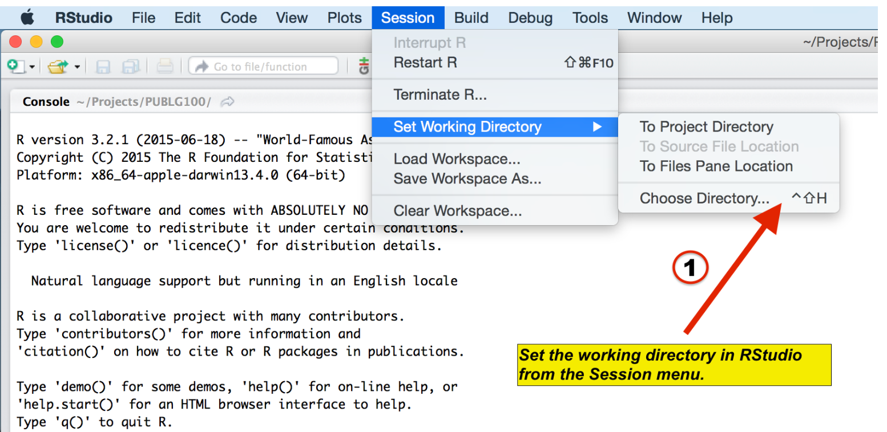
Setting the working directory
Your current working directory is usually your HOME directory
For projects, it’s best to keep everything in one folder:
input files
output files
scripts
Choose a working directory that’s easy to access
Let’s do this on the desktop:
Create a new folder called lecture_3
Open a new R script
Save the working directory to this folder
Session -> Set Working Directory -> Choose Directory
OR IN THE CONSOL
setwd("~/Desktop/lecture_3")
Notes:
By default, R’s working directory is often your HOME folder
For any project, it’s best to store everything in one folder:
Input files (data you bring in)
Output files (results, figures)
Scripts (your R code)
This keeps your workflow organized and makes it much easier to share or move the entire project later.
Always choose a working directory that’s easy to find and remember.
In RStudio, you can set it through the menu: Session → Set Working Directory → Choose Directory
Or, directly in the console using setwd("path/to/folder").
For today’s exercise, we’ll:
Create a folder called lecture_3 on the Desktop
Open a new R script
Set the working directory to this new folder
Tip: Once you start using R Projects, this step becomes automatic, since the project folder will be your working directory.

Slide 8
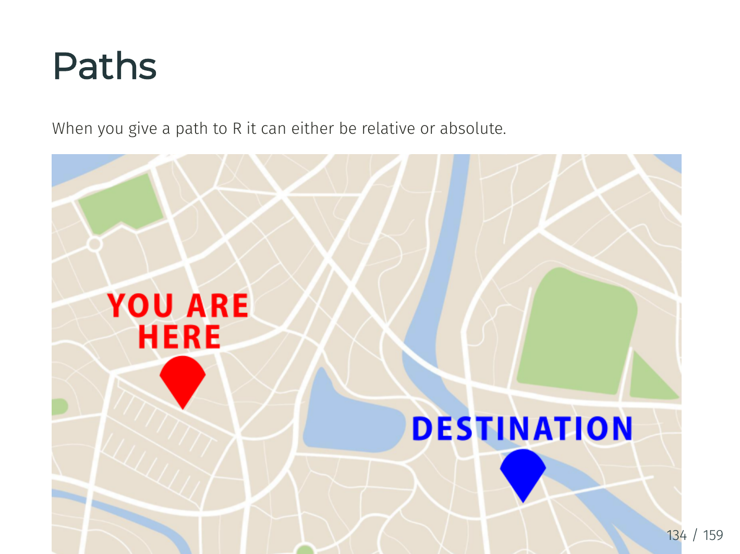
Paths
When you give a path to R it can either be relative or absolute
Notes:
When you give a path to R it can either be relative or absolute... I'll use our map to explain this

Slide 9
Paths
To use our map analogy:
Relative path are like directions i.e. take a left, go straight then take a right etc. The context of where you START is essential.
Absolute paths are like an address. They give you the final location in absence to any other external information
Both have their benefits
Notes:
To connect this back to the map analogy:
Relative paths are like giving someone directions
—“turn left, go straight, then turn right.”
These only make sense if you know where you’re starting from
—your current working directory.
Absolute paths are like a full street address
—no matter where you start, you can find the location without extra context.
In R, relative paths are great when you want your code to be portable
—if you move the whole project folder to another computer, relative paths will still work.
Absolute paths are helpful when you always want to point to the same location on your system,
regardless of your working directory.
Both have their uses, but for most project work
—especially when sharing code—relative paths are more flexible.

Slide 10
Paths in use
The command we used before was using an short hand ‘~’ of absolute path. The ‘~’ points to /Users/yourname
Absolute paths usually start with a ‘/’ to get to the top level of your computers file structure
Or use a relative path from your current working directory (e.g., if you're already in /Users/yourname):
setwd("~/Desktop/lecture_3")
setwd("/Users/yourname/Desktop/lecture_3")
setwd("Desktop/lecture_3")
Notes:
In the last example, we used the shorthand ~ in our file path.
~ means “your home directory” (on a Mac, /Users/yourname).
This is a quick way to write an absolute path without typing the whole thing.
Absolute paths usually start with /—this tells the computer to start from the very top of the
file system and follow the full route to your folder.
Example: /Users/yourname/Desktop/lecture_3
Relative paths don’t start with /. Instead, they’re written relative to your current working directory.
If your working directory is already /Users/yourname, you can just write: Desktop/lecture_3
Absolute paths are unambiguous—they’ll always point to the same place, no matter where your working directory is.
Relative paths are shorter, easier to read, and more portable, but they only work if your starting location is correct.

Slide 11
Data from external sources
Now we have set our location we can start thinking about reading in data. A standard format for data is ‘.csv’ for tables like this:
Go to week 3 lecture material and download the zipped folder ‘Path_example’ and put it on your desktop
Notes:
Now that we’ve set our working directory, we can start bringing in data.
A very common file type for tabular data is CSV—short for “Comma-Separated Values.”
CSV files are plain text files where each row is a record and each column is separated by a comma (or sometimes another delimiter).
This example table shows what CSV content looks like after it’s read into R—each column has a header, and rows store the data for each observation.
CSVs are widely used because they’re simple, lightweight, and work across many software programs.
For our exercise:
Go to the Week 3 lecture materials.
Download the zipped folder named Path_example.
Unzip it and place the folder on your Desktop.
By keeping it on the Desktop, it’s easier to locate when we set paths and import data in R.

Slide 12
Data from text file with read.csv()
Tables from text files can also be read using the read.csv() function. This is a wrapper for read.table() with sep = "," already set.
read.csv() automatically uses sep = ",", ideal for comma-separated files
header = TRUE tells R the first row contains column names
Console Output
Table <- read.csv("Path_example/Raw data/gene_data.csv", header = TRUE)
Table[1:4, 1:3]
Gene_Name Sample_1.hi Sample_2.hi
1 Gene_a 4.570237 3.230467
2 Gene_b 3.561733 3.632285
3 Gene_c 3.797274 2.874462
4 Gene_d 3.398242 4.415202
Notes:
In R, you can load data from a CSV file using the read.csv() function.
This function is essentially a shortcut for read.table() with sep = "," already built in
—so it’s perfect for comma-separated files.
Example: Table <- read.csv("Path_example/Raw data/gene_data.csv", header = TRUE) Table[1:4, 1:3]
header = TRUE tells R that the first row contains column names instead of data values.
When run, this imports the file into an R object called Table, and the Table[1:4, 1:3]
command shows just the first four rows and first three columns in the console.
The example output shows gene names in the first column, with numerical data in the following columns.
Quick tip: If you see unexpected column names like X.Gene_a., it’s often because of spaces or special characters in the file—cleaning column names can help.

Slide 13
Row names in read.csv()
read.csv() accepts the row.names argument to use a column as row names.
row.names = 1 uses the first column (Gene_Name) as the row names
Table <- read.csv("Path_example/Raw data/gene_data.csv", header = TRUE, row.names = 1)
Table[1:4, 1:3]
Notes:
read.csv() accepts the row.names argument to use a column as row names.
The argument row.names = 1 will define that the first row is the name of the first column

Slide 14
Setting factors from read.csv()
read.csv() lets you control whether character data should be read in as factors using stringsAsFactors.
stringsAsFactors = FALSE is the default in R 4.0 and above
Prevents automatic conversion of text columns to factor variables
Other useful arguments:
skip — skip a number of lines when reading
comment.char — ignore lines starting with a given character
Table <- read.csv("Path_example/Raw data/gene_data.csv", header = TRUE, stringsAsFactors = FALSE)
Table[1:4, 1:3]
Notes:
By default in R 4.0 and above, stringsAsFactors = FALSE
—meaning character columns stay as character vectors instead of being automatically converted to factors.
Factors are useful for categorical data, but converting everything to factors can be annoying if you actually want to work with text (e.g., gene names).
If you’re using older versions of R (<4.0), you had to explicitly set stringsAsFactors = FALSE to prevent automatic conversion.
Example: Table <- read.csv("Path_example/Raw data/gene_data.csv", header = TRUE, stringsAsFactors = FALSE) Table[1:4, 1:3]
Other useful read.csv() arguments:
skip → skip a set number of lines at the top of the file (e.g., metadata or comments).
comment.char → tell R to ignore lines starting with a certain character (default is #).
Pro tip: You can always convert between characters and factors later using as.character() or as.factor()—so it’s often safer to keep them as characters when reading data in.

Slide 15
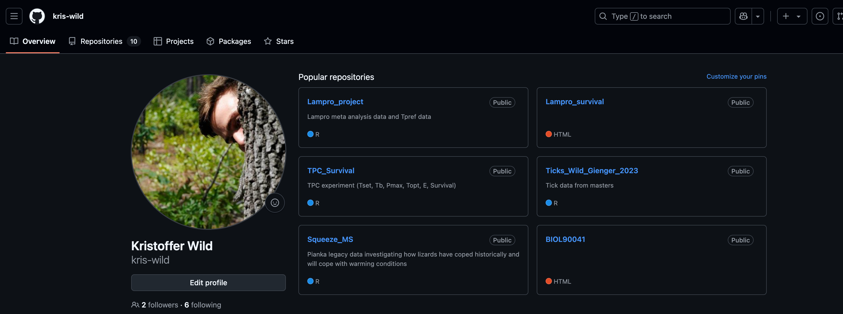
Reading data from outher sources
You can load data directly from GitHub using read.csv() — just make sure you link to the raw version of the file:
URL <- "https://raw.githubusercontent.com/kris-wild/TPC_Survival/main/R/Final.Analysis/Final.Figure.data/Field_Tb_vs_Tb_predict_SI.csv"
Table <- read.csv(URL, header = TRUE)
head(Table)
Notes:
You can also read in things directly from the internet, say git hub in this example.

Slide 16

Class assignment (15 min)
JUST using using the ‘Path_example’ I want you to tell me (you can open the folders in R)…
how many .csv files are in there?
for each csv file tell me how many columns are character and numeric for each file
Now what if I want to back out of a file or go to a folder ‘behind’ my current directory
- Demo quick demo with Kris
Notes:
Assignment
Show how to back out of files

Slide 17
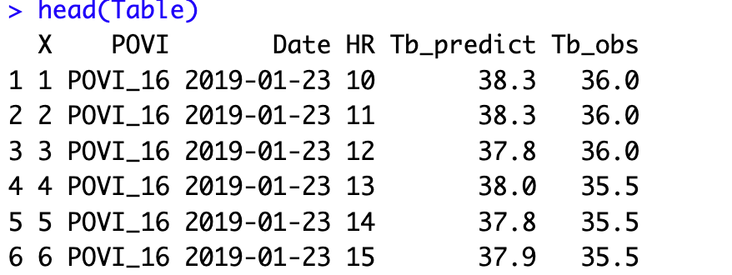
Reviewing your data
It is always important to know what your data is. Especially when you are reading it in for the first time. There are three functions to quickly use your data.
head()
Notes:
Okay now that you have successfully found your data I'm going to show you a few functions that I
ALWAYS do to look at my own data quickly. Just to get an idea of things
The head() function in R is used to display the first parts of an object, such as a vector, matrix, data frame, or list.

Slide 18
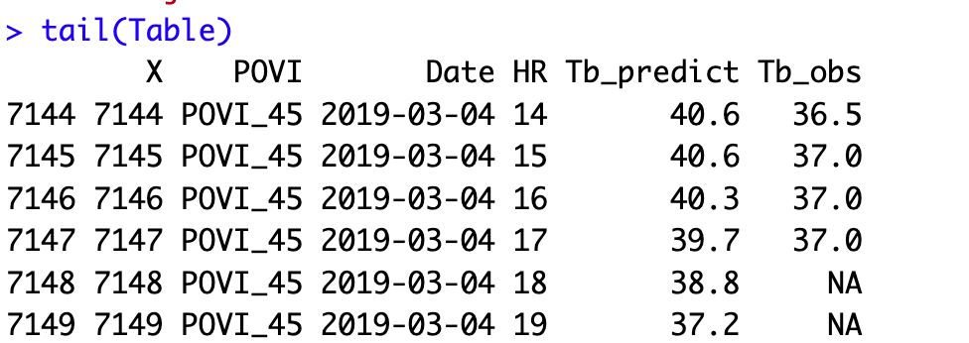
Reviewing your data
It is always important to know what your data is. Especially when you are reading it in for the first time. There are three functions to quickly use your data.
head()
tail()
Notes:
The tail() function in R is used to display the last parts of an object, such as a vector, matrix, data frame, or list.

Slide 19
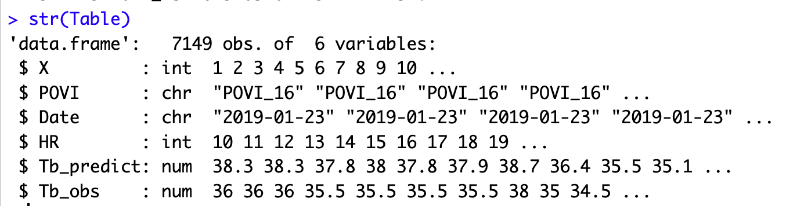
Reviewing your data
It is always important to know what your data is. Especially when you are reading it in for the first time. There are three functions to quickly use your data.
head()
tail()
str()
Notes:
In a nutshell, str()
stands for “structure” and offers a concise summary of the structure of an R object.
It presents essential details about the object, including its data type, dimensions, and the first few values.
By providing an overview of your data, str()
allows you to grasp the fundamentals at a glance and proceed with a
clearer understanding of what you’re working with

Slide 20
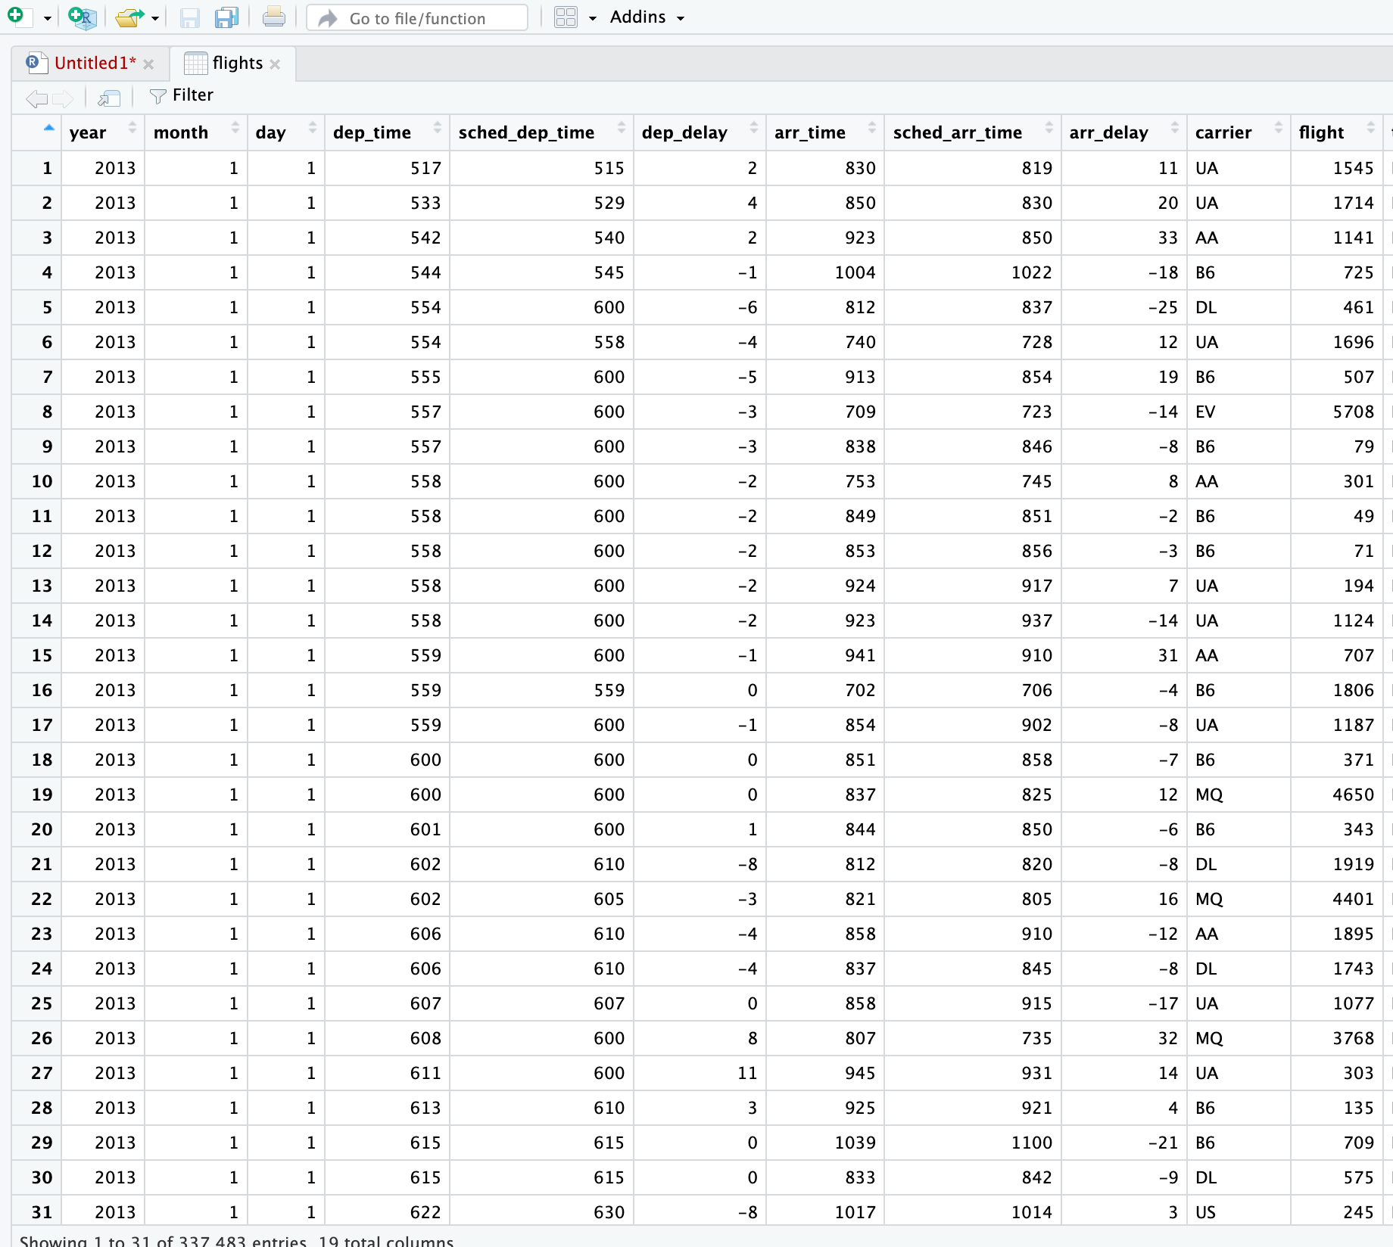
Reviewing your data
It is always important to know what your data is. Especially when you are reading it in for the first time. There are three functions to quickly use your data.
head()
tail()
str()
View()

Slide 21
Saving Data with write.csv()
Save your data in a standard format (CSV) using write.csv()
Useful for:
Sharing data with others
Opening in Excel or other programs
Backing up cleaned datasets
Keep in mind:
Data types like dates and factors may lose formatting when reloaded
All columns become character or numeric upon re-import
Table <- read.csv('Path_example/Final data/not final yet/lizard.csv', header = TRUE)
write.csv(Table, file = ”data/my_data.csv", row.names = FALSE)
Notes:
Once you’ve cleaned or transformed a dataset in R, you can save it as a CSV using write.csv().
Example:T able <- read.csv("Path_example/Final data/not final yet/lizard.csv", header = TRUE)
write.csv(Table, file = "data/my_data.csv", row.names = FALSE)
file = specifies where and under what name to save the file.
row.names = FALSE is important—it prevents R from writing an extra first column with row numbers,
which can cause confusion when reloading the data.
When to use write.csv():
To share data with colleagues or collaborators.
To open your R-processed data in Excel or other software.
To create a “frozen” copy of a cleaned dataset for reproducibility.
Things to watch out for:
Data types like dates and factors may lose formatting when saved to CSV—reloading might require re-specifying them.
On re-import, columns will default to character or numeric unless you convert them back to their intended type.

Slide 22
Saving R objects with saveRDS()
Save an entire R object exactly as-is using saveRDS()
To reload it later:
RDS files are great because:
They preserve object structure (e.g., factors, dates, models)
Compact and efficient for saving any R object
Perfect for saving data between script runs or analyses
Note: RDS files can only be read back into R, not into Excel or other programs
saveRDS(Table, file = "output/my_data.rds")
Table <- readRDS("output/my_data.rds")
Notes:
saveRDS() saves an R object exactly as it is, keeping its structure intact.
Example: saveRDS(Table, file = "output/my_data.rds")
Reload later with:
Table <- readRDS("output/my_data.rds")
Why use RDS files:
Preserve full object structure (factors, dates, models, etc.).
Compact and efficient for any R object.
Great for saving intermediate results between script runs.
Note:
Can only be read back into R, not Excel or other programs.

Slide 23


Now you have your data!

Slide 24
“I spend more than half of my time integrating, cleansing and transforming data without doing any actual analysis. Most of the time I’m lucky if I get to do any ‘analysis’ at all…
… Most of the time once you transform the data ... the insights can be scarily obvious.”

Slide 25
“Once you play with the data you realize you made an assumption that is completely wrong. It’s really useful, it’s not just a waste of time, even though you may be banging your head.”
“In practice it tends not to be just data prep, you are learning about the data at the same time, you are learning about what assumptions you can make.”

Slide 26

Data Wrangling
Aka Data Prep, Data Munging, Data Transformation
Assessing and transforming raw data to make it fit for use
That depends!
Fit for what use?
Notes:
Now that you have your data, this is where data wrangiling comes in.
Really the data prep
So here I’m talking about assessing and transforming raw data to make it fit for use.
This will all depend on what you are planning on using it for

Slide 27
Data Wrangling
Aka Data Prep, Data Munging, Data Transformation
Assessing and transforming raw data to make it fit for use
This is how you “get your head in the game”
Understand what you have
Assess strengths and weaknesses of your data
Hypothesize about what to do with your data
Get it ready
Nobody will know your data as well as you do while wrangling
Not even the “you” of a few days later
Notes:
So asking yourself that question, what are you going to use the data for, is how you
get your head in the game.
so understand what you have
what are the weaknesses of your data (are there missing values, lots of zeros)
start hypothessing on how how you want to use yoru data
do all of this to get you ready.
Remember this is the only way of how you are going to get familiar with your data

Slide 28
Discussion
When is data “dirty”?
How does that happen?
Outliers
Misspellings
Type/constraint violations
Inconsistencies
Duplication
Missing data
Unusual distributions
Wrong granularity
Wrong time or other scope
Data entry
Measurement error
Bad data integration
Poor experimental design
Mismatch of data to task
Notes:
Many possibilities here for discussion
Outliers
Misspellings
Type/constraint violations
Inconsistencies
Duplication
Missing data
Unusual distributions
Wrong granularity
Wrong time or other scope
Data entry
Measurement error
Bad data integration
Poor experimental design
Mismatch of data to task

Slide 29
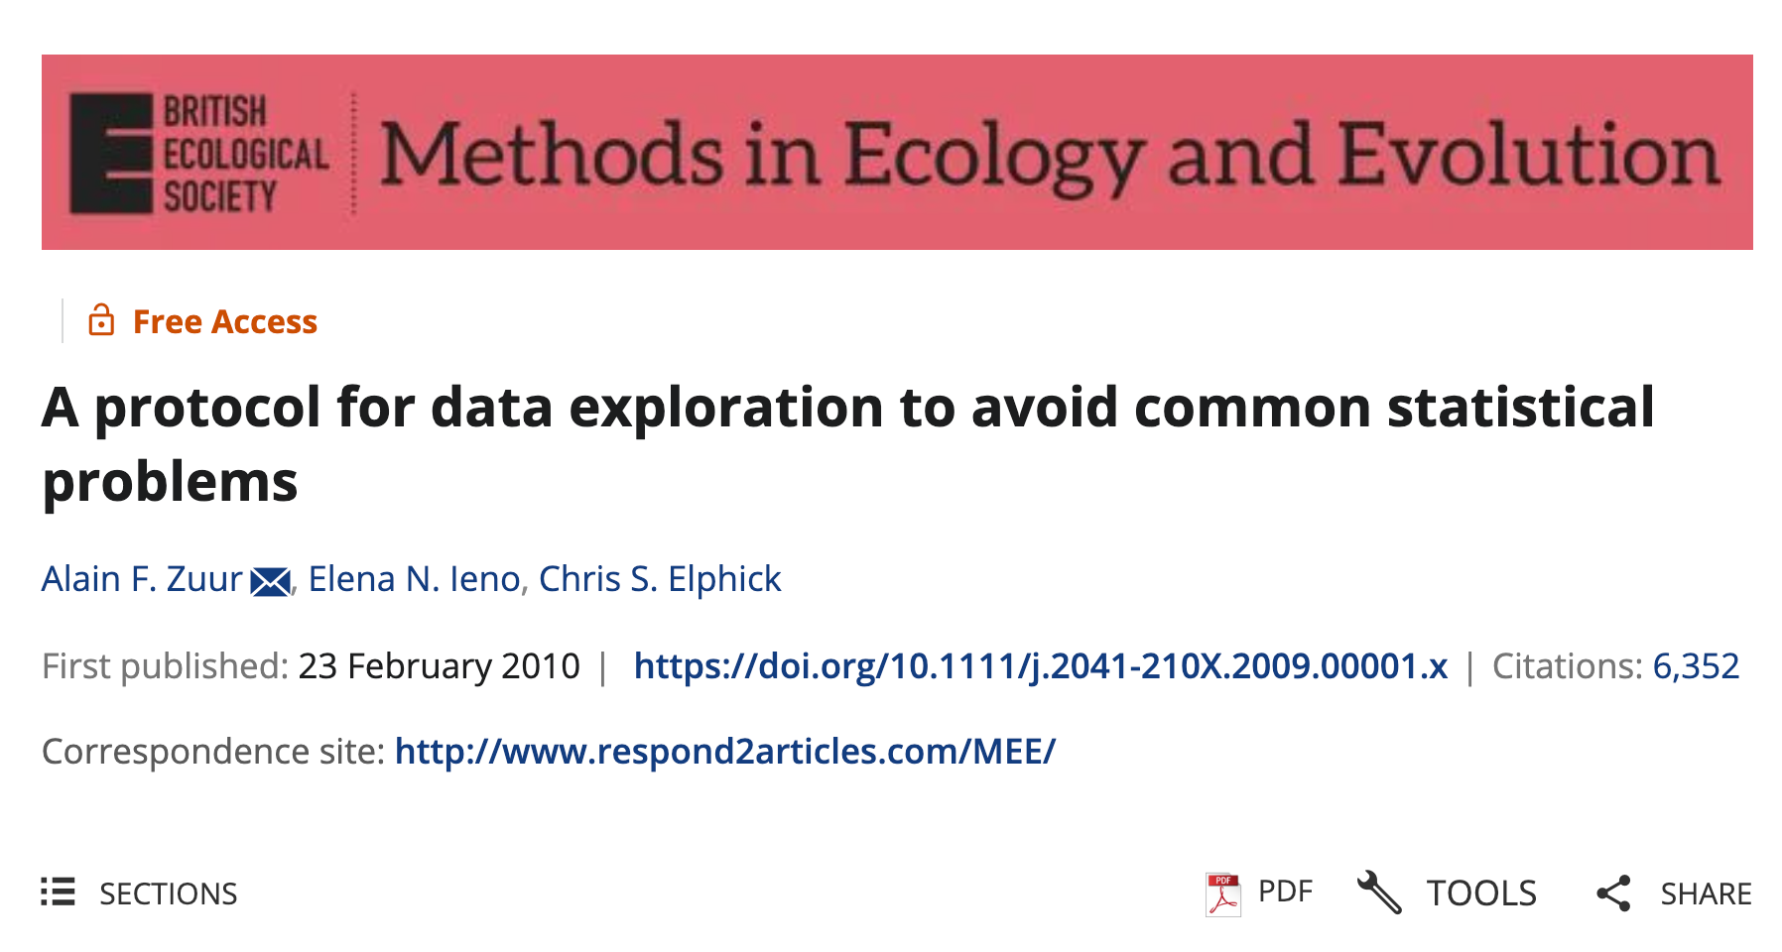
https://besjournals.onlinelibrary.wiley.com/doi/10.1111/j.2041-210X.2009.00001.x
Notes:
This is where Zuur’s paper came in I have highlighted 5-6 key steps that I want you guys to think about
with your projects.

Slide 30
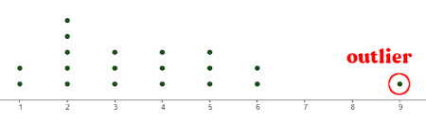
Step 1 – Are There Outliers in Y or X?
Outliers are extreme values that differ from the rest of the data
They may arise from data entry errors, measurement errors, or real biological extremes
Outliers can skew visualisations, violate model assumptions, and bias results
"Outliers can dominate model outcomes or visualizations. Identifying them is essential before analysis.” - Zuur et al. (2010)

Slide 31
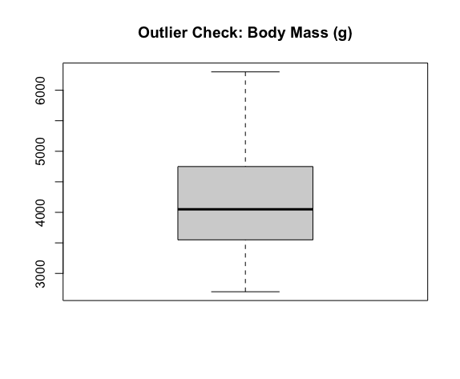
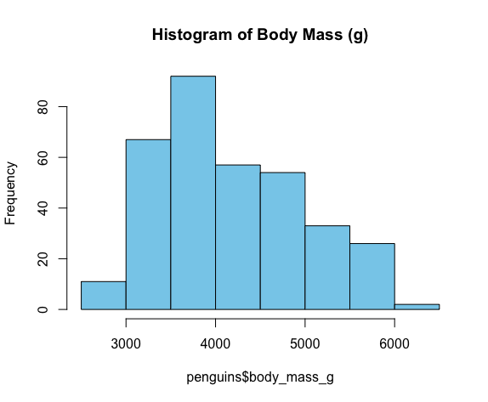
Step 1 – Are There Outliers in Y or X?
How would we look for outliers?
pacman::p_load(palmerpenguins, dplyr)
# Boxplot to detect outliers
boxplot(penguins$body_mass_g,
main = "Outlier Check: Body Mass (g)",
col = "lightgrey")
# Histogram to see distribution
hist(penguins$body_mass_g,
main = "Histogram of Body Mass (g)",
col = "skyblue")
Tip: Combine with summary() or sort()
to see extremes numerically.

Slide 32
Step 2 – Is the Variance Similar Across Groups?
Homogeneity means groups have a similar spread (variance).
Unequal variance can affect models like ANOVA or regression.
Can be visualized by comparing group distributions.
"Even moderate variance differences can degrade model reliability." — Zuur et al. (2010)

Slide 33
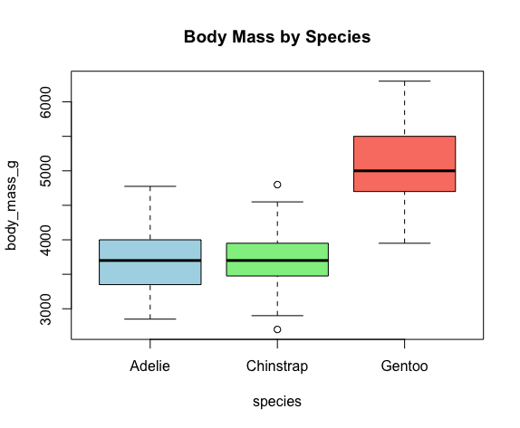
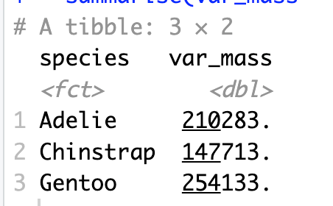
Step 2 in R – Check Variance (penguins)
How would we compare variance?
# Compare body mass variance across species
boxplot(body_mass_g ~ species, data = penguins,
main = "Body Mass by Species",
col = c("lightblue", "lightgreen", "salmon"))
# Numerical check of variances
penguins %>%
group_by(species) %>%
summarise(var_mass = var(body_mass_g, na.rm = TRUE))

Slide 34
Step 3 – Are the Data Normally Distributed?
Normality refers to the bell-shaped curve in data distribution.
Histograms and QQ plots are used to inspect this.
Not all methods require normality, but it's important to check.
🗣 "Many methods are robust, but checking normality helps you choose the right approach." — Zuur et al. (2010)

Slide 35
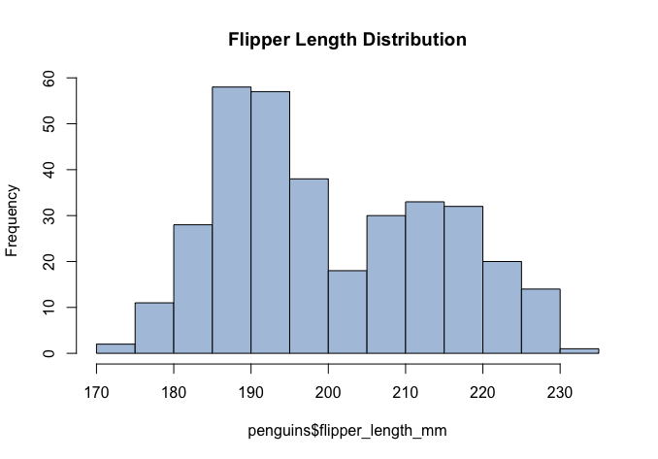
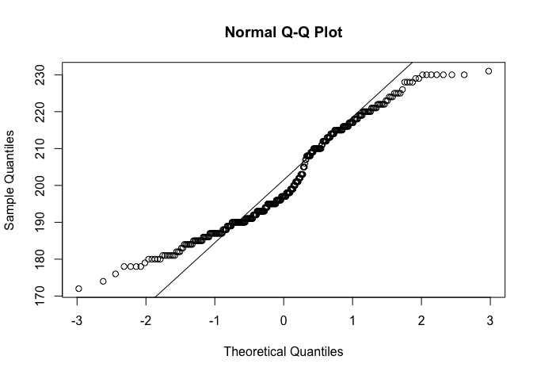
Step 3 – Check Normality (penguins)
# Histogram of flipper length
hist(penguins$flipper_length_mm,
main = "Flipper Length Distribution",
col = "lightsteelblue")
# QQ plot (optional)
qqnorm(penguins$flipper_length_mm)
qqline(penguins$flipper_length_mm)
Tip: Look for symmetry and smooth tails in histograms

Slide 36
Step 4 – Are There Lots of Zeros?
Excess zeros can distort models for count or binary data.
May require special modeling approaches.
Check both counts and joint absences (multivariate).
🗣 "Zero inflation requires special models or interpretation techniques." — Zuur et al. (2010)

Slide 37
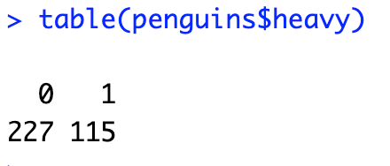
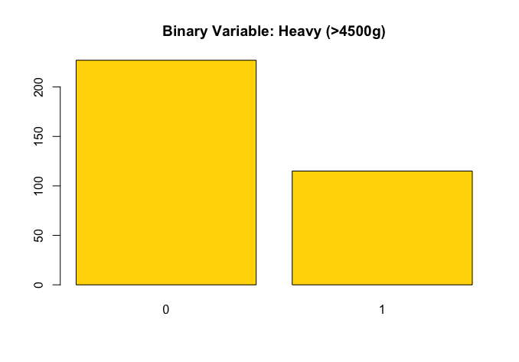
Step 4 –Check Zeros (penguins)
# Create a binary variable
penguins$heavy <- ifelse(penguins$body_mass_g > 4500, 1, 0)
# now check frequency of 0s and 1s
table(penguins$heavy)
# Visualise
barplot(table(penguins$heavy),
main = "Binary Variable: Heavy (>4500g)",
col = "gold")

Slide 38
Step 5 – What Is the Relationship Between Y & X?
Helps identify if a linear model is appropriate, or if relationships are nonlinear.
Can reveal thresholds, curvatures, or outliers.
Always plot your response variable vs. each predictor.
"Scatterplots can reveal patterns that inform model design."— Zuur et al. (2010)

Slide 39
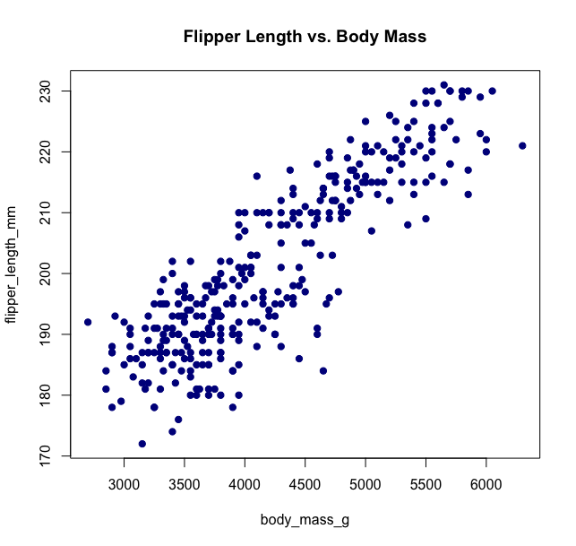
Step 5 in R – Plot Y vs. X (penguins)
# Base R scatterplot
plot(flipper_length_mm ~ body_mass_g,
data = penguins,
main = "Flipper Length vs. Body Mass",
col = "darkblue", pch = 19)

Slide 40
Step 6 – Are the Predictors Too Similar?
Collinearity occurs when two or more predictors are strongly correlated.
This can inflate standard errors and mask variable importance
Use correlation matrices or visual tools to detect it.
"Collinearity reduces model interpretability and power.” — Zuur et al. (2010)

Slide 41
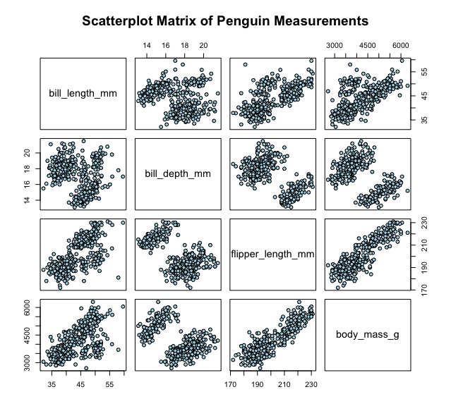
Step 6 in R – Check Collinearity (penguins)
# Prepare numerical data
num_vars <- penguins %>%
select(bill_length_mm, bill_depth_mm, flipper_length_mm, body_mass_g) %>%
filter(if_all(everything(), ~ !is.na(.)))
# Now use correlation matrix to look at 4 variables
cor(num_vars)
# Visualise correlations by a pairs plot
pairs(num_vars,
main = "Scatterplot Matrix of Penguin Measurements",
pch = 21,
bg = "lightblue")

Slide 42


Notes:
Now that we have spent time in interrogating our data we now need
put it in an organised place for it to be… Click…
Sure putting it all in r script is good
but that’s so 2020…. it can be more organised!

Slide 43

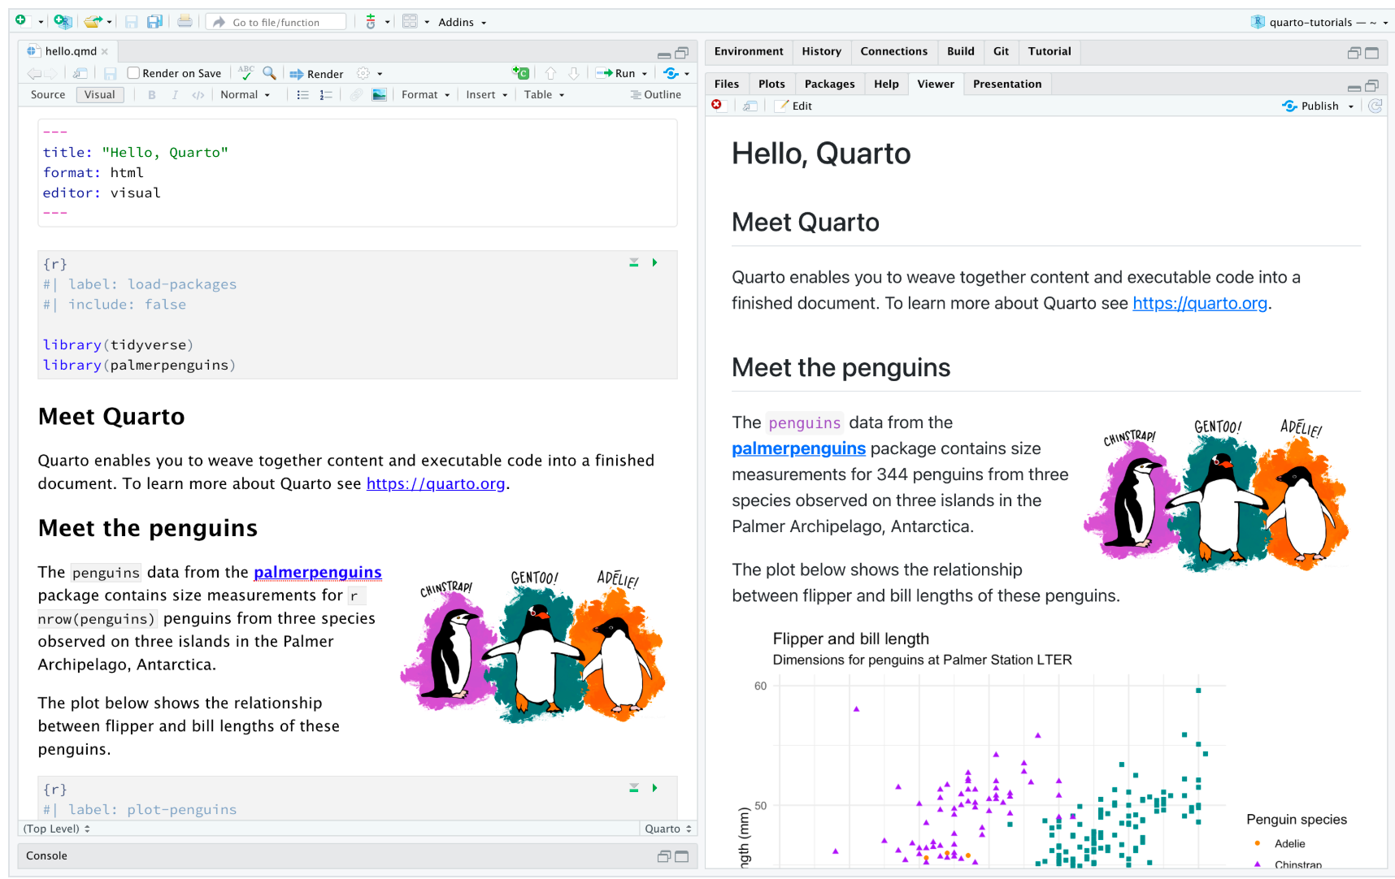
Notes:
That’s where quarto comes in! This is a really flexible system to keep your code and your plots
I’ve seen a few of you already using it. I’m glad to see this but hopefully I will get to show you
some new tricks of the trade in this class.
We will be using quarto to submit our coding assignment that I’ll cover in the workshop on wed

Slide 44



A basic R project set up
Data_Science_for_Biologists
Data_Science_for_Biologists.Rproj
Data
Quarto (.qmd)
Lecture_scripts_Script
Workshop_scripts_Script
Output
Plots
Lecture
Notes:
So a few of you were asking questions on how your R projects will look…
This will depend on the project or task that you are doing but lets say you just had this
folder set up….
CLICK

Slide 45
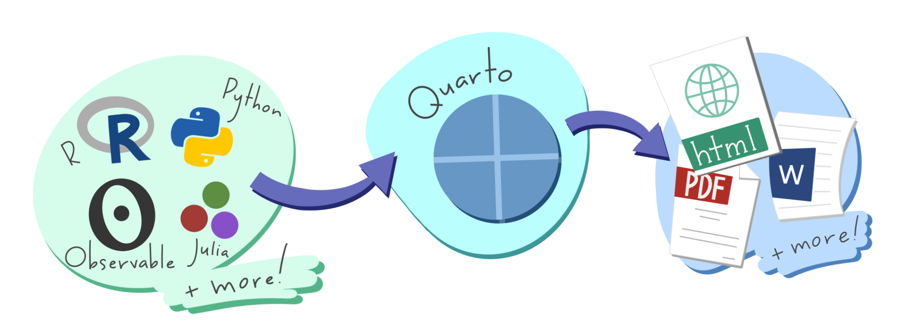

What is Quarto?
An open-source tool that seamlessly integrates code, results, and narrative text into a single document
Key Features:
Multi-language Support: Works with R, Python, Julia, and more.
Versatile Outputs: Generate reports, presentations, websites, and dashboards in formats like HTML, PDF, and Word.
Reproducibility: Ensures that analyses are transparent and reproducible by embedding code and its output directly within the document
Use Cases:
Communication: Present findings to stakeholders with clear narratives and visualisations.
Collaboration: Share comprehensive analyses with peers, including code and results.
Documentation: Maintain a detailed record of data analysis processes and decisions.
Integration:
Fully compatible with RStudio and other IDEs, providing a user-friendly interface for creating and rendering documents.
Notes:
Quarto is an open-source publishing system that combines code, results, and narrative text into one document.
Key features:
Works with multiple languages (R, Python, Julia, etc.).
Can output reports, presentations, websites, dashboards in HTML, PDF, Word, and more.
Promotes reproducibility by embedding code and outputs directly in the document.
Use cases:
Communicate findings with clear text, visuals, and results.
Collaborate by sharing code and outputs together.
Document your workflow for transparency and future reference.
Fully integrates with RStudio and other IDEs for easy document creation and rendering.

Slide 46
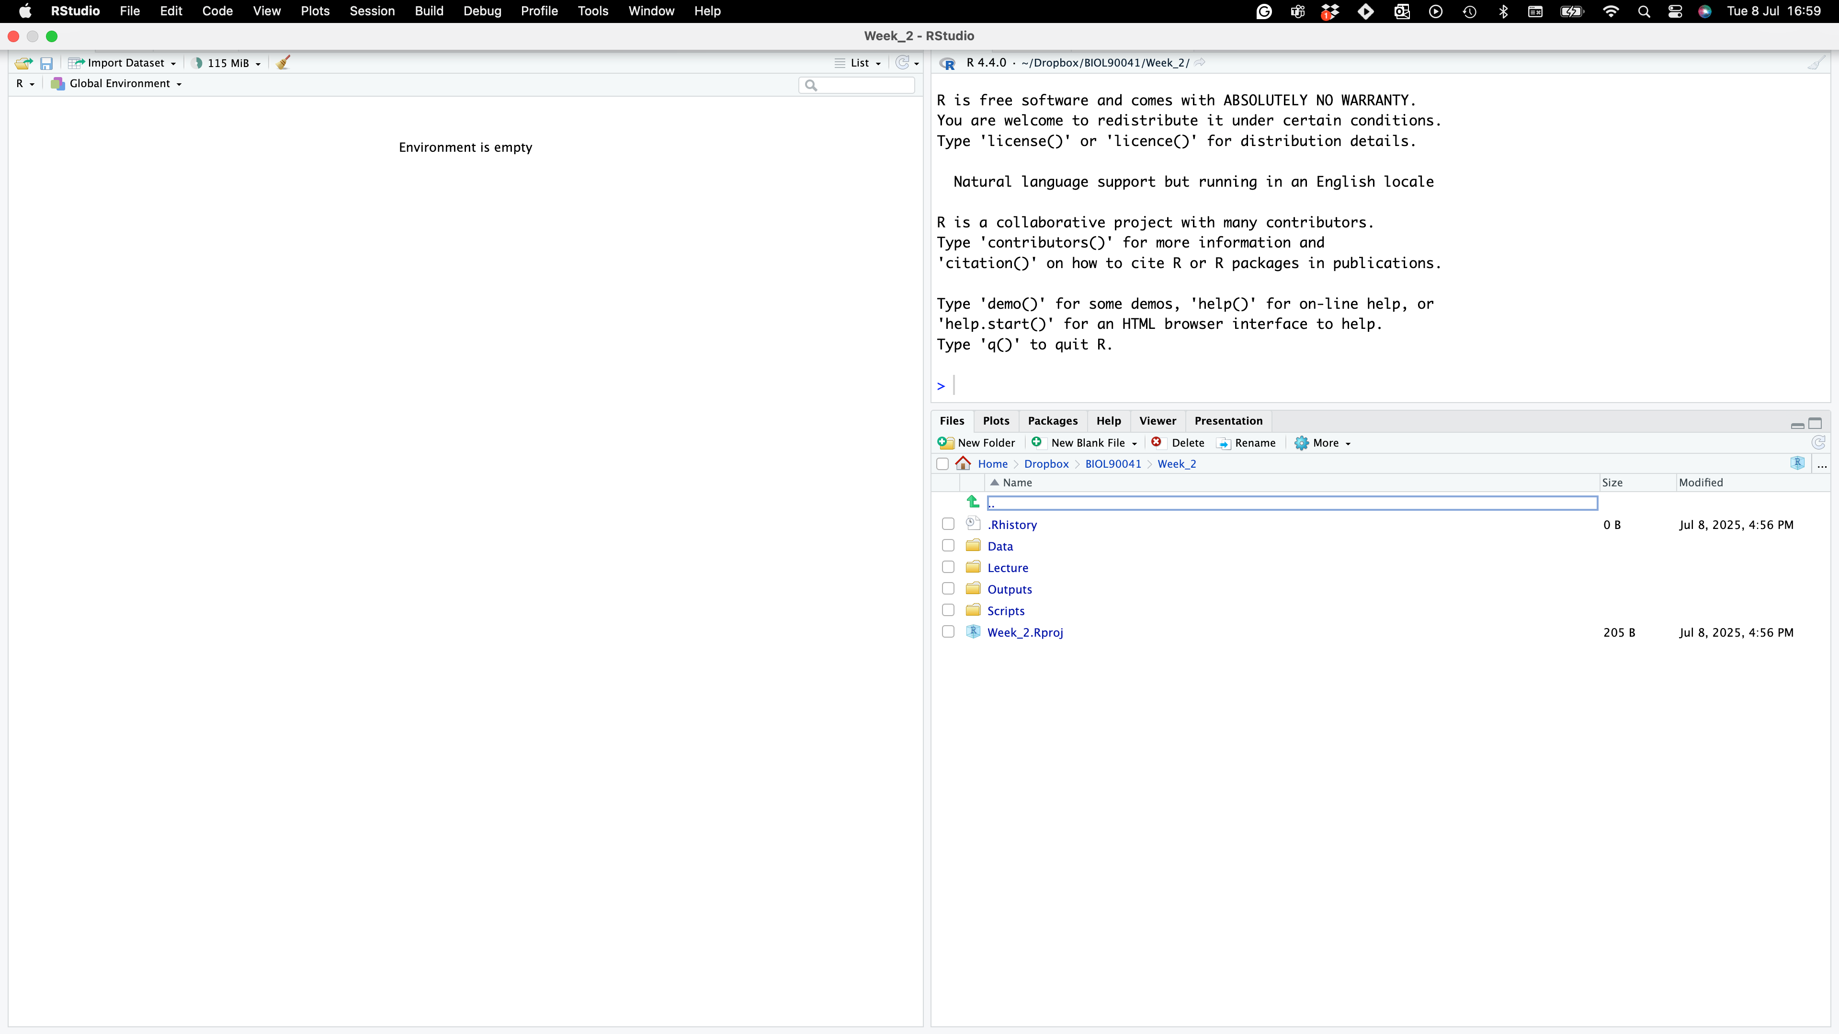

Where to find it?
Project name
NO SCRIPT?!?!!
Project folders

Slide 47
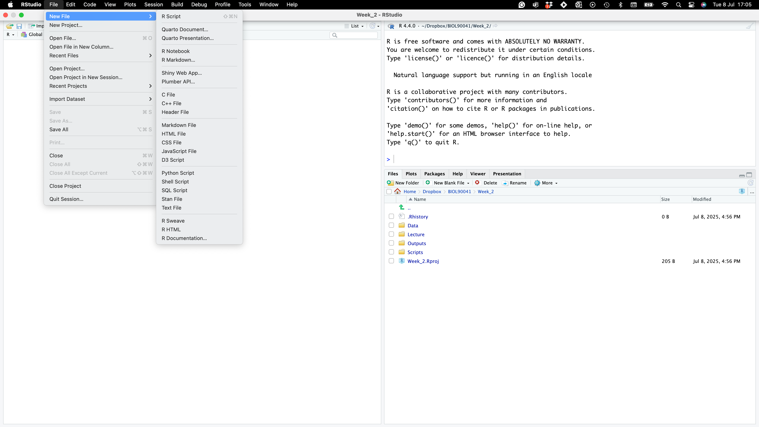
Where to find it?
NO SCRIPT?!?!!

Slide 48
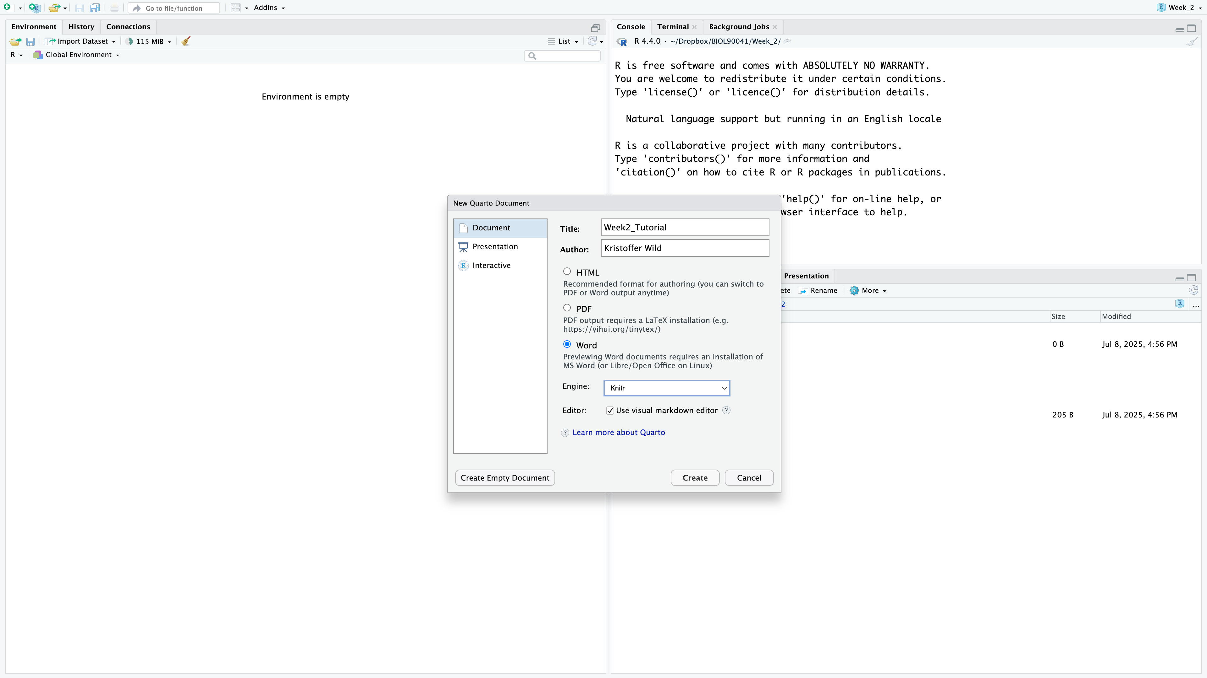
Where to find it?
NO SCRIPT?!?!!

Slide 49
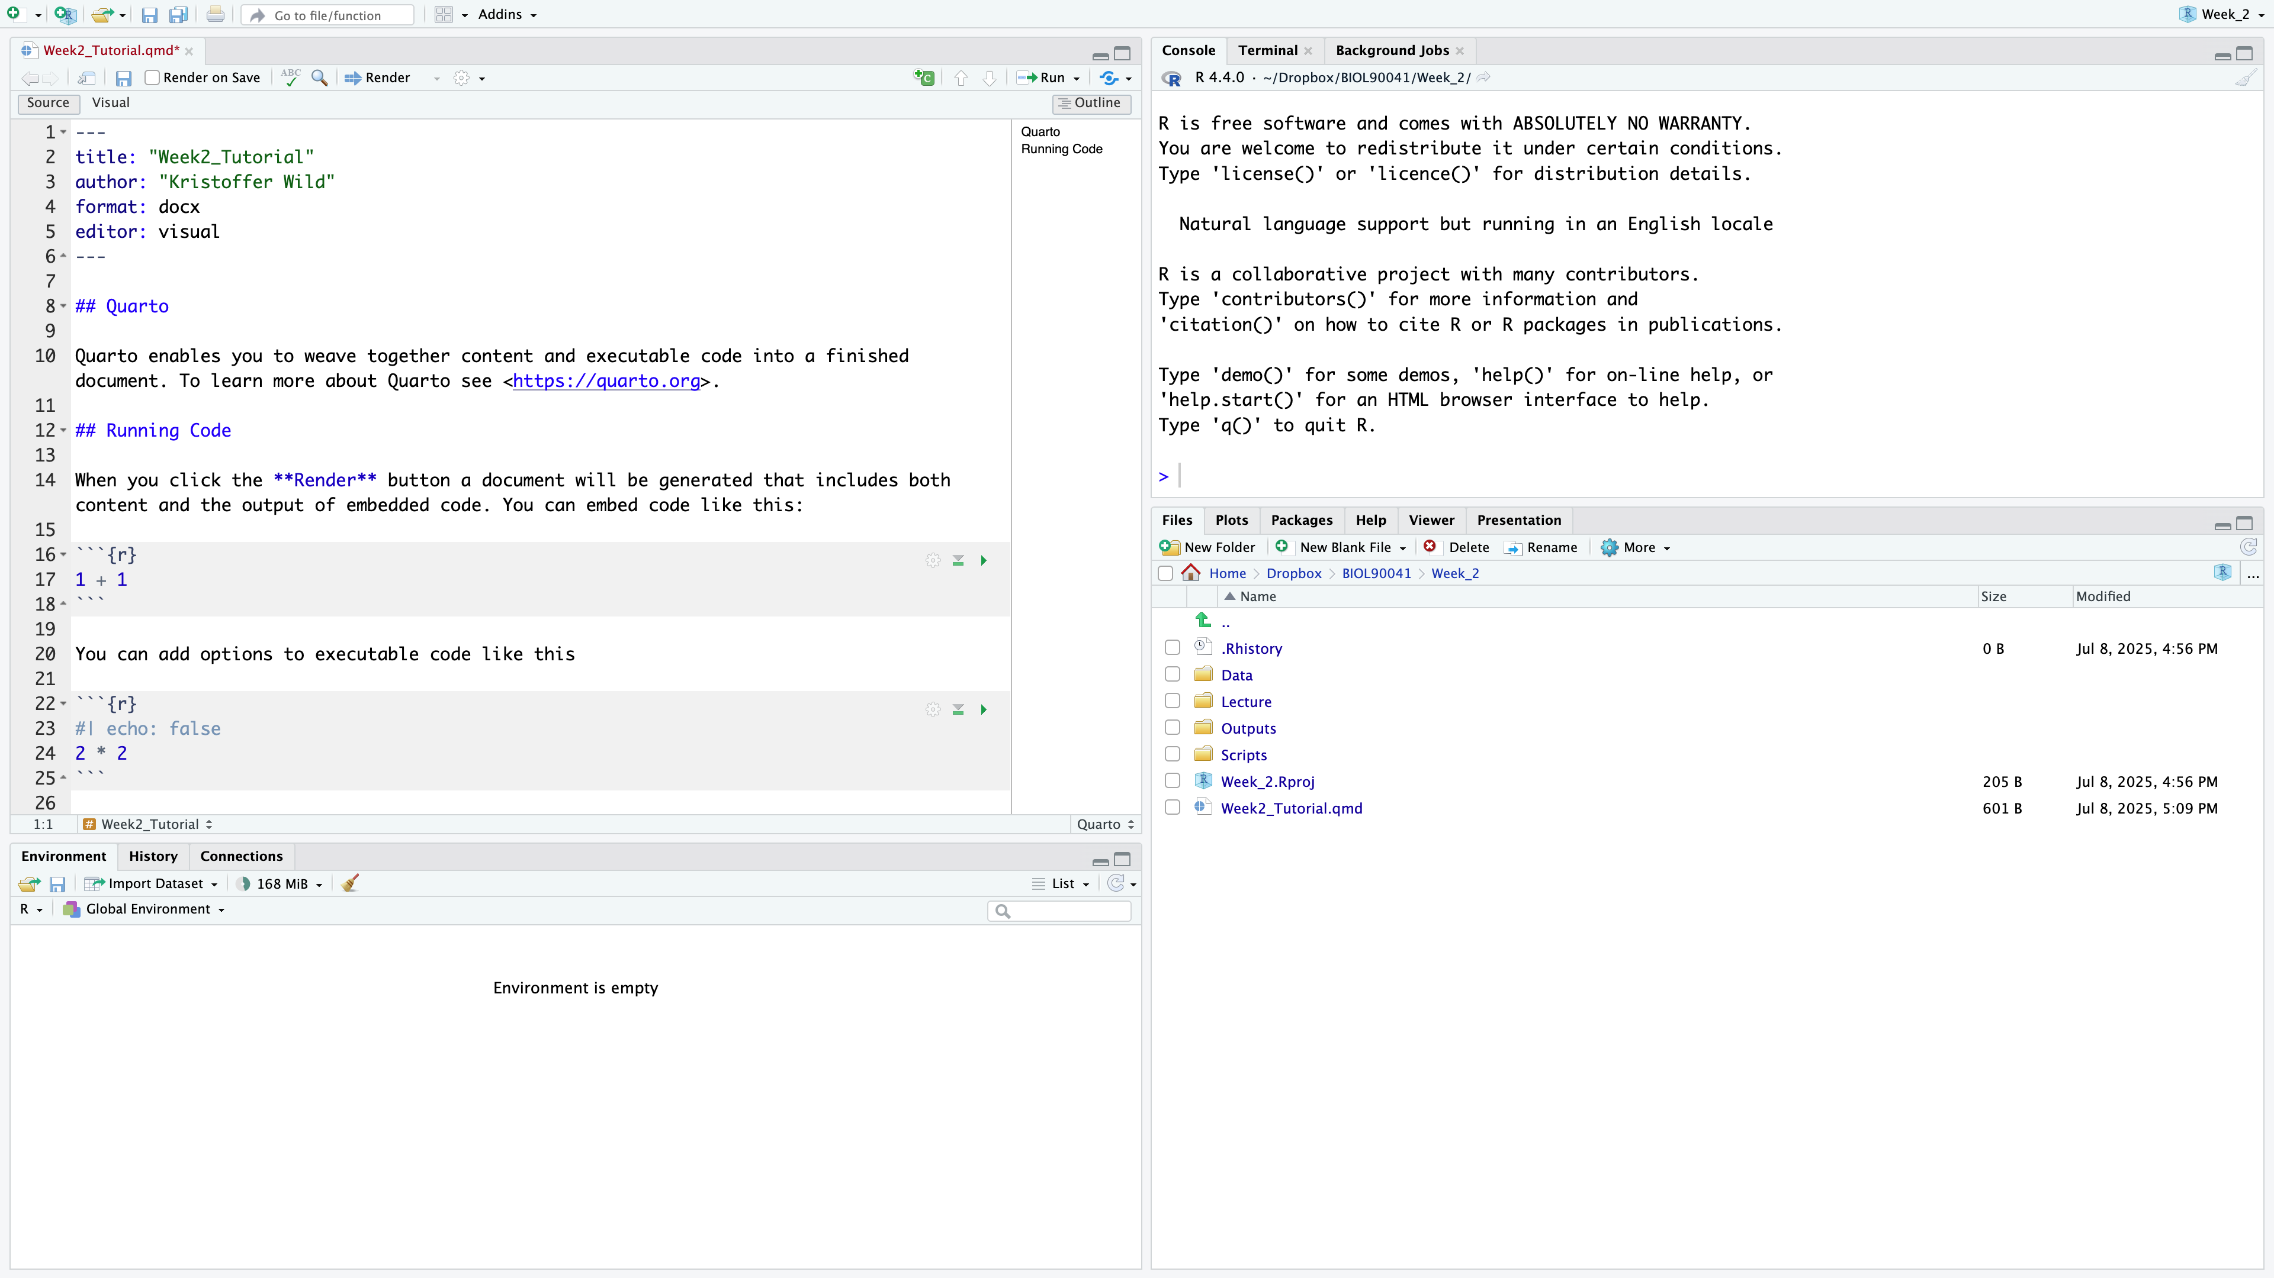
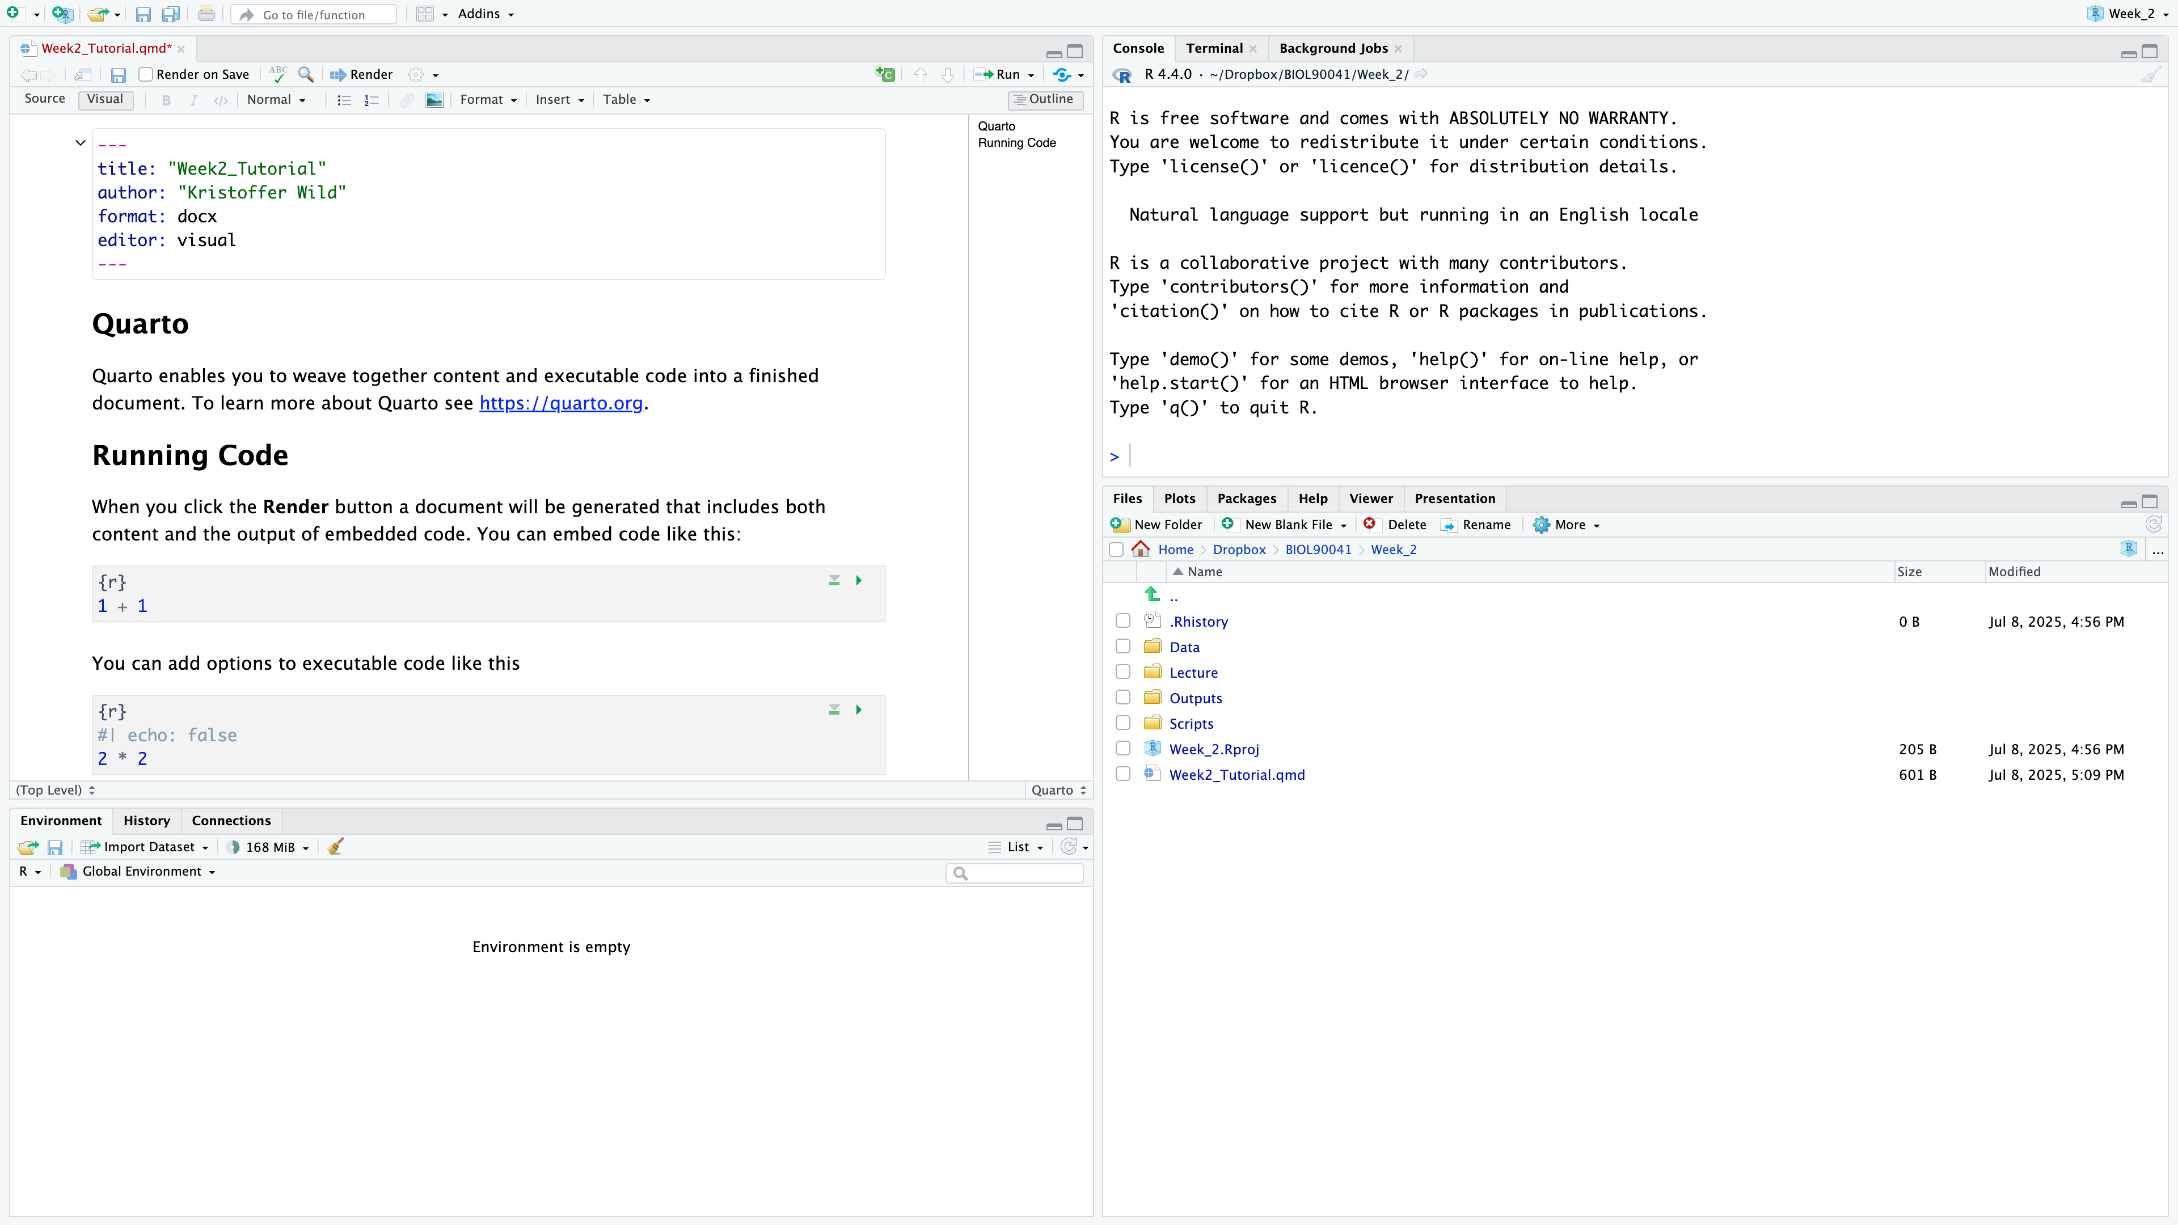
Where to find it?
Render
Metadata
LINE #’s
NO SCRIPT?!?!!
Notes:
Slide: Quarto Document Layout in RStudio
.qmd files contain both metadata and content.
The metadata block at the top (lines 1–5) defines title, author, output format, and editor type.
Content can mix narrative text (Markdown syntax) and code chunks.
Code chunks start with three backticks and {r} (line 16) and end with three backticks.
You can add chunk options (e.g., echo: false on line 23) to control whether code is shown in the output.
Rendering (Render button) combines the text and code output into the chosen format (e.g., Word).

Slide 50
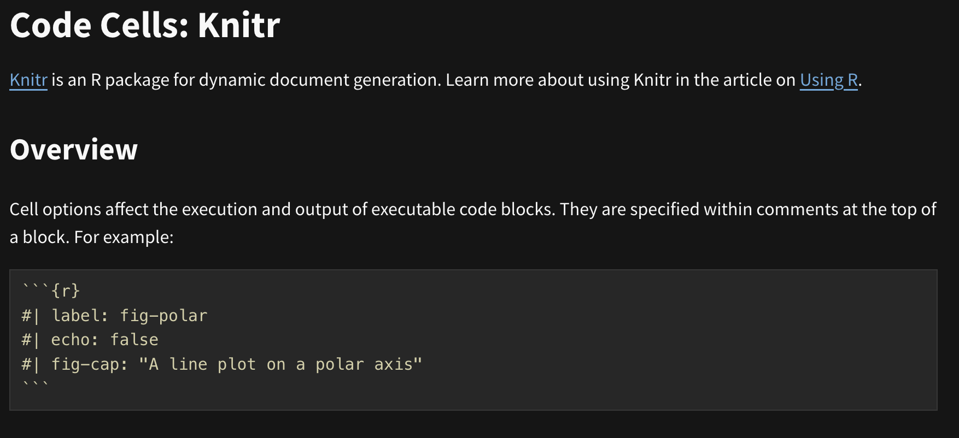
Where to find it?
Text
Text headings
Code ‘Chunks’
NO SCRIPT?!?!!
READ MORE HERE:
https://quarto.org/docs/reference/cells/cells-knitr.html
Notes:
A Quarto file (.qmd) contains both narrative text and code chunks.
Text headings use Markdown syntax (e.g., ## Heading).
Code chunks are enclosed in triple backticks with {r} (or another language).
You can add chunk options—e.g., echo: false hides code in the output.
The Render button runs all chunks and produces the chosen output format (Word, PDF, HTML, etc.).
Quarto integrates seamlessly into RStudio’s Source and Visual editing modes.

Slide 51
Where to find it?
Check out the tool bar : change text formatting and see how source code changes!
NO SCRIPT?!?!!
Notes:
Now play with the tool bar
you can bold, italicize text
you can add in links
Change the formatting headings
If you go back to the source code you can see what it’s doing under the hood.
Here if you used markdown in the past, you would have to know this laytext code

Slide 52
Quarto live DEMO with Kris
On your own try to put your notes from this lecture in quarto…
set it up to render to a word document
formatting code chunks – make sure you have you notes above
putting in code chunks:
practicing writing results under code chunks
try putting in plots, see how to show them
keep rendering document with appropriate code, plots, and write up

Slide 53
Next week…
But first…reminder we have a workshop this week!
Wednesday, 11-1 at PAR125-L1-Room 127 (WEBS)
Cleaning your data and coding assignment rubric!
Next week we will cover:
summarise
gsub
stringr
merging
joining

