Slide 1
an educator’s perspective of the tidyverse

Slide 2
introduction
collaborators
Johanna Hardin, Pomona College
Benjamin S. Baumer, Smith College
Amelia McNamara, University of St Thomas
Nicholas J. Horton, Amherst College
Colin W. Rundel, Duke University
setting the scene

Slide 3



Slide 4
takeaway
The tidyverse provides an effective and efficient pathway for undergraduate students at all levels and majors to gain computational skills and thinking needed throughout the data science cycle.
Çetinkaya-Rundel, M., Hardin, J., Baumer, B. S., McNamara, A., Horton, N. J., & Rundel, C. (2021). An educator’s perspective of the tidyverse. arXiv preprint arXiv:2108.03510. arxiv.org/abs/2108.03510

Slide 5
principles of the tidyverse
tidyverse

Slide 6

meta R package that loads eight core packages when invoked and also bundles numerous other packages upon installation
tidyverse packages share a design philosophy, common grammar, and data structures

Slide 7
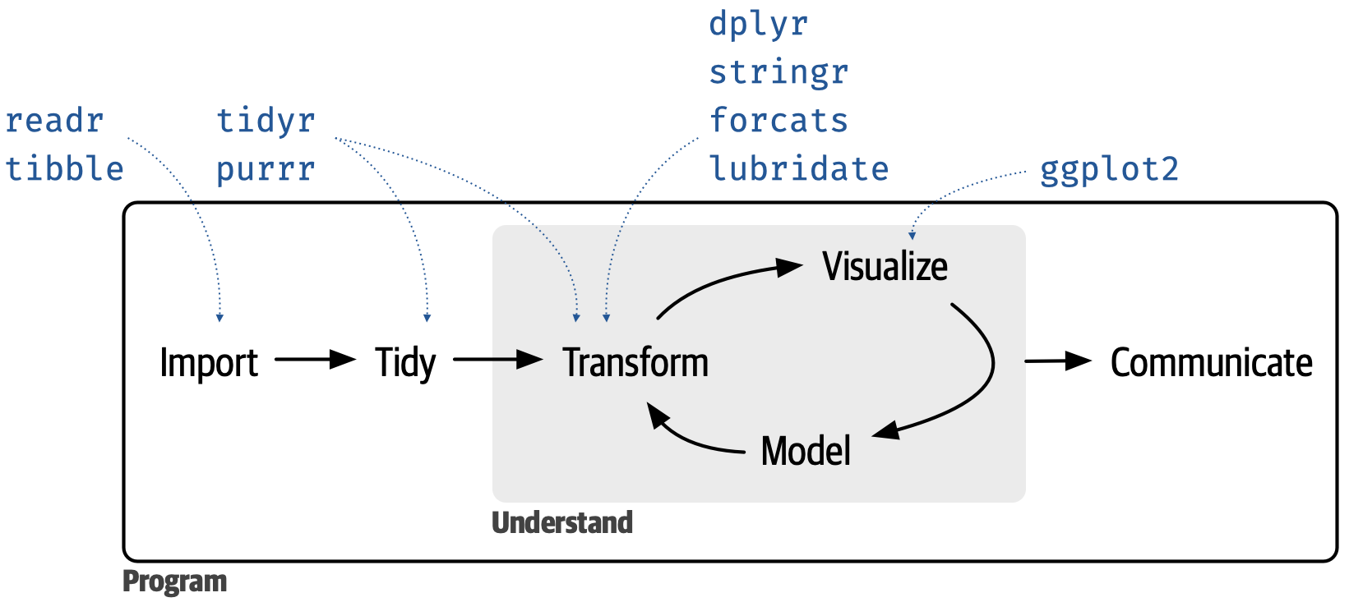

Slide 8
setup
Data: Thousands of loans made through the Lending Club, a peer-to-peer lending platform available in the openintro package, with a few modifications.
start with a data frame
# A tibble: 9,976 × 6 loan_amount homeownership bankruptcy application_type annual_income <int> <chr> <chr> <fct> <dbl> 1 28000 Mortgage No individual 90000 2 5000 Rent Yes individual 40000 3 2000 Rent No individual 40000 4 21600 Rent No individual 30000 5 23000 Rent No joint 35000 6 5000 Own No individual 34000 # ℹ 9,970 more rows # ℹ 1 more variable: interest_rate <dbl>
tidy data
Each variable forms a column
Each observation forms a row
Each type of observational unit forms a table
Wickham, H. . (2014). Tidy Data. Journal of Statistical Software, 59(10), 1–23. doi.org/10.18637/jss.v059.i10.
task: calculate a summary statistic
Calculate the mean loan amount.
# A tibble: 9,976 × 6 loan_amount homeownership bankruptcy application_type annual_income <int> <chr> <chr> <fct> <dbl> 1 28000 Mortgage No individual 90000 2 5000 Rent Yes individual 40000 3 2000 Rent No individual 40000 4 21600 Rent No individual 30000 5 23000 Rent No joint 35000 6 5000 Own No individual 34000 # ℹ 9,970 more rows # ℹ 1 more variable: interest_rate <dbl>
. . .
. . .
Error: object 'loan_amount' not found
accessing a variable
Approach 1: With attach():
[1] 16357.53
. . .
Not recommended. What if you had another data frame you’re working with concurrently called car_loans that also had a variable called loan_amount in it?
accessing a variable
Approach 2: Using $:
[1] 16357.53
. . .
Approach 3: Using with():
[1] 16357.53
accessing a variable
Approach 4: The tidyverse approach:
# A tibble: 1 × 1 mean_loan_amount <dbl> 1 16358.
. . .
More verbose
But also more expressive and extensible
the tidyverse approach
tidyverse functions take a data argument that allows them to localize computations inside the specified data frame
does not muddy the concept of what is in the current environment: variables always accessed from within in a data frame without the use of an additional function (like with()) or quotation marks, never as a vector

Slide 9
teaching with the tidyverse
task: grouped summary
Based on the applicants’ home ownership status, compute the average loan amount and the number of applicants. Display the results in descending order of average loan amount.
break it down I

Slide 10
Based on the applicants’ home ownership status, compute the average loan amount and the number of applicants. Display the results in descending order of average loan amount.
# A tibble: 9,976 × 6 loan_amount homeownership bankruptcy application_type annual_income <int> <chr> <chr> <fct> <dbl> 1 28000 Mortgage No individual 90000 2 5000 Rent Yes individual 40000 3 2000 Rent No individual 40000 4 21600 Rent No individual 30000 5 23000 Rent No joint 35000 6 5000 Own No individual 34000 # ℹ 9,970 more rows # ℹ 1 more variable: interest_rate <dbl>

Slide 11
break it down II

Slide 12
Based on the applicants’ home ownership status, compute the average loan amount and the number of applicants. Display the results in descending order of average loan amount.
[input] data frame
# A tibble: 9,976 × 6 # Groups: homeownership [3] loan_amount homeownership bankruptcy application_type annual_income <int> <chr> <chr> <fct> <dbl> 1 28000 Mortgage No individual 90000 2 5000 Rent Yes individual 40000 3 2000 Rent No individual 40000 4 21600 Rent No individual 30000 5 23000 Rent No joint 35000 6 5000 Own No individual 34000 # ℹ 9,970 more rows # ℹ 1 more variable: interest_rate <dbl>
data frame [output]

Slide 13
break it down III

Slide 14
Based on the applicants’ home ownership status, compute the average loan amount and the number of applicants. Display the results in descending order of average loan amount.
# A tibble: 3 × 2 homeownership avg_loan_amount <chr> <dbl> 1 Mortgage 18132. 2 Own 15665. 3 Rent 14396.

Slide 15
break it down IV

Slide 16
Based on the applicants’ home ownership status, compute the average loan amount and the number of applicants. Display the results in descending order of average loan amount.
# A tibble: 3 × 3 homeownership avg_loan_amount n_applicants <chr> <dbl> <int> 1 Mortgage 18132. 4778 2 Own 15665. 1350 3 Rent 14396. 3848

Slide 17
break it down V

Slide 18
Based on the applicants’ home ownership status, compute the average loan amount and the number of applicants. Display the results in descending order of average loan amount.
# A tibble: 3 × 3 homeownership avg_loan_amount n_applicants <chr> <dbl> <int> 1 Mortgage 18132. 4778 2 Own 15665. 1350 3 Rent 14396. 3848

Slide 19
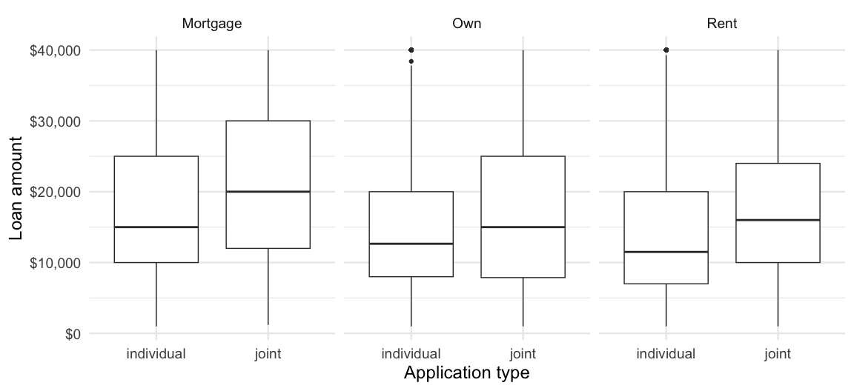
putting it back together
[input] data frame
# A tibble: 3 × 3 homeownership avg_loan_amount n_applicants <chr> <dbl> <int> 1 Mortgage 18132. 4778 2 Own 15665. 1350 3 Rent 14396. 3848
[output] data frame
grouped summary with aggregate()
homeownership loan_amount 1 Mortgage 4778 2 Own 1350 3 Rent 3848
homeownership n_applicants 1 Mortgage 4778 2 Own 1350 3 Rent 3848
grouped summary with aggregate()
homeownership avg_loan_amount 1 Mortgage 18132.45 2 Own 15665.44 3 Rent 14396.44
. . .
homeownership n_applicants avg_loan_amount 1 Mortgage 4778 18132.45 2 Own 1350 15665.44 3 Rent 3848 14396.44
grouped summary with aggregate()
. . .
Good: Inputs and outputs are data frames
Not so good: Need to introduce
formula syntax
passing functions as arguments
merging datasets
square bracket notation for accessing rows
grouped summary with tapply()
Mortgage Own Rent 18132.45 15665.44 14396.44
. . .
Not so good:
passing functions as arguments
distinguishing between the various apply() functions
ending up with a new data structure (array)
reading nested functions
task: data visualization
Create side-by-side box plots that shows the relationship between loan amount and application type, faceted by homeownership.

Slide 20
break it down I

Slide 21

Create side-by-side box plots that shows the relationship between annual income and application type, faceted by homeownership.

Slide 22
break it down II

Slide 23
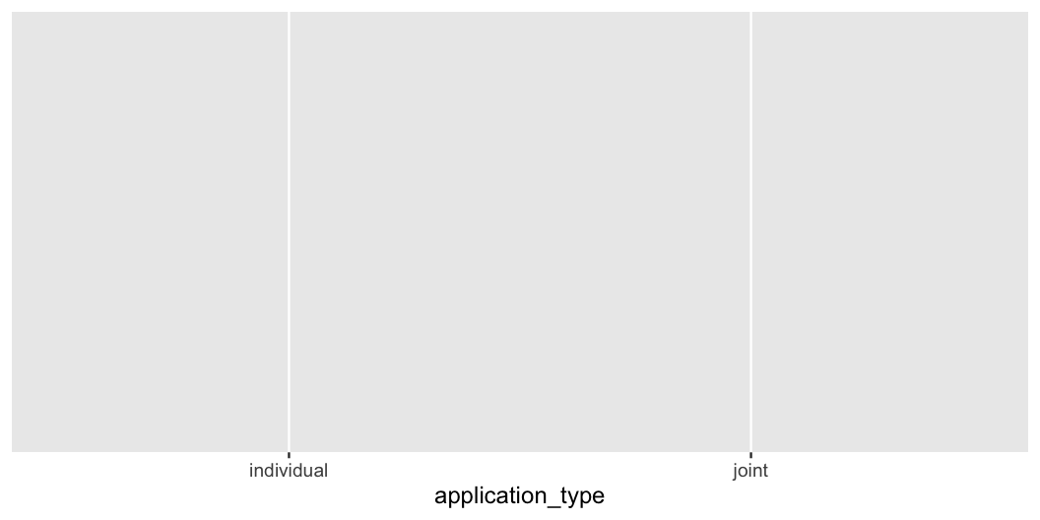
Create side-by-side box plots that shows the relationship between annual income and application type, faceted by homeownership.

Slide 24
break it down III

Slide 25
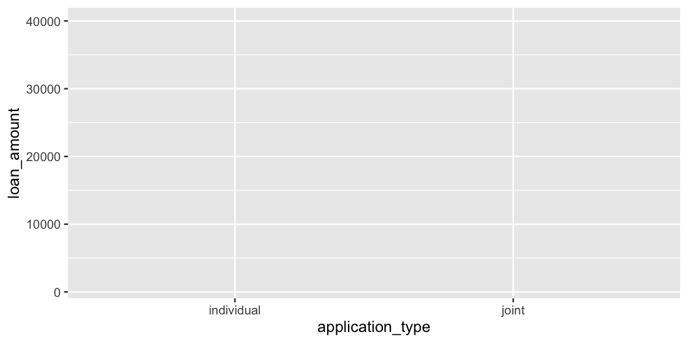
Create side-by-side box plots that shows the relationship between annual income and application type, faceted by homeownership.

Slide 26
break it down IV

Slide 27
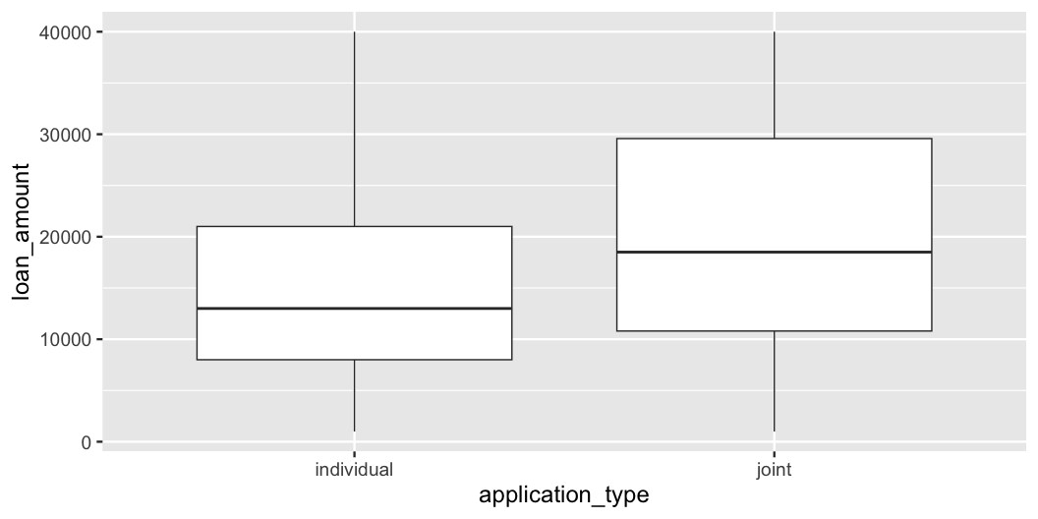
Create side-by-side box plots that shows the relationship between annual income and application type, faceted by homeownership.

Slide 28
break it down IV

Slide 29
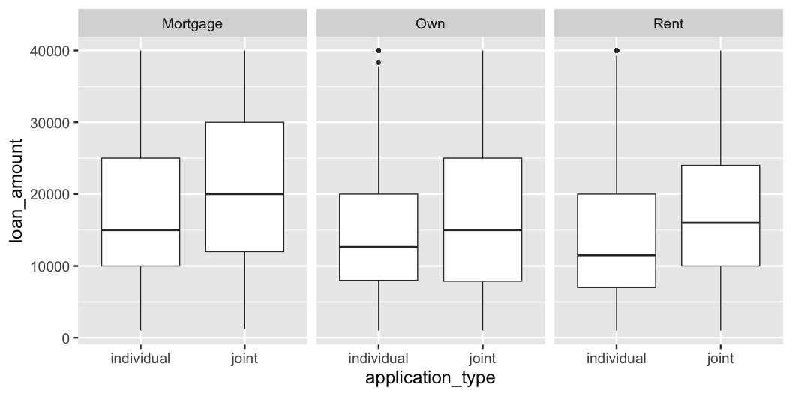
Create side-by-side box plots that shows the relationship between annual income and application type, faceted by homeownership.

Slide 30
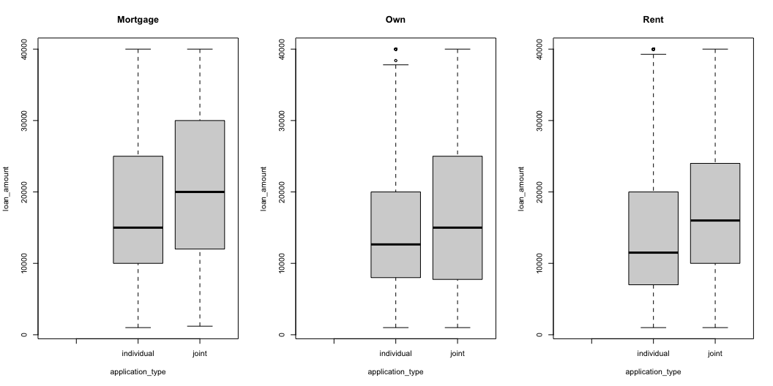
plotting with ggplot()
. . .
Each layer produces a valid plot
Faceting by a third variable takes only one new function
plotting with boxplot()
[1] "Mortgage" "Own" "Rent"
plotting with boxplot()

Slide 31
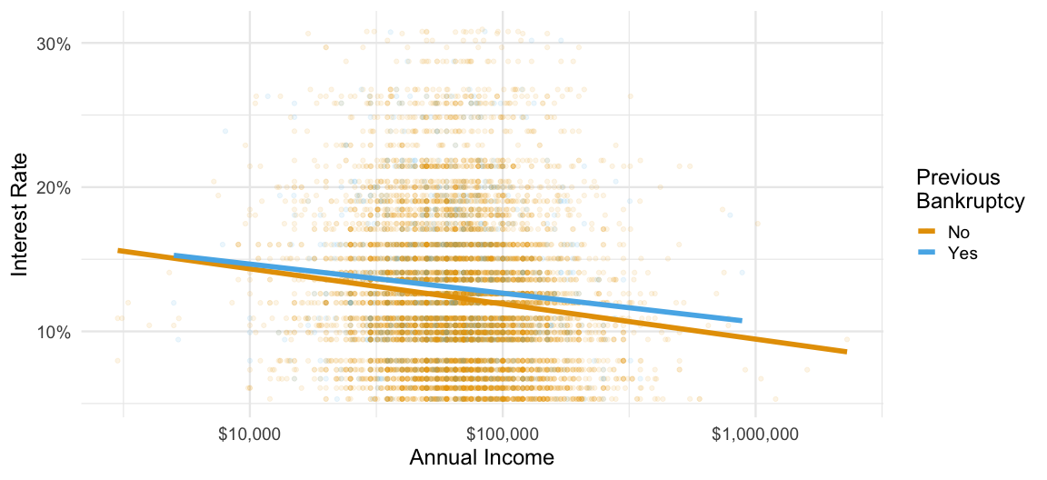
visualizing a different relationship
Visualize the relationship between interest rate and annual income, conditioned on whether the applicant had a bankruptcy.

Slide 32
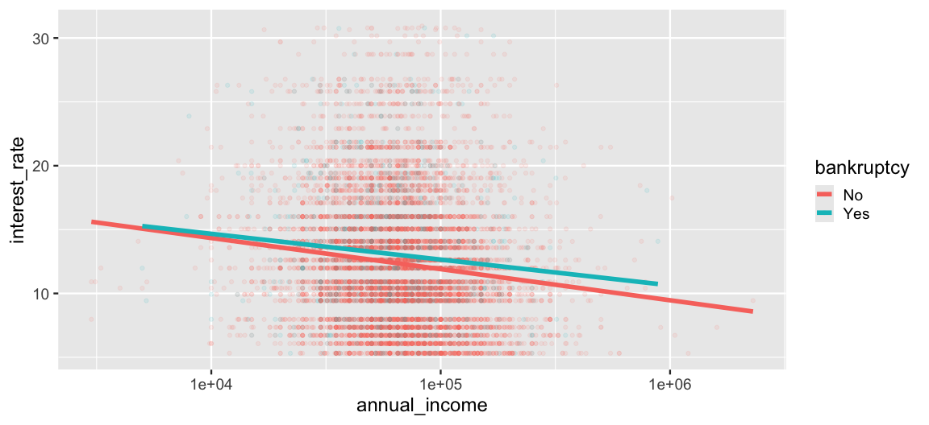
plotting with ggplot()

Slide 33
further customizing ggplot()

Slide 34
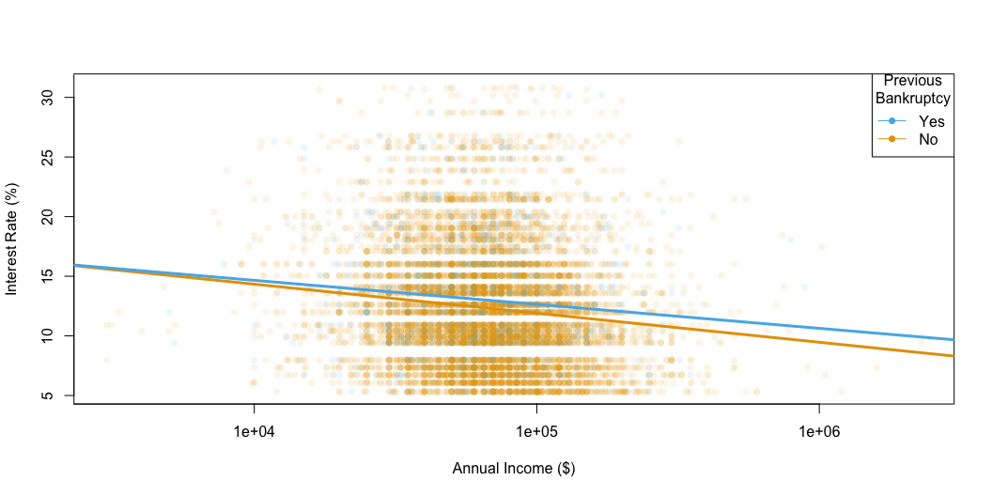
plotting with plot()
plotting with plot()

Slide 35
beyond wrangling, summaries, visualizations
Modeling and inference with tidymodels:
A unified interface to modeling functions available in a large variety of packages
Sticking to the data frame in / data frame out paradigm
Guardrails for methodology

Slide 36
pedagogical strengths of the tidyverse
consistency
No matter which approach or tool you use, you should strive to be consistent in the classroom whenever possible
tidyverse offers consistency, something we believe to be of the utmost importance, allowing students to move knowledge about function arguments to their long-term memory
teaching consistently
Challenge: Google and Stack Overflow can be less useful – demo problem solving
Counter-proposition: teach all (or multiple) syntaxes at once – trying to teach two (or more!) syntaxes at once will slow the pace of the course, introduce unnecessary syntactic confusion, and make it harder for students to complete their work.
“Disciplined in what we teach, liberal in what we accept”
Postel, J. (1980). DoD standard internet protocol. ACM SIGCOMM Computer Communication Review, 10(4), 12-51. datatracker.ietf.org/doc/html/rfc760
mixability
Mix with base R code or code from other packages
In fact, you can’t not mix with base R code!
scalability
Adding a new variable to a visualization or a new summary statistic doesn’t require introducing a numerous functions, interfaces, and data structures
user-centered design
Interfaces designed with user experience (and learning) in mind
Continuous feedback collection and iterative improvements based on user experiences improve functions’ and packages’ usability (and learnability)
readability
Interfaces that are designed to produce readable code
community
The encouraging and inclusive tidyverse community is one of the benefits of the paradigm
Each package comes with a website, each of these websites are similarly laid out, and results of example code are displayed, and extensive vignettes describe how to use various functions from the package together
shared syntax
Get SQL for free with dplyr verbs!

Slide 37
final thoughts
building a curriculum
Start with library(tidyverse)
Teach by learning goals, not packages
keeping up with the tidyverse
Blog posts highlight updates, along with the reasoning behind them and worked examples
Lifecycle stages and badges
coda

Slide 38
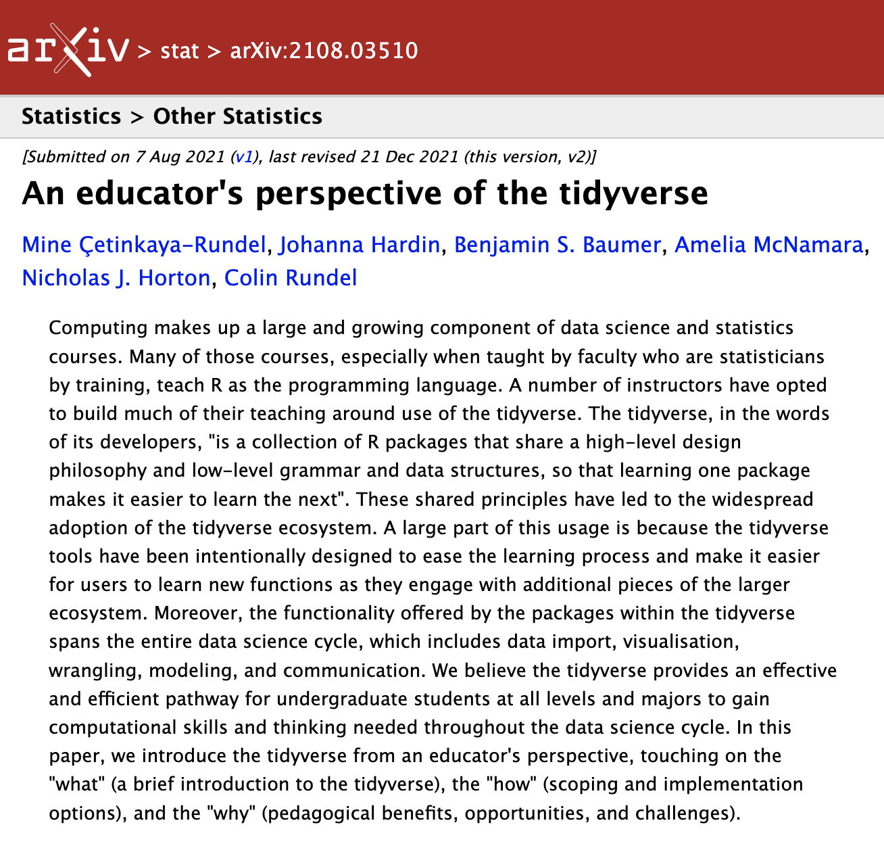
We are all converts to the tidyverse and have made a conscious choice to use it in our research and our teaching. We each learned R without the tidyverse and have all spent quite a few years teaching without it at a variety of levels from undergraduate introductory statistics courses to graduate statistical computing courses. This paper is a synthesis of the reasons supporting our tidyverse choice, along with benefits and challenges associated with teaching statistics with the tidyverse.

Slide 39
Çetinkaya-Rundel, M., Hardin, J., Baumer, B. S., McNamara, A., Horton, N. J., & Rundel, C. (2021). An educator’s perspective of the tidyverse. arXiv preprint arXiv:2108.03510. arxiv.org/abs/2108.03510

Slide 40
thank you!
bit.ly/tidyperspective-dagstat

