Slide 1
Workshop 1: Semester projects & using Quarto in an R project
BIOL90041
Week 2

Slide 2
Semester Group Projects

Slide 3


Stop and Code (3 mins)
A basic R project set up
Week_2
Week_2.Rproj
Create a project using the following structure
Data
Script
Lecture_script.R
Output
Plots
Lecture

Slide 4

A basic R project set up
Week_2
Week_2.Rproj
Data
Quarto (.qmd)
Script
Lecture_script.R
Output
Plots
Lecture

Slide 5
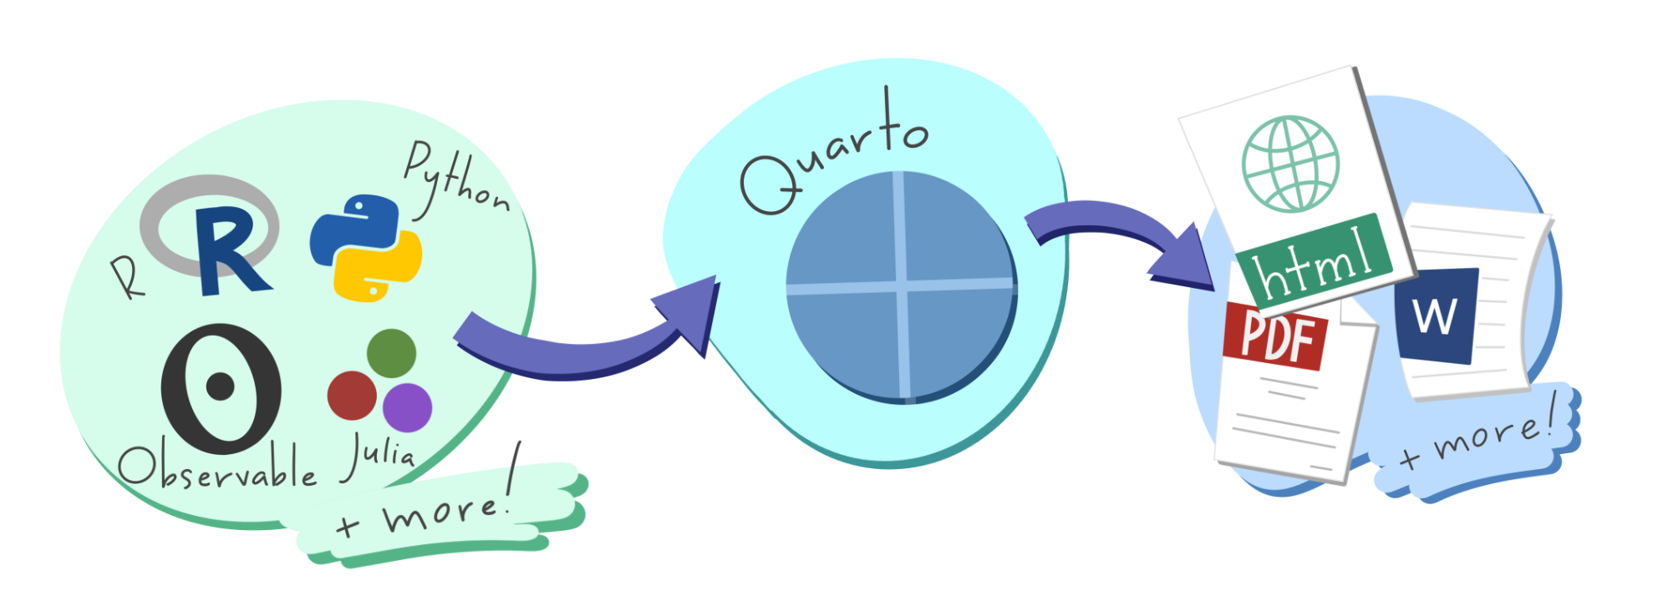

What is Quarto?
An open-source tool that seamlessly integrates code, results, and narrative text into a single document
Key Features:
Multi-language Support: Works with R, Python, Julia, and more.
Versatile Outputs: Generate reports, presentations, websites, and dashboards in formats like HTML, PDF, and Word.
Reproducibility: Ensures that analyses are transparent and reproducible by embedding code and its output directly within the document
Use Cases:
Communication: Present findings to stakeholders with clear narratives and visualisations.
Collaboration: Share comprehensive analyses with peers, including code and results.
Documentation: Maintain a detailed record of data analysis processes and decisions.
Integration:
Fully compatible with RStudio and other IDEs, providing a user-friendly interface for creating and rendering documents.

Slide 6
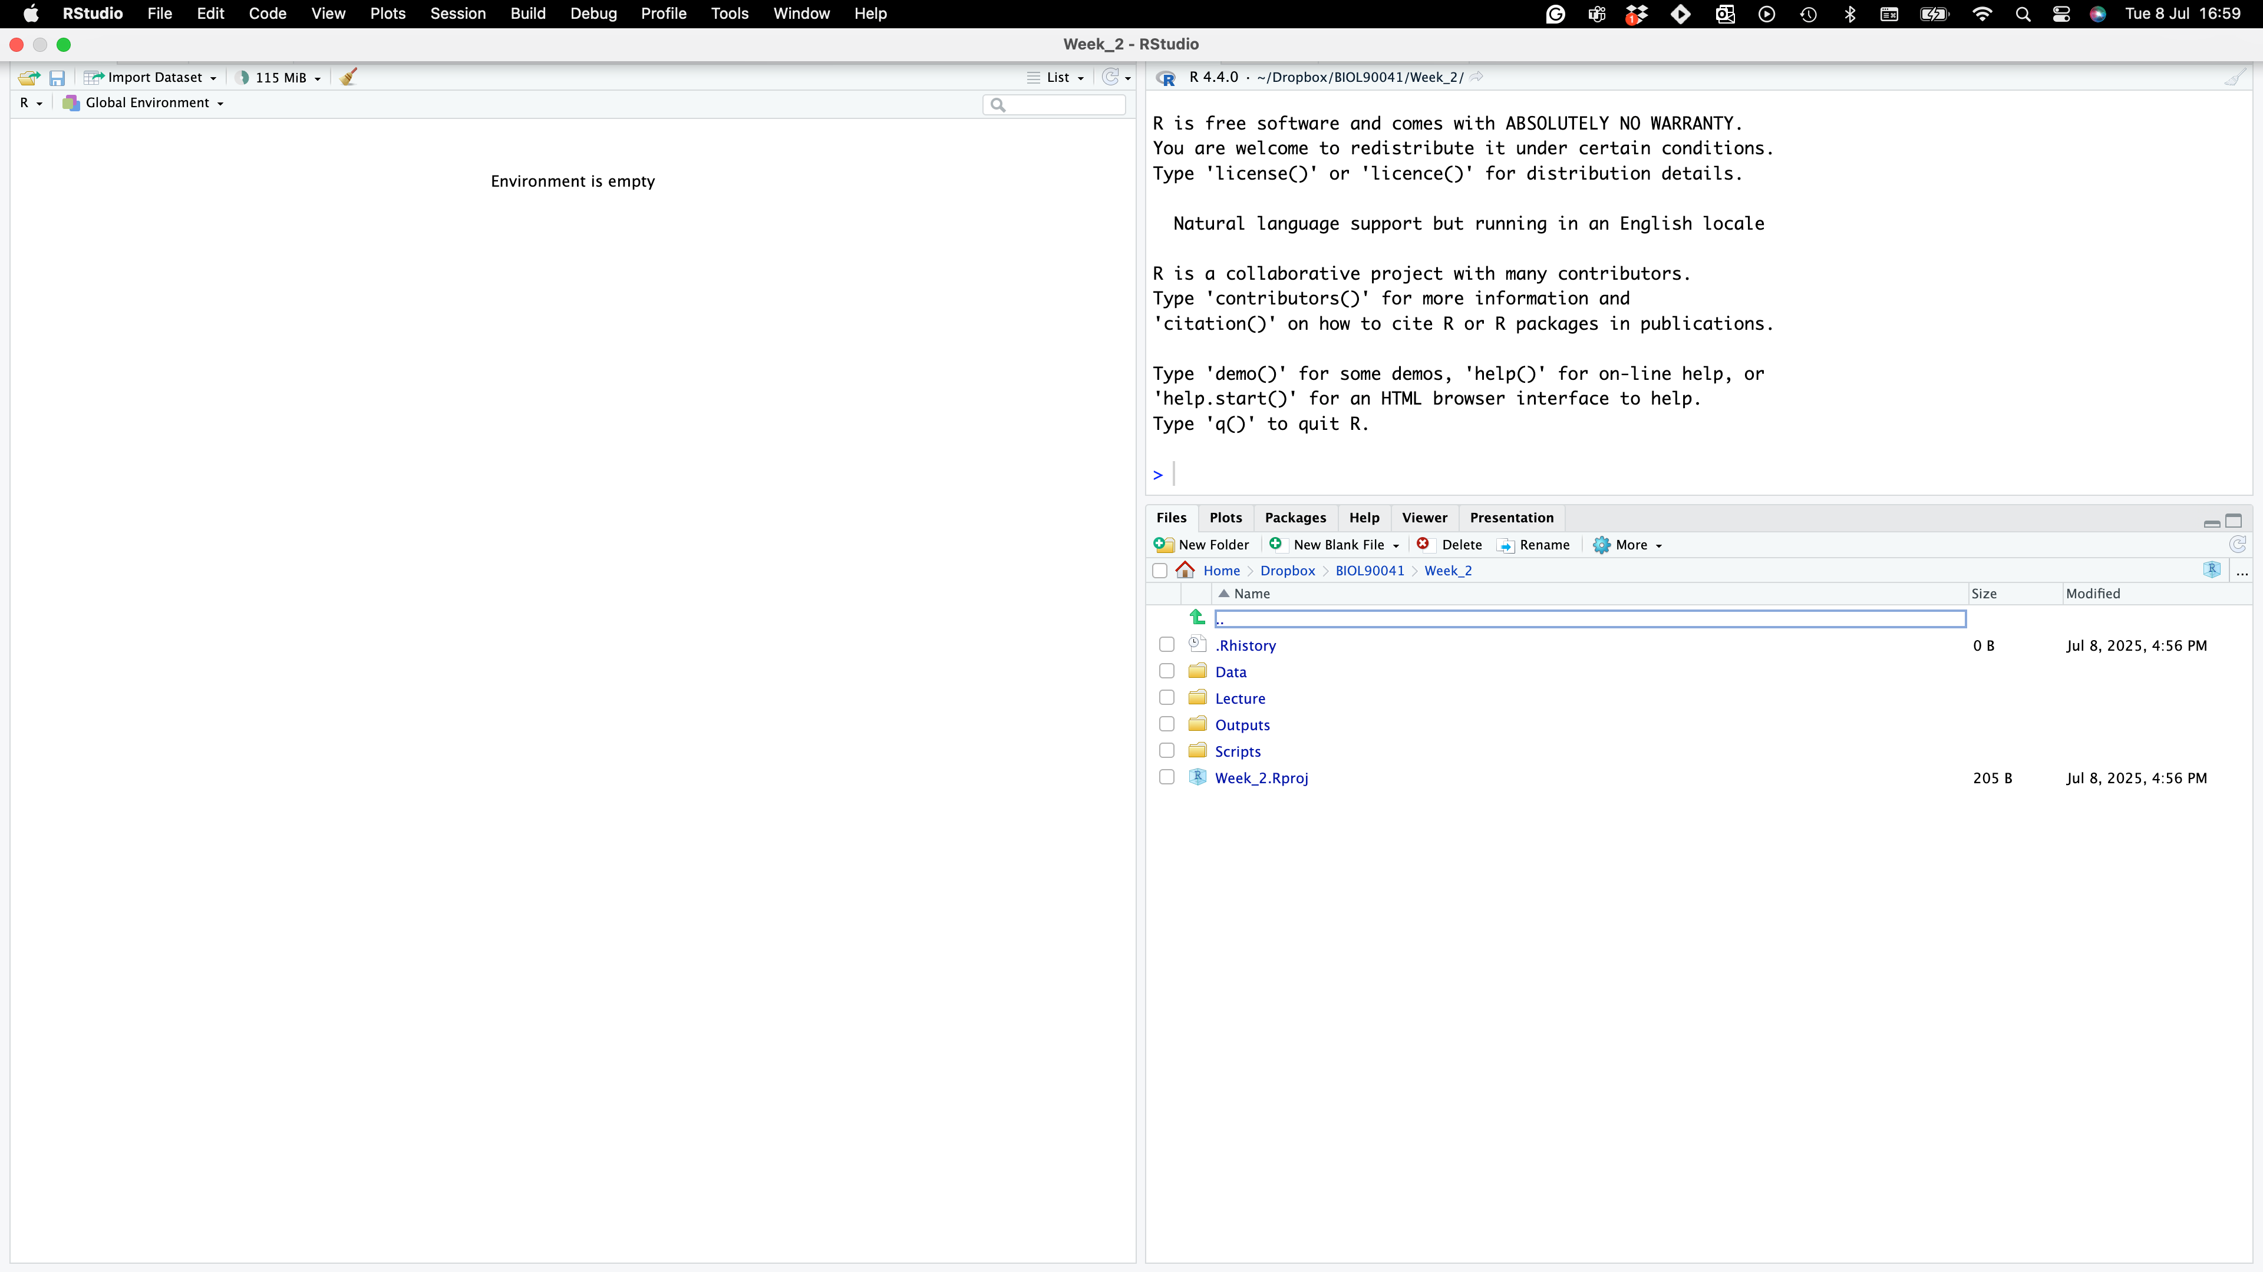

Where to find it?
Project name
NO SCRIPT?!?!!
Project folders

Slide 7
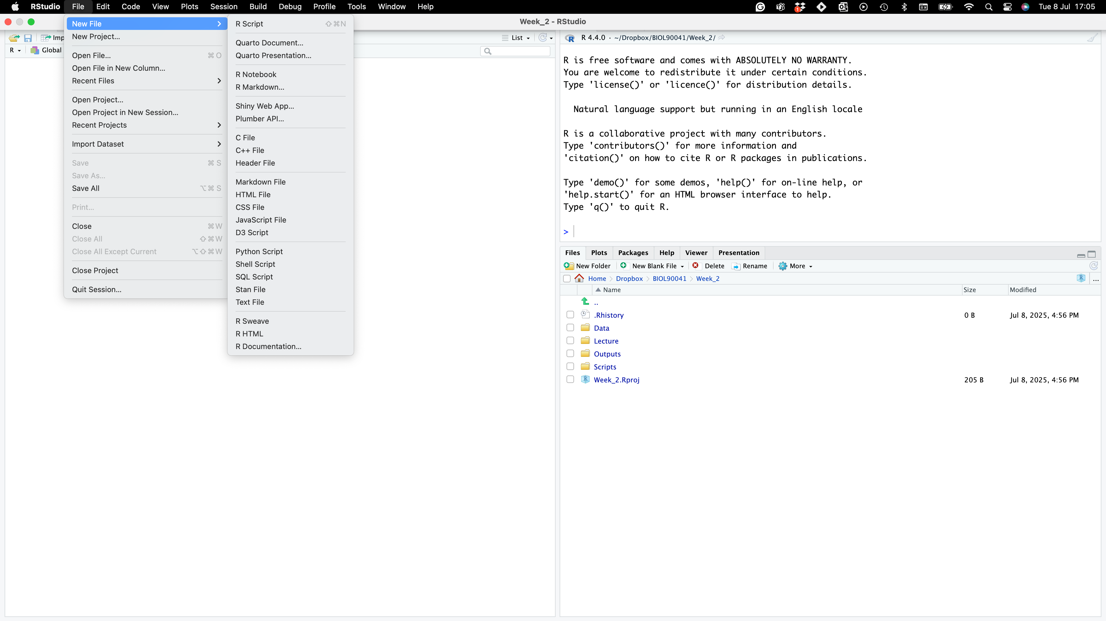
Where to find it?
NO SCRIPT?!?!!

Slide 8
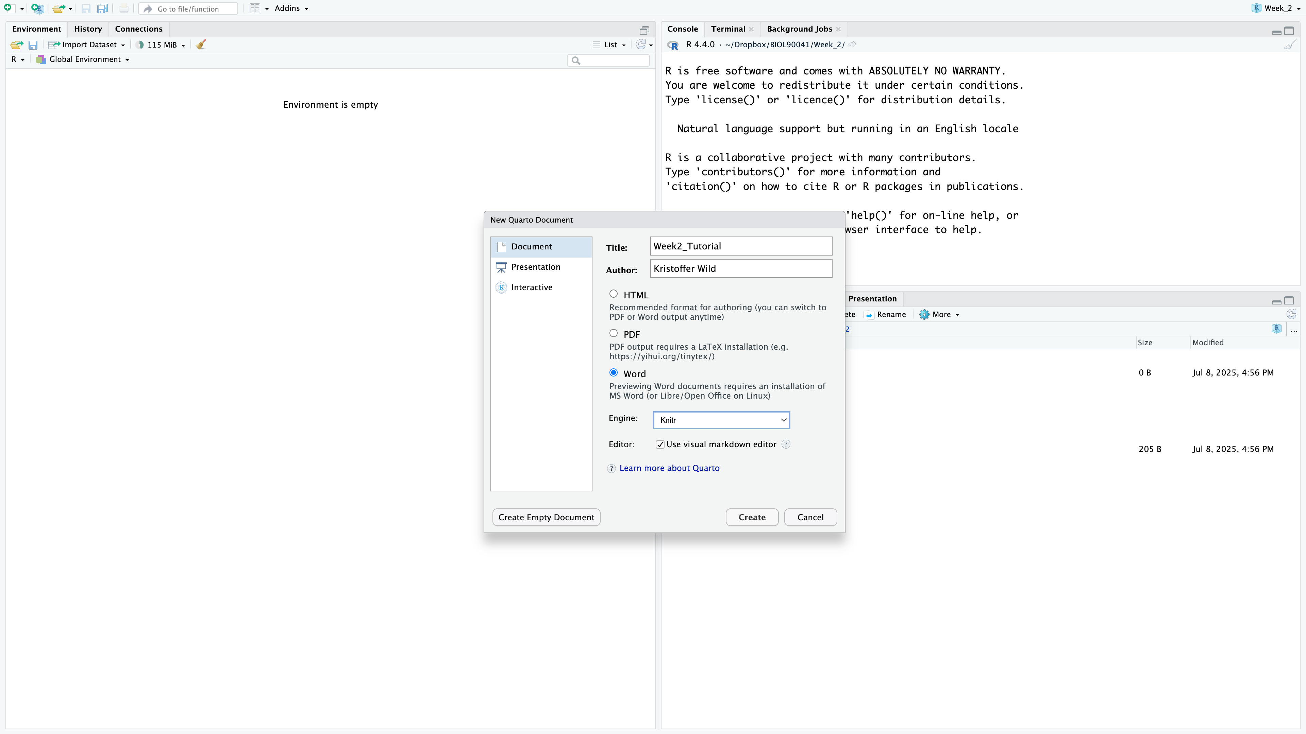
Where to find it?
NO SCRIPT?!?!!

Slide 9
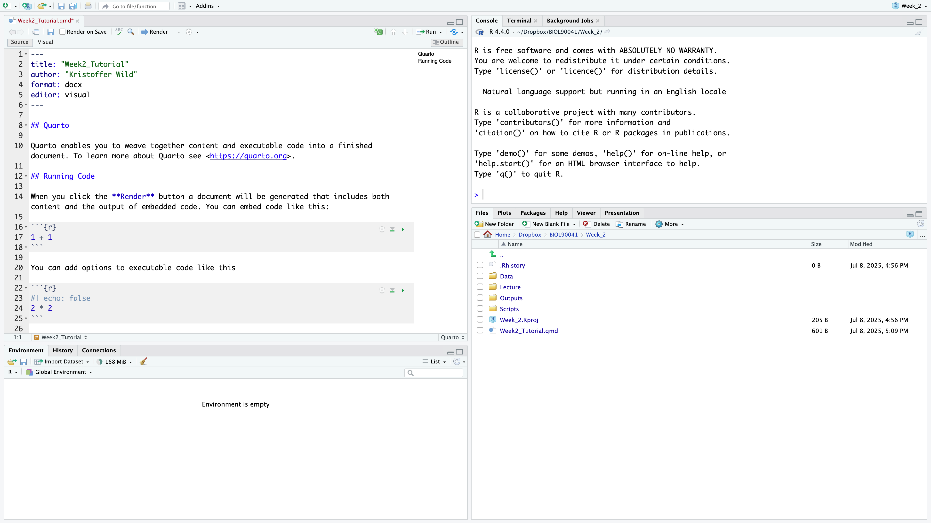
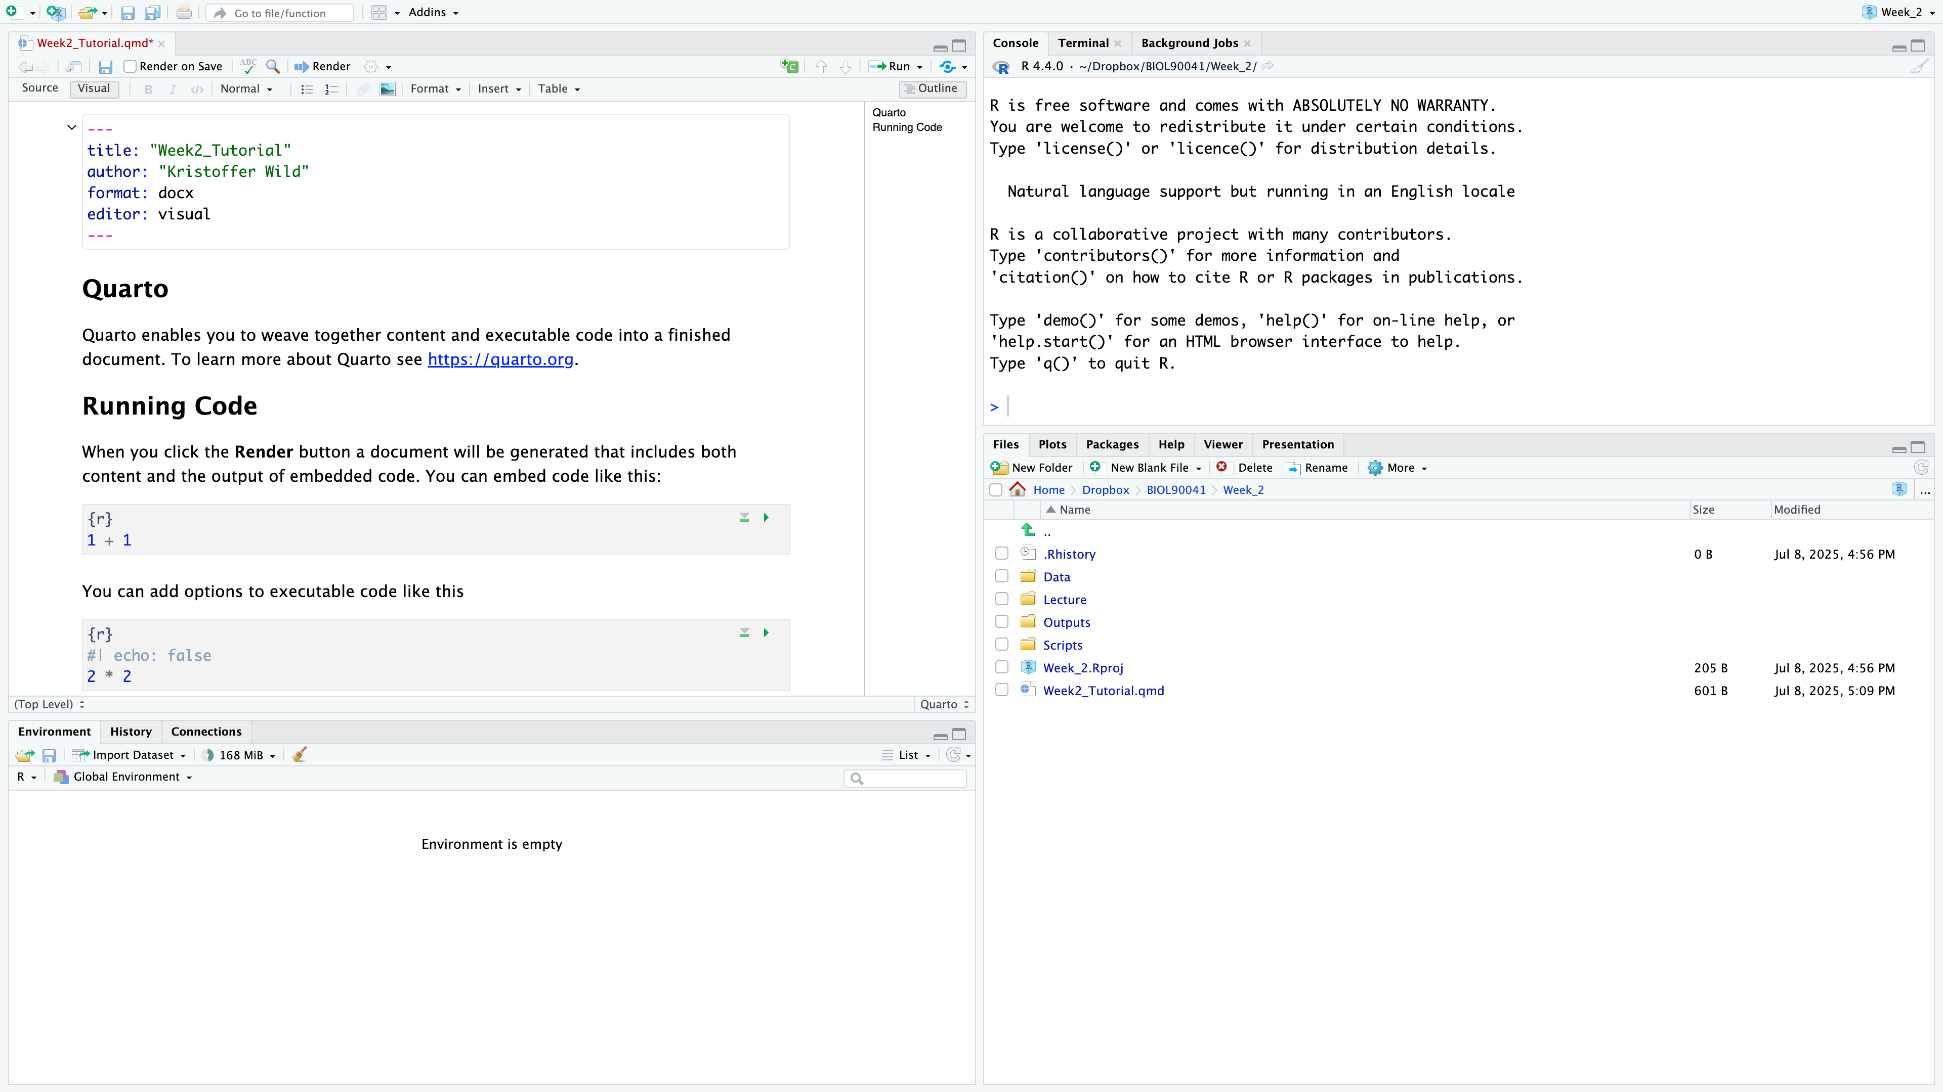
Where to find it?
Metadata
LINE #’s
NO SCRIPT?!?!!
Notes:
I saved my file as ‘Week2_tutorial.qmd’, for those of you that are use to markdown notice that the suffix has changed (rmd to qmd).
At the top of the document you will have some metadata on the document: title, format (word doc), editor….
The editor is a pretty awesome feature that you wouldn’t get in a markdown document. Here you can get the look of
what it would look like in a word document.

Slide 10
Where to find it?
Text
Text headings
Code ‘Chunks’
NO SCRIPT?!?!!
Notes:
I saved my file as ‘Week2_tutorial.qmd’, for those of you that are use to markdown notice that the suffix has changed (rmd to qmd).
At the top of the document you will have some metadata on the document: title, format (word doc), editor….
The editor is a pretty awesome feature that you wouldn’t get in a markdown document. Here you can get the look of
what it would look like in a word document.

Slide 11
Where to find it?
Check out the tool bar : change text formatting and see how source code changes!
NO SCRIPT?!?!!
Notes:
Now play with the tool bar
you can bold, italicize text
you can add in links
Change the formatting headings
If you go back to the source code you can see what it’s doing under the hood.
Here if you used markdown in the past, you would have to know this laytext code

Slide 12
Quarto live DEMO with Kris
Here we will go over…
setting up metadata to render into a word document
formatting code chunks
how code should be in code chunks
practicing writing results under code chunks
rendering document with appropriate code, plots, and write up

Slide 13
Class activity:
Q1. Create a vector that records the shoe sizes of 10 people in class
Q2. calculate the mean, median, sd, var, IQR
Q3. Create a histogram of the data. Is it skewed. Can you change the bin sizes of the histogramm
(Hint: ?hist)
Use other resources
Q4. Extra: separate your data into male and female show sizes and repeat 1-3 for the split data sets.

Slide 14
Using ChatGPT for code

Slide 15
An example of using ChatGPT with code

Slide 16
Quiz 1:
Open the zip file ‘Quiz 1’ in LMS – Follow the directions provided in the html file
RUBRIC:
- 20% if the file

Slide 17
Week_2_Quiz
Week_2_Quiz.Rproj
Week_2_Quiz.qmd
Data
hawk.csv
Script
Output

