Slide 1
Workshop 2: Getting to know your data and using Quarto
BIOL90041
Week 3
Notes:
Introduce Alexis who will be helping in demonstrating.

Slide 2
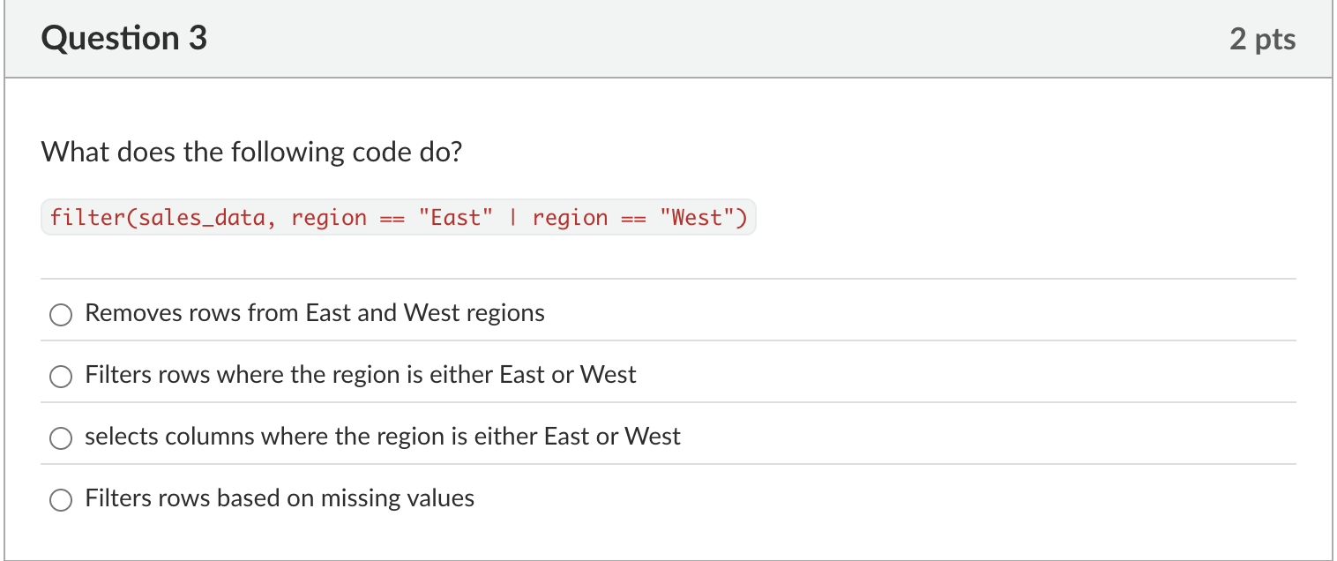
QUIZ
Notes:
Filters rows where the region is either East or West ‘ indicated by | ‘

Slide 3
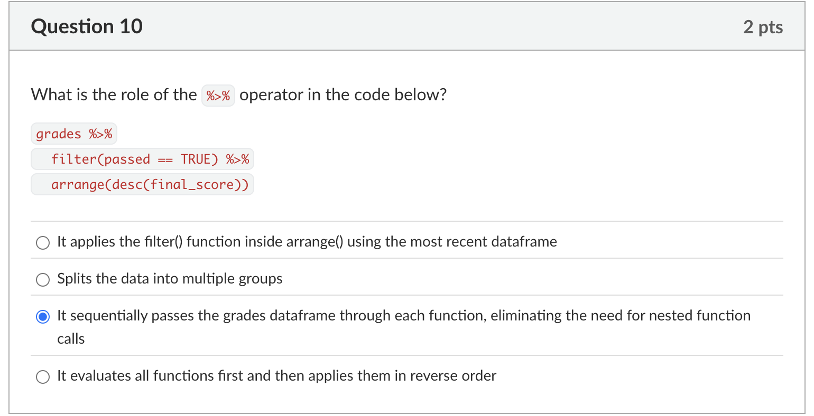
QUIZ
Notes:
It sequentially passes the grades dataframe through each function, eliminating the need for nested function calls

Slide 4
Todays objectives
Investigate your data: get with your groups and open up your project data. Using dplyr verbs look at your data (40min)
Show and tell: each group will come up and walk through an example of a problem and their solution (20 min)
Coding assignment: I will walk you through your coding assignment rubric (15 min)
Open up Quarto and start setting up coding assignment (45 min)
- Be sure you ask us questions!

Slide 5

Spring cleaning!

Slide 6

Coding Assignment – Overview
Goal: Demonstrate skills from Lectures 2–4 and Workshops 1–3 (20% of your grade)
Apply new coding techniques from class to your project data
Use your lecture notes & workshop assignments as a guide
Deliverables:
R Project folder
Project data files
Quarto document (.qmd)

Slide 7
File Structure & Saving (3%)
Name your project and files: STUDENT_FIRST_LAST_NAME_STUDENT#
Folder must contain:
R Project
Quarto document (.qmd)
Rendered Word document (.docx)
Data folder with your project data
Match the file structure covered in class
Zip the entire folder before submission
Ensure the project renders correctly

Slide 8
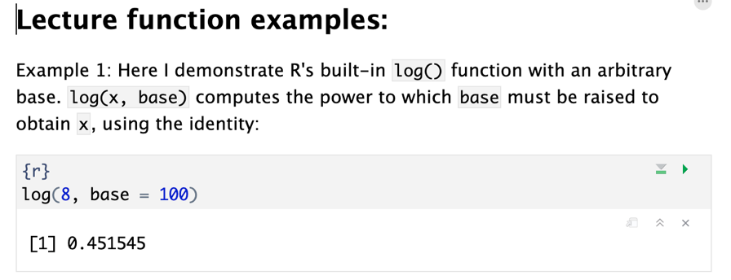
Functions from Class (5%)
Identify 5 functions from Lectures 2–4 (not related to project data)
Provide:
Function name & description (above code chunk)
Example code for each function
Clear numbering for each example
Ensure outputs display correctly when rendered

Slide 9
Project Protocol (10%)
Provide 5+ steps of cleaning, exploring, transforming project data
At least 2 steps use pipes (%>%)
3+ steps must address Zuur et al. (2010) checks:
Outliers / NA detection
Homogeneity of variance
Normality
Zero inflation
Y–X relationships
For each step, explain:
Initial data issue/check & related Zuur step
What the code achieves
Show evidence the data is cleaner (e.g., plots, tables)

Slide 10
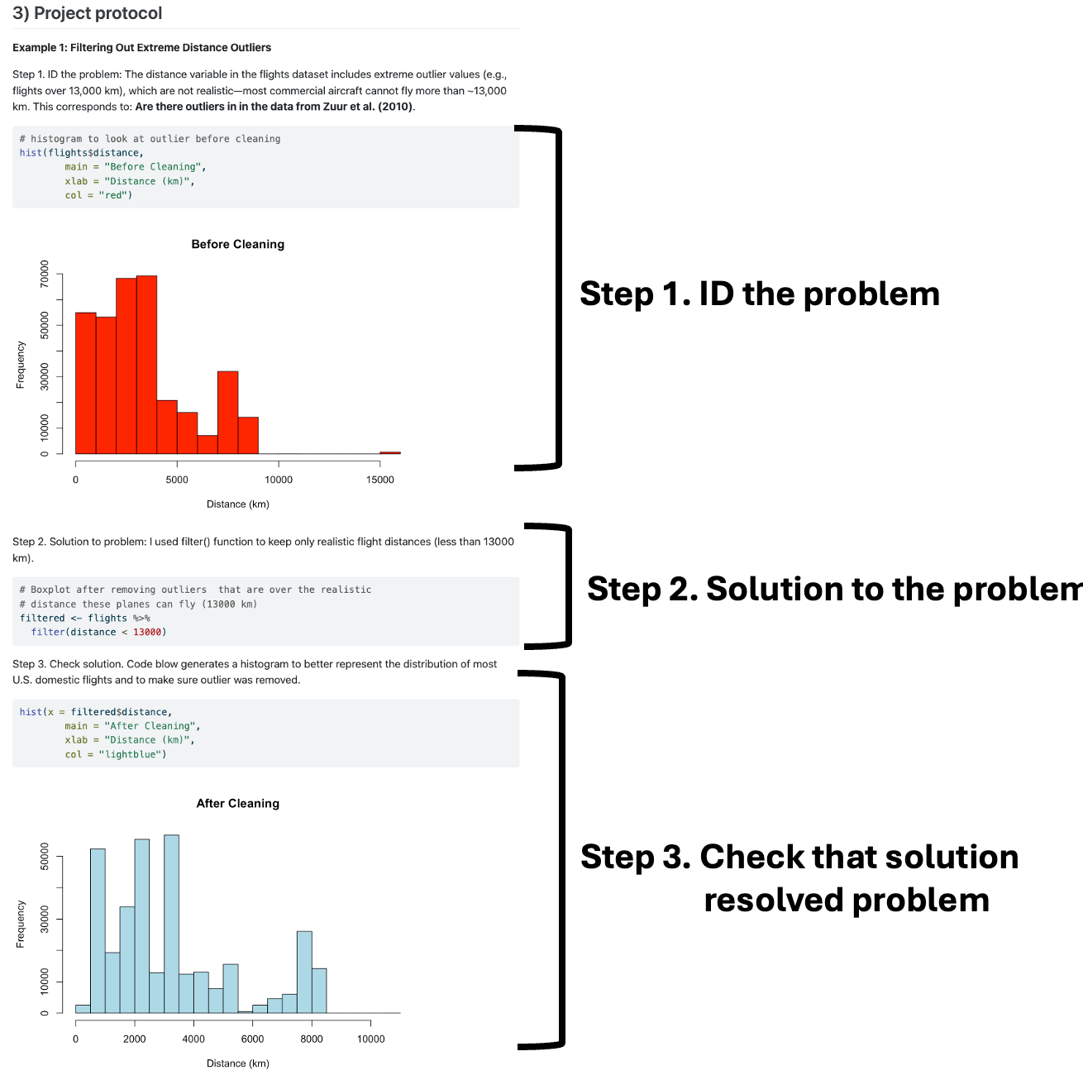
100-120 words

Slide 11
Look at the rubric on LMS
Libraries (1%)
Lecture notes (5%)
Project protocol (10%)
File formatting and how it is saved (3%)
Spelling, grammar, and English expression are being used correctly (1%)
… If you can’t find your answer there ask at the workshop or email me!

Slide 12
OPEN QUARTO!

