Slide 1

Data cleaning 2
Kristoffer Wild

Slide 2


Slide 3
Today’s learning objectives
Group problem and solution (25min)
Transforming your data (5min)
New functions for data cleaning (30min)
pivots, binds, joins, gsub, if_else
Apply with your group data (15min)
Review content for upcoming quiz/questions (15 min)

Slide 4
Break out in your groups (4min)
identify your problem and your solution
identify a problem you haven’t resolved
Be ready to share to the class!
Notes:
Break out in your groups & ID one problem and solution from last Wednesday. END ON A PROBLEM

Slide 5

TRANSFORMING YOUR DATA

Slide 6
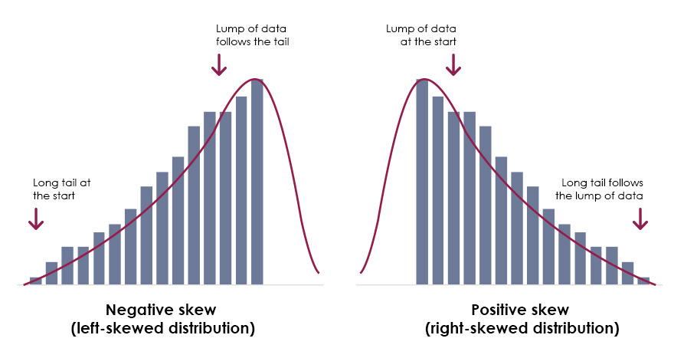
Transformations for Right (Positive) Skew
Use these transformations in increasing order of strength:
Root (√x, ³√x): Mild transformation for slight skew.
Logarithm (log(x)): Stronger; shift data to avoid log(0) using log(x + |min(x)| + 1).
Reciprocal (1/x, 1/x³): Strongest; avoid near-zero values by shifting.
Notes:
Why Transform? Right-skewed data can violate the assumptions of normality required for many statistical tests. By applying the right transformation, we can reduce skew, stabilize variance, and make data more suitable for analysis.
Start Mild – Use Root Transformations:
These include square roots (√x) or cube roots (³√x).
They are great first steps for mild skew.
These transformations compress larger values slightly without being too aggressive.
If Still Skewed – Try Logarithmic Transformations:
log(x) or log10(x) compresses higher values more.
This is stronger than root transformation and is widely used.
Be careful: You can’t take the log of 0 or negative numbers.
Use a shift: log(x + |min(x)| + 1) to avoid errors.
Most Aggressive – Reciprocal Transformations:
Examples include 1/x or 1/x³.
These dramatically reduce the impact of large values.
Also require a shift to avoid dividing by zero or near-zero numbers.
Shift Data When Needed: Always ensure the data is shifted appropriately if it contains zeros or negatives to avoid errors in log or reciprocal functions.

Slide 7
R Code: Transformations for Right-Skewed Data
# Example: Right-Skewed Data; simulate the data
set.seed(42)
x <- rexp(1000, rate = 0.2)
# Root transformations
sqrt_x <- sqrt(x)
cube_root_x <- x^(1/3)
# Log transformations
log_x <- log(x)
log10_x <- log10(x)
log1p_x <- log1p(x) # safer for zeros
# Shifted log to handle 0 or negatives
x_shifted <- x - min(x) + 1
log_shifted <- log(x_shifted)
# Reciprocal transformations
recip_x <- 1 / x
recip_x3 <- 1 / (x^3)

Slide 8
Transformations for Left (Negative) Skew
Reflect the data first, then apply transformations:
Reflect using: max(x) + 1 - x to reverse the skew direction.
Square (x²): Mild to moderate transformation; not suitable for negative values.
Exponential (eˣ): Strongest transformation; handles negative input well.
Notes:
This slide outlines how to transform negatively skewed data
Left-skewed data can’t be directly transformed like right-skewed data.
Instead, reflect the data first to reverse the skew direction.
Use this formula: max(x) + 1 - x
This flips the distribution so it becomes right-skewed, which allows us to use familiar transformations.
Apply Transformations After Reflection: Once reflected, apply one of the following transformations, based on skew severity.
Square Transformation (x²):
A mild-to-moderate option.
Best for slight to moderate skew.
Note: This isn’t suitable for negative values unless they’ve been shifted or reflected first.
Exponential Transformation (eˣ):
Strongest transformation.
Especially useful if the data includes negative values, since exponentials grow rapidly with increasingly negative inputs.
Use sparingly—this can drastically stretch the right tail.
Always Check Your Data After reflecting and transforming, plot the data again to confirm whether the skew has been corrected. Choose the transformation strength based on how skewed the distribution is after reflection.

Slide 9
R Code: Transformations for Left-Skewed Data
# Example: Left-Skewed Data simulate the data
set.seed(42)
x_left <- -rexp(1000, rate = 0.2)
# Reflect the data
x_reflected <- max(x) + 1 - x
# Apply transformations to reflected data
square_x <- x_reflected^2
exp_x <- exp(x_reflected)
log_reflected <- log(x_reflected)
log10_reflected <- log10(x_reflected)

Slide 10

PIVOTING YOUR DATA

Slide 11
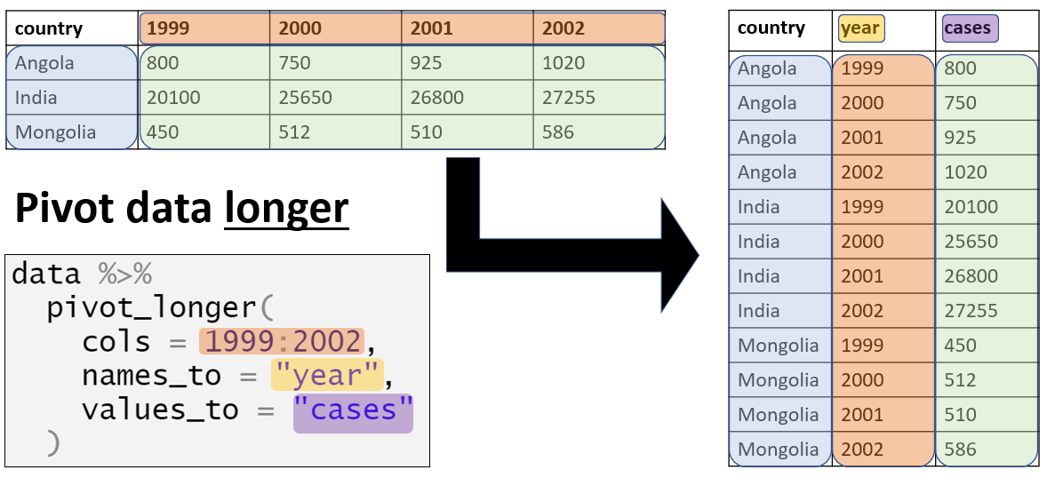
pivot_longer()
Converts wide data into long format.
Turns column names into values under a new variable.
Used for tidying data before visualization or analysis.
Syntax: pivot_longer(data, cols, names_to, values_to)
Notes:
You’ll often get datasets where repeated measurements
— like different months or treatments
— are spread across columns.
This is what we call “wide” format. pivot_longer() helps you convert that into a “long” format, where each row is a single observation. Long format is more compatible with ggplot2, modelling functions, and most tidyverse tools. Think of it as melting your data down into a tidy structure.

Slide 12
pivot_longer() in Action
```r
library(tidyr)
data <- data.frame(ID = c(1, 2), Jan = c(10, 20), Feb = c(15, 25))
pivot_longer(data, cols = Jan:Feb, names_to = 'Month', values_to = 'Value')
# Output:
# A tibble: 4 × 3
ID Month Value
1 1 Jan 10
2 1 Feb 15
3 2 Jan 20
4 2 Feb 25
Notes:
Here’s a simple dataset: two people with values recorded in January and February.
Using pivot_longer(), we collapse Jan and Feb into a single
column called “Month,” and their values into “Value.”
This structure is easier to work with when plotting trends across time,
for example, or when calculating monthly averages.
You can also combine this with group_by() and summarise() to do powerful analyses.

Slide 13
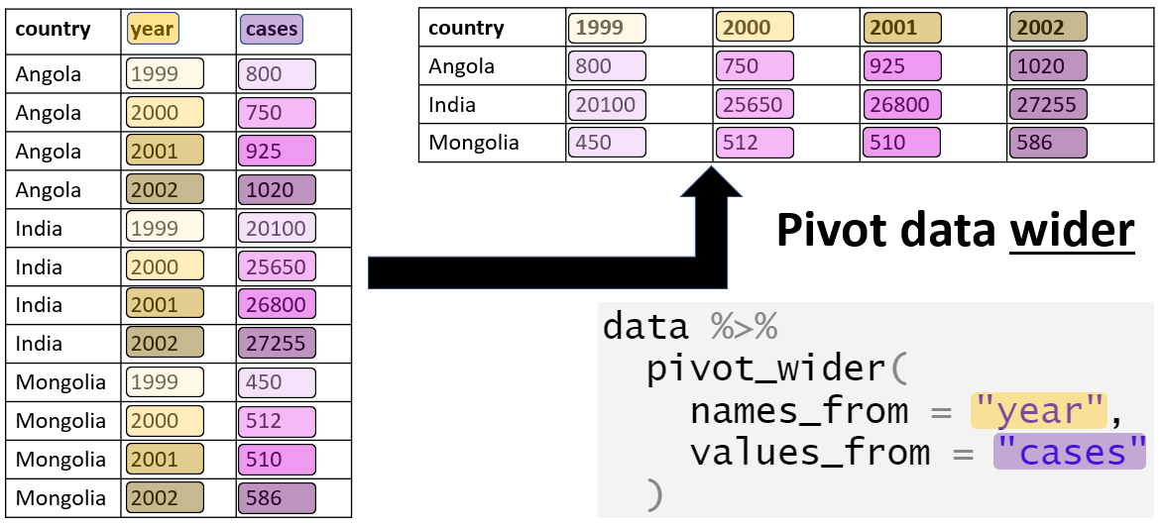
pivot_wider()
Converts long data into wide format.
Spreads values across multiple columns using a key column.
Useful when summarizing tidy data.
Syntax: pivot_wider(data, names_from, values_from)
Notes:
Now we do the reverse — let’s say we’ve summarized or grouped data and now want to spread it back out.
pivot_wider() takes key-value pairs and spreads them across columns.
You might use this when you’re making tables for reporting,
or when transforming output to match a wide-format model input.
Be careful: if you have duplicate entries for the same key, it might throw an error or aggregate unexpectedly.

Slide 14
pivot_wider() in Action
```r
library(tidyr)
data <- data.frame(
ID = c(1, 1, 2, 2),
Month = c('Jan', 'Feb', 'Jan', 'Feb'),
Value = c(10, 15, 20, 25))
pivot_wider(data, names_from = Month, values_from = Value)
# Output:
# A tibble: 2 × 3
ID Jan Feb
1 1 10 15
2 2 20 25
Notes:
You can see here that we had a long table with repeated IDs.
Using pivot_wider(), we spread the “Month” values into column names and fill them with the corresponding “Value.”
This is helpful when you need a compact, human-readable summary, or want to compare columns side-by-side.

Slide 15

BINDING YOUR DATA
Notes:
Introducing cbind() and rbind() helps us understand the basic mechanics of combining data.
These functions show how to stack data side-by-side (cbind) or on top of each other (rbind)
when the structure (e.g., number of rows or columns) is compatible.
they set up the foundation for thinking about how datasets align, which is essential for understanding joins
— where alignment happens by key variables, not just position.

Slide 16

cbind()
Combines dataframes **by columns**, binding them side-by-side.
Used when data has the **same number of rows** and you want to add variables.
Base R function (no packages needed).
Syntax: cbind(df1, df2)
Notes:
Use `cbind()` when your datasets are aligned by row order.
It’s a simple way to combine variables from two sources if you know the rows match perfectly.
We teach this before joins because it introduces the idea of combining datasets structurally
— but unlike joins, there's no key column. It's purely positional. Great for early data wrangling, but risky if rows don’t align.

Slide 17
cbind() in Action
```r
df1 <- data.frame(ID = 1:3)
df2 <- data.frame(Name = c('A', 'B', 'C'))
cbind(df1, df2)
# Output:
ID Name
1 1 A
2 2 B
3 3 C
Notes:
This combines the two dataframes side by side — row by row.
There’s no matching — R just assumes the rows are in the correct order.
This is useful for small, clean datasets, but we’ll soon see that joins are safer when keys are involved.

Slide 18
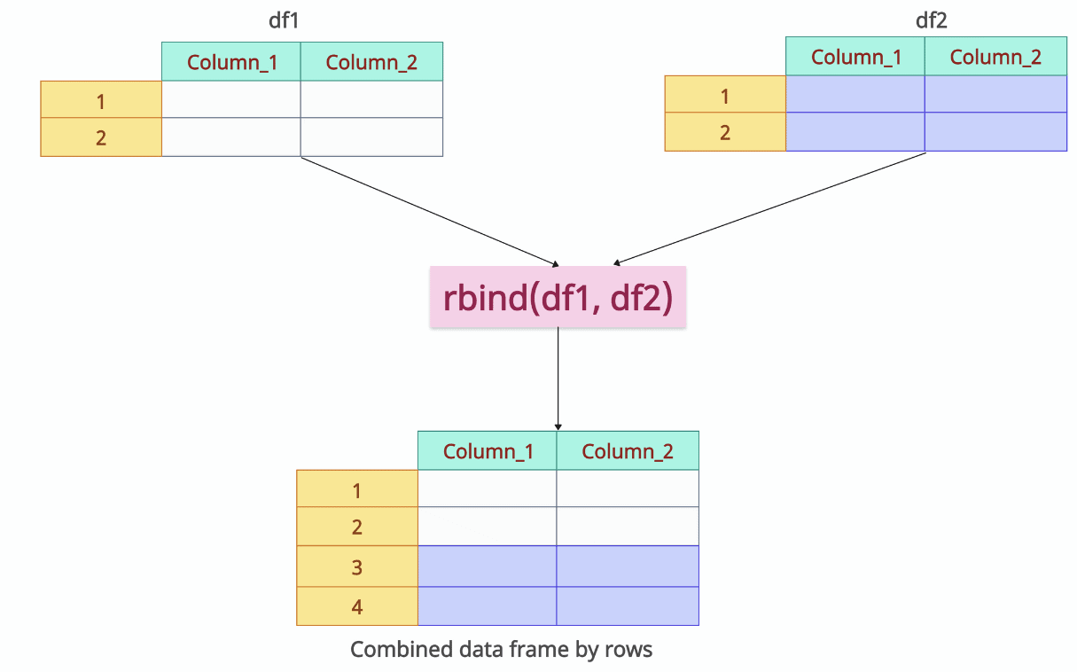
rbind()
Combines dataframes **by rows**, stacking them vertically.
Used when data has the **same columns** and you want to add observations.
Base R function (no packages needed).
Syntax: rbind(df1, df2)
Notes:
Use `rbind()` to stack data on top of each other. It’s a fast way to add more rows when the structure is identical.
We teach this before joins because it reinforces how rows and columns fit together in R. It’s structural, not relational. Joins, by contrast, let us be smarter about how data gets combined.

Slide 19
rbind() in Action
```r
df1 <- data.frame(ID = 1:2, Name = c('A', 'B'))
df2 <- data.frame(ID = 3, Name = 'C')
rbind(df1, df2)
# Output:
ID Name
1 1 A
2 2 B
3 3 C
Notes:
Here, we simply stack the second dataframe below the first. This is commonly used when reading in multiple files with the same format.
Once we move to `*_join()` functions, we’ll see how joins give us more control by matching rows on IDs rather than position.

Slide 20
Joining your data
Notes:
oins allow you to combine two dataframes based on one or more shared key columns,
rather than by position.
They’re essential when you want to merge related information
from different tables—like adding species names to observation records using a shared ID.
ALWAYS CHECK THE DATA AFER WITH THESE

Slide 21
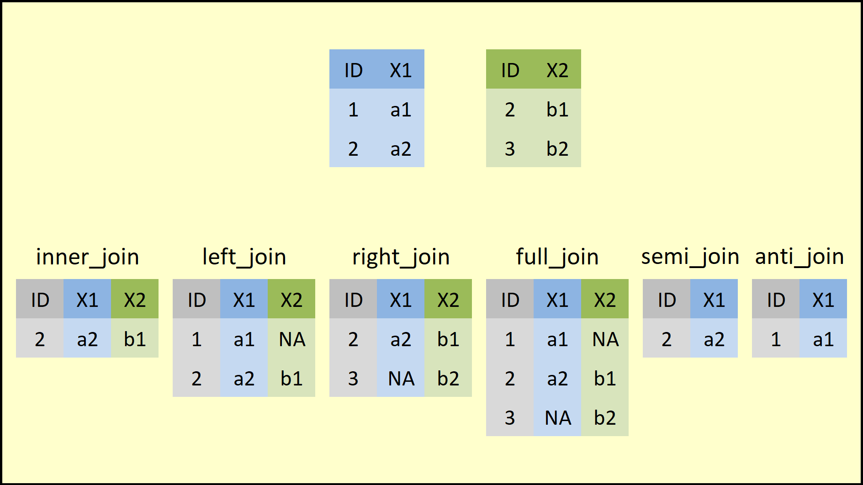
inner_join()
Combines two dataframes by common key.
Returns only rows with matching keys in both dataframes.
Rows without a match are excluded.
Syntax: inner_join(df1, df2, by = 'key')
Notes:
inner_join() is your go-to when you want only the overlap between two datasets.
Imagine having a list of students and a list of grades.
inner_join() gives you only the students that appear in both datasets.
This is useful for cleaning up messy data or preparing matched subsets. If something is missing on either side — it’s dropped.

Slide 22
inner_join() in Action
```r
library(dplyr)
df1 <- data.frame(ID = c(1, 2, 3), Name = c('A', 'B', 'C'))
df2 <- data.frame(ID = c(2, 3, 4), Score = c(80, 90, 70))
inner_join(df1, df2, by = 'ID')
# Output:
ID Name Score
1 2 B 80
2 3 C 90
Notes:
Here, IDs 2 and 3 are present in both df1 and df2, so they’re kept. ID 1 (only in df1) and ID 4 (only in df2) are excluded. This helps enforce data integrity when you only want fully matched records for analysis.

Slide 23
left_join()
Combines two dataframes by key.
Returns all rows from the left dataframe.
Adds matching rows from right; unmatched = NA.
Syntax: left_join(df1, df2, by = 'key')
Notes:
left_join() is one of the most commonly used joins. You keep everything from the left dataframe, and only bring in matches from the right. It's great when the left dataset is your primary data and the right one is just adding extra info
— like attaching site coordinates or extra annotations.

Slide 24
left_join() in Action
```r
left_join(df1, df2, by = 'ID')
# Output:
ID Name Score
1 1 A NA
2 2 B 80
3 3 C 90
Notes:
Here, we keep ID 1, even though it has no match — Score is NA. This kind of result is often a red flag when you’re expecting complete matches.
It can help you identify missing or mismatched data.

Slide 25
right_join()
Combines two dataframes by key.
Returns all rows from the right dataframe.
Adds matching rows from left; unmatched = NA.
Syntax: right_join(df1, df2, by = 'key')

Slide 26
right_join() in Action
```r
right_join(df1, df2, by = 'ID')
# Output:
ID Name Score
1 2 B 80
2 3 C 90
3 4 <NA> 70
Notes:
Same setup as before, but now we keep all IDs from df2. ID 4 didn’t have a name match in df1, so it’s filled with NA. This is good for sanity-checking your merges
— especially if you suspect missing records.

Slide 27
full_join()
Combines two dataframes by key.
Returns all rows from both dataframes.
Unmatched rows get NA values for missing columns.
Syntax: full_join(df1, df2, by = 'key')
Notes:
full_join() is the most generous.
It gives you everything from both datasets. This is great for comparing lists or running diagnostics to see where datasets don’t align. You’ll usually use this in early exploratory stages of analysis, or when doing data reconciliation.

Slide 28
full_join() in Action
```r
full_join(df1, df2, by = 'ID')
# Output:
ID Name Score
1 1 A NA
2 2 B 80
3 3 C 90
4 4 <NA> 70
Notes:
As expected, we get all four IDs
— the shared ones match up, and the unmatched ones get NAs.
I this to track down what’s missing or to build a master list from multiple sources.

Slide 29
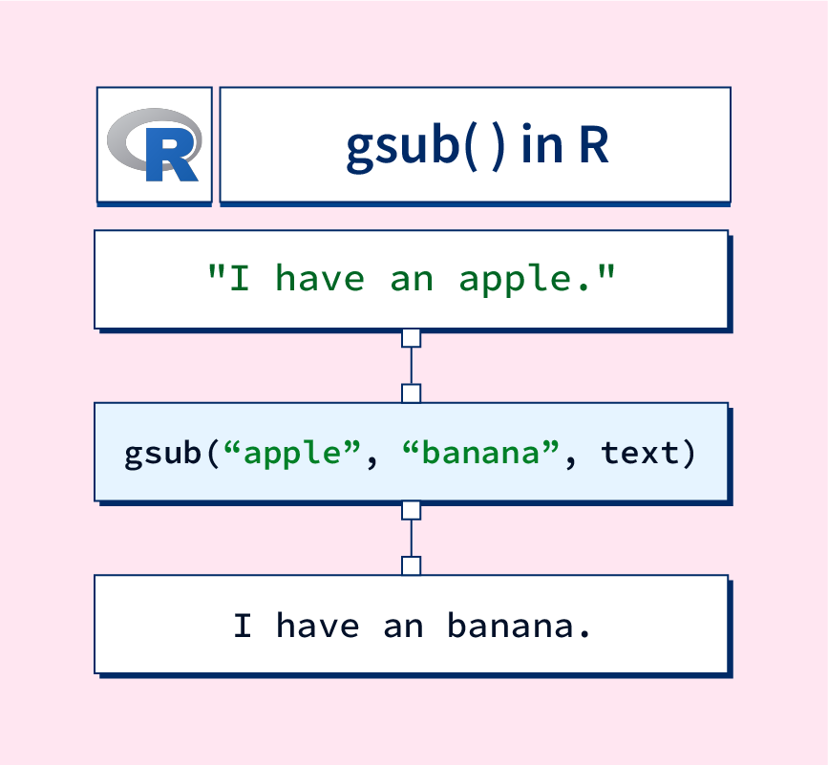
gsub()
Replaces all matches of a pattern in a string.
Commonly used for text cleaning.
Syntax: gsub('pattern', 'replacement', x)
Returns a character vector with substitutions.
Notes:
gsub() is short for “global substitution.”
It replaces every match of a string pattern.
This is super useful for cleaning text
— removing spaces, fixing capitalization, converting inconsistent values.
You can use regular expressions (regex) to target complex patterns too.

Slide 30
gsub() in Action
```r
text <- c('apples', 'bananas', 'apples')
gsub('apples', 'oranges', text)
# Output:
[1] 'oranges' 'bananas' 'oranges'
Notes:
In this example, all occurrences of “apples” are swapped with “oranges.” The function is vectorized, so it works across entire character vectors. This saves time when dealing with messy survey responses, filenames, or categorical variables.

Slide 31
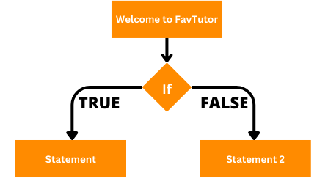
if_else()
Vectorized conditional statement from dplyr.
Returns value A if TRUE, value B if FALSE.
Safer and faster than base ifelse().
Syntax: if_else(condition, true, false)
Notes:
This is a vectorized version of the classic if statement. It checks a condition, then returns one value if it’s true, and another if it’s false
— across an entire vector.
if_else() is stricter than ifelse()
— it checks that true and false outputs are the same type.
Great for classifying, flagging outliers, or creating conditional labels.

Slide 32
if_else() in Action
```r
x <- c(10, 5, 8)
if_else(x > 7, 'high', 'low')
# Output:
[1] 'high' 'low' 'high'
Notes:
Each number in x is evaluated — is it greater than 7? If so, it’s labelled “high”; otherwise, “low.” You’ll use this a lot in data wrangling and summarisation, especially when preparing data for plotting or regression.

Slide 33
PRACTICE WITH YOUR DATA

Slide 34
QUIZ 2
Go over dplyr verbs
use the dplyr cheat sheet
Practice connecting the verbs with %>%
READ over Zuur paper and know the protocol for cleaning data
Practice pivoting and joining datasets!

