Slide 1
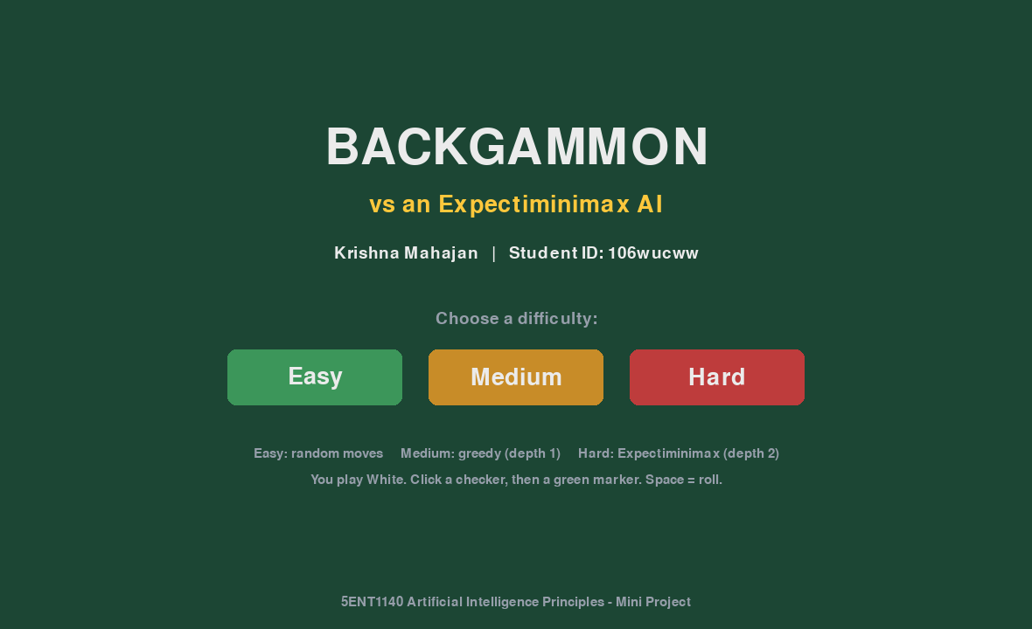
5ENT1140 ARTIFICIAL INTELLIGENCE PRINCIPLES · MINI PROJECT
Backgammon AI
An Expectiminimax opponent for a game of chance
Krishna Mahajan · 106wucww
kris072008.itch.io/backgammon-ai
Notes:
About 30 seconds. Introduce yourself and the project: a full game of backgammon where you play against an AI that reasons about dice. Mention the game is live online at the link and that you will demo it in a few minutes.

Slide 2
The brief
Implement a two-player game that involves chance. At each turn the algorithm evaluates all possible consequences of each move and chooses the one closest to victory.
Game of chance
All consequences
Four deliverables
Backgammon: two dice decide every turn
Every legal turn, every roll, every reply
Published game, deck, report, code
Krishna Mahajan (106wucww) · 5ENT1140 AI Principles
2
Notes:
About 45 seconds. Read the key line of the brief. Stress the two words chance and all consequences, because they drive every design decision that follows.

Slide 3
Why backgammon
The dice decide which moves even exist, so plain Minimax is not enough.
21
15 × 24
1995
distinct dice rolls every turn
checkers each on 24 points, full rules
TD-Gammon made it the classic AI benchmark
Krishna Mahajan (106wucww) · 5ENT1140 AI Principles
3
Notes:
About 45 seconds. Explain that in chess you can plan against a fixed set of replies, but in backgammon the roll changes what is legal. That is why the textbook answer is Expectiminimax. Full rules are implemented: hitting, the bar, bearing off, doubles played four times, must use both dice, larger die rule.

Slide 4
System architecture
backgammon.py
ai.py
Rules engine: board, dice, legal-turn generation, win detection
Evaluation function, Expectiminimax search, three difficulty levels
gui.py + main.py
experiments.py
Pygame interface, async loop so it runs in the browser
500+ AI-vs-AI games, results table and charts
Krishna Mahajan (106wucww) · 5ENT1140 AI Principles
4
Notes:
About 45 seconds. The board is a list of 24 integers: positive for White, negative for Black. Keeping rules, AI and interface separate meant each could be tested alone, for example running hundreds of random games to test the rules before any AI existed.

Slide 5
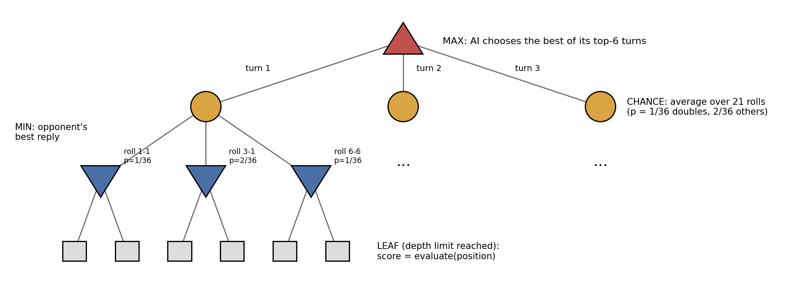
How the AI thinks: Expectiminimax
MAX picks its best turn · CHANCE averages all 21 rolls by probability · MIN assumes the opponent's best reply
Krishna Mahajan (106wucww) · 5ENT1140 AI Principles
5
Notes:
About 1 minute. Walk the tree top to bottom. The AI tries each of its turns. For each, it considers every one of the 21 rolls the opponent could get, weighted 1 in 36 for doubles and 2 in 36 otherwise, and assumes the opponent plays the reply that is worst for the AI. At depth 2 the positions are scored by the evaluation function. To stay fast, a beam keeps only the six most promising turns at each decision. Next slide shows a real decision.

Slide 6
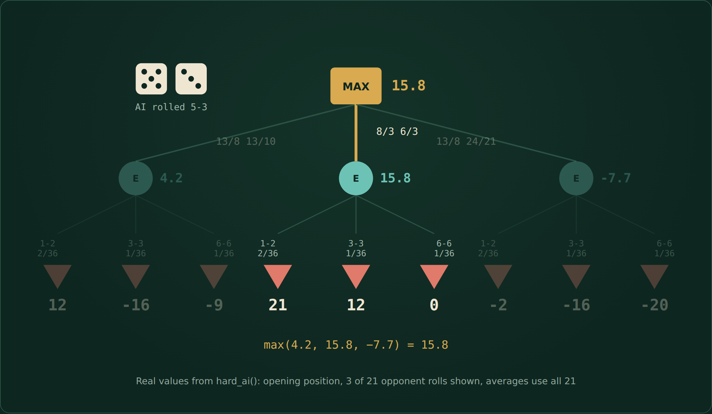
Watch one real decision
MAX
AI's turn: take the best value
CHANCE
Σ P(roll) × value over all 21 rolls
MIN
Opponent's best reply
Krishna Mahajan (106wucww) · 5ENT1140 AI Principles
6
Notes:
About 45 seconds. Click to play the video. The AI rolls 5-3 at the start of the game. Each move leads to a chance node, because the opponent's dice are unknown. For each roll the opponent plays its best reply. Chance nodes average over all 21 rolls. MAX takes the best average. These are real values from my code.

Slide 7
Scoring a position
Feature | Weight | Why
Pip-count lead | +1 per pip | Ahead in the race
Opponent on the bar | +8 each | Hitting costs them tempo
Made points | +2 (+3 home) | Blocks and traps the opponent
Checkers borne off | +3 each | Direct progress to winning
Exposed blot | −4 each | Risk of being hit
Blot out of reach | −1 each | Loose structure
Win / loss | ±10000 | A finished game beats everything
Krishna Mahajan (106wucww) · 5ENT1140 AI Principles
7
Notes:
About 45 seconds. At the bottom of the tree, positions are scored with these hand-set weights. They are constants at the top of ai.py, so they are easy to tune. A win or loss scores plus or minus 10,000 so the AI always prefers a certain win.

Slide 8
Inside one decision: the opening 5-3
Input
Opening position, AI plays White, rolls 5-3
Output
8/3 6/3: makes the 3-point, leaves no blots
Why
Even the opponent's best roll, 6-6, only drops it to 0. 13/8 13/10 is punished by 3-3 down to −16.
Check
8/3 6/3 is the standard expert move for 5-3
Krishna Mahajan (106wucww) · 5ENT1140 AI Principles
8
Notes:
About 45 seconds. These are the real expected values my Hard AI computes for the opening 5-3. It picks 8/3 6/3 with 15.8, far ahead of the rest, because the chance node judges each move over every roll, not one lucky or unlucky one. It is also the move expert players make, which suggests the evaluation weights are sensible.

Slide 9
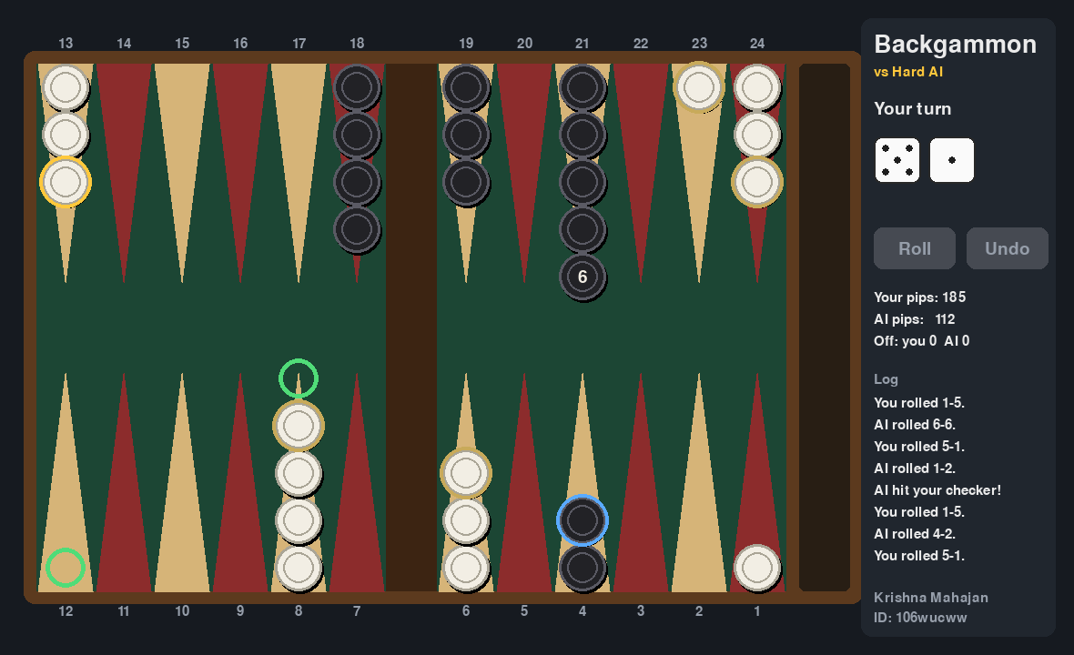
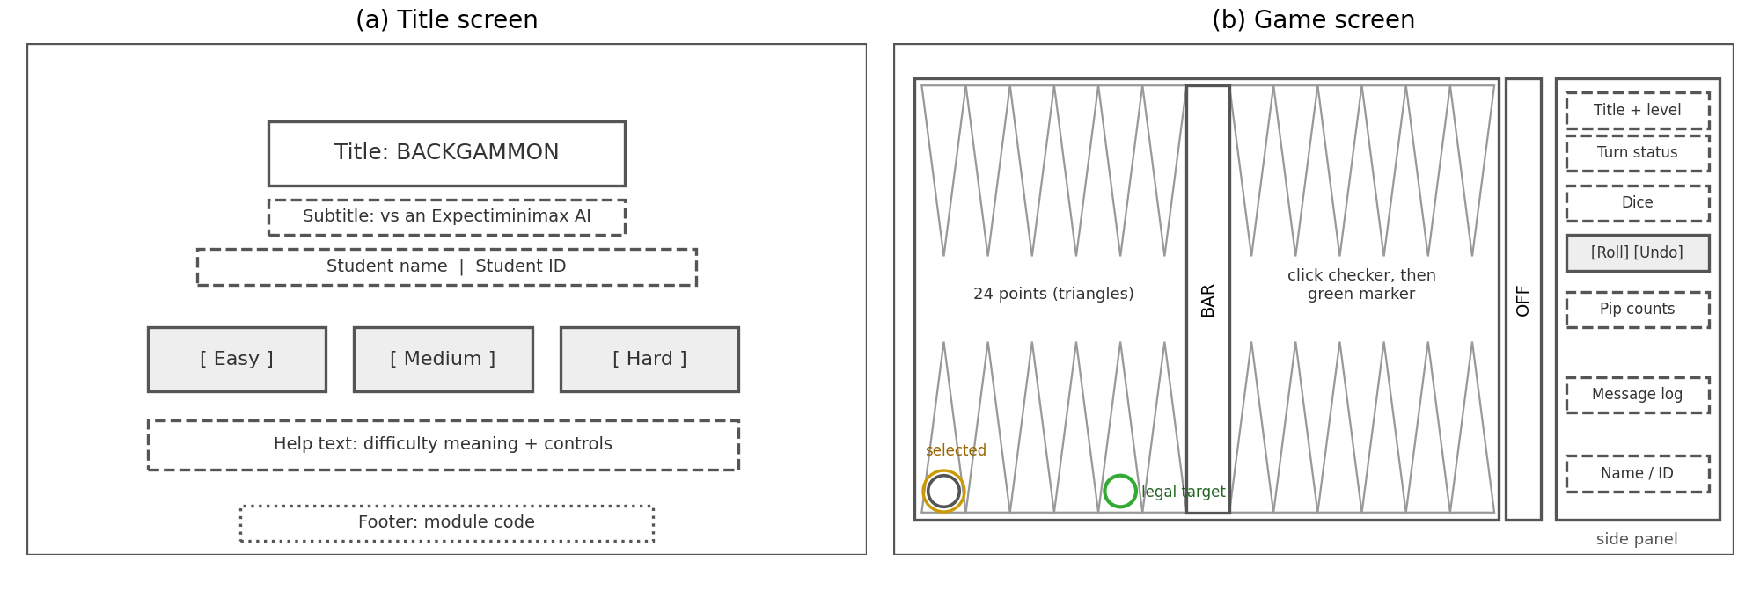
From wireframe to game
Gold ring: pieces you can move · green: legal targets · blue: the AI's last move
Krishna Mahajan (106wucww) · 5ENT1140 AI Principles
9
Notes:
About 45 seconds. Show that the finished screen follows the wireframe. The player can never make an illegal move, because only legal targets are highlighted. Undo takes back the current turn.

Slide 10
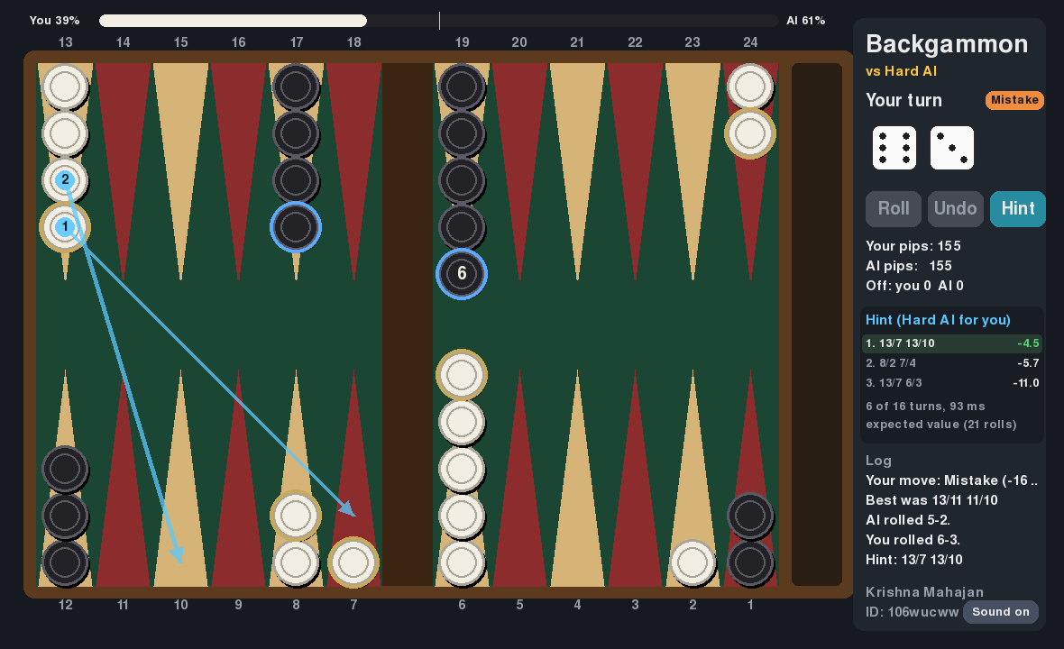
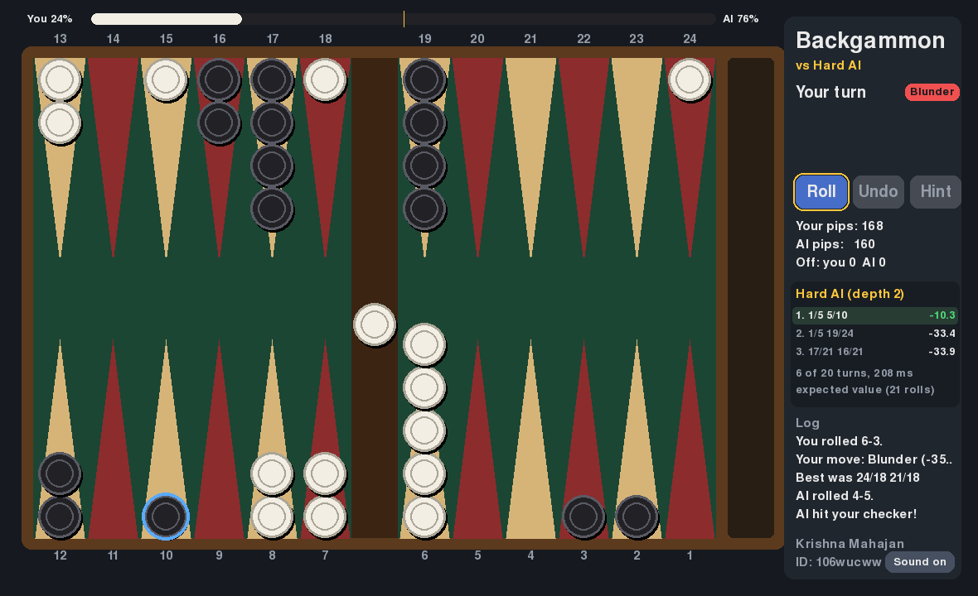
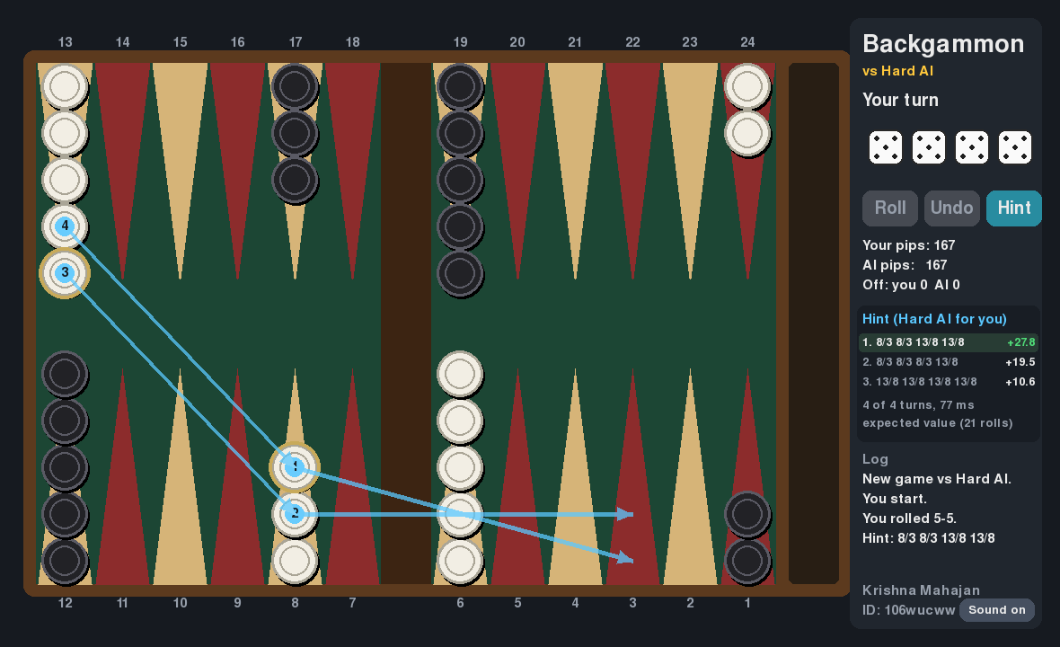
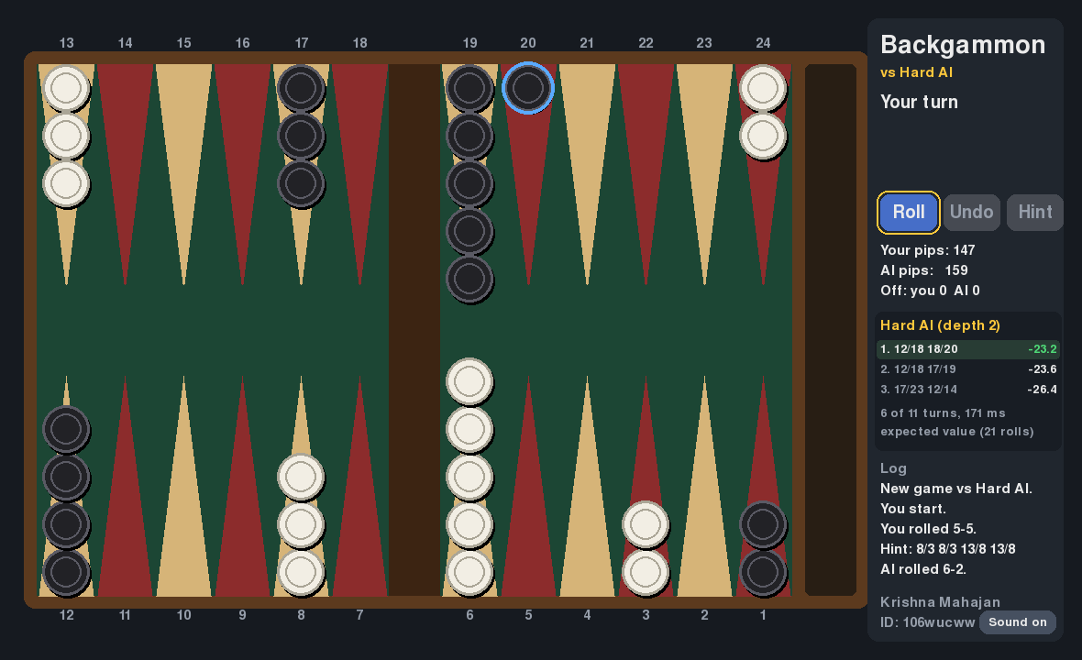
New: see the AI think, and get graded
Win-chance bar (calibrated on 300 games) · Hint arrows · AI panel · every move graded Best to Blunder
Krishna Mahajan (106wucww) · 5ENT1140 AI Principles
10
Notes:
About 45 seconds. Since the first version I added two features that make the Expectiminimax search visible. Press Hint or H and the Hard AI searches your own roll and draws its best move as numbered arrows. After every Medium or Hard turn, the side panel lists the AI's top three moves with their scores, how many turns it searched and how long it took. The panel re-runs the same search as ai.py, and I checked it picks exactly the same move in 149 test positions. Two more features: the bar at the top is the estimated win chance. It is my evaluation function passed through a logistic curve fitted on 300 simulated games, and it is well calibrated: positions it rated 70 to 80 percent were won 76 percent of the time. And after each of your turns, the Hard AI grades your move, from Best to Blunder, by how many evaluation points it gave up.

Slide 11
Live demo
kris072008.itch.io/backgammon-ai
Pick Hard · roll · press H for a hint · watch the win-chance bar and your move grade
Notes:
About 2 minutes. Open the itch.io link (have it loaded in a tab beforehand). Choose Hard, roll, show the gold and green highlights, make a move, then let the AI reply and point out the blue ring. If time allows, leave a blot to show the AI hitting it. Backup plan if the Wi-Fi fails: run python3 main.py locally. Also press H to show a hint, and after the AI moves point at the side panel listing its top three moves and scores. Sound is on: the dice rattle when rolled.

Slide 12
Results: 500+ AI-vs-AI games
100%
Medium vs Easy, 97 of 100 by gammon
100%
Hard vs Easy
55.5%
Hard vs Medium over 200 games (two runs: 52% and 59%)
Krishna Mahajan (106wucww) · 5ENT1140 AI Principles
12
Notes:
About 1 minute. Any evaluation function crushes random play. Hard beats Medium by a smaller margin: I ran it twice, 52% and 59%, which shows how much luck there is in 100 games; combined it is 111 of 200. Dice randomness limits how much deeper search helps, and both share the same evaluation function. Colours were swapped halfway through every match.

Slide 13
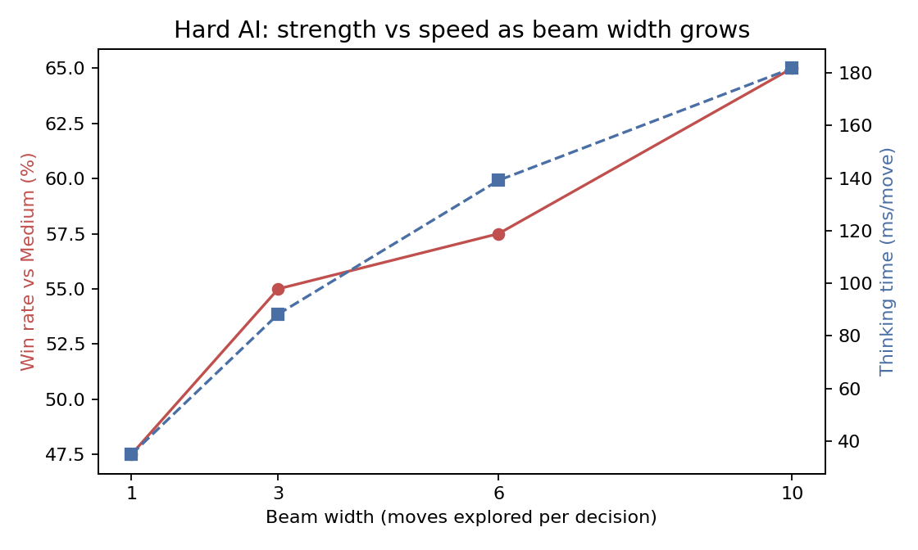
Strength costs time
Exploring more candidate moves raises the Hard AI's win rate against Medium from 47.5% to 65%, but thinking time rises with it.
Beam of 6 chosen to stay well under a second per move in the browser.
Krishna Mahajan (106wucww) · 5ENT1140 AI Principles
13
Notes:
About 45 seconds. Each extra candidate move costs another 21 rolls of opponent replies. This is the classic trade-off between search effort and playing strength.

Slide 14
Challenges solved
Problem | Fix
Must use both dice, larger-die rule | Generate complete turns, not single moves
Pygame crashed on Python 3.14 | Switched to pygame-ce
Blank screen in the browser | Import Pygame in main.py so pygbag loads it
Browsers have no threads | Async main loop, AI runs between frames
Browser stuck on 'Loading' | Leave experiments.py (matplotlib) out of the web build
No sound in the browser | Build sounds from raw samples in the mixer's own format
Krishna Mahajan (106wucww) · 5ENT1140 AI Principles
14
Notes:
About 45 seconds. Pick one story to tell properly, for example the blank screen: the debug console showed pygame had no init, because pygbag only loads libraries imported in main.py.

Slide 15
Conclusion and next steps
Delivered
Next
Full-rules backgammon
Three AI levels, Expectiminimax on Hard
Hints, move grades and a win-chance bar
Finds the expert opening for 5-3
Playable online in any browser
Measured with 500+ games
Learn weights by self-play (TD-Gammon)
Pruning for chance nodes (*-minimax)
Deeper search, doubling cube
Mobile-friendly layout
Krishna Mahajan (106wucww) · 5ENT1140 AI Principles
15
Notes:
About 45 seconds. Sum up: the brief asked for a chance game whose AI evaluates all consequences, and the Hard AI does exactly that, even finding the expert opening move on its own. The biggest improvement would be learning the evaluation weights instead of setting them by hand.

Slide 16
Questions?
kris072008.itch.io/backgammon-ai
Krishna Mahajan · 106wucww
Notes:
Thank the audience and invite questions. Likely ones: why not plain Minimax (dice change which moves exist), why Hard only wins about 55% against Medium (dice randomness and shared evaluation), how the beam works (keeps the top six turns by evaluation), why 8/3 6/3 (no blots, best average over all rolls).

