Slide 1



Hackathon 2026
Idea Submission Template
Instructions (Remove this slide while submitting)
Prepare the solution document as per this template, feel free to modify layouts while keeping core content .
Kindly keep the maximum slides limit up to six (6-7). ( Including the title slide)
Try to avoid paragraphs and post your idea in points /diagrams / Infographics /pictures .
You can only use provided template for making the PPT without changing the idea details pointers (mentioned in previous slides).
You need to save the file in PDF and upload the same on portal. No PPT, Word Doc or any other format will be supported.
FILE NAMING CONVENTION
Team Name_PSNo (E.g. i4C_PS01)
REMOVE THIS SLIDE FOR INSTRUCTIONS IN FINAL SUBMISSION

Slide 2




Team Details
Team Name:
Enter Team Name Here...
SR. NO
ROLE
NAME
ACADEMIC YEAR
1
Team Leader
Krishna R
3rd Year
2
Member 1
Sumana Sadhukhan
3rd Year
3
Member 2
Shreyanshi Singh
3rd Year
A team can have up to 4 members including the team leader. Add rows if necessary.
COLLEGE NAME
Vellore Institute of Technology, Chennai Campus
TEAM LEADER CONTACT NUMBER
TEAM LEADER EMAIL ADDRESS
+91 9487211358
krishna.r2024@vitstudent.ac.in

Slide 3


Problem Statement Addressed
Problem statemen addresses: AI-Based Restoration of Degraded Semiconductor Wafer Inspection Images
DESCRIPTION / DETAILS
In semiconductor manufacturing, high-resolution optical inspection images are critical for verifying chip quality and identifying microscopic structural defects. However, optical inspection tools often yield severely degraded images caused by heavy speckle noise and spatial resolution loss, obscuring fine circuit patterns.
Our solution, ContextNAFNet, is a deep learning restoration network built to reverse this degradation. By pairing explicit noise feature conditioning with an activation-free residual architecture, our pipeline eliminates speckle grain and reconstructs sharp sub-micron circuit boundaries without altering authentic wafer geometry or introducing false visual artifacts.

Slide 4



Idea Description - Describe your Idea/Solution/Prototype
ContextNAFNet — a noise-conditioned, activation-free U-Net that de-speckles a degraded wafer scan and rebuilds it at 2x resolution in a single forward pass.
KEY CONCEPT & APPROACH
Condition, then restore: eight explicit noise-statistic channels are estimated from the input and fed in alongside it.
Activation-free NAFBlocks (SimpleGate + simplified channel attention) — no ReLU clipping of out-of-range speckle.
Three-level U-Net with 7x7 depthwise convolutions and a 256-channel bottleneck holding two self-attention blocks (8 heads).
Sub-pixel PixelShuffle head learns only the residual added to the bicubic upsample, then clamps to [0, 1].
SOLUTION OVERVIEW
One model reverses all three degradations together: speckle noise, Gaussian blur/noise and 2x resolution loss.
Measured on 480 validation wafers: PSNR 24.88 → 29.15 dB (+4.27 dB), SSIM 0.797 → 0.825.
8.19 M parameters, ~0.45 s per image with 8-fold TTA; one offline command, CUDA with automatic CPU fallback.

Slide 5

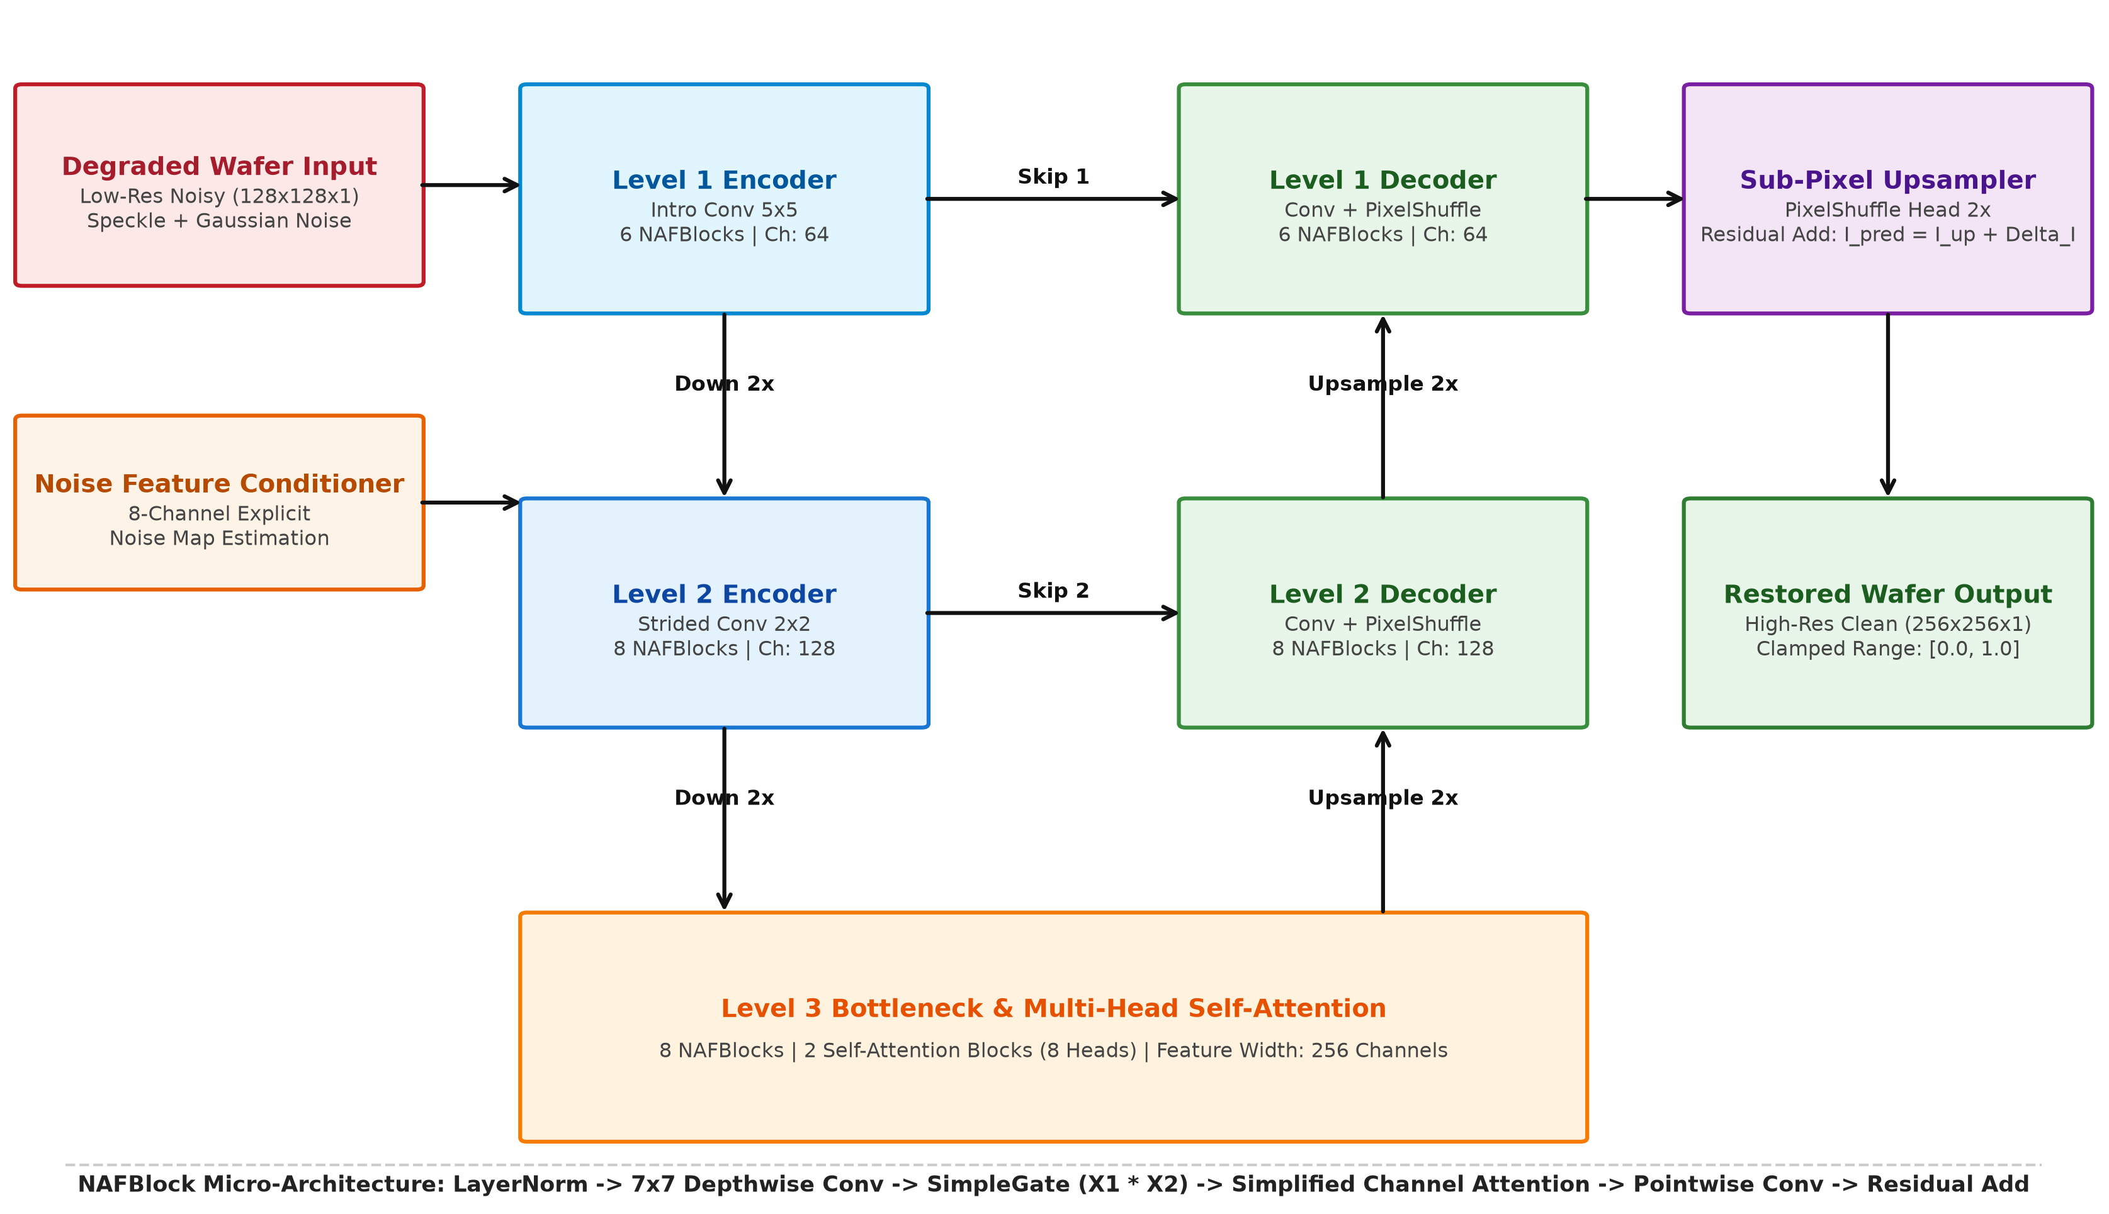
Proposed Solution - Describe your Idea/Solution/Prototype
Calibrated degradation model → explicit noise conditioning → activation-free U-Net → sub-pixel 2x reconstruction.
SOLUTION DETAILS
Degradation calibrated from 200 sample pairs: quadratic 0.0266, VST margin 0.05.
Variance stabilisation cuts noise heteroscedasticity from 14.6x to 1.51x.
Input expanded into eight channels encoding local noise power.
Depths 6-8-8 at widths 64 / 128 / 256, linked by skip connections.
Two 8-head self-attention blocks at quarter resolution for wide context.
Trained 72 epochs: AdamW, cosine schedule, fp16, MSE on 128 px patches.
Inference uses EMA weights and an 8-fold dihedral self-ensemble.

Slide 6
Innovation and Uniqueness
What sets ContextNAFNet apart from off-the-shelf denoisers and SR networks:
KEY INNOVATION
COMPETITIVE ADVANTAGE
The network is told how noisy each region is — eight explicit noise-statistic channels instead of blind inference.
Zero activation functions: SimpleGate multiplication keeps speckle intensities above 1.0 that ReLU/GELU would clip.
Attention only where it is affordable — 8 heads at quarter resolution, so global context costs little compute.
De-speckling and 2x super-resolution are learned jointly, not chained as two lossy stages.
+4.27 dB PSNR and +0.028 SSIM over the degraded input across 480 wafers, with no hand-tuned filter parameters.
Holds up across regimes: +5.05 dB on a patterned wafer, +2.95 dB SNR on the heaviest-noise sample.
8.19 M parameters and 31 MiB of weights — small enough to sit beside the inspection tool.
~0.45 s per image, fully offline: no API keys, downloads or operator settings.
Evaluator-ready: one command, same-named float32 .npy outputs at exactly 2H x 2W.

Slide 7



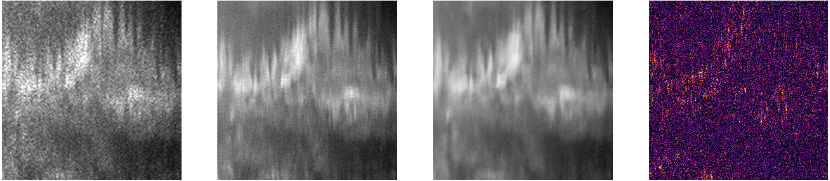
Impact and Benefits
Sharper images mean defects are caught earlier — with no change to the optical tool.
Primary Impact
Quantifiable Outcomes
Defects hidden by speckle become visible again.
Doubles usable resolution from existing scans.
No optics, sensor or tool changes required.
PSNR 24.88 → 29.15 dB (+4.27 dB) on 480 wafers.
SSIM 0.797 → 0.825; peak wafer 35.76 dB / 0.957.
~0.45 s per image · 8.19 M params · 126 MiB model.
Degraded input (128×128)
Clean reference
ContextNAFNet output (256×256)
Residual error map

Slide 8




Technology & Feasibility/Methodology Used
A standard PyTorch stack, one commodity GPU, and an evaluator command that runs offline in a single step.
IMPLEMENTATION STRATEGY
One command: python run.py <input-dir> <output-dir> — discovers every top-level .npy, auto-selects CUDA or CPU, writes one same-named output per input.
Loads models/best.pt (EMA weights, 126 MiB), pads to a multiple of four, runs eight dihedral passes, crops back to exactly 2H x 2W.
Outputs are float32, finite, two-dimensional and bounded to [0, 1]; the contract is covered by an automated pytest suite.
Feasibility is proven, not projected: checkpoint at epoch 71 (28.95 dB / 0.818 SSIM), dataset run at 29.15 dB / 0.825 SSIM.
Software Architecture
Hardware Components
Development Tools
PyTorch 2.x · torchvision · NumPy / SciPy · YAML-driven configs · src/semicon_restore package
NVIDIA CUDA 12.1 GPU for training and 8-fold TTA inference · automatic CPU fallback
Git / GitHub · pytest · ruff · Matplotlib reporting · seeded split manifests

Slide 9




GitHub & Video Link
GitHub Repository
https://github.com/kris07hna/ContextNafNet-AI-Image-Restoration-Semicon-2026
Prototype / Simulation Video
ADD VIDEO LINK BEFORE SUBMISSION — paste the YouTube / Drive URL here

Slide 10


Research and References
Research Background & Methodology
Published restoration research, then calibrated to the degradation actually present in the inspection data.
NAFNet (ECCV 2022) showed activation-free SimpleGate blocks outperform ReLU/GELU designs on denoising and deblurring; we extend that block with explicit noise conditioning and a 2x super-resolution head.
Noise-map conditioning follows FFDNet: telling the network the local noise level lets one model cover a wide degradation range instead of one model per noise level.
Degradation was fitted from 200 sample pairs, and a variance-stabilising transform cut heteroscedasticity from 14.6x to 1.51x, so synthetic training pairs match the measured inspection noise.
References & Citations
The three papers this architecture builds on directly.
L. Chen, X. Chu, X. Zhang, J. Sun, “Simple Baselines for Image Restoration” (NAFNet), ECCV 2022 — arXiv:2204.04676
K. Zhang, W. Zuo, L. Zhang, “FFDNet: Fast and Flexible CNN-Based Image Denoising”, IEEE TIP 27(9), 2018 — arXiv:1710.04026
W. Shi et al., “Real-Time Super-Resolution with an Efficient Sub-Pixel CNN” (ESPCN), CVPR 2016 — arXiv:1609.05158

