Slide 1
Nucleo-F411RE

Slide 2
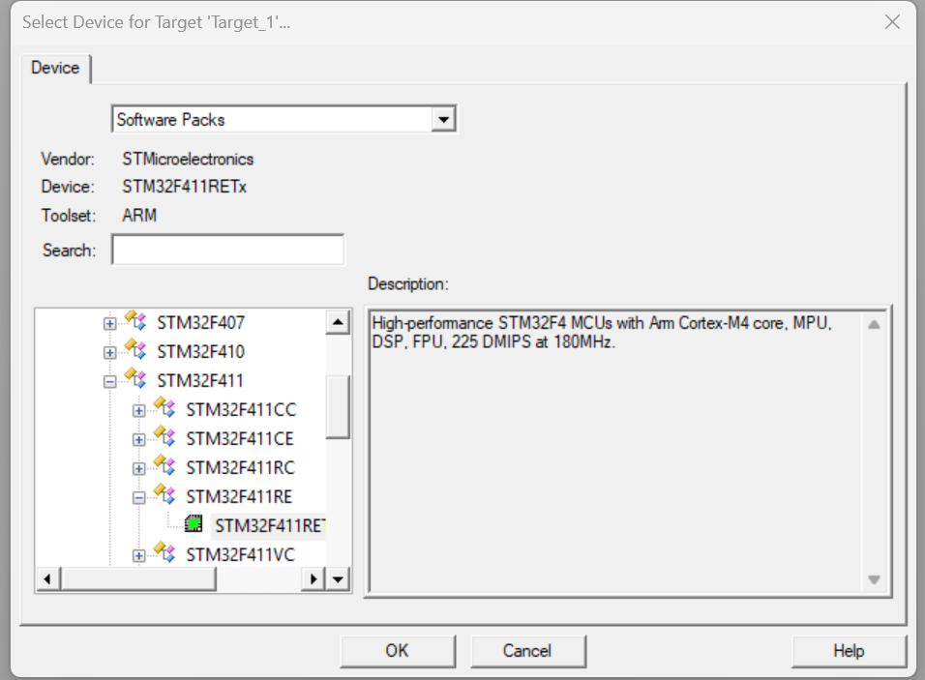
Phase 1: Create the Folder and Project
Create a New Folder: In Windows, create a folder named STM32_DMA_Test. (Always keep your projects in their own folders to avoid file mix-ups).
Open Keil: Go to Project -> New uVision Project...
Save it: Navigate to your new folder and name the project DMA_Project.
Select Device: In the search box, type STM32F411RE. Select it and click OK.

Slide 3
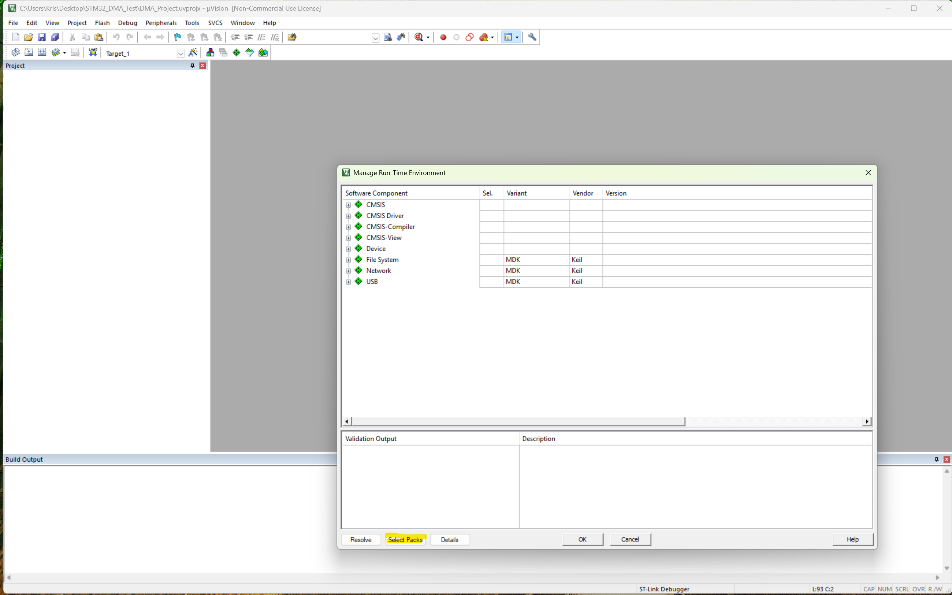
Phase 2: Force the "Classic" Pack (Crucial Step)
A window titled "Manage Run-Time Environment" will open. Do not check anything yet.
Click the Select Packs button at the bottom left.
Uncheck the box at the top: "Use latest versions of all installed Software Packs".
Find Keil::STM32F4xx_DFP in the list.
Click the version number (likely 3.1.1) and change it to 2.17.1.
Click OK.

Slide 4
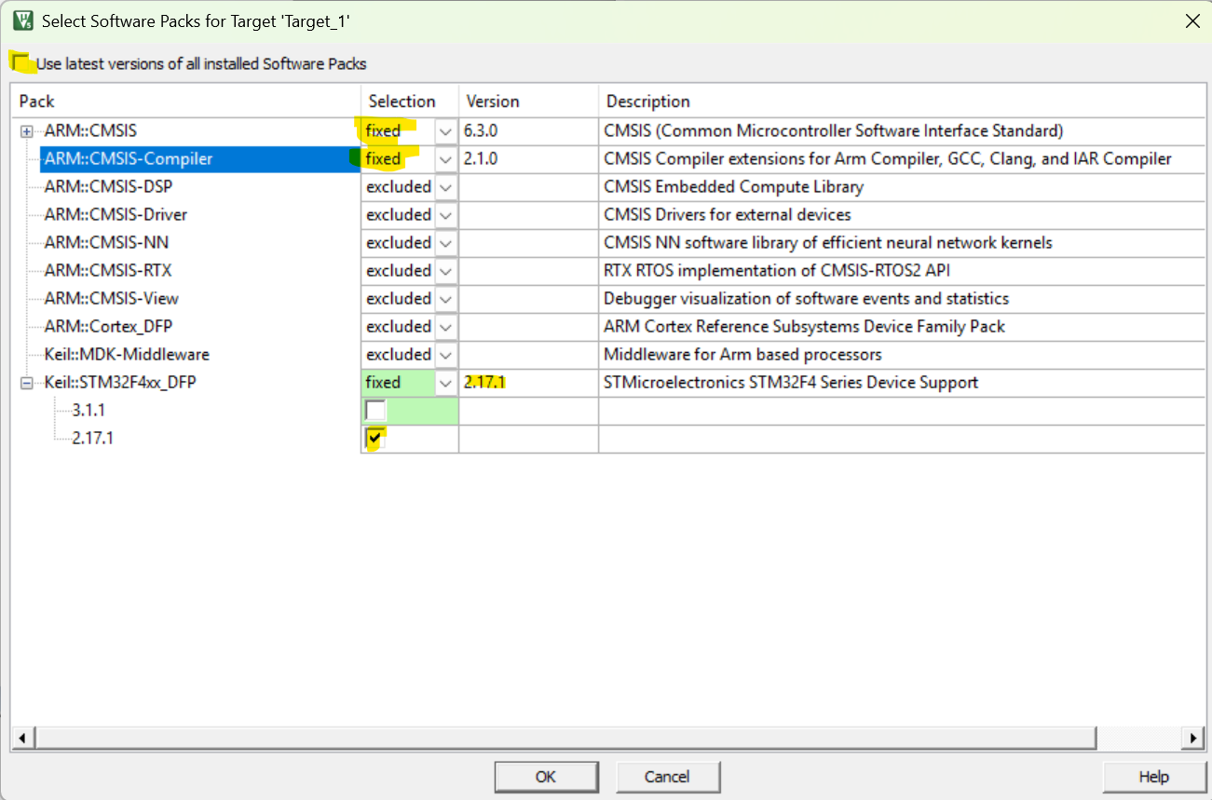

Slide 5
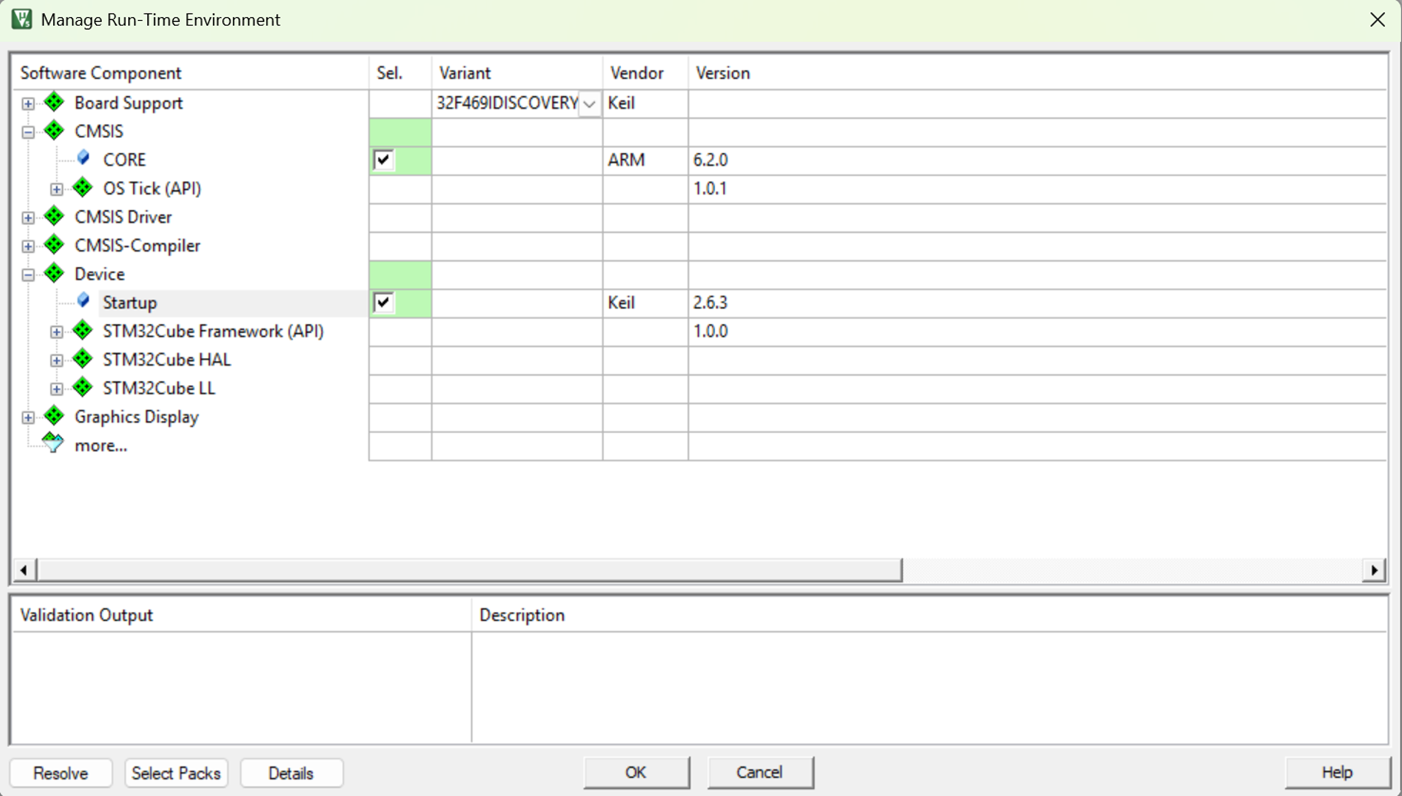
Phase 3: Select the Components
Once you click OK in Phase 2, you'll be back in the Manage Run-Time Environment window.
Expand CMSIS and check CORE.
Expand Device and check Startup.
Note: If you see "STM32Cube" options, ignore them. You only want the plain "Startup" box.
Click OK.

Slide 6
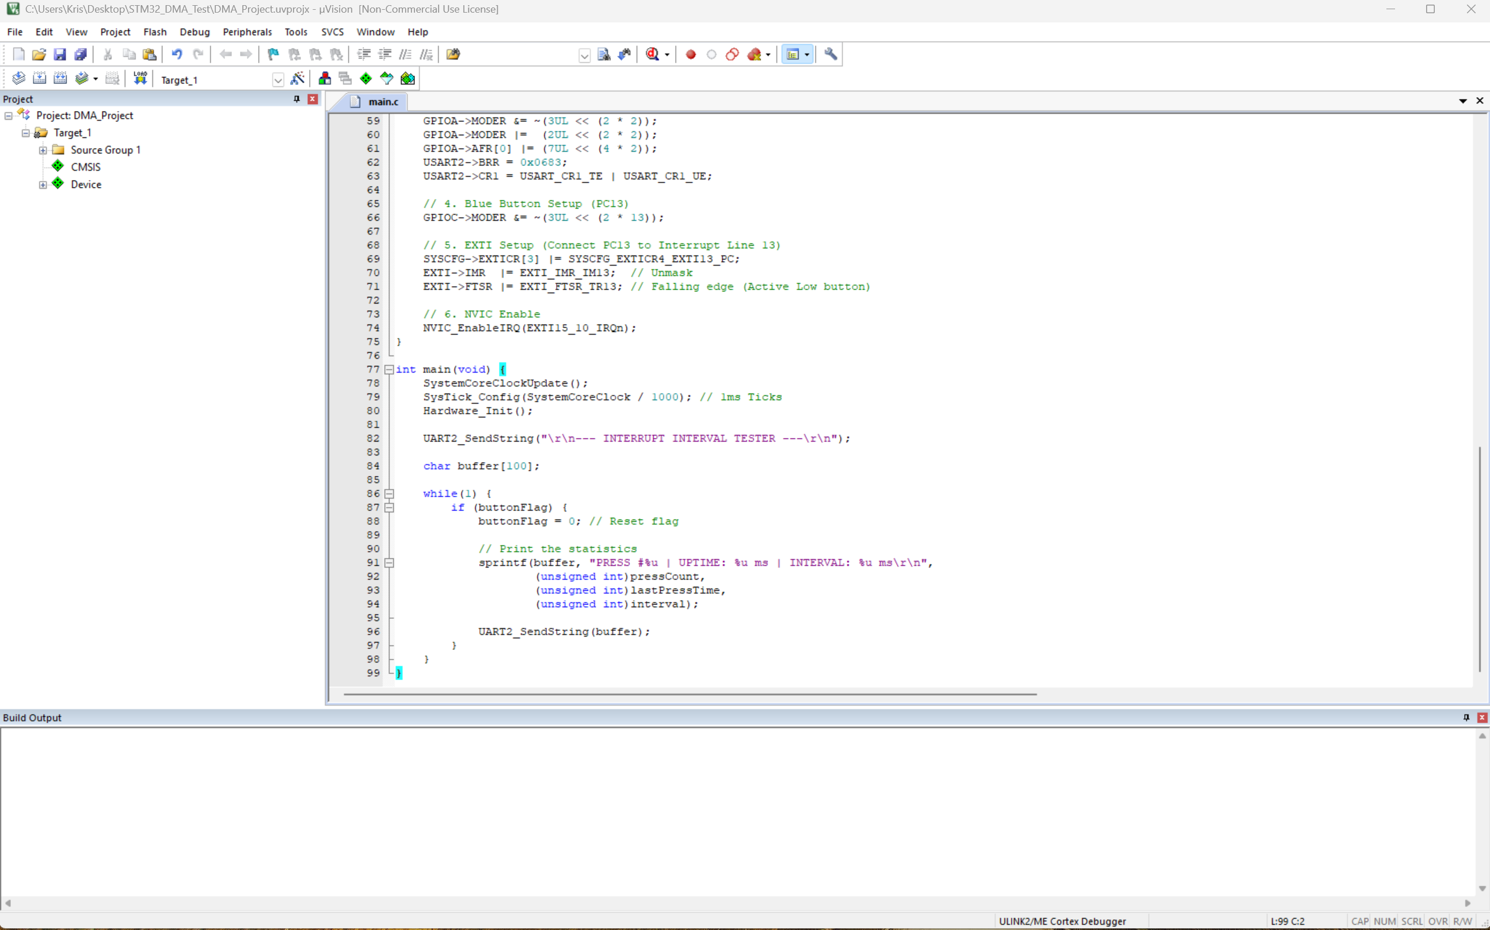
Phase 4: Create the Code File
In the Project window on the left, right-click Source Group 1.
Select Add New Item to Group 'Source Group 1'...
Choose C File (.c), name it main, and click Add.
Paste your code into the editor.

Slide 7
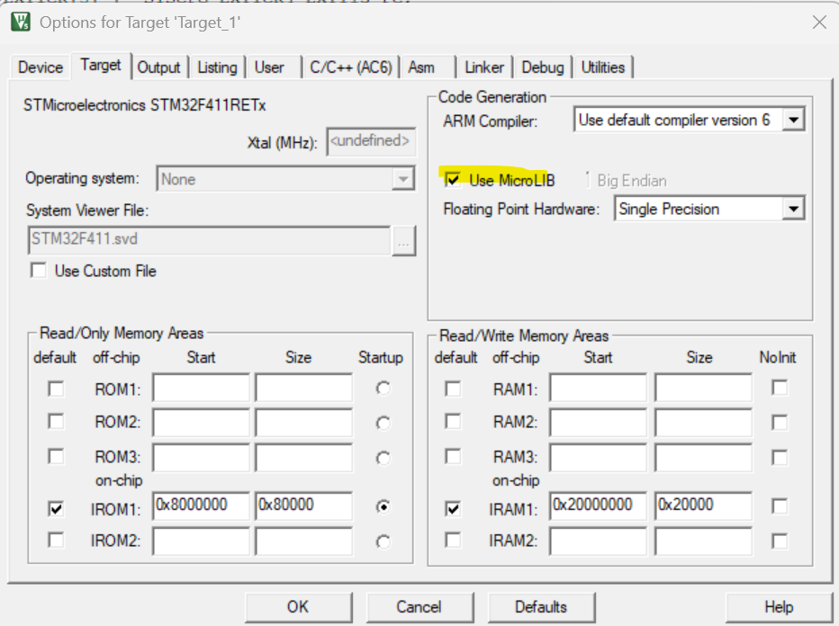
Phase 5: Configure Target Settings (The "Magic Wand")
Click the Options for Target icon (the magic wand).
Target Tab: * Set Xtal (MHz) to 16.0.
Check Use MicroLIB (required for printf and sprintf).
Debug Tab: * Ensure the right-hand side is set to ST-Link Debugger.
Click Settings next to it, go to the Flash Download tab, and check Reset and Run.
Click OK.
The reason Xtal (MHz) is greyed out in your image_ef4942.png is that you have successfully moved to the "Classic" 2.17.1 pack.
In the newer ARM Compiler 6 (AC6), Keil ignores that box because the clock speed is now defined physically inside your system_stm32f4xx.c file rather than a text box in the menu.

Slide 8
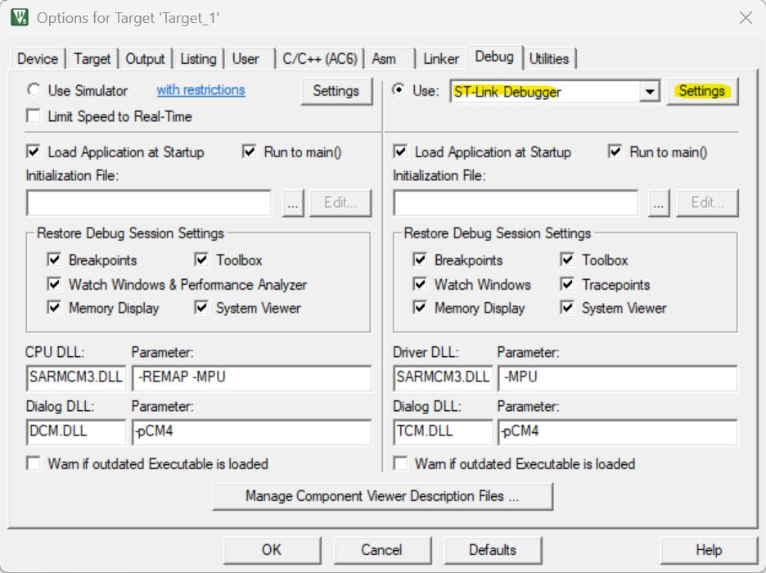
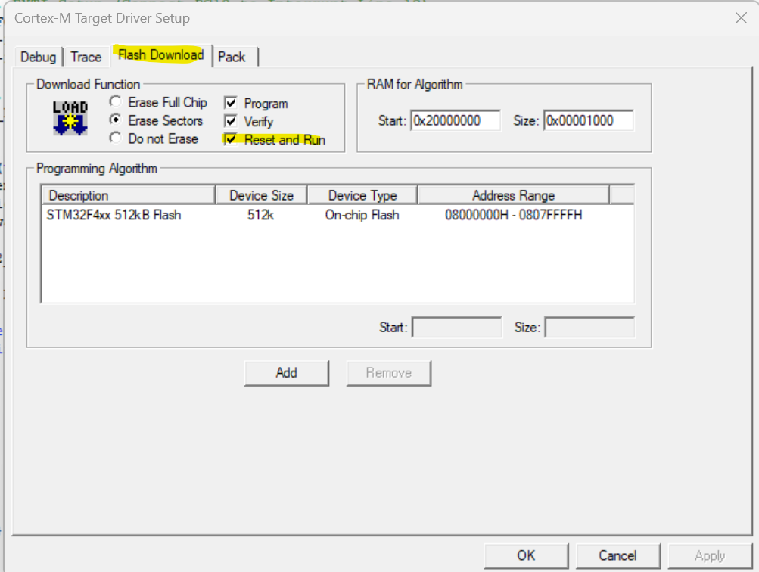

Slide 9
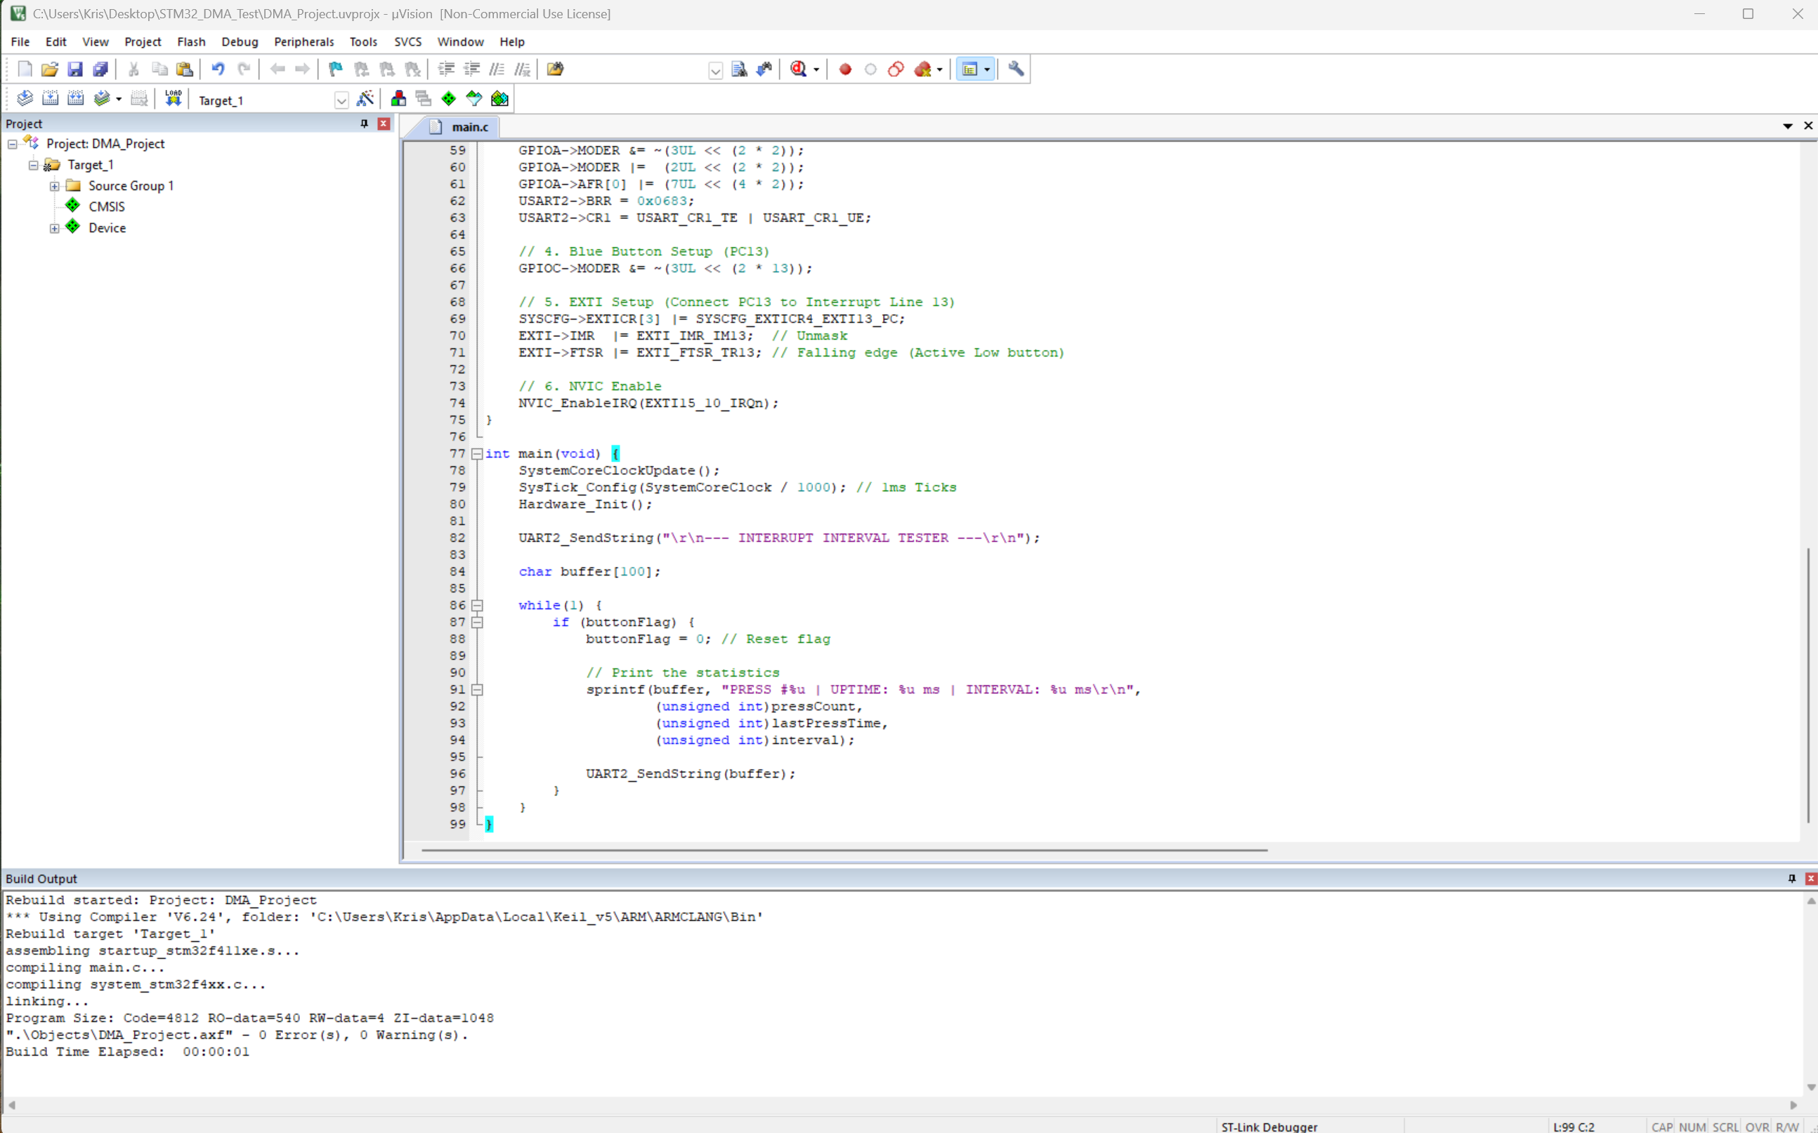
Phase 6: Build and Load
Build: Press F7 (or the icon with two blue arrows). Check the bottom window for 0 Error(s).
Load: Press F8 (or the LOAD icon) to send the code to your Nucleo board.
Reset: Press the Black Button on your board to start the program.

Slide 10
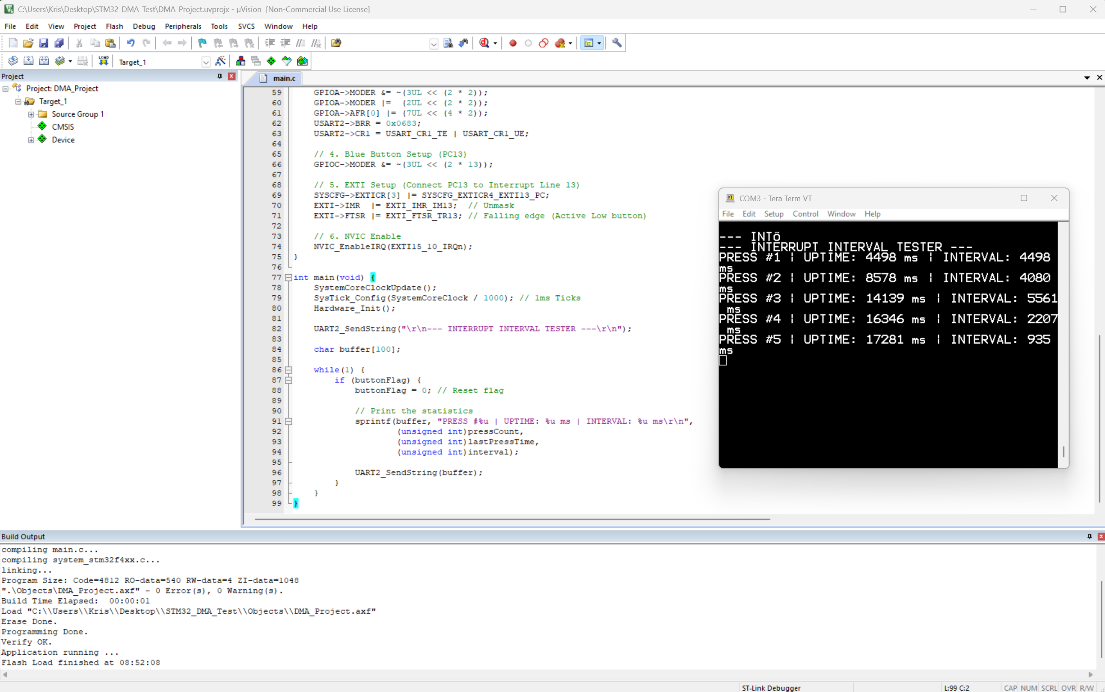

Slide 11
DMA Version of Code

Slide 12
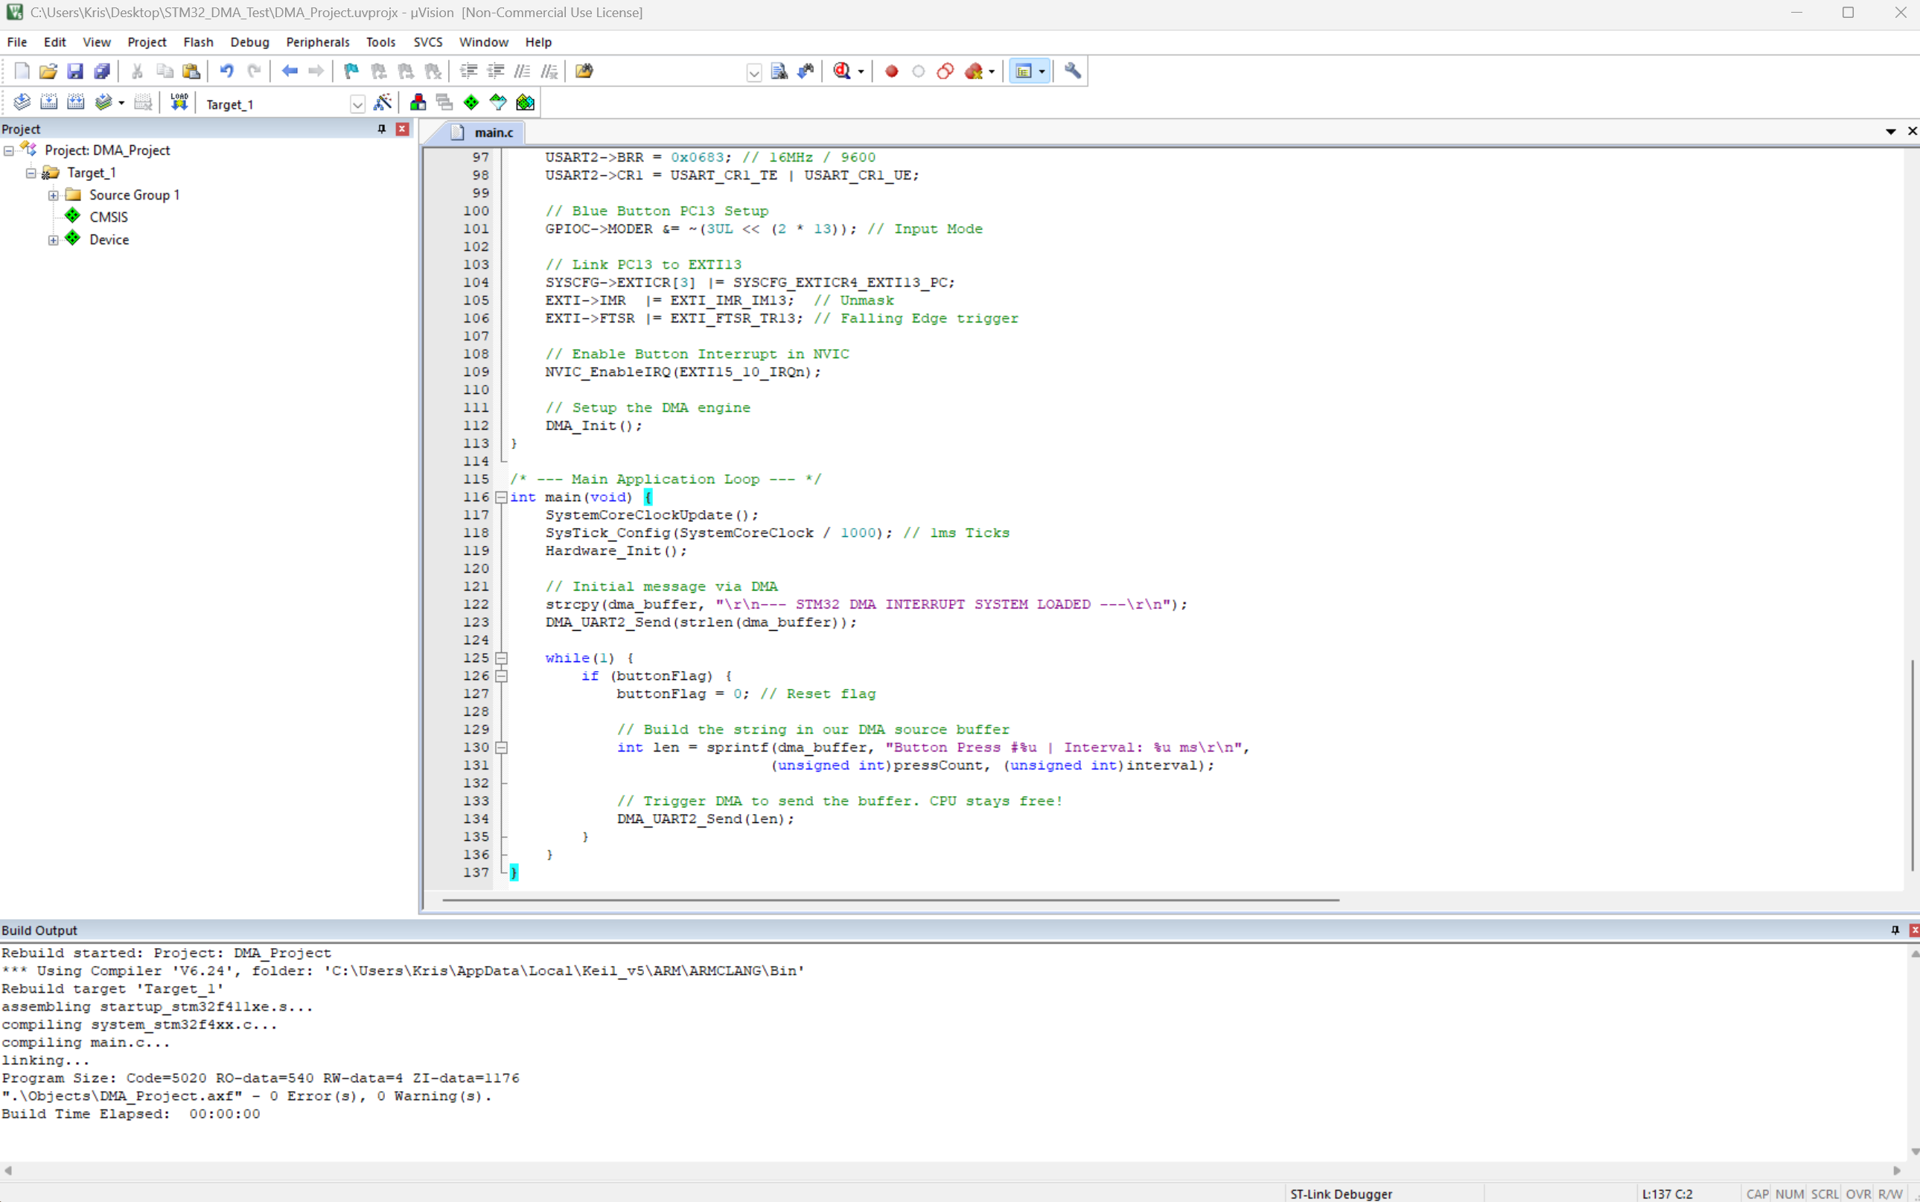

Slide 13
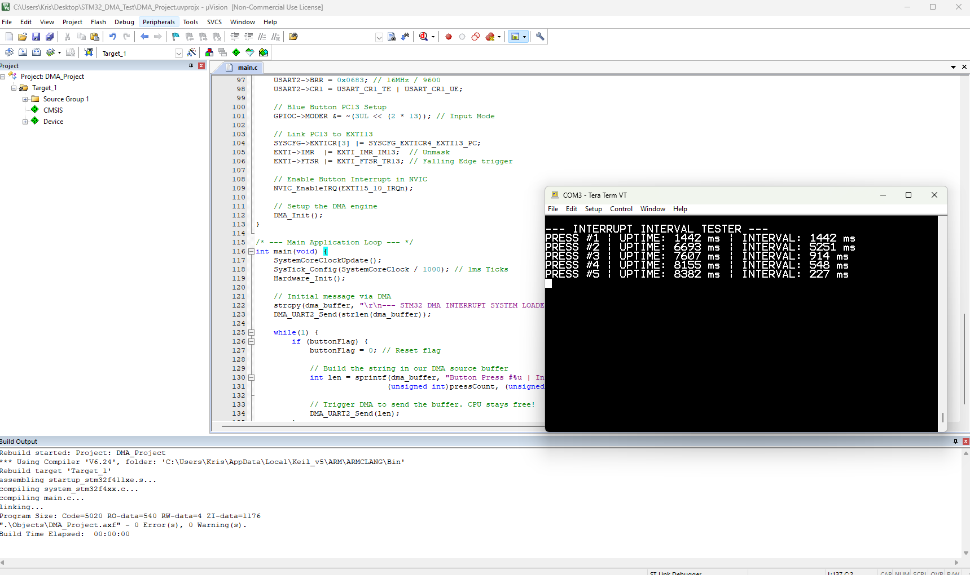

Slide 14
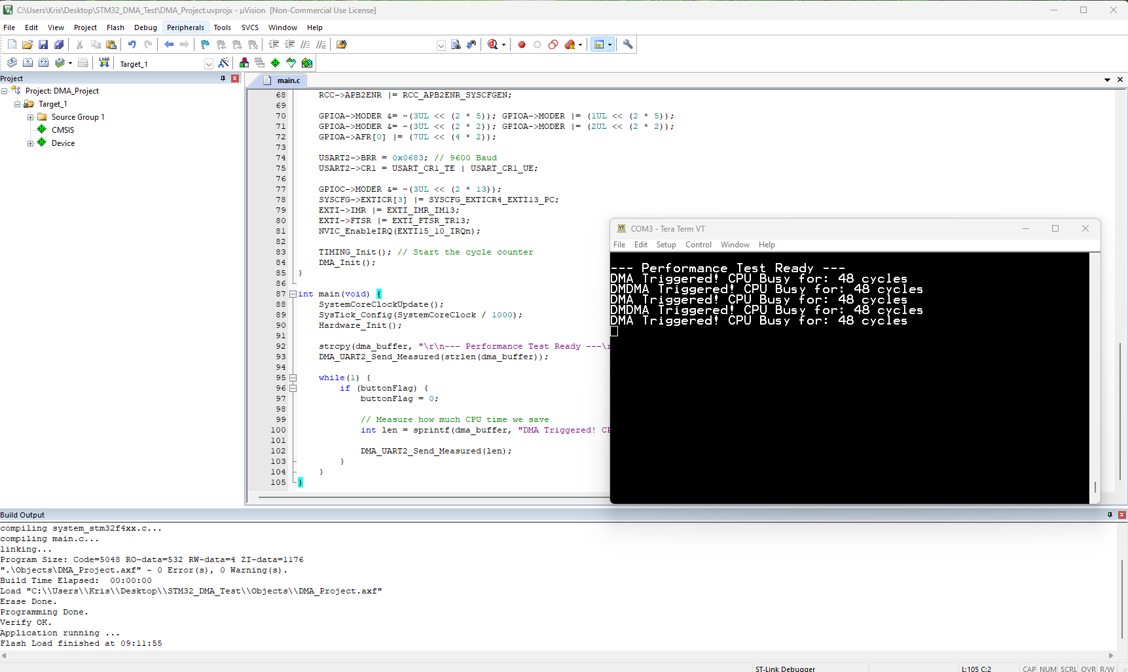

Slide 15
