Slide 1
Predicting CTR

Slide 2
Introduction and problem statement
In online advertising, click-through rate (CTR) is a very important metric for evaluating ad performance. As a result, click prediction systems are essential and widely used for sponsored search and real-time bidding.
The main goal of this project is to predict whether an ad will be clicked upon or not.

Slide 3
Data Fields
id: ad identifier
click: 0/1 for non-click/click
hour: format is YYMMDDHH, so 14091123 means 23:00 on Sept. 11, 2014 UTC.
C1 -- anonymized categorical variable
banner_pos
site_id
site_domain
site_category
app_id
app_domain
app_category
device_id
device_ip
device_model
device_type
device_conn_type
C14-C21 -- anonymized categorical variables

Slide 4
Exploratory data analysis
The dataset has about 40M records across 24 predictor variables
A resampled data of about 2M records has been considered for the modeling effort
The dataset does not contain any NaN/NULL values

Slide 5
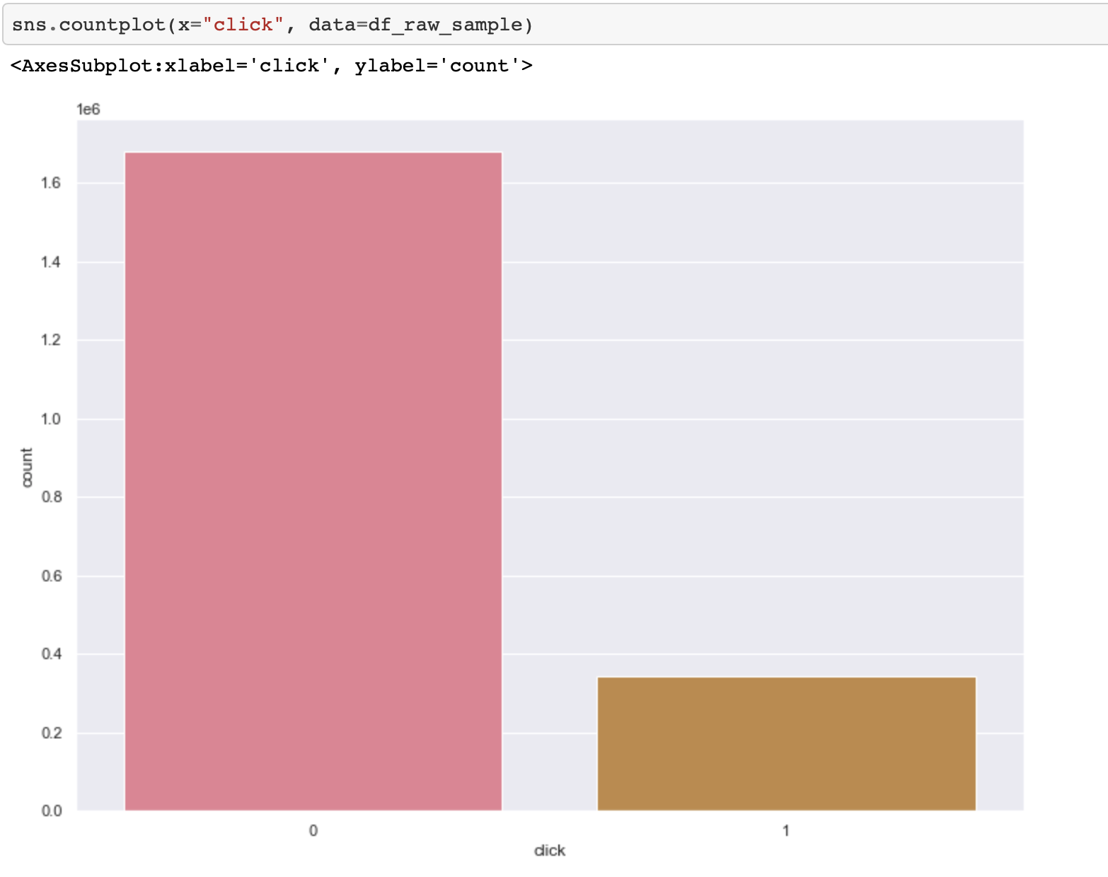
Exploratory data analysis (Contd.)
The dataset is heavily imbalanced. With 0 clicks being more prevalent than 1’s.

Slide 6
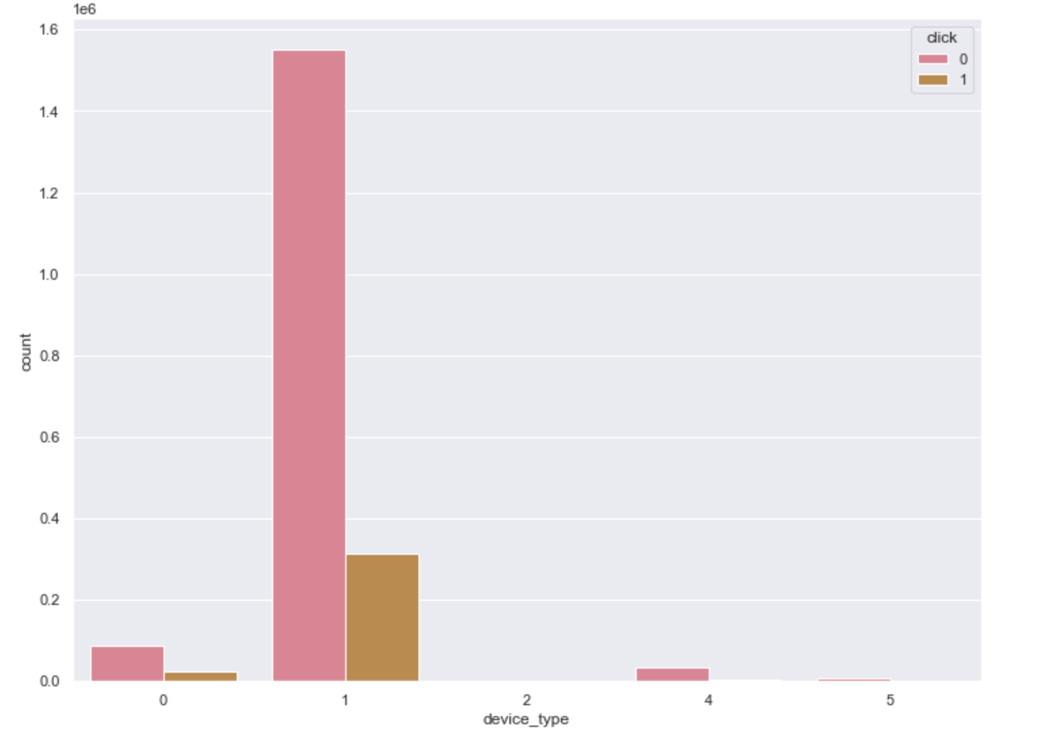
Exploratory data analysis (Contd.)
Most of the ads were shown from device type 1.

Slide 7
Exploratory data analysis (Contd.)
The data types are as below:
Data columns (total 24 columns):
# Column Dtype
--- ------ -----
0 id float64
1 click int64
2 hour int64
3 C1 int64
4 banner_pos int64
5 site_id object
6 site_domain object
7 site_category object
8 app_id object
9 app_domain object
10 app_category object
11 device_id object
12 device_ip object
13 device_model object
14 device_type int64
15 device_conn_type int64
16 C14 int64
17 C15 int64
18 C16 int64
19 C17 int64
20 C18 int64
21 C19 int64
22 C20 int64
23 C21 int64

Slide 8
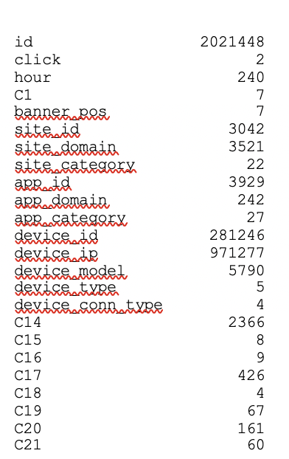
Exploratory data analysis (Contd.)
Number of unique items from the dataset are as shown

Slide 9
Data preprocessing
The dataset didn’t have any NaN/Null values; hence Imputation was not required.
The hour field in the dataset which is of type timestamp is converted to multiple different datetime attributes; like year, month, day, int_hour, is_weekend, is_weekday.
Columns such as "app_id","device_id","device_ip","dt_hour","site_id","hour" were dropped from the dataset, since they contained ids.
The categorical columns were label encoded.
The dataset was divided into test, train and val sets.

Slide 10
ModelLing
Baseline Evaluation: Logsitic Regression
• Using accuracy as the metric, LR model was 83% accurate on the imbalanced dataset. Since the 0 responses outweigh the 1’s, the accuracy is skewed.
• Upon treating the imbalance, the LR showed accuracy of about 57%.

Slide 11
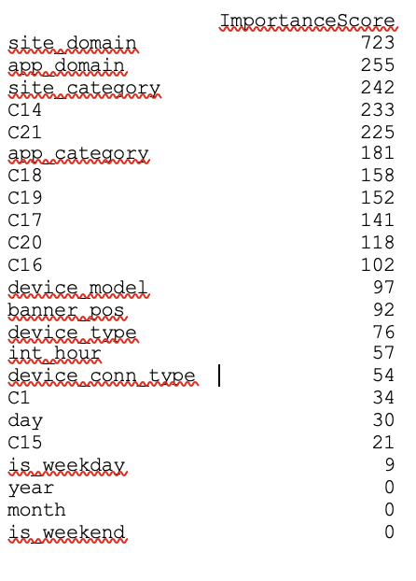
MODELLING (Contd.)
As per the LightGBM algorithm, site_domain is of the highest importance when it comes to predict the click. Followed by app_domain, C14, site_category etc.
Features with 0 importance score are dropped from the final dataset.

Slide 12
Hyperparameter optimization and evaluation
The LightGBM based model was trained on training set and performance was evaluated on both train and validation set to test for issues such as over and underfitting. The model appears to be free from these effects
The imbalance in the dataset was handled by assigning the response weights
Random Search algorithm was used to tune the hyperparameters
The LightGBM model produced an accuracy of about 83% better than Logistic Regression model

