Slide 1
Hands-On KNN: A Step-by-Step Guide to Nearest Neighbor Classification
Kristopher Wilson

Slide 2
Learning Objectives

Slide 3
Learning Objectives
Define supervised learning and unsupervised learning

Slide 4
Learning Objectives
Define supervised learning and unsupervised learning
Compare and contrast parametric and nonparametric models

Slide 5
Learning Objectives
Define supervised learning and unsupervised learning
Compare and contrast parametric and nonparametric models
Understand the difference between classification and regression

Slide 6
Learning Objectives
Define supervised learning and unsupervised learning
Compare and contrast parametric and nonparametric models
Understand the difference between classification and regression
Fit K-nearest neighbors (KNN) algorithm in R

Slide 7
I’m Glad You Signed Up, but Why are You Here?
Notes:
Audience participation!!

Slide 8
I’m Glad You Signed Up, but Why are You Here?
Data is all around us, and we need to know how to make sense of it

Slide 9
I’m Glad You Signed Up, but Why are You Here?
Data is all around us, and we need to know how to make sense of it
K-Nearest Neighbors is a gentle introduction into machine learning

Slide 10
What is Machine Learning?

Slide 11
What is Machine Learning?
Focuses on models with the goal of prediction

Slide 12
What is Machine Learning?
Focuses on models with the goal of prediction
Statistical learning emphasizes interpretability/explainability

Slide 13
What is being predicted?
Data is collected to investigate something of interest

Slide 14
What is being predicted?
Data is collected to investigate something of interest
Call this the response (short for response variable)

Slide 15
What is being predicted?
Data is collected to investigate something of interest
Call this the response (short for response variable)
Goal is to predict a particular outcome of interest given a set of predictors

Slide 16
What is being predicted?
Data is collected to investigate something of interest
Call this the response (short for response variable)
Goal is to predict a particular outcome of interest given a set of predictors
In some cases, we don’t have anything to predict!

Slide 17
Types of Machine Learning

Slide 18
Statistical Learning
Supervised
Unsupervised

Slide 19
Statistical Learning
Supervised
Unsupervised
Regression
Classification

Slide 20
Statistical Learning
Supervised
Unsupervised
Regression
Classification

Slide 21
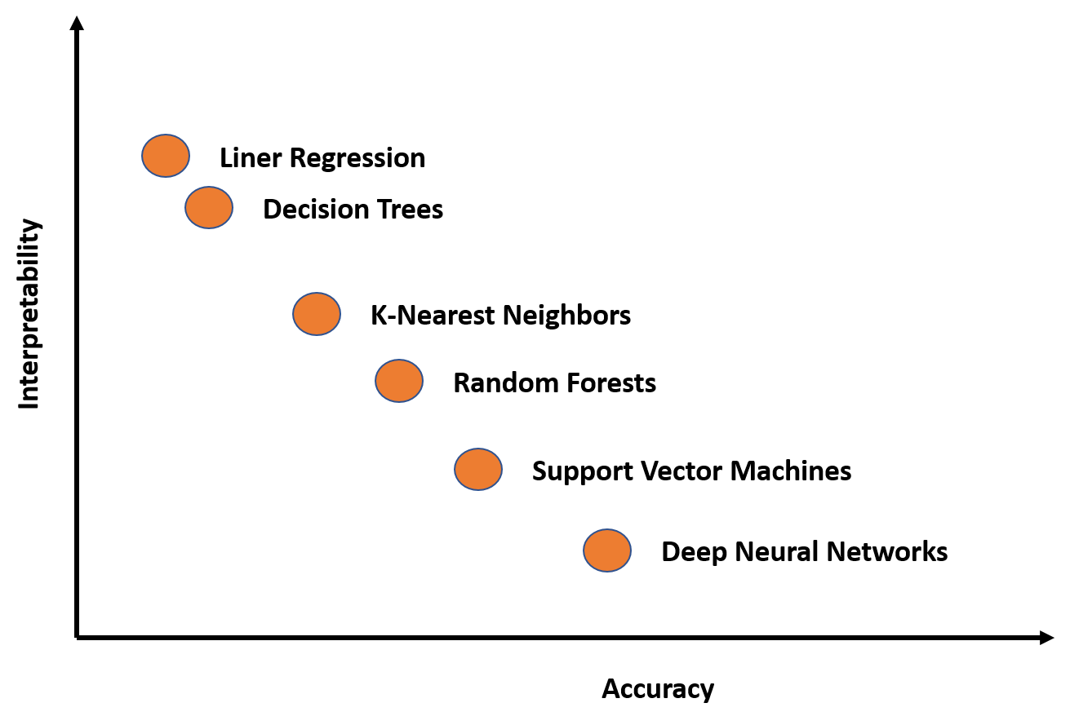
Types of Machine Learning
Notes:
Generally, more complex algorithms ➔ more accurate predictions, but at the cost of interpretability/explainability (“black box models”)

Slide 22
Unsupervised Learning
No associated response variable

Slide 23
Unsupervised Learning
No associated response variable
Goal: better understand the relationships between the predictors, or between each observation

Slide 24
Unsupervised Learning
No associated response variable
Goal: better understand the relationships between the predictors, or between each observation
Examples:
Grouping similar things together (clustering)
Uncover hidden patterns in the data (association)

Slide 25
Supervised Learning
A response is measured for each observation.

Slide 26
Supervised Learning
A response is measured for each observation.
What is our goal here?

Slide 27
Supervised Learning
A response is measured for each observation.
What is our goal here?
Potential Goal #1: predict the value of the response using the values of the predictors

Slide 28
Supervised Learning
A response is measured for each observation.
What is our goal here?
Potential Goal #1: predict the value of the response using the values of the predictors
Potential Goal #2: better understand how the predictors affect the response

Slide 29
Supervised Learning
A response is measured for each observation.
Suppose the response, Y, can be approximated by some function, f, applied to the information we gathered, X:

Slide 30
Supervised Learning
A response is measured for each observation.
Suppose the response, Y, can be approximated by some function, f, applied to the information we gathered, X:
Y ≈ f(X)

Slide 31
Supervised Learning
A response is measured for each observation.
Suppose the response, Y, can be approximated by some function, f, applied to the information we gathered, X:
Y ≈ f(X)
What about information we don’t have?

Slide 32
Supervised Learning
A response is measured for each observation.
Suppose the response, Y, can be approximated by some function, f, applied to the information we gathered, X:
Y = f(X) + ε
What about information we don’t have?
Call this random error

Slide 33
Parametric Models
Y = f(X) + ε

Slide 34
Parametric Models
Y = f(X) + ε
A model is parametric if the form of the function f is predefined
Notes:
Predefined = can be written down beforehand

Slide 35
Parametric Models
Y = f(X) + ε
A model is parametric if the form of the function f is predefined
These models are usually simpler to fit and easier to explain
Notes:
See previous slide

Slide 36
Nonparametric Models
Y = f(X) + ε
Nonparametric models make no assumption about the shape of f

Slide 37
Nonparametric Models
Y = f(X) + ε
Nonparametric models make no assumption about the shape of f
Often more accurate, but more complex to fit and harder to explain

Slide 38
Nonparametric Models
Y = f(X) + ε
Nonparametric models make no assumption about the shape of f
Often more accurate, but more complex to fit and harder to explain
Prone to overfitting

Slide 39
Which Model is Best for the Task?
Y = f(X) + ε

Slide 40
Which Model is Best for the Task?
Y = f(X) + ε
It depends!

Slide 41
Which Model is Best for the Task?
Y = f(X) + ε
It depends!
Ways to assess accuracy:

Slide 42
Which Model is Best for the Task?
Y = f(X) + ε
It depends!
Ways to assess accuracy:
Mean-squared error (MSE)

Slide 43
Which Model is Best for the Task?
Y = f(X) + ε
It depends!
Ways to assess accuracy:
Mean-squared error (MSE)
Misclassification rate

Slide 44
The Response Decides the Task

Slide 45
The Response Decides the Task
Our response, Y, is either:

Slide 46
The Response Decides the Task
Our response, Y, is either:
Qualitative (categorical)

Slide 47
The Response Decides the Task
Our response, Y, is either:
Qualitative (categorical)
No natural ordering of the response

Slide 48
The Response Decides the Task
Our response, Y, is either:
Qualitative (categorical)
No natural ordering of the response
Example: eye color (blue, brown, green) has no natural order

Slide 49
The Response Decides the Task
Our response, Y, is either:
Qualitative (categorical)
No natural ordering of the response
Example: eye color (blue, brown, green) has no natural order
Quantitative (numeric)

Slide 50
The Response Decides the Task
Our response, Y, is either:
Qualitative (categorical)
No natural ordering of the response
Example: eye color (blue, brown, green) has no natural order
Quantitative (numeric)
Or, if categorical, there is a natural ordering of the response

Slide 51
The Response Decides the Task
Our response, Y, is either:
Qualitative (categorical)
No natural ordering of the response
Example: eye color (blue, brown, green) has no natural order
Quantitative (numeric)
Or, if categorical, there is a natural ordering of the response
Example, “Strongly Agree” is better than “Agree” which is better than “Neither Agree Nor Disagree”

Slide 52
The Response Decides the Task
Our response, Y, is either:
Qualitative (categorical)
Classification problem

Slide 53
The Response Decides the Task
Our response, Y, is either:
Qualitative (categorical)
Classification problem
Task: determine the most likely class of a set of response variable classes

Slide 54
The Response Decides the Task
Our response, Y, is either:
Qualitative (categorical)
Classification problem
Task: determine the most likely class of a set of response variable classes
Quantitative (numeric)
Regression problem

Slide 55
The Response Decides the Task
Our response, Y, is either:
Qualitative (categorical)
Classification problem
Task: determine the most likely class of a set of response variable classes
Quantitative (numeric)
Regression problem
Task: estimate the average value of the response

Slide 56
The Response Decides the Task
Our response, Y, is either:
Qualitative (categorical)
Classification problem
Task: determine the most likely class of a set of response variable classes
Quantitative (numeric)
Regression problem
Task: estimate the average value of the response
K-Nearest Neighbors (KNN) can do both!

Slide 57
K-Nearest Neighbors Explained

Slide 58
K-Nearest Neighbors Explained
KNN: “majority voting approach”

Slide 59
K-Nearest Neighbors Explained
KNN: “majority voting approach”
Step 1: find the k observations closest to the new point x

Slide 60
K-Nearest Neighbors Explained
KNN: “majority voting approach”
Step 1: find the k observations closest to the new point x
Step 2: determine the most common response from those k observations closest to x

Slide 61
K-Nearest Neighbors Explained
KNN: “majority voting approach”
Step 1: find the k observations closest to the new point x
Step 2: determine the most common response from those k observations closest to x
Step 3: assign most common response from those k observations to the new point x
In other words, the prediction for x is the “majority vote” of the points closest to x

Slide 62
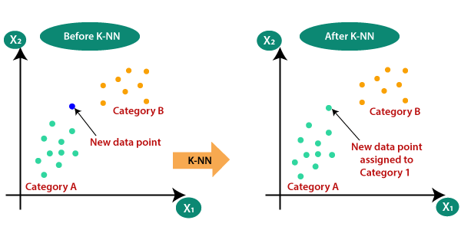
K-Nearest Neighbors Explained

Slide 63
K-Nearest Neighbors Explained
A
Notes:
At this point: ask if KNN (non)parametric?

Slide 64
K-Nearest Neighbors Explained
What does it mean to be “close” to x?
A
Notes:
Close = Euclidean distance (straight line)

Slide 65
K-Nearest Neighbors Explained
What does it mean to be “close” to x?
How many neighbors k should we choose?
A
Notes:
Close = Euclidean distance (straight line). K is a hyperparameter—evaluation metrics help us choose

Slide 66
Example 1: NFL field goal attempts

Slide 67
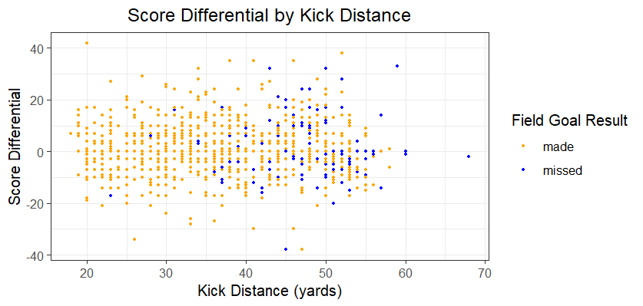
Example 1: NFL field goal attempts

Slide 68
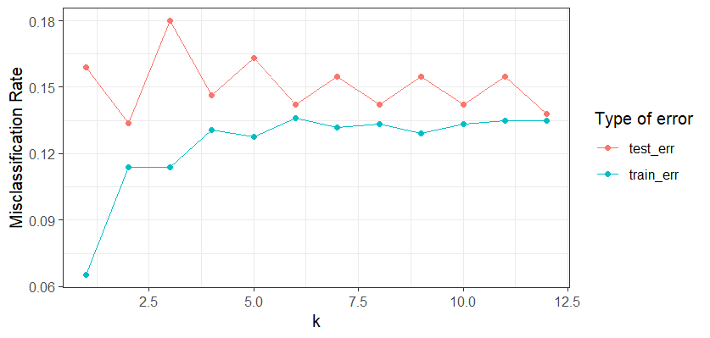
Example 1: NFL field goal attempts

Slide 69
Example 2: Predicting Student Success

Slide 70
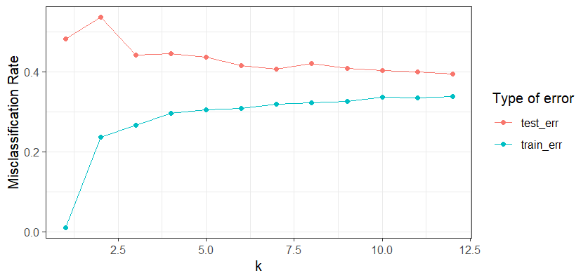
Example 2: Predicting Student Success

Slide 71
Example 2: Predicting Student Success
Most accurate predicting Graduate
74.67% sensitivity, 57.47% specificity.
The model struggles with Enrolled
16.22% sensitivity, 91.18% specificity
Overall accuracy is 59.32%
Fairly good performance (no information rate is 50.85%)
Notes:
Sensitivity: true positives (“if it’s in there, the model gets it”)
Specificity: true negatives (“if it’s not in there, the model gets it”)
No info rate: success rate if you just guessed most common class for everything

Slide 72
Extension: KNN regression with Scooby-Doo ratings

Slide 73
Extension: KNN regression with Scooby-Doo ratings
Response Y is no longer categorical, but numeric

Slide 74
Extension: KNN regression with Scooby-Doo ratings
Response Y is no longer categorical, but numeric
Now we take the average value of the nearest neighbors!

Slide 75
Extension: KNN regression with Scooby-Doo ratings
KNN regression: average value of the response
Step 1: find the k observations closest to the new point x
Step 2: determine the average value of the response from those k observations closest to x

Slide 76
Extension: KNN regression with Scooby-Doo ratings
KNN regression: average value of the response
Step 1: find the k observations closest to the new point x
Step 2: determine the average value of the response from those k observations closest to x
Step 3: assign average value of the response from those k observations to the new point x
In other words, the prediction for x is the average of the points closest to x

Slide 77
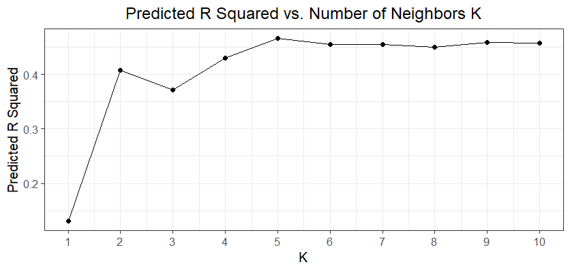
Extension: KNN regression with Scooby-Doo ratings

Slide 78
Learning Objectives Review
Define supervised learning and unsupervised learning
Compare and contrast parametric and nonparametric models
Understand the difference between classification and regression
Fit K-nearest neighbors (KNN) algorithm in R

Slide 79

Learning Objectives Review
Define supervised learning and unsupervised learning
Compare and contrast parametric and nonparametric models
Understand the difference between classification and regression
Fit K-nearest neighbors (KNN) algorithm in R

Slide 80
More Resources
An Introduction to Statistical Learning (it’s free!)
NC State’s Data Science Academy
ST 563 (Introduction to Statistical Learning) or ST 558 (Data Science for Statisticians)
Notes:
ISL: both R and Python!

Slide 81
Acknowledgements
NCSU Libraries
Carnegie Mellon University Department of Statistics and Data Science
NC State University Department of Statistics

