Slide 1
Hands-On KNN: A Step-by-Step Guide to Nearest Neighbor Classification
Kristopher Wilson
Notes:
Reminder 1: don’t just read off the slides!!!

Slide 2
Learning Objectives
Notes:
Leave ~45 mins for workshop demos

Slide 3
Learning Objectives
Define supervised learning and unsupervised learning

Slide 4
Learning Objectives
Define supervised learning and unsupervised learning
Compare and contrast parametric and nonparametric models

Slide 5
Learning Objectives
Define supervised learning and unsupervised learning
Compare and contrast parametric and nonparametric models
Understand the difference between classification and regression

Slide 6
Learning Objectives
Define supervised learning and unsupervised learning
Compare and contrast parametric and nonparametric models
Understand the difference between classification and regression
Fit K-nearest neighbors (KNN) algorithm in R
Notes:
Reminder 2: don’t just read off the slides!!!

Slide 7
I’m Glad You Signed Up, but Why are You Here?
Link to slides, code, and data
Notes:
Audience participation!! Ask them why they’re here

Slide 8
I’m Glad You Signed Up, but Why are You Here?
Data is all around us, and we need to know how to make sense of it

Slide 9
I’m Glad You Signed Up, but Why are You Here?
Data is all around us, and we need to know how to make sense of it
K-Nearest Neighbors is a gentle introduction into machine learning
Notes:
But what is ML?

Slide 10
What is Machine Learning?
Notes:
(poll the audience)

Slide 11
What is Machine Learning?
Focuses on models with the goal of prediction
Notes:
A subset of statistical learning

Slide 12
What is Machine Learning?
Focuses on models with the goal of prediction
Statistical learning emphasizes interpretability/explainability
Notes:
ML cares more about prediction than SL

Slide 13
What is being predicted?
Data is collected to investigate something of interest
Notes:
Data is collected via experiments, studies, surveys, etc., and there’s usually an outcome or target variable that we’re interested in.

Slide 14
What is being predicted?
Data is collected to investigate something of interest
Call this the response (short for response variable)

Slide 15
What is being predicted?
Data is collected to investigate something of interest
Call this the response (short for response variable)
Goal is to predict a particular outcome of interest given a set of predictors
Notes:
The other information we collected. We hope this can inform us/provide some information about the response

Slide 16
What is being predicted?
Data is collected to investigate something of interest
Call this the response (short for response variable)
Goal is to predict a particular outcome of interest given a set of predictors
In some cases, we don’t have anything to predict!

Slide 17
Types of Machine Learning

Slide 18
Machine Learning
Supervised
Unsupervised

Slide 19
Machine Learning
Supervised
Unsupervised
Regression
Classification

Slide 20
Machine Learning
Supervised
Unsupervised
Regression
Classification

Slide 21
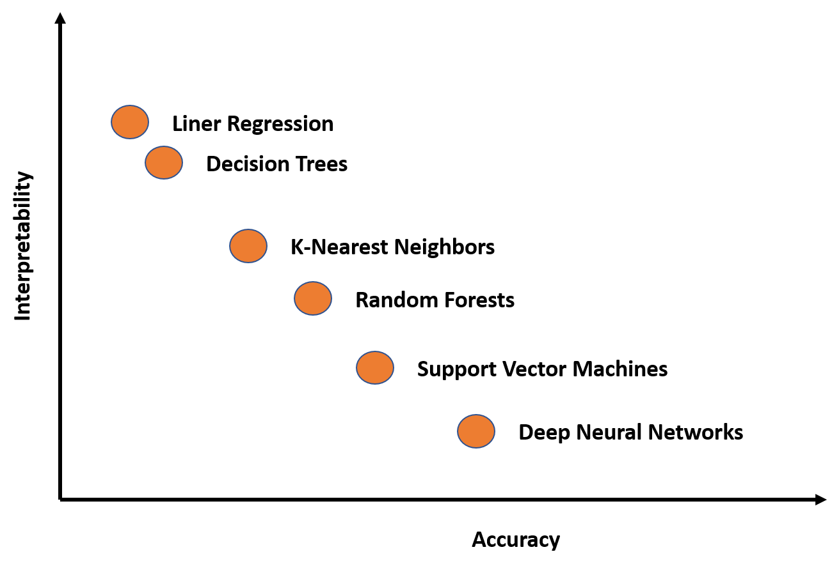
Not All Machine Learning Models Are Created Equally
Linear Regression
Notes:
Generally, more complex algorithms ➔ more accurate predictions, but at the cost of interpretability/explainability (“black box models”)

Slide 22
Unsupervised Learning
No associated response variable
Notes:
No target outcome we want to predict. What’s the point, then???

Slide 23
Unsupervised Learning
No associated response variable
Goal: better understand the relationships between the predictors, or between each observation
Notes:
Did we collect redundant information? Is there a natural grouping/structure within the data?

Slide 24
Unsupervised Learning
No associated response variable
Goal: better understand the relationships between the predictors, or between each observation
Examples:
Grouping similar things together (clustering)
Uncover hidden patterns in the data (association)

Slide 25
Supervised Learning
A response is measured for each observation.

Slide 26
Supervised Learning
A response is measured for each observation.
What is our goal here?

Slide 27
Supervised Learning
A response is measured for each observation.
What is our goal here?
Potential Goal #1: predict the value of the response using the values of the predictors

Slide 28
Supervised Learning
A response is measured for each observation.
What is our goal here?
Potential Goal #1: predict the value of the response using the values of the predictors
Potential Goal #2: better understand how the predictors affect the response
Notes:
What does this look like in math?

Slide 29
Supervised Learning
A response is measured for each observation.
Suppose the response, Y, can be approximated by some function, f, applied to the information we gathered, X:

Slide 30
Supervised Learning
A response is measured for each observation.
Suppose the response, Y, can be approximated by some function, f, applied to the information we gathered, X:
Y ≈ f(X)
Notes:
Apply some function f to our data X to get Y!

Slide 31
Supervised Learning
A response is measured for each observation.
Suppose the response, Y, can be approximated by some function, f, applied to the information we gathered, X:
Y ≈ f(X)
What about information we don’t have?

Slide 32
Supervised Learning
A response is measured for each observation.
Suppose the response, Y, can be approximated by some function, f, applied to the information we gathered, X:
Y = f(X) + ε
What about information we don’t have?
Call this (unobservable) error
Notes:
Could be measurement error, data entry error, “lack of information” (cause we’ll never know everything), could be due to budget (i.e., costs for another study/bigger study are too high)

Slide 33
Parametric Models
Y = f(X) + ε

Slide 34
Parametric Models
Y = f(X) + ε
A model is parametric if the form of the function f is predefined
Notes:
Predefined = can be written down beforehand. You know what it looks like before it’s fit. Not specific to the data

Slide 35
Parametric Models
Y = f(X) + ε
A model is parametric if the form of the function f is predefined
These models are usually simpler to fit and easier to explain
Notes:
See previous slide

Slide 36
Nonparametric Models
Y = f(X) + ε
Nonparametric models make no assumption about the shape of f
Notes:
Can’t write it down beforehand, no idea what it looks like.

Slide 37
Nonparametric Models
Y = f(X) + ε
Nonparametric models make no assumption about the shape of f
Often more accurate, but more complex to fit and harder to explain
Notes:
You may be able to know how it works or what it’s doing, but can’t write down the form

Slide 38
Nonparametric Models
Y = f(X) + ε
Nonparametric models make no assumption about the shape of f
Often more accurate, but more complex to fit and harder to explain
Prone to overfitting
Notes:
Overfitting → fits particular data(set) too well, bad at generalizing to unseen data. “Capturing the error”

Slide 39
Which Model is Best for the Task?
Y = f(X) + ε

Slide 40
Which Model is Best for the Task?
Y = f(X) + ε
It depends!

Slide 41
Which Model is Best for the Task?
Y = f(X) + ε
It depends!
Ways to assess accuracy:

Slide 42
Which Model is Best for the Task?
Y = f(X) + ε
It depends!
Ways to assess accuracy:
Mean-squared error (MSE)

Slide 43
Which Model is Best for the Task?
Y = f(X) + ε
It depends!
Ways to assess accuracy:
Mean-squared error (MSE)
Misclassification rate
Notes:
Mse for regression, misclassification for classification

Slide 44
The Response Decides the Task

Slide 45
The Response Decides the Task
Our response, Y, is either:

Slide 46
The Response Decides the Task
Our response, Y, is either:
Qualitative (categorical)

Slide 47
The Response Decides the Task
Our response, Y, is either:
Qualitative (categorical)
No natural ordering of the response

Slide 48
The Response Decides the Task
Our response, Y, is either:
Qualitative (categorical)
No natural ordering of the response
Example: eye color (blue, brown, green) has no natural order

Slide 49
The Response Decides the Task
Our response, Y, is either:
Qualitative (categorical)
No natural ordering of the response
Example: eye color (blue, brown, green) has no natural order
Quantitative (numeric)

Slide 50
The Response Decides the Task
Our response, Y, is either:
Qualitative (categorical)
No natural ordering of the response
Example: eye color (blue, brown, green) has no natural order
Quantitative (numeric)
Or, if categorical, there is a natural ordering of the response

Slide 51
The Response Decides the Task
Our response, Y, is either:
Qualitative (categorical)
No natural ordering of the response
Example: eye color (blue, brown, green) has no natural order
Quantitative (numeric)
Or, if categorical, there is a natural ordering of the response
Example, “Strongly Agree” is better than “Agree” which is better than “Neither Agree Nor Disagree”

Slide 52
The Response Decides the Task
Our response, Y, is either:
Qualitative (categorical)
Classification problem

Slide 53
The Response Decides the Task
Our response, Y, is either:
Qualitative (categorical)
Classification problem
Task: determine the most likely class of a set of response variable classes
Notes:
Ask someone up front what their favorite ice cream flavor is, then use that to “predict” the favorite flavor of someone next to them

Slide 54
The Response Decides the Task
Our response, Y, is either:
Qualitative (categorical)
Classification problem
Task: determine the most likely class of a set of response variable classes
Quantitative (numeric)
Regression problem

Slide 55
The Response Decides the Task
Our response, Y, is either:
Qualitative (categorical)
Classification problem
Task: determine the most likely class of a set of response variable classes
Quantitative (numeric)
Regression problem
Task: estimate the average value of the response for a given value of the predictor(s)
Notes:
“how many hours do you sleep a night?”

Slide 56
The Response Decides the Task
Our response, Y, is either:
Qualitative (categorical)
Classification problem
Task: determine the most likely class of a set of response variable classes
Quantitative (numeric)
Regression problem
Task: estimate the average value of the response for a given value of the predictor(s)
K-Nearest Neighbors (KNN) can do both!

Slide 57
K-Nearest Neighbors Explained

Slide 58
K-Nearest Neighbors Explained
KNN: “majority voting approach”

Slide 59
K-Nearest Neighbors Explained
KNN: “majority voting approach”
Step 1: find the k observations closest to the new point x

Slide 60
K-Nearest Neighbors Explained
KNN: “majority voting approach”
Step 1: find the k observations closest to the new point x
Step 2: determine the most common response from those k observations closest to x

Slide 61
K-Nearest Neighbors Explained
KNN: “majority voting approach”
Step 1: find the k observations closest to the new point x
Step 2: determine the most common response from those k observations closest to x
Step 3: assign most common response from those k observations to the new point x
In other words, the prediction for x is the “majority vote” of the points closest to x

Slide 62
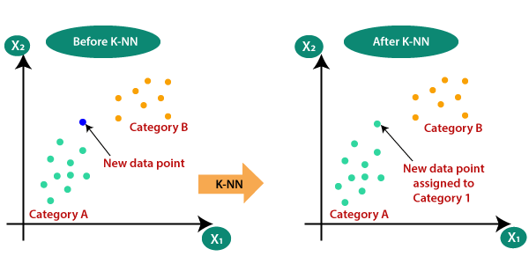
K-Nearest Neighbors Explained

Slide 63
K-Nearest Neighbors Explained
A
Notes:
At this point: ask if KNN (non)parametric?

Slide 64
K-Nearest Neighbors Explained
What does it mean to be “close” to x?
A
Notes:
Close = Euclidean distance (straight line)

Slide 65
K-Nearest Neighbors Explained
What does it mean to be “close” to x?
How many neighbors k should we choose?
A
Notes:
Close = Euclidean distance (straight line). K is a hyperparameter—evaluation metrics help us choose

Slide 66
Example 1: NFL field goal attempts
Dataset contains play-by-play data from the 2014 NFL regular season
Notes:
Play-by-play data from 2014 NFL regular season.

Slide 67
Example 1: NFL field goal attempts
Dataset contains play-by-play data from the 2014 NFL regular season
Link: https://tinyurl.com/ykr289ew
(I would not click this if I was you!)
Notes:
Play-by-play data from 2014 NFL regular season.

Slide 68
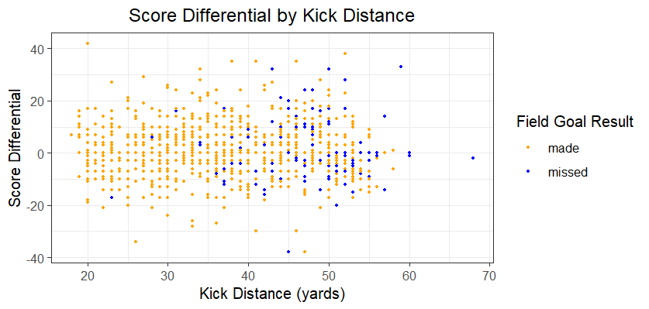
Example 1: NFL field goal attempts
Notes:
Kickers usually make under 35 yards. Doesn’t appear to be related to score differential. Switch to code now!

Slide 69
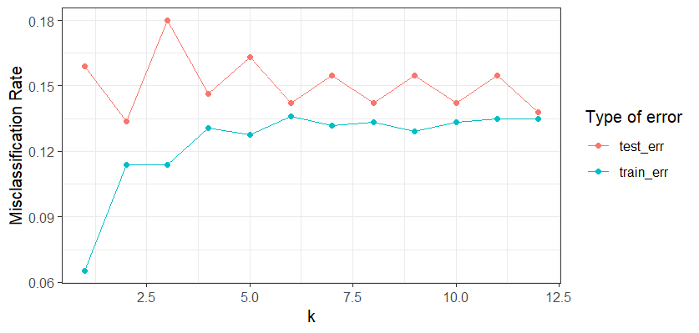
Example 1: NFL field goal attempts

Slide 70
Example 2: Predicting Student Success
Information about the dataset
Notes:
Dataset of student enrollment information (academic path, undergraduate major, demographics, and socioeconomic factors) and the students' academic performance at the end of the first and second semesters. Three classes—graduate, enrolled, dropout—with a strong imbalance towards one of the classes.

Slide 71
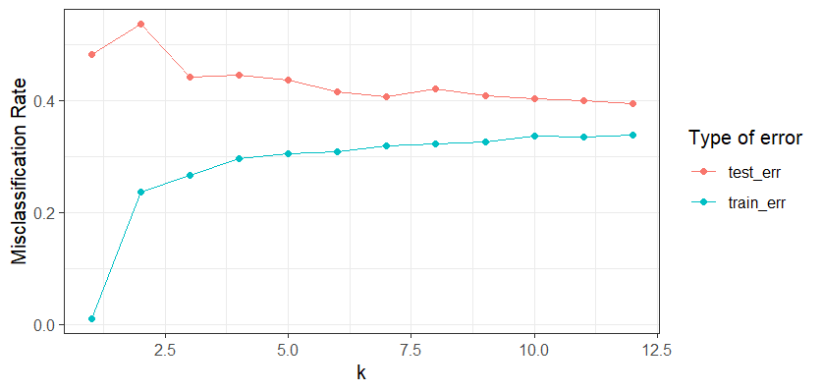
Example 2: Predicting Student Success

Slide 72
Example 2: Predicting Student Success
Most accurate predicting Graduate
74.67% sensitivity, 57.47% specificity.
The model struggles with Enrolled
16.22% sensitivity, 91.18% specificity
Overall accuracy is 59.32%
Fairly good performance (no information rate is 50.85%)
Notes:
Struggles with enrolled bc class with least amount of responses
Sensitivity: true positives (“if it’s in there, the model gets it”)
Specificity: true negatives (“if it’s not in there, the model gets it”)
No info rate: success rate if you just guessed most common class for everything

Slide 73
Extension: KNN regression with Scooby-Doo ratings
Link to repository
Notes:
Every Scooby-Doo episode and movie's various variables. Collected by hand and some subjectivity, but it’s fun! If you’re unaware, The show follows the iconic mystery solving detectives, know as Mystery Inc., as they set out to solve crime and unmask criminals, bent on revenge or committing criminal acts for their own personal gain
Goal: predict IMDB rating

Slide 74
Extension: KNN regression with Scooby-Doo ratings
Response Y is no longer categorical, but numeric

Slide 75
Extension: KNN regression with Scooby-Doo ratings
Response Y is no longer categorical, but numeric
Now we take the average value of the nearest neighbors!

Slide 76
Extension: KNN regression with Scooby-Doo ratings
KNN regression: average value of the response
Step 1: find the k observations closest to the new point x
Step 2: determine the average value of the response from those k observations closest to x

Slide 77
Extension: KNN regression with Scooby-Doo ratings
KNN regression: average value of the response
Step 1: find the k observations closest to the new point x
Step 2: determine the average value of the response from those k observations closest to x
Step 3: assign average value of the response from those k observations to the new point x
In other words, the prediction for x is the average of the points closest to x

Slide 78
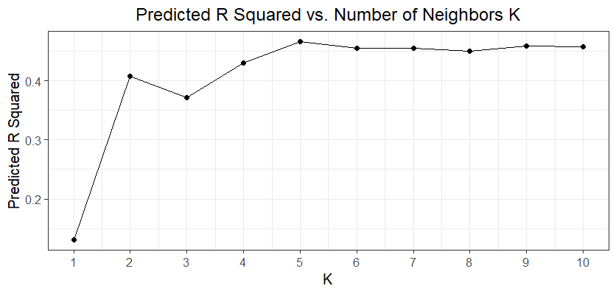
Extension: KNN regression with Scooby-Doo ratings

Slide 79
Learning Objectives Review
Define supervised learning and unsupervised learning
Compare and contrast parametric and nonparametric models
Understand the difference between classification and regression
Fit K-nearest neighbors (KNN) algorithm in R

Slide 80

Learning Objectives Review
Define supervised learning and unsupervised learning
Compare and contrast parametric and nonparametric models
Understand the difference between classification and regression
Fit K-nearest neighbors (KNN) algorithm in R

Slide 81
More Resources
An Introduction to Statistical Learning (it’s free!)
NC State’s Data Science Academy
ST 563 (Introduction to Statistical Learning) or ST 558 (Data Science for Statisticians)
Notes:
ISL: both R and Python!

Slide 82
Acknowledgements
NCSU Libraries
Carnegie Mellon University Department of Statistics and Data Science
NC State University Department of Statistics

