Slide 1
Global Southern Ocean, Global Argentine Basin, and Global Station Papa
By Chris Bradley

Slide 2

My Question
What are some major differences between the Argentine Basin, South Pacific Ocean, and North Pacific Ocean, and have there been any major changes at the bottom of the ocean at these points over time?

Slide 3
Data Acquisition
Data was requested and acquired from the OOI (Ocean Observatories Initiative).
Looked at CTD data from each of the three points at the deepest depths for each location.
Data collected from profile moorings.
Took oldest data that wasn’t corrupt, and compared it to latest data.

Slide 4
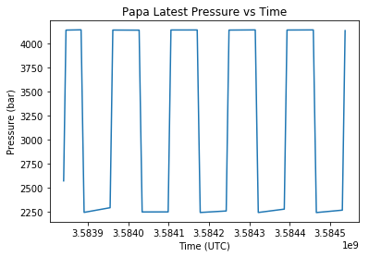
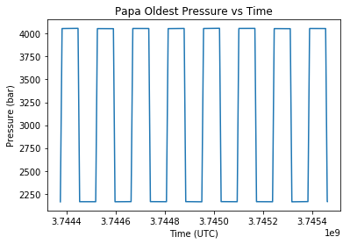
Global Station Papa
Latest Papa: 8-27-18 to 9-9 18
Average: 3207.9819939271256 bar
Oldest Papa: 7-26-13 to 8-03-13
Average: 3099.50934375 bar

Slide 5
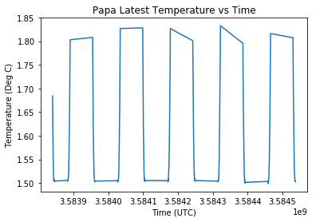
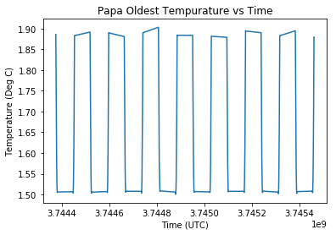
Global Station Papa
Latest Papa: 8-27-18 to 9-9 18
Average: 1.5820363360323888 Deg C
Oldest Papa: 7-26-13 to 8-03-13
Average: 1.626214375 Deg C

Slide 6
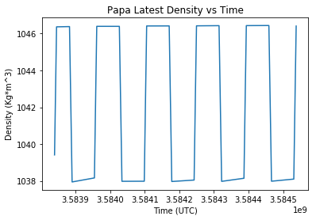
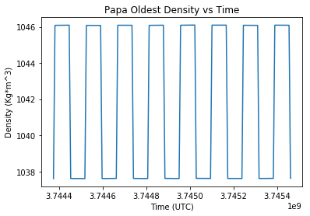
Global Station Papa
Latest Papa: 8-27-18 to 9-9 18
Average: 1042.311133096154 Kg*m^3
Oldest Papa: 7-26-13 to 8-03-13
Average: 1041.848967625 Kg*m^3

Slide 7
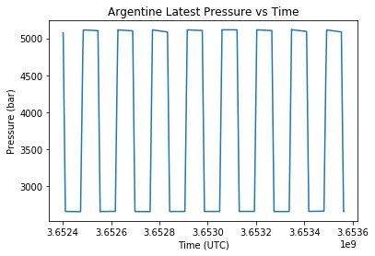
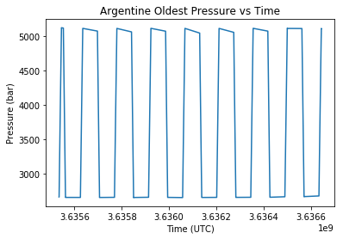
Global Argentine Basin
Latest Argentine: 9-28-15 to 10-11-15
Average: 3903.5521925955945 bar
Oldest Argentine: 3-16-15 to 3-29-15
Average: 3890.0279435368566 bar

Slide 8
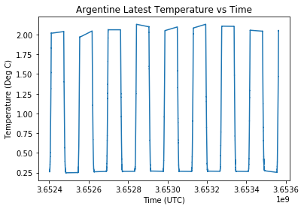
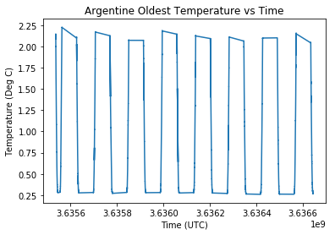
Global Argentine Basin
Latest Argentine: 9-28-15 to 10-11-15
Average: 0.8181388981596263 Deg C
Oldest Argentine: 3-16-15 to 3-29-15
Average: 0.8541304061330656 Deg C

Slide 9
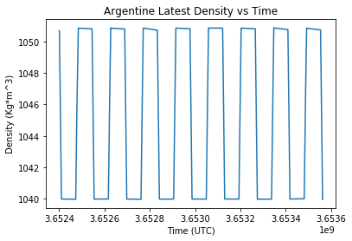
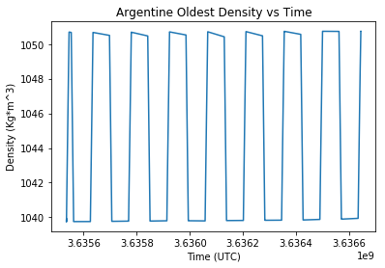
Global Argentine Basin
Latest Argentine: 9-28-15 to 10-11-15
Average: 1045.5540857503217 Kg*m^3
Oldest Argentine: 3-16-15 to 3-29-15
Average: 1045.3290821040857 Kg*m^3

Slide 10
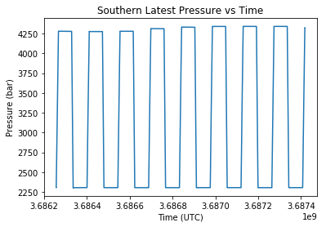
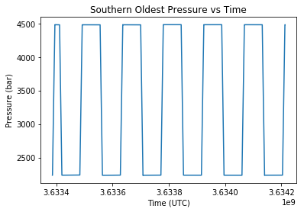
Global Southern Ocean
Latest Southern: 10-24-16 to 11-6-16
Average: 3319.2563973302485 bar
Oldest Southern: 2-20-15 to 3-1-15
Average: 3357.317516595882 bar

Slide 11
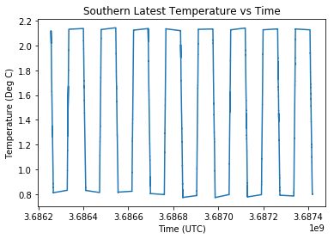
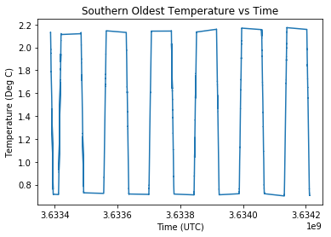
Global Southern Ocean
Latest Southern: 10-24-16 to 11-6-16
Average: 1.4469025612197148 Deg C
Oldest Southern: 2-20-15 to 3-1-15
Average: 1.41266299475356 Deg C

Slide 12
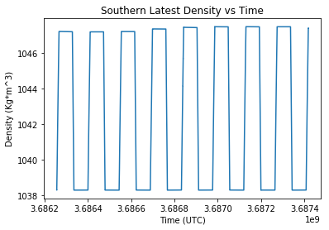
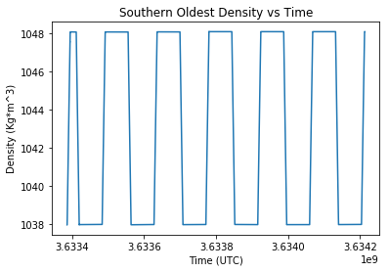
Global Southern Ocean
Latest Southern: 10-24-16 to 11-6-16
Average: 1042.910468735423 Kg*m^3
Oldest Southern: 2-20-15 to 3-1-15
Average: 1043.05559739086 Kg*m^3

Slide 13
Observations
The Global Argentine Basin has the highest pressure, lowest temperature, and highest density when compared to the other points.
Over time, most of the points showed very small changes to data averages.
Both Argentine Basin and Station Papa had an increase in pressure, a decrease in temperature, and an increase in density. But the Southern Ocean had the exact opposite.

Slide 14
Data Links
Global Southern:
https://ooinet.oceanobservatories.org/data_access/?search=GS02HYPM-WFP03-04-CTDPFL000#GS02HYPM-WFP03-04-CTDPFL000/ctdpf_ckl_wfp_instrument_recovered
Global Argentine:
https://ooinet.oceanobservatories.org/data_access/?search=GA02HYPM-WFP03-04-CTDPFL000#GA02HYPM-WFP03-04-CTDPFL000/ctdpf_ckl_wfp_instrument_recovered
Global Station Papa:
https://ooinet.oceanobservatories.org/data_access/?search=GP02HYPM-WFP03-04-CTDPFL000#GP02HYPM-WFP03-04-CTDPFL000/ctdpf_ckl_wfp_instrument
OOI Base link:
https://oceanobservatories.org/data-portal/

