Slide 1
EDA
(only the cool and fancy stuff!)

Slide 2

Data Scientist at United Nations
Objective:
Estimate world population

Slide 3
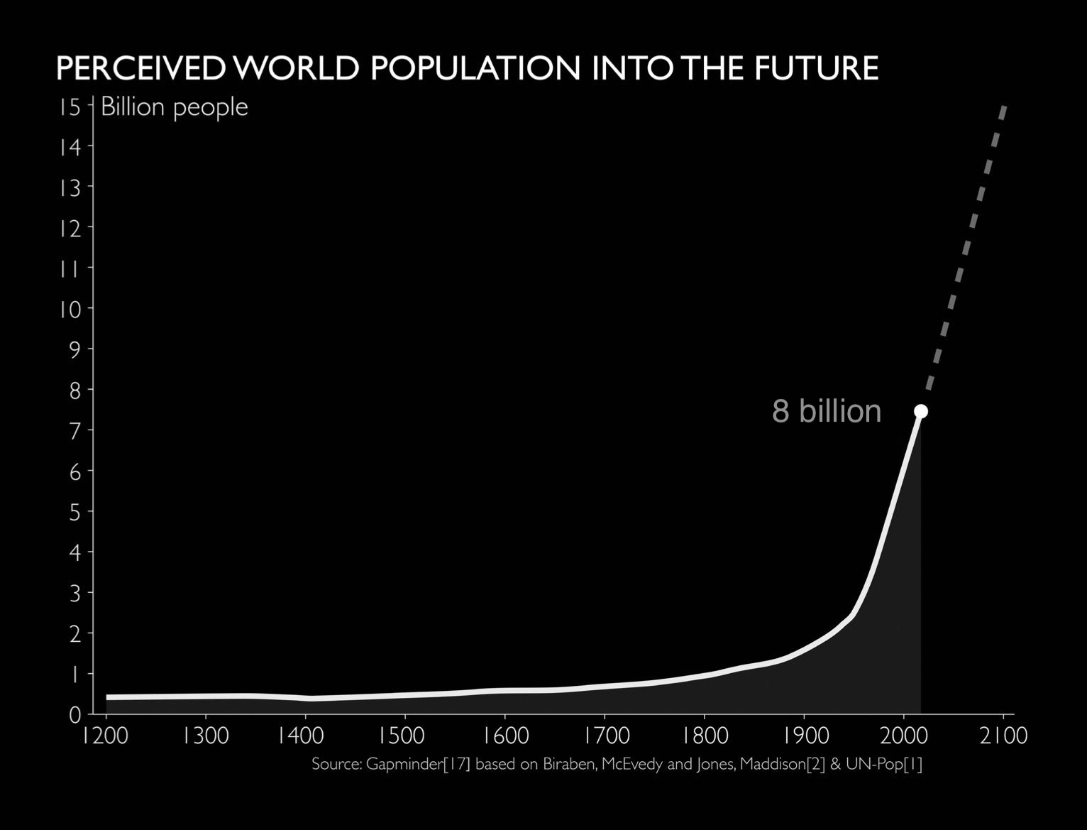
Overpopulation

Slide 4
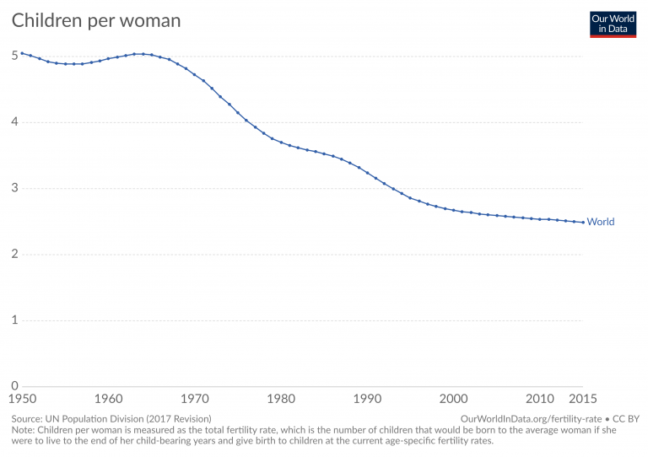
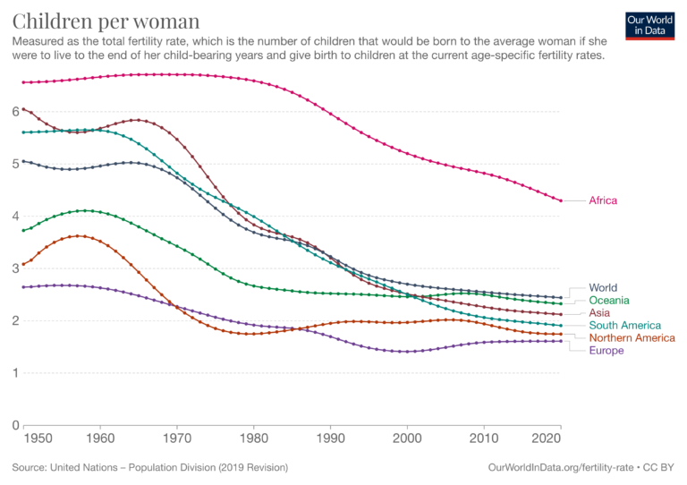
Children per woman

Slide 5
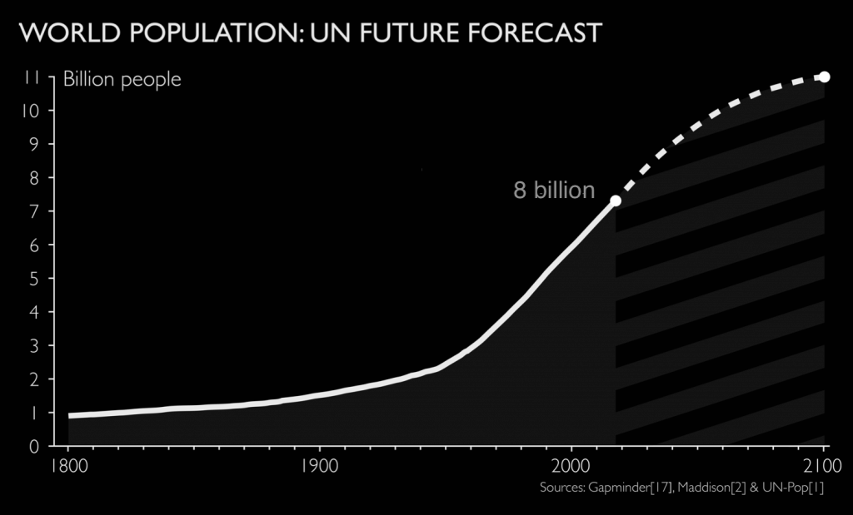
Population Forecast
WRONG ❌
CORRECT ✅

Slide 6
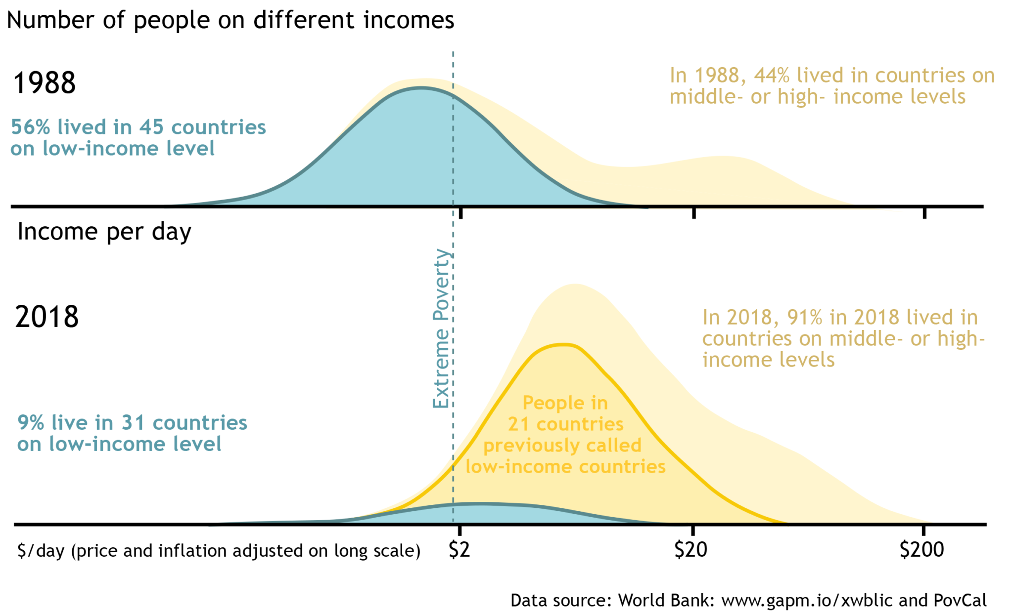

Slide 7
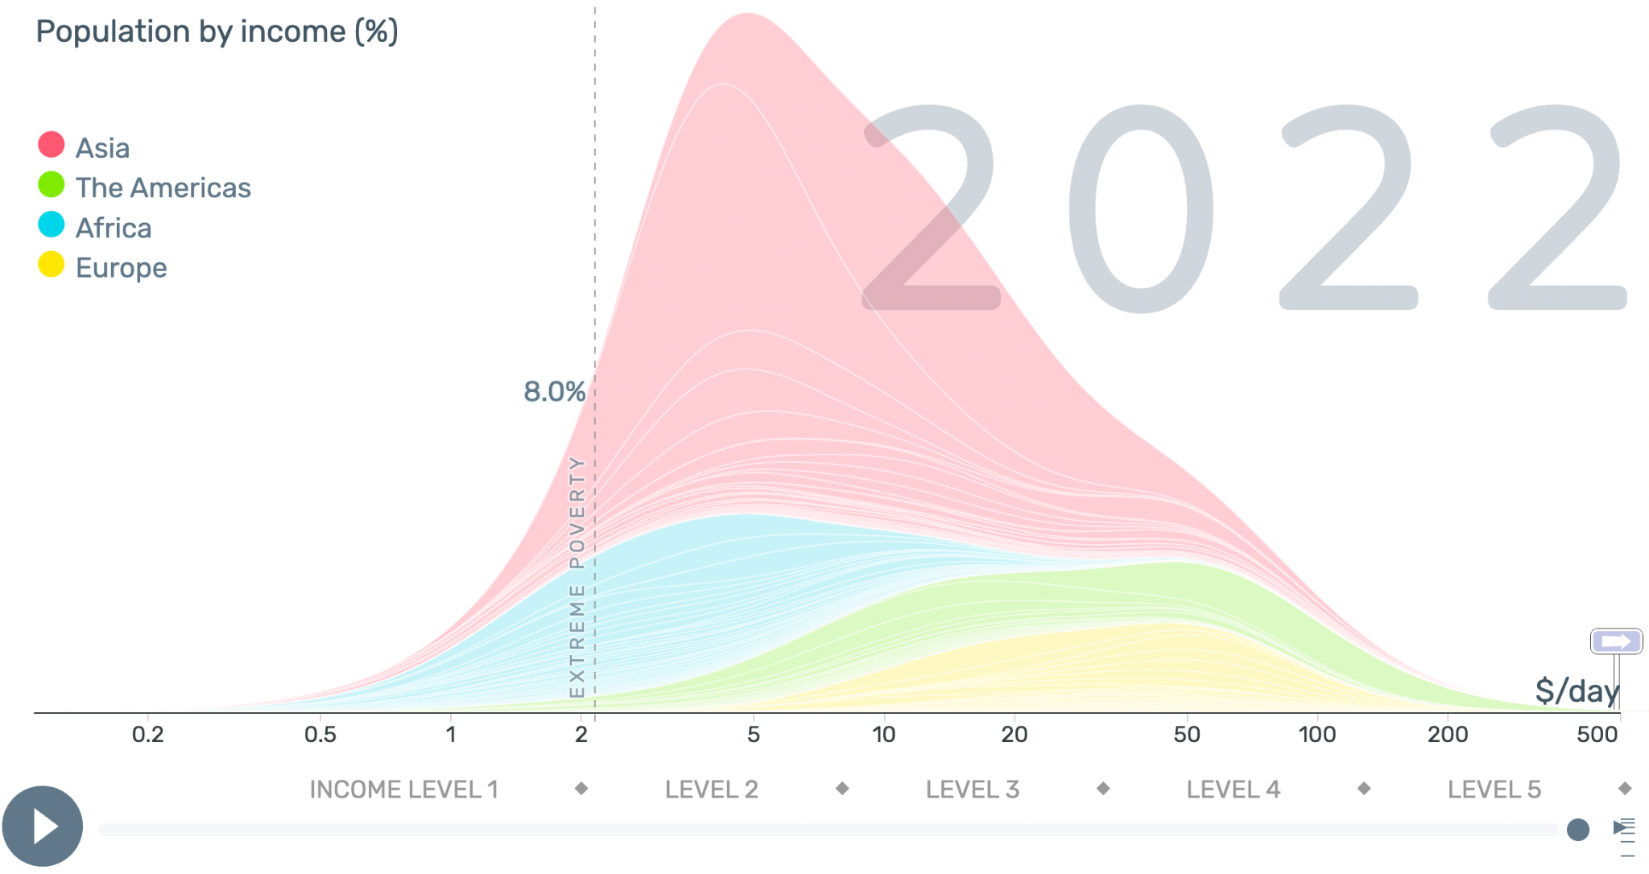

Slide 8
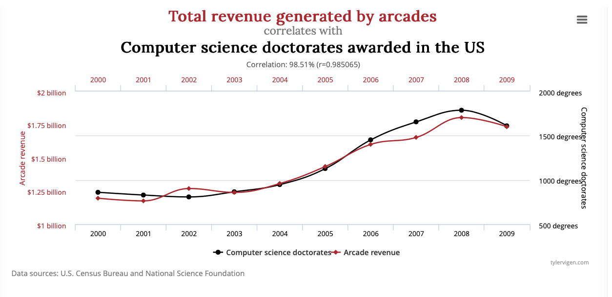

Slide 9
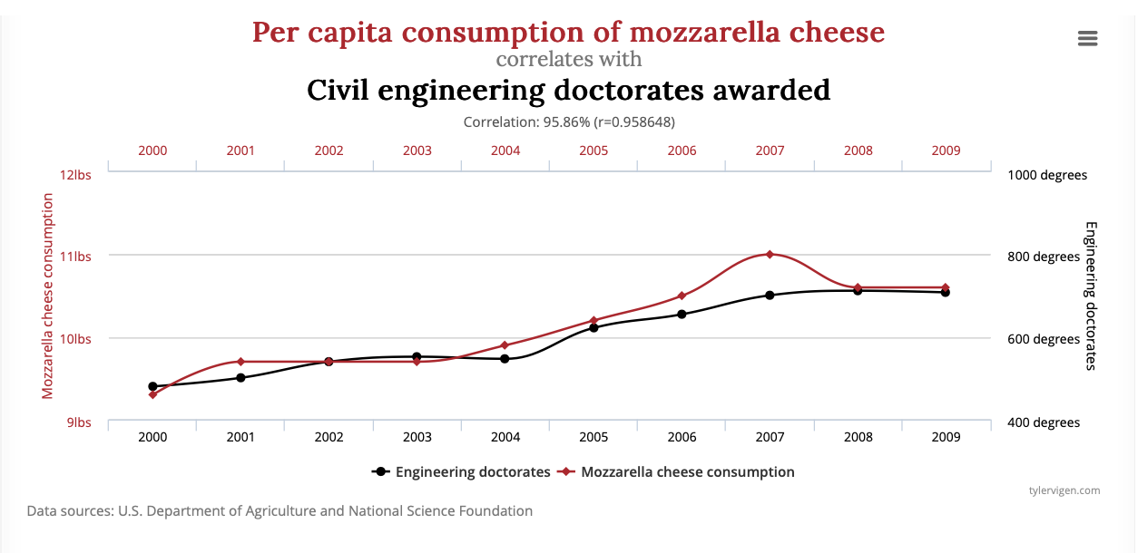

Slide 10
