Slide 1


!!

Slide 2




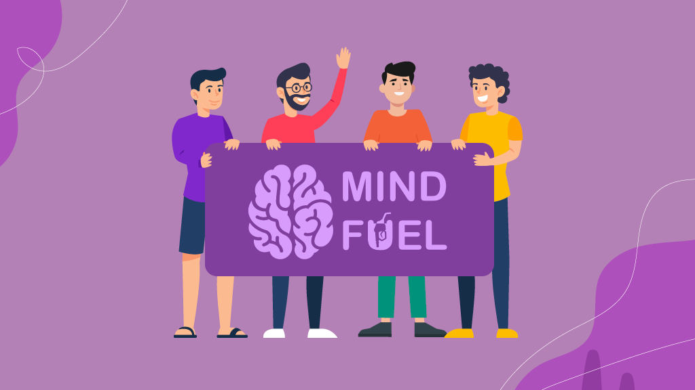


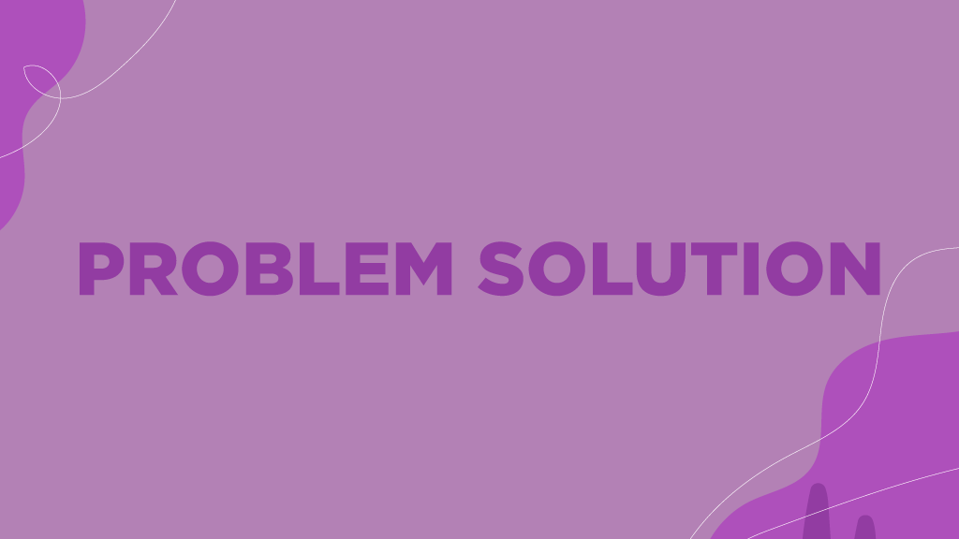
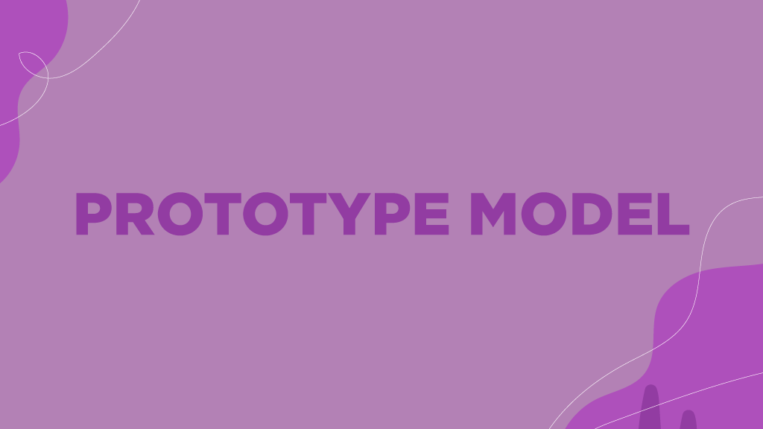



Slide 8


Problem Statement
According to globallyminded.org about 16.1% people suffer from anxiety, depression.
Misconception
Lack of Comprehensive Platforms
Communication Gaps

Slide 9

OBJECTIVE
User-friendly website with comprehensive mental health resources.
An online hub with a variety of mental health resources, including articles, self-assessment tools (emotion chatbot).
What is MindFuel?

Slide 10
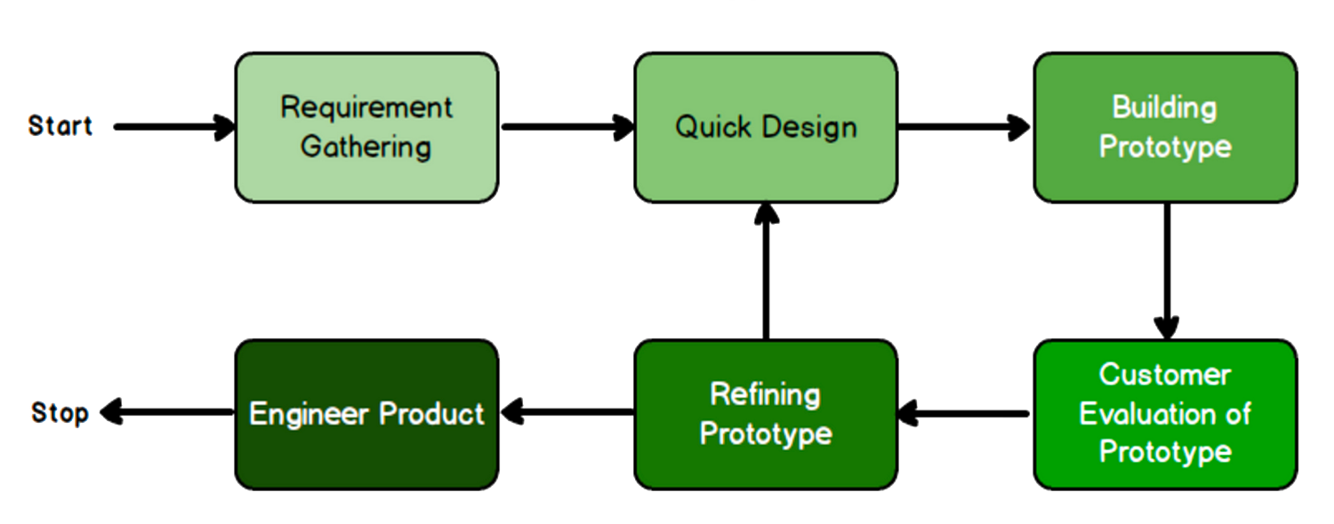

Prototype model
OBJECTIVE
User-friendly website with comprehensive mental health resources.
An online hub with a variety of mental health resources, including articles, self-assessment tools (emotion chatbot).

Slide 11
User Type
Prototype model

Slide 12

User Type

Slide 13

SCOPE
Establish a comprehensive, user-centric platform for mental well-being.
Engage users in interactive conversations, offering real-time guidance and support.

Slide 14

Problem Solution
Providing Resources: The campaign offers easily accessible resources.
Engagement through Chatbot: Utilizing the chatbot enables immediate engagement and support.
Bridging the Gap: By connecting users with mental health professionals.

Slide 16


