Slide 1
Project 4
By Krisdan Kalinisan

Slide 2
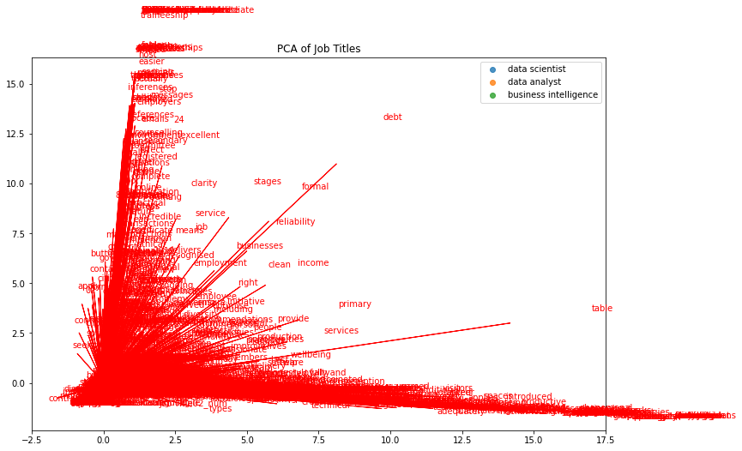
PCA 2d

Slide 3
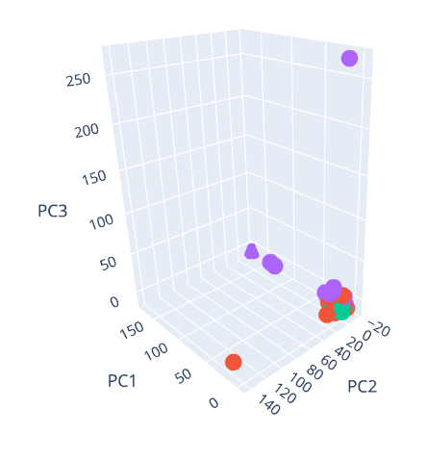
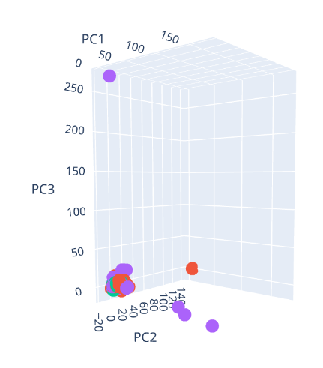
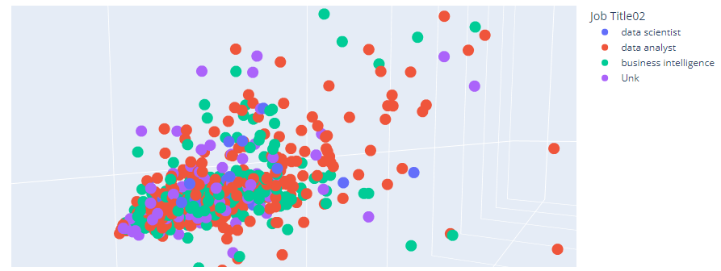
PCA 3d

Slide 4
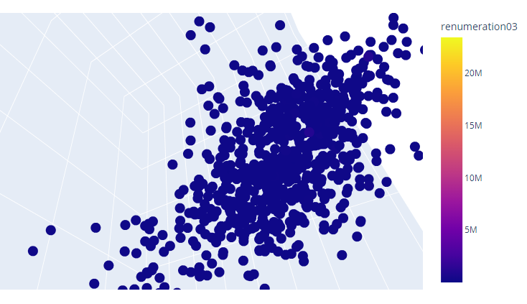
PCA 3d

Slide 5
Most Common Words
data scientist | data analyst | business intelligence
data 134 | data 2729 | business 1510
business 75 | experience 1155 | data 1310
experience 64 | business 1147 | experience 753
science 45 | work 951 | work 558
team 42 | role 920 | team 537
work 41 | team 862 | role 503
learning 37 | reporting 776 | Job Title02_num 454
machine 30 | skills 748 | working 424
statistical 29 | working 681 | skills 415
role 27 | people 584 | requirements 389
working 26 | support 563 | analyst 357
models 23 | analysis 541 | support 339
analytics 22 | insights 497 | analysis 327
using 21 | analyst 492 | management 323
techniques 20 | analytics 448 | reporting 308
skills 20 | development 444 | intelligence 273
modelling 20 | ability 441 | people 271
people 20 | management 398 | development 267
building 19 | strong 397 | solutions 263
strong 19 | key 390 | ability 255

Slide 6
Most Common Words
data scientist | data analyst | business intelligence
learning 37 | reporting 776 | requirements 389
machine 30 | people 584 | solutions 263
statistical 29 | support 563 | development 267

