Slide 1
gUERILLA
Kaiseki sushi restaurant

Slide 3
Charge: €400
Basic fee is around €1000
Only 52% billable, more or less
Still learning and networking

Slide 4
Issues:
Site was too “full”
Annoyingly fast sushi carrousel
Not in proportion
http://www.kaiseki-antwerpen.be/
https://krisderycke.github.io/Guerilla/

Slide 5
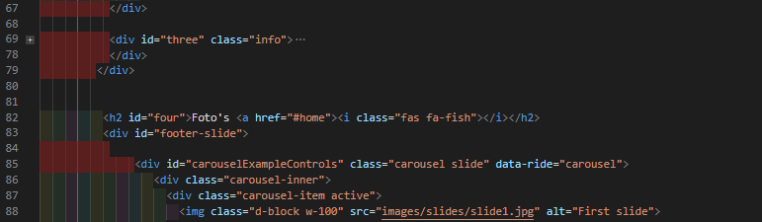

Slide 6
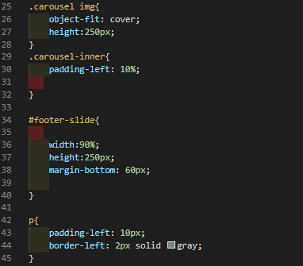

Slide 7
Readme:
https://github.com/krisderycke/Guerilla

Slide 8
If I had more time:
Larger page
More pictures
Finetuning carrousel
Lighthouse

Slide 9
conclusion
Im a very junior junior, more like a premature junior
Still got a lot to learn
Templates are a pain to adjust
Hang in there!

