Slide 1
Unicode

Slide 2
Unicode:
What are they?
What do they do?
How do I use them?

Slide 3
What are they?
Unicode is an international coding standard of graphical signs and symbols in binairy code.
The purpose of Unicode is to support all used languages. Even the Greek alphabet and Chinese letters.
Unicode does not limit de number of languages that can be used in one document. Beside numbers and letters, Unicode also uses symbols like: pounds (aka “the hashtag”), currency symbols ($, £, €) and mathematical symbols (+ * /) etc.

Slide 4
What do they do?
They bring the “UNI” in the Unicode: it offers a unique number for each and every sign. No matter what platform, language, nor used program.
The use of Unicode in client-servers (i.e.: the server is on your own computer) and websites makes that one software product or webpage can be used on different platforms without loosing or changing data, wherever, whenever.
We all use it in our HTML, wether you know it or not!

Slide 5
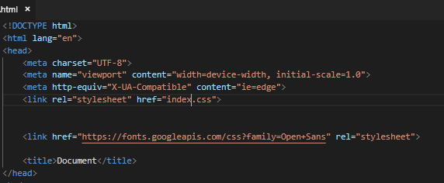

Slide 6
Say whut??
Unicode is mainly based on the UTF-8 character set.
(you also have the UTF-16 and UTF-32). The UTF-8 is the dominant encoding on the WWW. Most say it is mandatory.
UTF stands for: Unicode Transformation Format an it is capable of encoding all 1,112,064 valid code points in Unicode!
It’s a way to save Unicode signs as Bytes

Slide 7
How to use Unicode?
Easy!
Implement the code in your HTML
Done!

Slide 8
Examples:

Slide 9
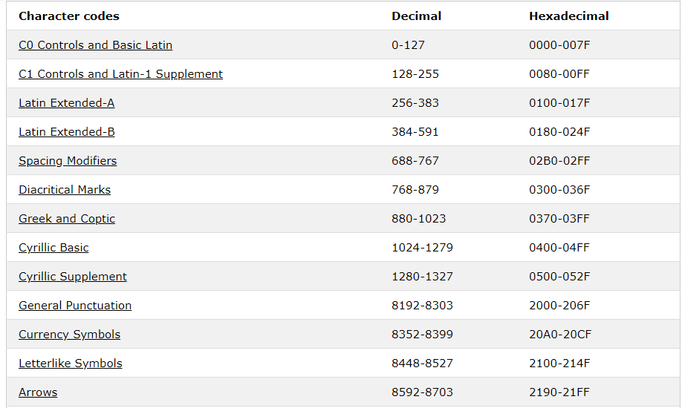
Does it makes sense?
Source: W3school

Slide 10
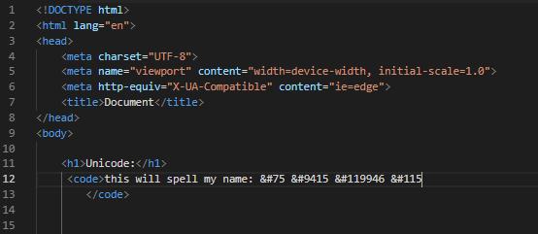

Slide 11
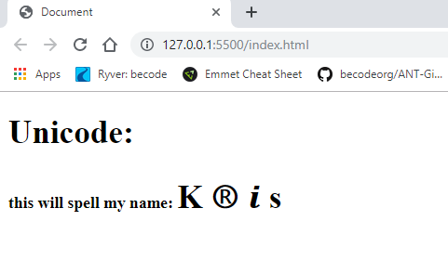

Slide 12

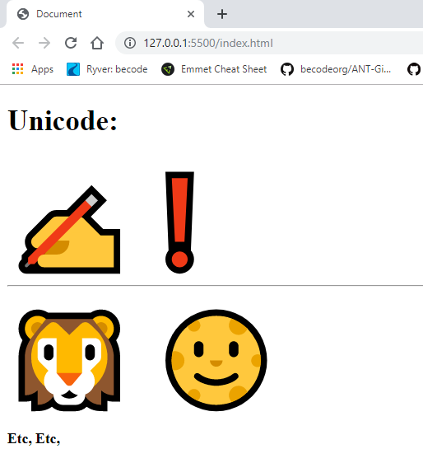



But not only letters:

Slide 13
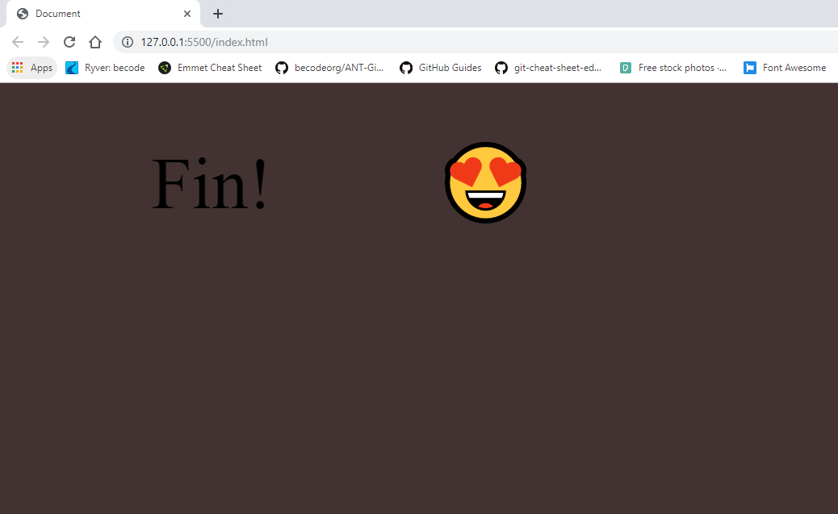

Slide 14
Q&A

