Slide 1

Modern Periodic Table using B+Tree
Div: CS_B
Group-No: SY-29
Date:29th April 2024
Day : Monday
Krushna Gore | 12211656
Kartarsingh Gothwal | 12210284
Tanvi Gunjal | 12211632
Sejal Hage | 12210494
Project Guide:
Prof . Sonali Antad
Vishwakarma Institute of Technology , Pune
Department of Computer Engineering

Slide 2
OUTINE
Flow Diagram
Result
Conclusion
References
Introduction
Motivation
Problem statement
Objective
Methodology

Slide 3
Introduction
The periodic table is a cornerstone of chemistry, providing a systematic way to organize and understand the properties of chemical elements.
The project focuses on building a modern periodic table using the B+ tree in C. This efficient data structure enables swift operations like search, insertion, and deletion, enhancing accessibility and organization of element properties. Through this approach, we aim to deliver a dynamic and streamlined representation of the periodic table, empowering users with rapid access to vital element data.

Slide 4
Motivation
Efficiency Boost: Using a B+ tree enhances efficiency, enabling swift access and management of element data.
Interactive Learning: The project fosters interactive learning by creating a modern periodic table, engaging users with dynamic data exploration.
Innovative Representation: Employing advanced data structures like the B+ tree showcases innovation in organizing and accessing chemical element information.

Slide 5
Problem Statement
The project aims to develop a modern periodic table using a B+ tree data structure implemented in C. It involves creating a program capable of efficiently handling operations such as insertion, deletion, search, range search, and displaying s, p, d, f block elements separately. The goal is to provide users with a dynamic and interactive platform for exploring and understanding chemical elements.

Slide 6
Objectives
Developing a program capable of efficiently managing element data through operations such as insertion, deletion, and search.
Implementing functionality for range searches to retrieve elements within specified atomic number ranges.
Organizing and displaying s, p, d, and f block elements separately to enhance user interaction and understanding.
Providing a dynamic and interactive platform for users to explore and learn about chemical elements in a structured manner.

Slide 7
Methodology
Data Structures Definition
B+Tree Characteristics
Initialization
File Handling
Insertion Algorithm
Splitting Nodes
Searching for Elements
Deletion Mechanism
Range Search Capability
Display Functions for Blocks

Slide 8
Flow Chart
Start Program
Main Program
Initialize Tree from File
Read element data from a file and insert them into the B+Tree data structure.
Exit Program
Terminate the program.
Main Menu
Display a menu of options for the user to interact with the B+Tree.
Insert Element
Prompt the user for an element's details and insert it into the B+Tree
Display F-Block Elements
Traverse the B+Tree and display all elements belonging to the f-block
Delete Element
Prompt the user for an element's atomic number and delete it from the B+Tree
Display D-Block Elements
Traverse the B+Tree and display all elements belonging to the d-block.
Search Element
Prompt the user for an element's atomic number and search for it in the B+Tree
Display P-Block Elements
Traverse the B+Tree and display all elements belonging to the p-block.
Range Search
Prompt the user for a range of atomic numbers and display all elements within that range.
Display S-Block Elements
Traverse the B+Tree and display all elements belonging to the s-block.

Slide 9
Display
Start Block Display
Display S-Block Elements
Call the display_s_block_elements function to traverse the B+Tree and print all s-block elements
Display P-Block Elements
Call the display_p_block_elements function to traverse the B+Tree and print all p-block elements.
Display D-Block Elements
Call the display_d_block_elements function to traverse the B+Tree and print all d-block elements.
Display F-Block Elements
Call the display_f_block_elements function to traverse the B+Tree and print all f-block elements.
Block Display Complete
Main Program

Slide 10
Range Search
Start Range Search
Get Atomic Number Range
Prompt the user to enter the lower and upper bounds of the atomic number range.
Display Search Results
Print the name, symbol, atomic number, and atomic mass of all elements found within the range
Range Search Complete
Main Program

Slide 11
Insert
Start Insert
Get Element Details
Prompt the user to enter the atomic number, symbol, name, and atomic mass of the element to be inserted.
Insert Element into B+Tree
Call the insert function to add the new element to the B+Tree data structure.
Insert Successfull
Main Program

Slide 12
Search
Start Search
Search for Element in B+Tree
Call the search function to find the element with the specified atomic number in the B+Tree.
Display Search Result
If the element is found, print its name, symbol, and atomic mass.
Search Complete
Main Program

Slide 13
Delete
Start Delete
Get Atomic Number
Prompt the user to enter the atomic number of the element to be searched.
Call Search
Delete Element from B+Tree
Call the delete function to remove the element with the specified atomic number from the B+Tree.
Delete Successful
Main Program

Slide 14
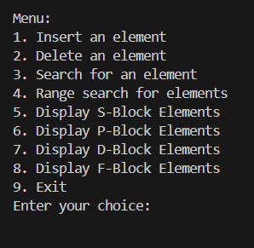

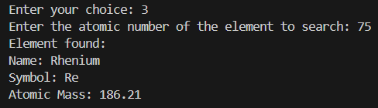
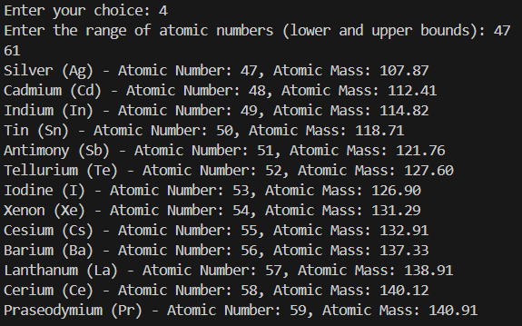
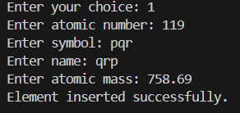
Result
Deletion
Searching
Menu
Range Search
Insertion

Slide 15
Conclusion
The development of a modern periodic table using a B+ tree data structure in C has resulted in an efficient and dynamic tool for organizing and accessing element data. By implementing operations such as insertion, deletion, and search, along with range searches and separate displays for s, p, d, and f block elements, the project offers a comprehensive solution for exploring and understanding chemical elements. Through this project, users can interact with the periodic table in a structured manner, facilitating easier access to valuable chemical information.

Slide 16
THANK YOU!!

