Slide 1

SMART INDIA HACKATHON 2026
Drone3D — Single-Pass Drone Video to Accurate, Walkable 3D Models
• Problem Statement ID – SIH26158
• Problem Statement Title – Single-Pass Drone Video to Accurate 3D Model Generation System
• Theme – Drones & Robotics
• PS Category – Software
• Team ID – (to be filled on portal)
• Team Name (Registered on portal) – Your Team Name

Slide 2
One Flight Pass In, Measured 3D Out
Your Team Name
PROPOSED SOLUTION
• One video pass from a drone or phone, plus its GPS/IMU telemetry, is the only input — no flight planning, no ground control points, no second flight.
• It cleans the footage, solves the cameras, recovers true metric scale and gravity, then reconstructs the scene twice: a photoreal 3D-Gaussian-Splatting model and a survey-grade dense mesh.
• Results are georeferenced (UTM + EGM96) with writers for all six SIH-mandated formats, plus a browser viewer an operator can walk through.
• An 11-rule automatic gate and blinded A/B renders decide what ships; anything unproven is reported as “not demonstrated”.
• Drone or phone capture; GPS-denied scans fall back to AR pose priors.
INNOVATION & UNIQUENESS
• Motion-consistent dynamic veto — moving cars and people are removed from matching using camera geometry, not a segmentation network (reprojection error −7.8%).
• Four-ruler metric scale recovery (AR prior > GPS fit > height > speed) yields true metres and a correct “up” with zero ground control points.
• Walkability by measurement: two candidate ground meshes are routed by an autopilot and the one that walks further is shipped.
• Honesty-first: no generative invention of unseen surfaces; measured, weak and unobserved regions are reported separately.
• Every run is reproducible: code SHA, parameters and timings archived in the run bundle.
1
drone pass in — no GCPs, no re-flight
video + GPS / IMU telemetry only
6
official export formats implemented
OBJ · PLY · LAS · GeoTIFF · GLB · FBX
65 m
autonomous walk, 0 falls
measured on a real capture, 6 GB laptop GPU

Slide 3
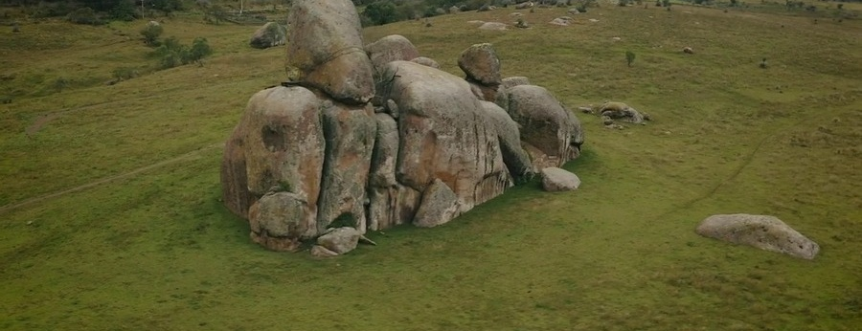
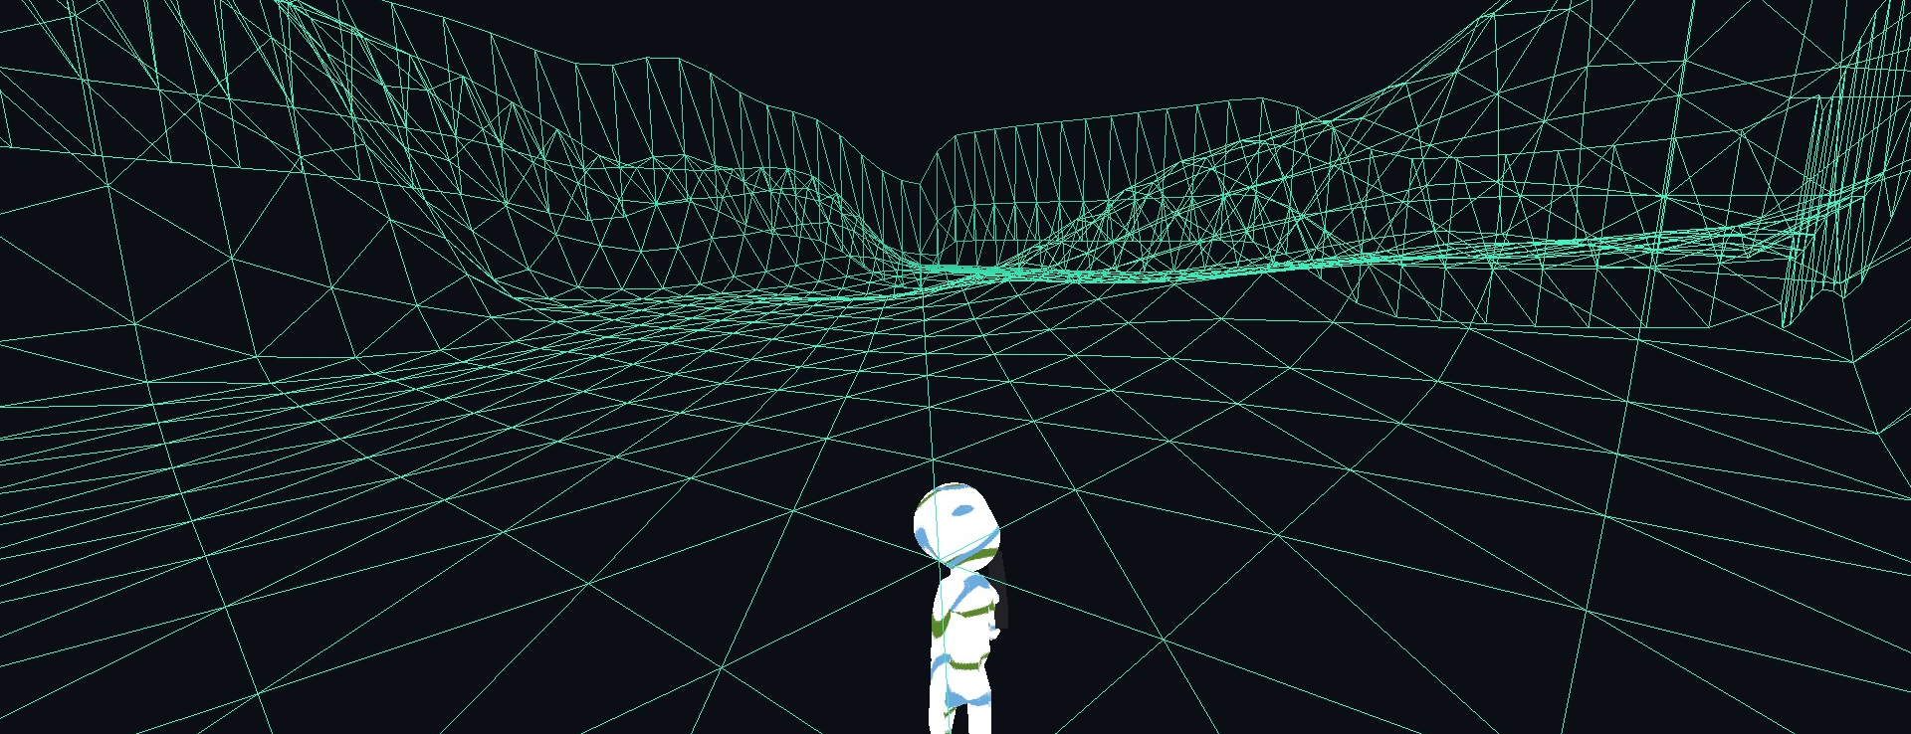
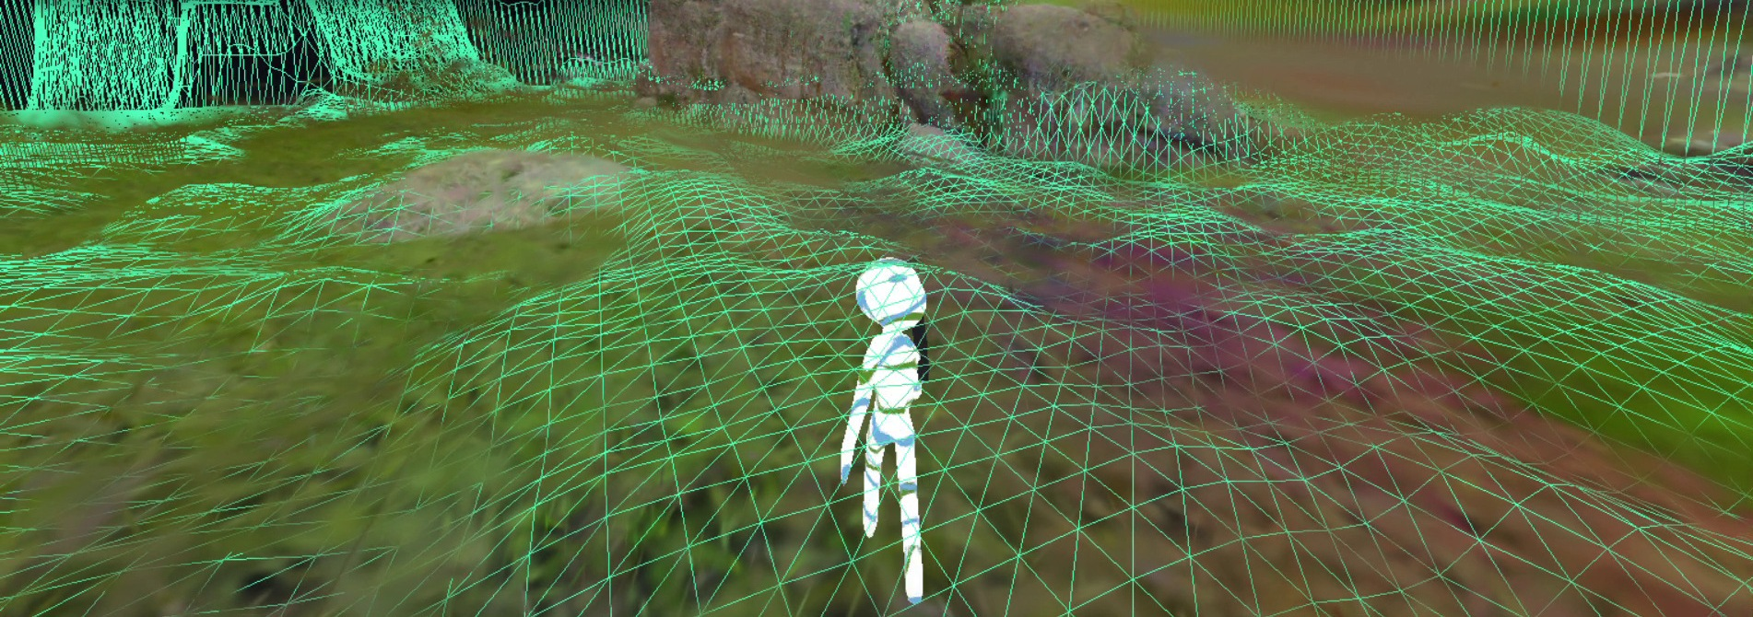
TECHNICAL APPROACH
Your Team Name
END-TO-END PIPELINE — ONE FLIGHT PASS IN, GEOREFERENCED WALKABLE WORLD OUT
01 CAPTURE & INGEST
Drone / phone video 1080p–4K + GPS·IMU telemetry; blur-scored keyframe pick (OpenCV, ffmpeg)
02 CLEAN & MATCH
Dynamic-object veto + illumination flatten on matching copies; GPU SIFT matching (COLMAP 4.1.1)
03 SOLVE & GEOREF
SfM bundle adjustment with GPS-as-priors; four-ruler metric scale + gravity; UTM/EGM96 Sim(3) fit
04 RECONSTRUCT
3D Gaussian Splatting (gsplat) for the photoreal view + COLMAP dense MVS → Poisson survey mesh
05 DELIVER & VERIFY
Six official formats, ortho/DSM rasters, textured GLB; walkable viewer, 11-rule gate, blinded A/B
INPUT · one 12 s drone pass over the rocks site
RECONSTRUCT · 350 k dense points → shell + navmesh
OUTPUT · metric, textured, walkable world
TECH STACK
Compute Python 3.12 + 3.10/CUDA 12.4 · PyTorch 2.4.1 · gsplat 1.5.3
Vision COLMAP 4.1.1 (SfM / MVS / Poisson) · OpenCV 5 · ffmpeg 9
Geo PROJ / GDAL · rasterio · laspy · EGM96 geoid · Umeyama Sim(3)
Viewer PlayCanvas · ammo.js/Bullet · recast-navigation · Next.js console
Harness Playwright walk tests · 663 CPU tests · blinded A/B
NOVEL ENGINEERING
1 Dynamic veto: epipolar + temporal-median masks remove movers with no neural net (−7.8% reprojection error)
2 Metric truth: four named rulers + GPS-as-priors give metres and up with no GCPs; degenerate tracks refused
3 Measured walkability: an autopilot routes two candidate grounds; the 11-rule gate ships only what passes
4 Honest occlusion: measured / weak / unobserved kept separate

Slide 4
FEASIBILITY AND VIABILITY
Your Team Name
FEASIBILITY — ALREADY DEMONSTRATED
• Runs end-to-end on one 6 GB laptop GPU (RTX 3050); VRAM-aware budgets keep splat training under 1.3 GiB.
• Real captures solved: 72/72 and 288/291 frames registered; up to 1.57 M fused dense points.
• Georeferenced delivery proven on a real run: 287/287 cameras matched, Sim(3) fit RMSE 0.64 m, 5/6 formats georeferenced + WGS84 table.
• 663 automated CPU tests; every LAS / GeoTIFF is re-read by laspy / GDAL and deleted if misread.
• Export writers validated by re-reading every file they write; five real writer defects were caught this way.
CHALLENGES & RISKS → MITIGATION
• Speed gate (<15 min per 10-min video) not yet met on 6 GB → streaming-window reconstruction + fast dense profile (2.33× measured).
• No surveyed checkpoints yet → checkpoint RMSE / P95 harness ready; the 1.14 m VIO hold-out is flagged as the wrong reference, never quoted as accuracy.
• Moving objects corrupt matching → motion-consistent dynamic veto (tracks −18.4%, reprojection error −7.8%).
• Cloud / fog reconstructs as solid geometry → saturation + height cloud cull with compact-structure protection.
• Low-texture or rotation-only footage degenerates the solve → phone / AR pose priors as a fallback path.
TECHNICAL VIABILITY
CPU-only path for everything except splat training and dense MVS; Windows today, Linux porting next.
Step markers hash the code that ran, so stale caches cannot hide a fix; every failure is classified with a fix line.
Trainer peak 1.26 GiB at the high preset; partial-PLY checkpoints survive OS kills.
OPERATIONAL VIABILITY
One operator, one pass; a phone WebXR scan is a valid fallback when a drone cannot fly.
Browser viewer and Next.js console need no install; outputs open in GDAL / laspy / any glTF tool.
Ground Control console shows stage timings, peak VRAM and gate verdicts per run.
ECONOMIC VIABILITY
All-core open source (COLMAP, gsplat, PlayCanvas) — no paid SDKs or per-seat licences.
Replaces survey-crew fieldwork and GCP campaigns with one video pass on a commodity laptop.
One laptop replaces photogrammetry workstations and licence seats.

Slide 5
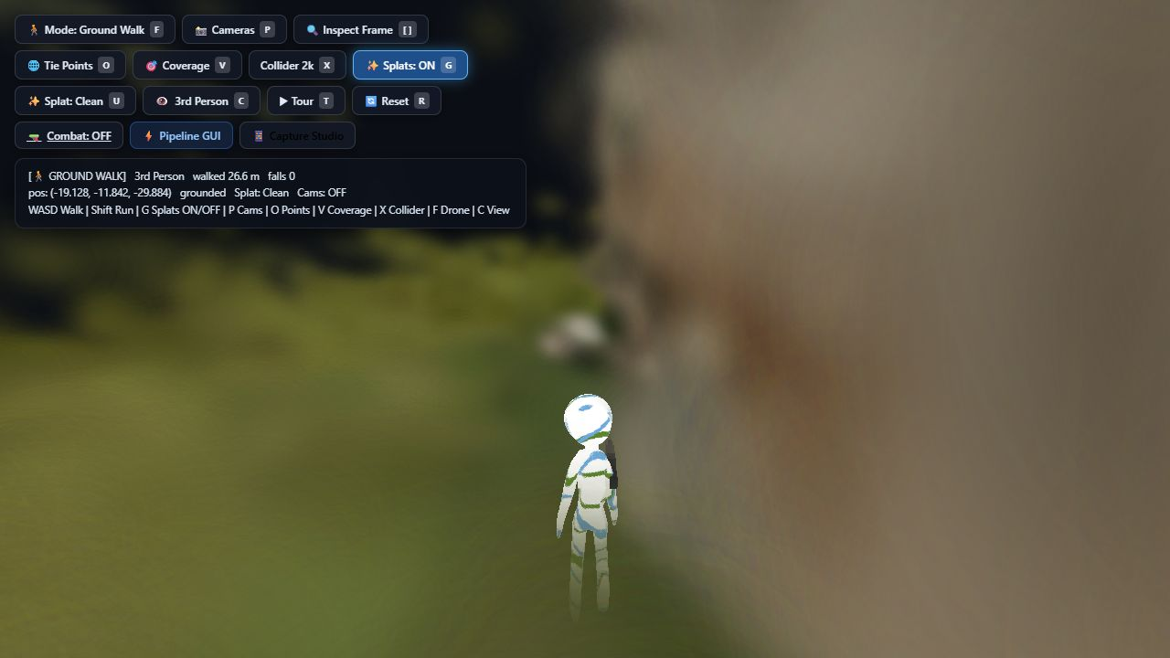
IMPACT AND BENEFITS
Your Team Name
POTENTIAL IMPACT ON THE TARGET AUDIENCE
• Defence & intelligence (NTRO): a georeferenced 3D model of an area from a single reconnaissance pass, ready for mission rehearsal.
• Disaster response: damage assessment and route planning inside a walkable replica of the affected site within minutes of capture.
• Survey, mining, construction & urban planning: metric DSM / DTM, orthomosaic and volume-ready meshes without a ground crew.
• All eight official application verticals are served by one pipeline.
• Inspection & archaeology: repeat passes diff against the archived model.
VERIFICATION · headless-browser autopilot walk with live telemetry
SOCIAL & SAFETY
Rescue teams rehearse and plan routes inside the site before entering it; no personnel exposed to unstable structures.
Evidence-grade documentation of disaster and heritage sites, reproducible from the archived run bundle.
Walkable replicas train responders without exposing them to the real site.
ECONOMIC
Removes GCP field campaigns and multi-pass flights — one pass, one operator, commodity hardware.
Open-source core avoids per-project photogrammetry licence costs (Metashape / Pix4D class).
Throughput prediction error 1.0% against measured runtime on a real run.
ENVIRONMENTAL
Fewer flight hours and no ground-survey vehicle trips per site modelled.
The occlusion policy reports unobserved areas instead of inventing them, so decisions rest on measured ground.
One pass replaces repeated ground surveys across fragile terrain.

Slide 6
RESEARCH AND REFERENCES
Your Team Name
CORE METHODS IN USE
COLMAP 4.1.1 — SfM, patch-match MVS, Poisson & Delaunay meshing
3D Gaussian Splatting; gsplat trainer (nerfstudio, Apache-2.0)
Umeyama / Procrustes Sim(3) scale & georef fit; RANSAC
SMRF bare-earth filter; A* + string-pulling navigation
EGM96 (NGA 15′ geoid) + PROJ / GDAL / rasterio / laspy
PlayCanvas engine, ammo.js / Bullet, recast-navigation
MoGe-2 monocular depth as an independent second ruler
ffmpeg 9 decode; Laplacian / Tenengrad frame-quality scoring
recast-navigation navmesh bake; Playwright walk harness
SURVEYED & COMPARED (docs 06–08)
VGGT / VGGT-Long / VGGT-SLAM (CVPR 2025 best paper)
DROID-SLAM, DPVO, MASt3R-SLAM, DUSt3R
Depth Anything v2/v3; AnySplat, MVSplat, DepthSplat
2DGS; SuGaR / PGSR / GOF (licence-reviewed)
OpenDroneMap, Meshroom, OpenMVG / OpenMVS
Metashape, Pix4D, RealityCapture (UI / accuracy benchmarks)
LightGlue / ALIKED learned matching; SAM 2, YOLO
LaMa / ProPainter inpainting — evaluated, rejected for measurement
NeRF / Zip-NeRF / ReconFusion / Cat3D (surveyed, not used)
TRELLIS / Hunyuan3D / GSCompleter (completion research)
BENCHMARKS, SOURCES & EVIDENCE
SIH26158 official statement, NTRO (Problem 17, pp. 37–39)
Nex & Remondino 2014 — UAV photogrammetry review
ETH3D, Tanks & Temples, DTU, UrbanScene3D (planned benchmarks)
09_SIH26158 Evaluation & Improvement Report, 2026-09-22
docs/readiness findings & evidence map, 2026-09-23
docs/GAPS_AND_OPTIMIZATIONS.md (status 2026-09-26)
06 Splat Completion · 07 Video-to-3D Alternatives · 08 Splat Cleaning (2026)
scratch/SIH26158 official statement scans (pp. 37–39)
repo test suite: 663 CPU tests passing (2026-09-26)

