Slide 1

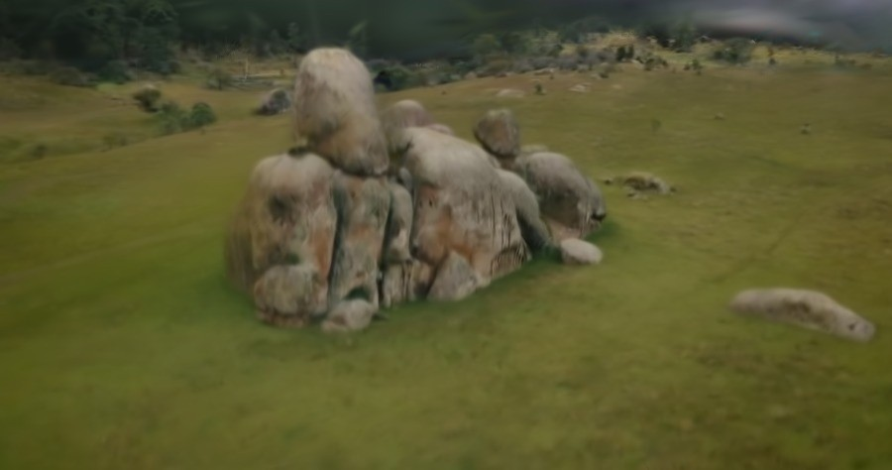
RECONSTRUCTED SURFACE, RENDERED FROM THE MODEL
PROBLEM STATEMENT SIH26158 · IDEA SUBMISSION
Single-Pass Drone Video to Accurate 3D Model Generation System
Drone3D turns one pass of drone or phone video, GPS and flight metadata into a georeferenced point cloud, mesh and six standard formats - and reports, point by point, what it actually measured.
PROBLEM STATEMENT ID
SIH26158
THEME
287/287
cameras registered in one geo-constrained solve
PS CATEGORY - SOFTWARE / HARDWARE
TEAM ID
1.57 M
measured points written with a real CRS
6
official output formats from a single run
TEAM NAME (REGISTERED ON SIH PORTAL)
Runs end to end on a 6 GB laptop. 663 CPU tests green.

Slide 2
PROPOSED SOLUTION
Idea title: Drone3D · what we build, why it answers the brief, and what makes it different
Drone3D - one video, one solve, one coordinate system: a georeferenced point cloud and mesh that reports which parts it measured, which it inferred weakly, and never saw.
DETAILED EXPLANATION
Ingest video + GPS + flight metadata (GPX, DJI .srt, CSV)
Select sharp, well-spaced frames by blur, compression and camera baseline
Solve poses and depth with COLMAP; optional Gaussian-splat view
Align to WGS84/UTM, export six formats, a QC ledger and a browser viewer
HOW IT ADDRESSES THE PROBLEM
Limited angles and blur: quality-scored frames, never every frame
Moving objects: epipolar motion veto, no labels or manual masking
GPS noise: priors inside the solve, RANSAC Sim(3), EGM96 vertical datum
Speed: windowed submaps and cost-tiered dense profiles
INNOVATION AND UNIQUENESS
GNSS used as a constraint in bundle adjustment, not a stamp after it
Per-point evidence and occlusion-checked support - a model you can audit
The same measured surface becomes a walkable, navigable scene in the browser
Single-pass video, no LiDAR, no GCP flight, no per-site calibration
OFFICIAL CONTRACT WE DESIGN AGAINST (SIH26158 DESIRED OUTPUT)
WHAT WE DELIBERATELY DO NOT DO
No generative inpainting of unseen faces: gaps stay flagged, not fabricated
No splat-first output: splats are an optional view, the measured cloud is the product
No scale assumed from speed x altitude
No black-box result: every run leaves an evidence and refusal ledger
≤ 1 m
spatial accuracy
< 15 min
for a 10-minute video
6 formats
OBJ · PLY · LAS · GeoTIFF · GLB · FBX
Entire scene
visible coverage, web or desktop viewer
Scoring weights: Accuracy 30 · Completeness 20 · Speed 20 · Innovation 15 · Scalability 10 · UI 5. Accuracy, completeness and speed are 70% of the marks - all three are geometry, none is a render.
SIH26158 · Single-Pass Drone Video to Accurate 3D Model Generation System
02 / 06

Slide 3
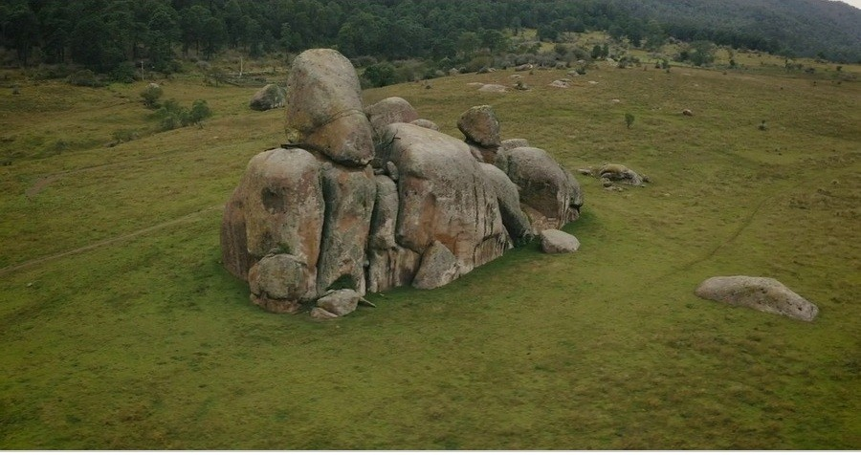
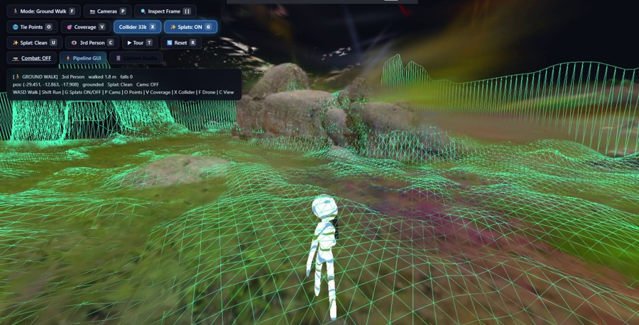
TECHNICAL APPROACH
Six-stage run path, CPU-orchestrated, GPU only where marked · every stage carries a measured figure from a real run
METHODOLOGY AND PROCESS FOR IMPLEMENTATION
01 Ingest and validate
GPX · DJI .srt · CSV telemetry parser
GNSS quality gates reject drift before any solve
Camera model and intrinsics resolved per rig
02 Keyframe selection
extract_keyframes + baseline-aware picker
Blur and compression scored, weak frames dropped
288 candidate frames reduced to 68 solves
03 Geo-constrained SfM
COLMAP 4.1.1 pose_prior_mapper · GPU
GPS positions enter bundle adjustment as priors
RANSAC Sim(3); straight-line tracks refused
3 telemetry sources · run refuses without GPS
mean parallax 5.5° → 20.8°
287/287 cameras registered
04 Motion veto
survey_dynamics · epipolar inconsistency
Second gated match pass, kept only if strictly better
No segmentation model and no manual masks
05 Dense geometry to mesh
patch_match_stereo → fusion → Poisson · GPU
Confidence-filtered depth, three cost profiles
2.33x faster stereo at P/R 0.95 / 0.94
06 Georeference and deliver
survey_georef + survey_deliver ledger
LAS and GeoTIFF re-read by GDAL / laspy or deleted
Measured, weak and unobserved kept separate
4.85% pixels vetoed · error -7.8%
1.57 M measured points
EPSG:32643 · six official formats
TECHNOLOGIES USED
WORKING PROTOTYPE: REAL OUTPUTS FROM A RUN
Language and runtime Python 3.12 pipeline · Node 18 · OpenCV · ffmpeg · PyTorch 2.4.1+cu124
Reconstruction COLMAP 4.1.1 (mapper, patch-match stereo, Poisson mesher) · gsplat 1.5.3 for the optional splat view
Geometry and GIS PDAL · GDAL / Rasterio · pyproj · LAS 1.4 · GeoTIFF · EGM96 geoid for the vertical datum
Delivery and viewer OBJ · PLY · GLB/glTF · FBX · PlayCanvas with recast-navigation · Next.js mission console
Hardware Laptop RTX 3050 6 GB (measured) · RTX 4090 / A100 burst · Jetson Orin field target
Held-out frame from the source video
The same surface as a walkable collider
SIH26158 · Single-Pass Drone Video to Accurate 3D Model Generation System
03 / 06

Slide 4
FEASIBILITY AND VIABILITY
What already runs today, the four risks that can lose the score, and how each one is closed
ANALYSIS OF FEASIBILITY - EVIDENCE FROM COMPLETED RUNS
End-to-end
one command, CPU-orchestrated, GPU explicit and gated
287/287 cameras
1.57 M points delivered with EPSG:32643 on a real take
663 CPU tests
green; every LAS and GeoTIFF re-read by laspy and GDAL
1 km² / 25.6 s
terrain pass over 3 M points, 100% ground recall
POTENTIAL CHALLENGES AND RISKS → STRATEGIES FOR OVERCOMING THEM
Speed against the 15-minute gate
A 10-minute take implies ~270 keyframes and ~1,800 s of dense work - projected, not yet run.
Cut redundant work, never quality
Baseline-aware thinning 288→68, windowed submaps, stereo ablation already 2.33x faster, splat branch optional.
Absolute accuracy without surveyed control
Consumer GNSS is ±1-3 m; our 1.14 m hold-out was measured against a drifting phone-VIO track.
Independent reference before any accuracy claim
Fit Sim(3) to withheld surveyed checkpoints or RTK on the supplied dataset; EGM96 geoid for height; publish residuals per point.
Completeness, and geometry that is not really there
Occluded and textureless faces stay empty; in one scene cloud and fog rebuilt as solid ground (28% of it).
Report the gap instead of inventing the surface
Visibility ray-check plus per-point evidence, sky and cloud cull, measured / weak / unobserved kept as three separate classes.
Data, licensing and scope
No compliant 1080p drone+GPS clip yet; VGGT-family terms bar defence use; UrbanScene3D and ETH3D are non-commercial.
Clean dependency stack, own the flight data
BSD / Apache / MIT runtime only (COLMAP, gsplat, PDAL, GDAL, Open3D); own controlled recording; semantics behind a swappable plug-in.
VALIDATION PLAN BEFORE SUBMISSION
1 Bench on the dataset supplied at the event
2 Withhold surveyed checkpoints from the solve
3 Timed 10-minute run, all six formats written
4 Third-party CRS and format audit of the output
SIH26158 · Single-Pass Drone Video to Accurate 3D Model Generation System
04 / 06

Slide 5
IMPACT AND BENEFITS
Who the output serves, what changes for them, and how the system scales after the hackathon
POTENTIAL IMPACT ON THE TARGET AUDIENCE
AGAINST THE STATUS QUO
Disaster response
a usable model of a collapsed block before teams move in
Border and field rehearsal
route and terrain check from one ordinary flight
Construction progress
repeat capture, measurable against the design model
LiDAR survey: crew, kit, days per site
Photogrammetry suites: multi-pass, per-seat licence, nothing walkable
Manual CAD: weeks of draughting per structure
Drone3D: one pass, one solve, six formats, audited per point
Utility corridors
georeferenced assets without a crew on the ground
Urban planning and GIS
outputs that drop into QGIS, CAD and web maps
Heritage and archaeology
a metric record of a site from one phone
BENEFITS OF THE SOLUTION
SOCIAL
One operator replaces a survey crew
Decisions on a metric model, not a shaky video
Auditable: the model states what it never saw
ECONOMIC
No LiDAR purchase, no per-seat photogrammetry licence
Laptop-class hardware: 6 GB measured, 443 MiB dense peak
Open formats remove re-modelling cost downstream
ENVIRONMENTAL
No ground crew driven into fragile or unsafe terrain
Cheap repeat capture replaces one-off heavy surveys
Open formats keep public data readable for decades
SCALABILITY AND DEPLOYMENT
Tiled and bounded
windowed submaps keep large scenes inside 6 GB
Burst to cloud
same stages on 4090 or A100, backend switch only
Edge field target
Jetson Orin class deployment on the roadmap
No licence wall
browser viewer, open formats, no per-seat cost
Measured reach today: a 1 km² terrain pass over 3 M points in 25.6 s, and a 65.3 m walk over the reconstructed collider at 16/16 waypoints with no falls.
SIH26158 · Single-Pass Drone Video to Accurate 3D Model Generation System
05 / 06

Slide 6
RESEARCH AND REFERENCES
What we built on, what we tested against, and what we chose not to use
RECONSTRUCTION AND SURFACE
COLMAP - Schönberger & Frahm, CVPR 2016; position priors, ECEF/ENU, RANSAC alignment [S7, S8]
Poisson surface reconstruction - COLMAP poisson_mesher
3D Gaussian Splatting - Kerbl et al., SIGGRAPH 2023
gsplat 1.5.3 - Apache-2.0 clean-room rasterizer and 2DGS trainer
2D Gaussian Splatting - arXiv:2403.17888 [S29]
DPVO / DPV-SLAM - arXiv:2408.01654 [S26]
Open3D TSDF fusion - MIT mesh fallback
GEOREFERENCING AND FORMATS
PDAL LAS writer - LAS/LAZ, CRS, scale and offset [S1]
GDAL GeoTIFF driver - CRS, nodata, masks [S2]
Rasterio georeferencing - pixel-to-world transform [S3]
PDAL GDAL raster writer - point-to-raster DSM [S4]
OpenDroneMap geolocation format - per-image positions [S9]
GTSAM GPS and IMU factors - optional smoothing [S11-S13]
pyproj - WGS84 / UTM / ENU transforms, EGM96 geoid
LEARNED ALTERNATIVES SURVEYED
VGGT (CVPR 2025) and VGGT-Long (ICRA 2026) [S23, S24] - acceptable-use policy bars defence
MapAnything-apache (Meta) - metric feed-forward geometry
Pi3 (ICLR 2026, BSD-3) - defence-clean geometry core
Depth Anything 3 + DA3-Streaming - Apache weight variants, long video under 12 GB
MASt3R-SLAM [S25]; Gaussian Opacity Fields, 24.2 min/scene on A100 [S31]
SAM 2 [S33], LightGlue [S20], ALIKED [S21]
Verdict: not shipped for VRAM and licence, not for maturity
BENCHMARKS AND OUR OWN RECORD
SIH26158 official brief, printed pages 37-39 [P0]
UrbanScene3D - LiDAR reference, non-commercial [S14, S15]
ETH3D high-res multi-view - CC BY-NC-SA 4.0 [S16-S19]
01 Research and Technology Survey; 02 System Architecture and Pipeline Design
06 Splat Completion Research; 07 Video-to-3D Alternatives 2026; 08 Splat Cleaning and Generation
09 SIH26158 Evaluation and Improvement Report, 22 Sep 2026
docs/readiness 01-05 - findings, wiring ledger, claims
WHY COLMAP, AND NOT A FEED-FORWARD MODEL
Feed-forward geometry needs cloud-scale VRAM for a long take, or returns scene shape without scene scale.
COLMAP has no VRAM floor, so the same run completes on the 6 GB laptop we already own.
Mesh-from-splats projects (SuGaR, PGSR, GOF) are non-commercial; gsplat's Apache 2DGS trainer is not.
STACK USABLE IN A DEFENCE SCOPE
COLMAP (BSD) · gsplat (Apache-2.0) · Open3D (MIT) · PDAL (BSD) · GDAL (MIT) · pyproj (BSD) · Pi3 (BSD-3) · DPVO (MIT)
VGGT weights are excluded by acceptable-use policy, not by quality.
SIH26158 · Single-Pass Drone Video to Accurate 3D Model Generation System
06 / 06

