Slide 1
IBM University Engagement Project Submission
“Exploring the Power of Agentic AI with IBM Granite and LangFlow”

Slide 2

Project Name – कारीGAR (by Team Thekedaars)
Project Title – Smart Migrant Labor Welfare &
Skill Mapping Platform
Domain of Project – Social Governance
Student Name | Recent Passport Photo | Email ID | Mobile number [WhatsApp]
Prasiddhi Mishra
mishraprasiddhi105@gmail.com
+91 7041441566

Slide 3
Problem Statement
Problem Statement : Karigar App
The Challenge
Gujarat hosts a massive interstate migrant workforce across construction, textiles, diamond polishing, and chemical processing.
Many workers lack access to government welfare schemes, fair wage protection, and safe grievance mechanisms.
This systemic gap leaves them vulnerable to severe exploitation, debt traps, and hazardous working conditions.
The Objective
Build an Agentic AI Platform (Karigar App) to empower migrant laborers through:
Skill & Location Mapping: Automatically extract technical skills and geographic clusters from unstructured worker speech/text.
Welfare Eligibility: Match worker profiles directly to central and state welfare schemes (e.g., BOCW, PM-SYM).
Wage Fairness & Grievance Reporting: Detect illegal wage withholdings and flag critical occupational health and safety hazards in real-time.
Labor Welfare Command Dashboard: Provide real-time surveillance and dispatch metrics for authorities and NGOs.

Slide 4
Proposed Solution
Proposed Solution : Agentic AI Ecosystem
Overview
The proposed solution is a multi-agent AI system built using IBM Granite LLM, IBM Cloudant, and Langflow / IBM Bob orchestration to safeguard migrant laborers.
Our 5 Specialized Agents:
Migrant Skill & Location Mapping Agent: Extracts artisan skills and location parameters from natural language inputs.
Welfare Scheme Eligibility Agent: Evaluates worker eligibility against state and national labor schemes.
Wage Fairness Monitoring Agent: Detects wage theft, excessive working hours, and underpayment anomalies against statutory standards.
Grievance & Safety Reporting Agent: Scans for high-risk safety hazards (e.g., silicosis risks, toxic exposure) and triggers severity ratings (Critical, High, Medium).
Labor Welfare Dashboard Agent: Aggregates real-time intelligence into a SaaS Command Center for rapid administrative intervention.

Slide 5
Technology & Components Used
The Technology & Components Used are :
Core Infrastructure:
IBM Granite Model (Granite-4.0-8B-Instruct): Powered our NLP translation, severity categorization, and scheme matching.
IBM Cloudant (NoSQL Document Database): Used to store dynamic JSON worker profiles, incident records, and schema-less data.
IBM watsonx.ai: Provided the core AI infrastructure, API management, and governance for our agentic workflows.
Orchestration & Development:
IBM Bob Platform: Used for rapid troubleshooting, visual UI generation, and architectural design.
FastAPI & Python: Handled our backend routing and AI API connections.
Render Cloud: Hosted our live, unblockable production server.
User Interfaces (Inputs/Outputs):
Flutter (Mobile App): Handled the chat/form input for workers to report grievances.
Tailwind CSS (Command Center): The live SaaS dashboard that outputs the structured AI responses and risk levels.

Slide 6
AI System Components
AI System Components (Custom Orchestration)
(Note: We opted for custom Python/FastAPI orchestration over visual builders to achieve lower latency and enterprise scalability).
1) Mobile Input Interface: Flutter-based UI where users enter their grievances, profile details, and evidence.
2) Custom API Orchestrator (FastAPI): Our Python backend that receives the data and dynamically routes it to the specific AI agents.
3) IBM watsonx AI Agent: Processes the payload using IBM Granite-4.0-8B-Instruct to generate personalized safety insights and welfare recommendations.
4) Cloudant Database Component: Stores and retrieves dynamic user profiles, incident logs, and structured datasets for tracking.
5) Web Dashboard Output: Displays the AI-generated structured JSON responses (risk levels, scheme matches) in a real-time command center.

Slide 7

Workflow & Architecture Blueprint
The Pipeline:
Autonomous Multi-Agent Collaboration: Rather than operating as a passive chatbot, specialized agents perform dedicated tasks (skill indexing, wage auditing, safety hazard analysis) and collaborate asynchronously.
Unstructured-to-Structured Intelligence: Converts informal, colloquial Hindi/Gujarati voice statements into actionable, prioritized JSON data points.
Real-Time Data Sync: The Flutter Mobile App securely sends data to the Python/FastAPI orchestrator, which interacts with IBM watsonx.ai and logs directly to IBM Cloudant.

Slide 8
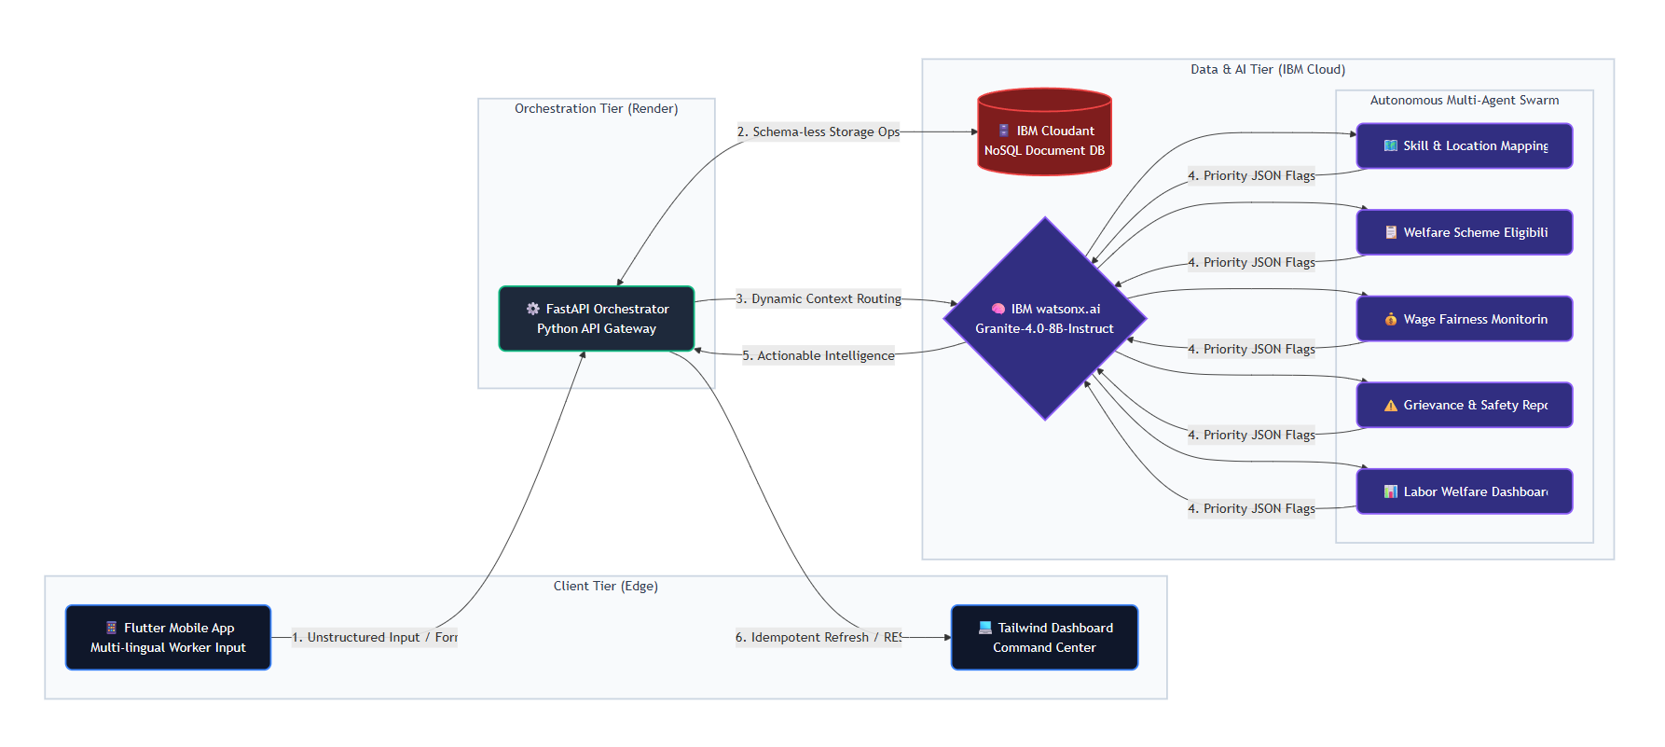
Architecture Blueprint

Slide 9

Role of Agentic AI in the Solution
Role of Agentic AI in Karigar App
Autonomous Multi-Agent Collaboration: Rather than operating as a passive chatbot, specialized agents perform dedicated tasks (skill indexing, wage auditing, safety hazard analysis) and collaborate asynchronously.
Unstructured-to-Structured Intelligence: Converts informal, colloquial Hindi/Gujarati voice statements into actionable, prioritized JSON data points.
Context-Aware Decision Making: Automatically cross-references dynamic worker symptoms (e.g., dust inhalation) with specific state welfare policies (e.g., Pneumoconiosis relief).
Proactive Risk Intervention: Directly escalates critical life-safety threats (e.g., mine flooding, boiler leaks) to the Command Center without requiring manual triage.

Slide 10
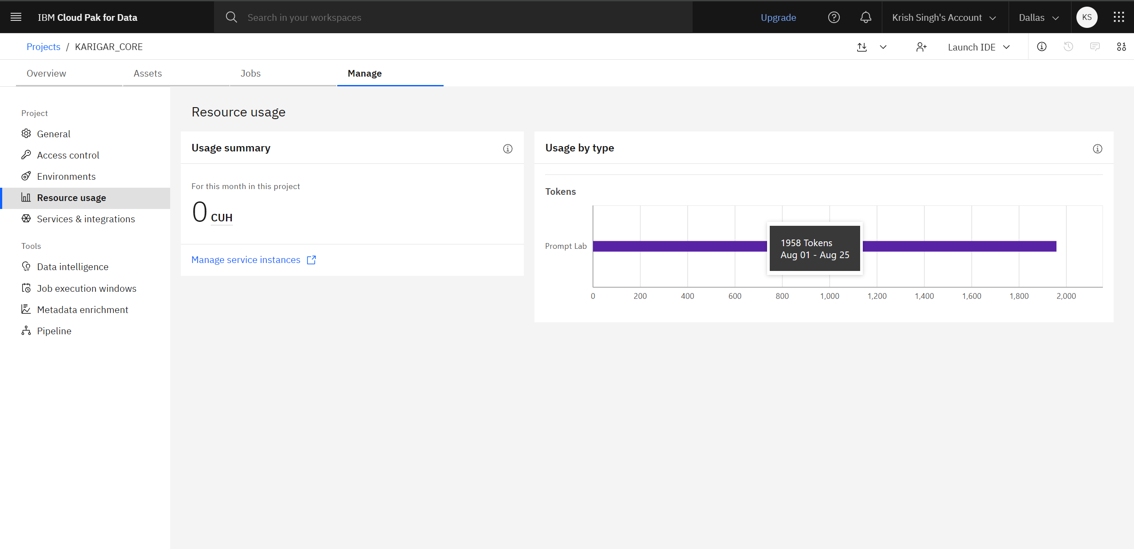
Token Usage on IBM Cloud
Token Metric Summary: Real-time extraction completed within optimal context window limits (~1,958 tokens per full grievance lifecycle audit).

Slide 11
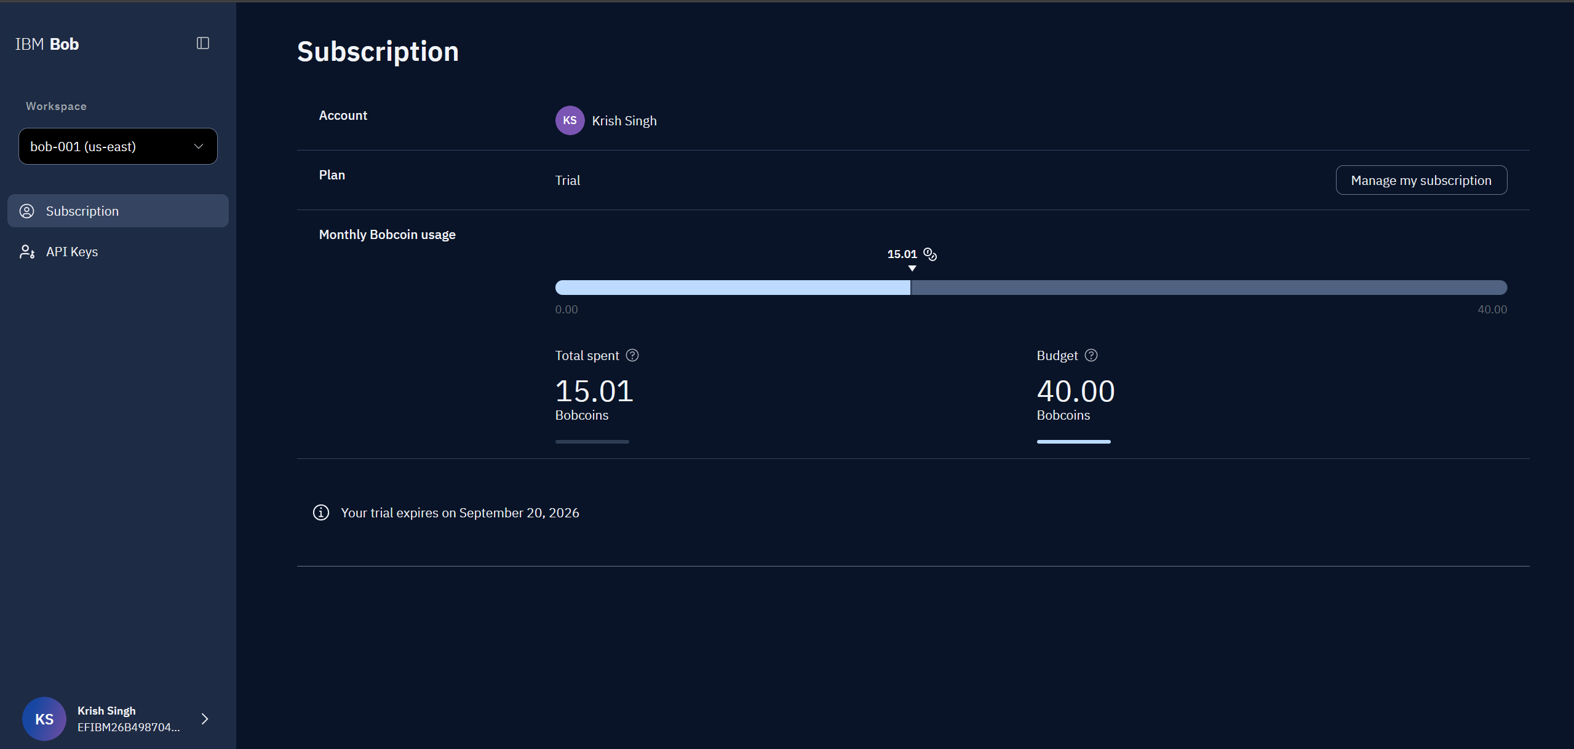
Token Usage on IBM Bob

Slide 12

Novelty and Uniqueness
.
Voice-First & Low Literacy Design: Enables informal workers to speak freely without navigating complex government web forms.
Agentic Multi-Layer Analysis: Simultaneously evaluates skills, wage compliance, and physical safety in a single pass.
Enterprise Command Center: Bridges vulnerable workers directly to district authorities via an interactive, real-time surveillance dashboard.
Schema-Less Scalability: Powered by IBM Cloudant, allowing dynamic violation tagging and multi-state expansion with zero schema friction.
Enterprise-Ready Governance: Built natively on IBM watsonx.ai and IBM Granite models for trusted and governed AI processing

Slide 13
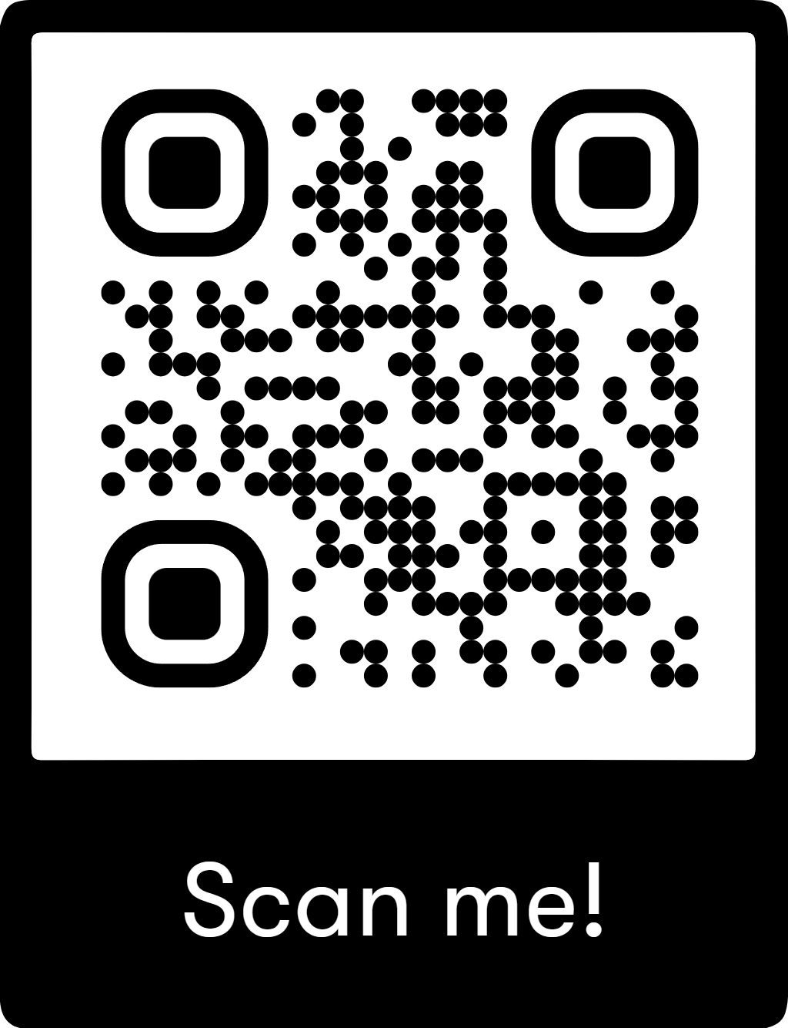
System Access & Repository
Links
Github Repository – [https://github.com/krish-7567/team-thekedaars-core]
Live Command Center Dashboard – [https://team-thekedaars-karigar.onrender.com/dashboard]
System Status: Production Live — Powered by IBM watsonx.ai & Cloudant NoSQL.
Scan the QR to Download कारीGAR Android APK (Release Version)

Slide 14
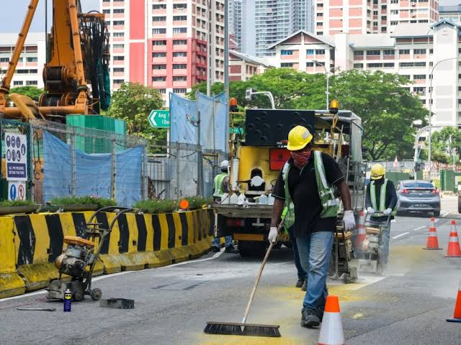
Future Scope
WhatsApp & IVR Voice Integration: Enable direct grievance logging via WhatsApp bots and toll-free telephone IVR for feature phones.
National e-Shram API Sync: Bi-directional sync with the Ministry of Labour & Employment database for instant identity verification.
Automated Legal & Medical Aid Dispatch: Direct automated alerting to district legal service authorities and mobile health clinics in industrial zones.

Slide 15
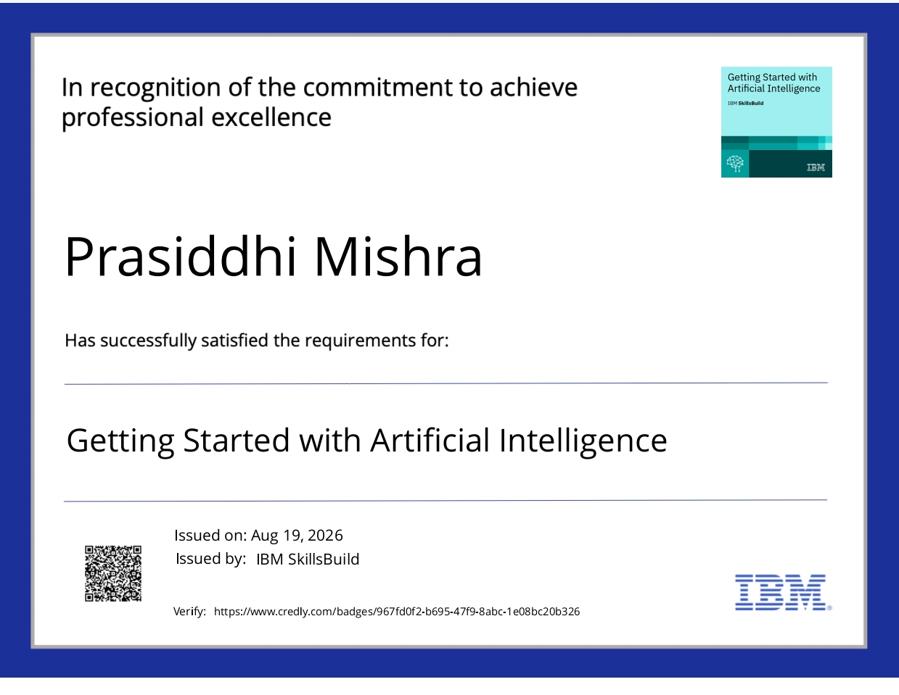
Certificates Earned

Slide 16
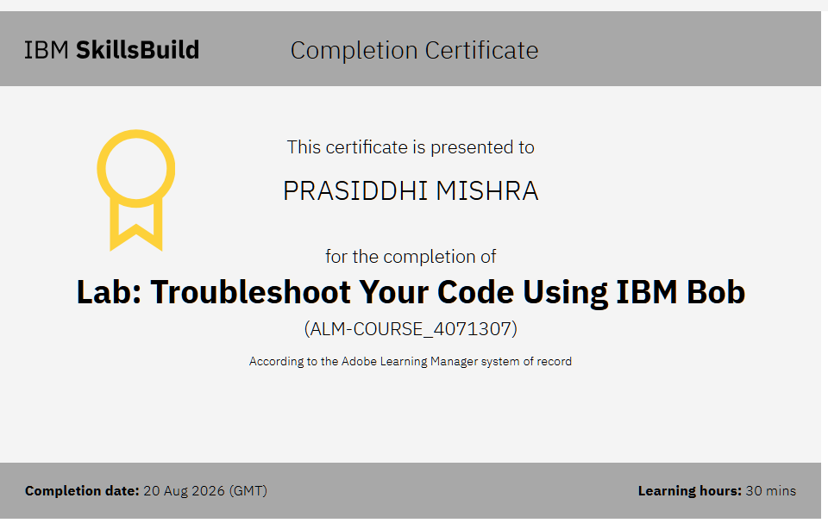
Certificates Earned

Slide 17


