Slide 1
Medical Recommendation System
Presented By:
Sharada Luitel
Krish Kumar Shrestha

Slide 2
Contents
Introduction
Problem
Objective
Methodology
Scope
Requirements
Algorithms
Expected outcome

Slide 3
Introduction
There is an increased use of technology in the healthcare sector from wearables, prescription suggesting tools, etc. They decrease the occurrence of human mistakes and the amount of mental burden on the healthcare staff and provide more precise and personalized treatment.

Slide 4
Problem
Limited Access to Healthcare personnels
Shortage of Qualified Practitioners
Urban-Rural Disparity
Economic Diversity

Slide 5
Objective
Enhance Prescribing Accuracy
Improve Patient Safety
Support Resource-Limited Areas
Increase Treatment Efficiency

Slide 6
Methodology(Feasibility study)
Technical Feasibility
The technical feasibility to develop a recommendation system that matches the medicine that can be prescribed for patients using Python, Django and machine learning is possible.

Slide 7
Methodology
Operational Feasibility
Documentation & Community
Developer Expertise
User Training
User-Friendly
Maintenance
Stability

Slide 8
scope
Medicine suggestion
Diet suggestion
Workout suggestion
Provide Precaution

Slide 9
limitation
Limited symptoms and disease
Data quality and availability
User input

Slide 10
Functional Requirements
User registration and authentication
Login option for the registered user
Search for symptoms
Get suggestions according to the outcome

Slide 11
Non-Functional Requirements
Easy to navigate user interface
Reliable and quick responses
Work on every device

Slide 12
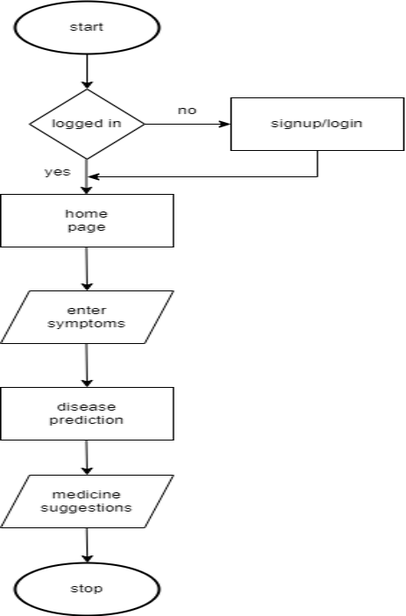
Flowchart

Slide 13
Algorithms
Support Vector Classifier
Random forest
K nearest Neighbor
MultinomialNB

Slide 14
Support vector classification
Support Vector Classification (SVC) is a machine learning algorithm used for binary and multi-class classification tasks. It works by finding the optimal hyperplane that maximizes the margin between different classes in the feature space.
Hyperplane: Finds the optimal boundary (hyperplane) that separates classes in the feature space.
Support Vectors: Data points closest to the hyperplane, crucial for determining the boundary.
Margin: Maximizes the distance between the hyperplane and the support vectors.

Slide 15
Dataset
Source:
Medicine recommendation dataset available on Kaggle.
“https://www.kaggle.com/datasets/noorsaeed/medicine-recommendation-system-dataset/data”
Content:
Symptoms: 132 symptoms
Diseases: 41 diseases

Slide 16
Expected outcomes
Improved Prescription Accuracy
Personalized Medication Recommendations
Enhanced Patient Safety
Cost Savings

Slide 17
Thank You !!!

