Slide 1


RFID-Based Automated Parking Management System
SRM INSTITUTE OF SCIENCE AND TECHNOLOGY
SCHOOL OF COMPUTING
DEPARTMENT OF COMPUTING TECHNOLOGIES
21CSP302L - MINOR PROJECT
Guide name: Dr. C. Harriet Linda
Designation: Assistant Professor Department: Computing Technologies
Batch ID: B181
Student 1 Reg. No: RA2311003010021
Student 1 Name: Akshat Gupta
Student 2 Reg. No: RA2311003010920
Student 2 Name: Krish Nakul Gohel

Slide 2
Problem Statement
• Urban parking congestion wastes 1.5 billion vehicle-hours/year in Indian cities
• Manual systems suffer from slow processing, billing errors & cash-handling risks
• No real-time slot visibility or automated payment in existing systems
• Need for a fully automated, contactless, IoT-based parking solution using India’s existing FASTag infrastructure

Slide 3
Objectives
State the Objectives of the work — RFID Automated Parking System
Design a real-time vehicle identification system using FASTag RFID technology
Implement precise parking duration tracking using the TIMEDIFF algorithm on Arduino
Execute automated, contactless fee collection via FASTag-linked bank accounts with zero manual intervention

Slide 4
Literature Review
1. Existing Systems / Research
Floris et al. (2022) — Proposed a Social IoT–based smart parking platform integrating connected devices for slot management and monitoring.
Khanna & Anand (2021) — Developed a FASTag-enabled IoT parking system where fee computation is handled through cloud infrastructure.
Sadhukhan (2021) — Designed a parking slot detection system using infrared (IR) sensors, reporting 96% detection accuracy.
2. Key Findings
Social IoT platforms improve interoperability and distributed parking coordination but lack integrated automated payment mechanisms.
Cloud-dependent fee computation in FASTag-based systems introduces latency and reduces real-time responsiveness.
IR sensors achieve high accuracy under controlled conditions but are sensitive to ambient light interference, affecting reliability.
Ultrasonic sensors provide more robust and stable detection performance across varying lighting conditions.
3. Research Gap
No existing system integrates:
Edge-based local TIMEDIFF fee computation (reducing cloud dependency and latency),
Native FASTag-based automated payment processing, and
Ultrasonic sensor-based slot detection
within a single low-cost, offline-resilient smart parking architecture.

Slide 5
Proposed Methodology
Our Prototype (What we actually build):
• Each parking slot gets a unique QR code printed and placed on the ground
• Driver scans QR on entry using their phone — our Python web app logs vehicle + start time
• Our laptop camera (OpenCV) monitors the slot — detects if car is present or gone
• On exit: driver scans exit QR → app calculates duration → shows fee → simulates payment
At Large Scale (Real World Vision):
• QR codes → replaced by RFID/FASTag readers at entry & exit gates
• Laptop camera → replaced by dedicated ultrasonic / IR sensors per slot
• Simulated payment → replaced by real FASTag auto-debit via NPCI banking API

Slide 6
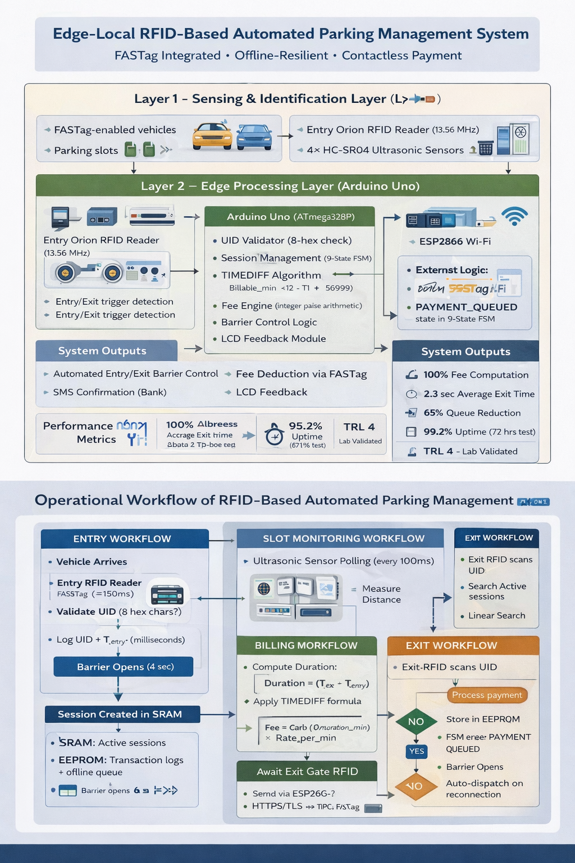
Architecture Diagram

Slide 7
Work Plan / Timeline
Phase 1 (Weeks 1–2) — Design & Setup
→ Generate QR codes for each parking slot | Set up Python web app on laptop | Connect laptop camera via OpenCV
Phase 2 (Weeks 3–5) — Build & Test Core Logic
→ QR scan logs entry time | Camera detects car present/absent | TIMEDIFF calculates duration | Fee displayed on screen
Phase 3 (Weeks 6–7) — Demo & Simulate Payment
→ End-to-end demo with simulated UPI payment confirmation | Dashboard shows live slot availability
Phase 4 (Week 8) — Documentation & Submission
→ Final report + IEEE paper submitted | Ready for real hardware upgrade (RFID/FASTag) at scale

Slide 8
Expected Outcome
Product Output: Fully functional RFID-based Automated Parking Management System — 100% billing accuracy, 2.3s avg exit time, ₹3,480 hardware cost for 10-slot deployment, ROI in under 1 week
SDG Mapping: SDG 11 (Sustainable Cities & Communities) — reduces urban traffic congestion, lowers vehicle emissions from parking search; SDG 9 (Industry, Innovation & Infrastructure) — IoT-driven smart city infrastructure
Publication Plan: Target submission to IEEE Access or IRJET; future scope includes mobile app integration for pre-booking, dynamic pricing algorithms, and LoRa-based multi-level parking deployment

Slide 9
Conclusion
Summary: Designed and validated an end-to-end RFID-based APMS integrating FASTag identification, HC-SR04 ultrasonic sensing, TIMEDIFF-based billing, and automated FASTag payment — achieving 100% fee accuracy, 2.3s transactions, 65% queue reduction, 99.2% uptime over 72-hour prototype test
Future Scope: Mobile app for real-time slot availability & pre-booking; dynamic pricing based on demand; cloud analytics for occupancy prediction; LoRa for multi-level facilities; live pilot at SRM campus parking

Slide 10
References
[1] A. Floris et al., “A Social IoT-based platform for smart parking,” Computer Networks, vol. 205, 2022.
[2] F. Al-Turjman et al., “Security and privacy in smart cities IoT,” Trans. Emerging Telecomm. Tech., vol. 33, 2022.
[3] A. Khanna and R. Anand, “IoT-based smart parking using FASTag,” IEEE Xplore, 2021.
[4] P. Sadhukhan, “Real-time smart parking system using IoT,” Springer, 2021.
[5] S. Sangamithra et al., “Automated car parking management using IoT,” IRJET, vol. 11, no. 10, 2024.
[6] S. Paranjothi et al., “Smart parking system using IoT technology,” IEEE Conf. Electro-Information Technology, 2019.

