Slide 1
Federated Fine-Tuning of Large Language Models via LoRA Adapters: A Flower-Based Simulation Study
By Team 16: Krish Patel and Ayush Alpesh Gupta

Slide 2
Motivation and Problem Statement
Fine-tuning LLMs usually requires centralizing sensitive domain data
In healthcare, finance, and legal settings, data sharing is restricted
Federated learning solves this by keeping data local
But direct FL on LLMs is difficult because:
full-model communication is too expensive
full-model fine-tuning is too memory intensive
Our question: can LoRA + QLoRA + Flower make federated LLM fine-tuning practical?

Slide 3
Research Objectives
Build a reproducible federated fine-tuning pipeline for an LLM
Use adapter-based tuning instead of full-model updates
Measure:
convergence behavior
fairness across clients
communication cost
token-level performance
Compare four settings:
IID baseline
non-IID baseline
higher client fraction
more rounds

Slide 4
Background: Federated Learning
Central server + multiple clients
Each client trains locally on private data
Clients send updates, not raw examples
Server aggregates updates using FedAvg
Standard round:
server broadcasts current parameters
selected clients train locally
server aggregates updates

Slide 5
Background: Why LoRA and QLoRA
LoRA freezes the pretrained model and trains low-rank adapter matrices
Instead of updating full weight matrix 𝑊 LoRA learns a low-rank update
Benefits:
fewer trainable parameters
lower communication
lower memory use
QLoRA adds 4-bit quantization to reduce base-model memory further

Slide 6
System Pipeline
Dataset loaded and formatted into instruction-style prompts
Data partitioned across 8 simulated clients
Base model: Phi-2 loaded in 4-bit
LoRA adapters attached to attention projections
Flower simulation orchestrates rounds, client selection, and aggregation
Only LoRA adapter weights are exchanged

Slide 7
Model and Training Configuration
Base model: Microsoft Phi-2
Model size: 2.7B parameters
LoRA settings:
rank r=8r = 8r=8
scaling factor α=16\alpha = 16α=16
dropout = 0.05
bias = none
LoRA applied to:
q_proj
k_proj
v_proj
dense
Trainable parameters: 11,796,480
This is 0.42% of full model parameters

Slide 8
Dataset and Client Partitioning
Dataset: Alpaca-GPT4
Original dataset size: about 52,000 instruction examples
Subsample used:
800 training
200 validation
8 simulated clients
Two partition schemes:
IID: roughly uniform random split
Non-IID: grouped by short, long, and code-related responses
Non-IID client sizes ranged from 20 to 261 examples

Slide 9
Experimental Design
Four experiments
IID Baseline
Non-IID Baseline
High Client Fraction
More Rounds

Slide 10
Evaluation Metrics
Training loss
Validation loss
Perplexity = exp⁡(Lval)
Token accuracy
Client validation loss gap
Communication cost
Runtime
Why client loss gap matters
measures fairness / heterogeneity
defined as max client validation loss minus min client validation loss

Slide 11
Main Result Table

Slide 12
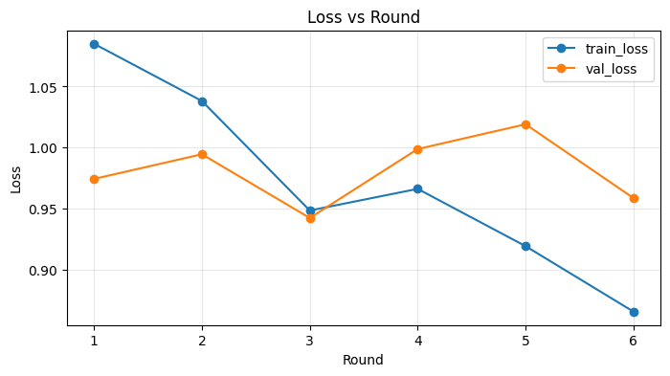
Convergence Behavior
Key observations
Training loss drops from 1.085 to 0.866
Validation loss decreases first, then oscillates
Best validation region occurs early, then rises again
Indicates client drift under heterogeneous local training

Slide 13
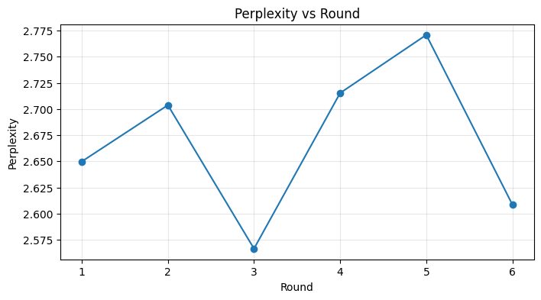
Perplexity Behavior
Key observations
Perplexity ranges from 2.566 to 2.771
Best value occurs around round 3
Later rounds do not guarantee better generalization
Confirms non-monotonic validation dynamics

Slide 14
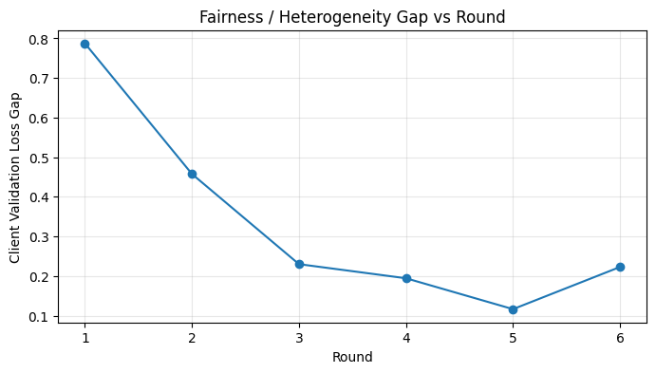
Fairness and Heterogeneity
Key observations
Client loss gap drops from 0.787 to 0.116 by round 5
Slight rebound to 0.223 in round 6
FedAvg helps distribute knowledge across clients
But fairness is not monotonic and depends on sampling

Slide 15
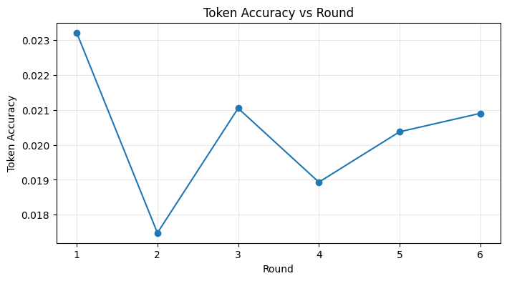
Token Accuracy
Key observations
Accuracy fluctuates in the 1.75% to 2.32% range in the 6-round run
Highest final token accuracy across experiments is 2.49% in More Rounds
Metric is strict because it requires exact next-token match
Useful, but incomplete for instruction-following quality

Slide 16
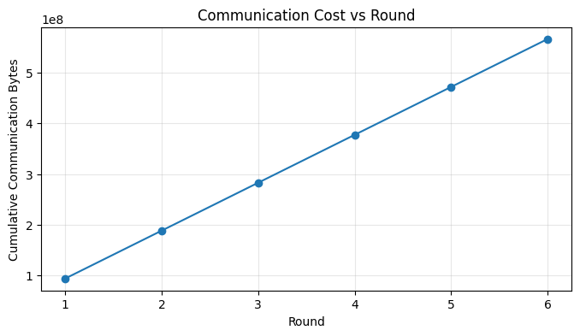
Communication Efficiency
Key observations
Communication grows linearly with rounds
Each round costs ~94 MB
Compared to ~10.8 GB per round for full model
114× reduction per round
Total cost after 6 rounds: ~566 MB

Slide 17
Cross-Experiment Insights
Data heterogeneity
Non-IID raises fairness gap from 0.053 to 0.292
About 5.5× larger than IID
Higher client fraction
Reduces gap from 0.292 to 0.213
Improves token accuracy from 1.91% to 2.21%
More rounds
Lowers training loss to 0.783
Raises token accuracy to 2.49%
But validation/perplexity improve only modestly
Communication cost rises from 540 MB to 900 MB

Slide 18
Discussion, Limitations, and Future Work
Practical implications
LoRA + QLoRA makes FL of LLMs feasible
Communication bottleneck is greatly reduced
Compute bottleneck remains on client side
Limitations
only 800 train / 200 validation examples
6 to 10 rounds only
single local epoch
token accuracy is limited as a quality metric
Future work
FedProx / SCAFFOLD
personalized adapters
larger datasets
better generation-quality metrics

Slide 19
Questions?

