Slide 1

LOCAL DIFFERENTIAL PRIVACY FOR SAMPLING
By ~ Krish Khadria [22112057]
DSAI, IIT ROORKEE

Slide 2
Table of Contents
Introduction
Method
Concept of Mollifiers
Algorithm
Results
Pros & Cons

Slide 3
Introduction
Local Differential Privacy (LDP) is a privacy protection technique where individuals inject random noise into their data before sharing it.
Unlike traditional methods, LDP decentralizes privacy protection, allowing each individual to safeguard their own data locally.
The core idea is to maintain privacy even in the presence of untrusted data aggregators or servers.
We propose a novel LDP method for sampling, based on a boosting-based density estimation algorithm. The idea is to learn a sampler that can produce synthetic data points from the distribution of each individual, while satisfying LDP.
These samplers can generate synthetic data points that mirror the distribution of the original dataset. Our main contribution lies in a highly efficient mollification algorithm, leveraging the latest advancements in boosted density estimation.

Slide 4
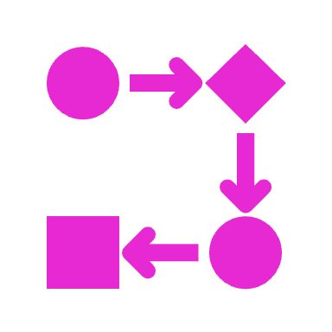
Method
We Formalize the problem in two steps:
We introduce the concept of a ‘mollifier’, which is a set of valid distributions from which one can obtain samples with a desired privacy level.
We define the goal of learning a private sampler as the task of computing the information-geometric projection of a private distribution onto a given mollifier called ‘mollification’.
Information-geometric projection involves transforming one probability distribution into another while minimizing the divergence between them. In this context, it is done with respect to a mollifier, which represents a collection of valid distributions

Slide 5
Concept of Mollifiers
Mollifiers, also known as approximations or smoothing functions, are mathematical functions that are used to "smooth out" or "regularize" other functions. The primary purpose of mollifiers is to construct a sequence of smooth functions that converge to a given function while retaining certain desirable properties.
These are sets of distributions that help protect privacy when sampling from a dataset. An ε-mollifier ensures that for any two distributions in the set, the probability of geting a particular sample is closely related.
Mathematically, a set M is an ε-mollifier if:
This means that the probability of getting a sample x from any distribution in M is close to the probability of getting the same sample from any other distribution in M while maintaining ε privacy.

Slide 6
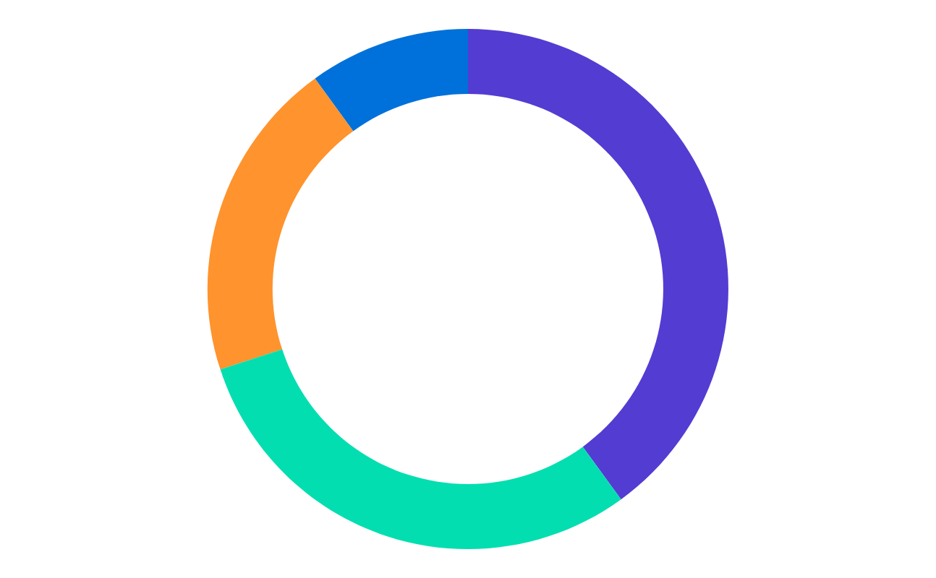
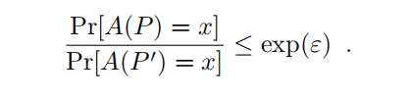

To keep the data private, we have introduced ε private sampler A where ε is used to represent the level of privacy. Sampler A ensures that probability of getting a sample x from two slightly different samples is nearly same.
The sampler takes a dataset and gives a random sample while safeguarding privacy . These samplers can be generated using Mollification . It changes the dataset into a form that’s easier to work with while maintaining the privacy.
The concept of private sampling through mollification involves finding a distribution 𝑃∗ inside a mollifier 𝑀 that minimizes the KL divergence:
The mollification mechanism takes a dataset 𝑃 and gives a sample from the mollified version 𝑃∧. It aims to find the best match to 𝑃 within a mollifier. To make it work, we use Mollified boosted density estimation algorithm.

Slide 7
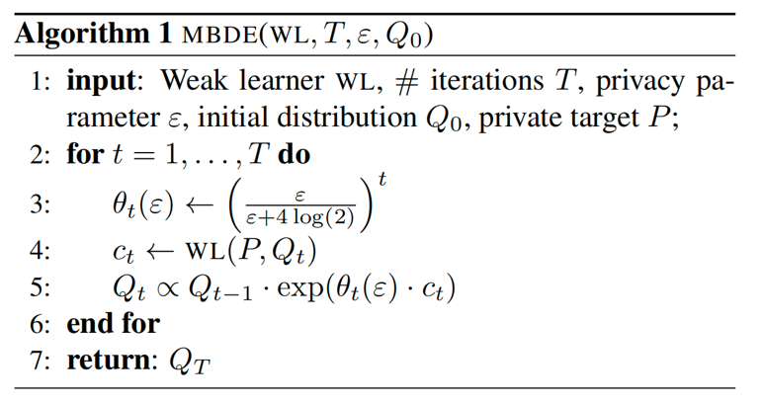
Mollified Boosted Density Estimation (MBDE) Algorithm
MBDE uses a weak learner to distinguish between the target distribution 𝑃 and the current guessed distribution 𝑄𝑡 refining 𝑄𝑡 iteratively for a fixed number of iterations T.
Boosting starts with 𝑄₀ as the initial distribution, often a simple non-informed distribution like a standard Gaussian. The classifier output is then combined into 𝑄𝑡 −1 as part of the iterative process.
This process repeats until t = T and the proposed distribution is Q_{ε} (x; P) = Q_{T}.
With higher boosting iterations, MBDE approaches the information- theoretic limit, which means it smooths out P, ensuring privacy.
This result is novel compared to previous work and highlights the effectiveness of our method in preserving privacy while approximating the true distribution.

Slide 8
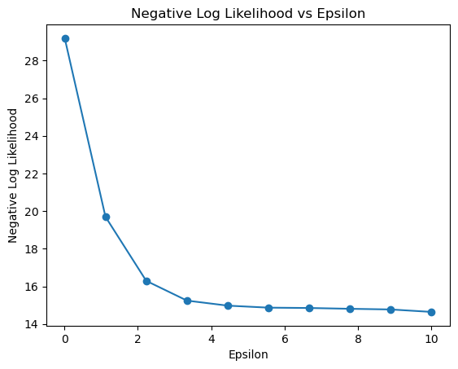
Results
The density models produced by MBDE exhibit smoother and more regular patterns, attributed partly to the choice of Q0 as a standard Gaussian.
Decreasing Negative Log Likelihood (NLL) :
Across all domains, including experiments with random 1D Gaussians, MBDE consistently shows decreasing negative log likelihood (NLL) as ε increases. This shows that MBDE effectively captures all modes of the mixture, leading to sharper improvements for smaller ε values.
Negative log likelihood measures the goodness of fit of the learned distribution Q to the target distribution P.

Slide 9
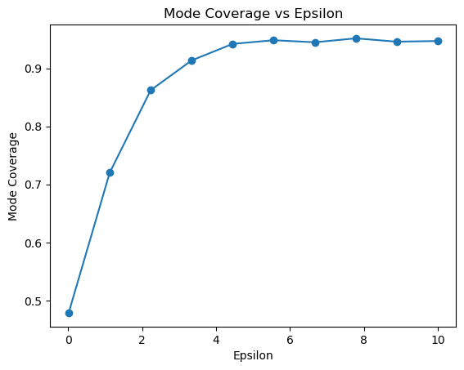
Results
Increasing Mode Coverage:
Mode coverage generally increases with ε for several experiments, for MBDE across all domains.
Mode coverage measures the ability of the algorithm to capture highly dense regions in the target distribution P.
This behavior is governed by the choice of Q₀, which captures a portion of existing modes. As ε increases, MBDE performs better, showing substantial improvement over Q₀.
This trend is also observed in experiments with random 1D Gaussians, where small standard deviations lead to significant stability in MBDE solutions.

Slide 10
ADVANTAGES
Privacy Guarantees: MBDE provides differential privacy guarantees, ensuring that individual data points remain private even during the learning process.
Smoothness with Epsilon: The algorithm smoothly adjusts its behaviour based on the privacy parameter epsilon, allowing for fine-tuning of the trade-off between privacy and utility.
01
04
Mode Capture: MBDE can capture high-density regions or modes of the underlying data distribution, ensuring that important statistical features are preserved in the synthetic data generation process.
Flexibility: The boosting algorithm allows for flexibility in the choice of weak learners, enabling the adaptation to different datasets and learning tasks.
02
03

Slide 11
LIMITATIONS
Computational Complexity: Training a neural network for weak learning can be computationally expensive, especially for large datasets or complex distributions.
Sensitivity to Weak Learners: The performance of MBDE heavily relies on the choice and quality of weak learners. Inadequate weak learners may lead to suboptimal results.
01
02
04
Limited Generalization: Although MBDE aims to capture the underlying distribution accurately, its performance may vary across different datasets and distributions. Generalization to unseen data may be limited.
Tuning Parameters: Requires tuning of parameters such as the number of boosting iterations T and the learning rate, which can impact performance and convergence.
03

Slide 12
Thank You

