Slide 1

Learning Analytics Platform
A Web-Based System for Tracking and Analyzing Student Learning Progress
Group Members
24CE082-Jenil Patel
24CE085-Krish Patel

Slide 2
Introduction
The Learning Analytics Platform is a web-based system that collects and analyzes student learning information across the full academic cycle.
Course & Topic Completion
Track which topics students have studied and completed
Quiz & Assignment Scores
Centralized record of all performance data
Activity Tracking
Log every learning action automatically
Progress Metrics
Overall and topic-wise progress at a glance

Slide 3


Problem Statement
The Core Problem
Student learning data is fragmented and difficult to act on:
Learning data is scattered across multiple platforms
Students cannot easily track their overall progress
Teachers must manually check individual student performance
Weak topics are difficult to identify systematically
Quiz and assignment scores are not centralized
Manual analysis and report generation is time-consuming
Solution Required: A centralized platform to collect, manage, analyze, and visualize student learning data in one place.

Slide 4





Proposed Solution
A single, unified platform for both learning management and learning analytics — end to end.
Create
Learn
Collect
Teacher creates course, topics, materials, quizzes & assignments
Students study materials and complete all activities
System automatically stores all activity and performance data
Analyze
Visualize
Rule-based analytics process the data with predefined formulas
Dashboards display clear insights to students and teachers

Slide 5

Project Objectives
1
Track Progress in Real-Time
Monitor student learning activity as it happens
2
Manage Courses & Materials
Organize topics, PDFs, quizzes, and assignments in one place
3
Rule-Based Performance Analysis
Analyze scores using predefined thresholds
4
Identify Weak & Strong Topics
Automatically flag areas needing improvement
5
Enable Data-Driven Decisions
Empower both students and teachers with actionable insights

Slide 6
Users & Main Modules
👨‍🎓 Student
👨‍🏫 Teacher
👨‍💼 Admin
Access courses and topics
Study learning materials
Attempt quizzes
Submit assignments
View personal progress and performance
Create and manage courses
Add topics and learning materials
Create quizzes and assignments
View student performance analytics
Manage user accounts
Manage courses and system settings

Slide 7
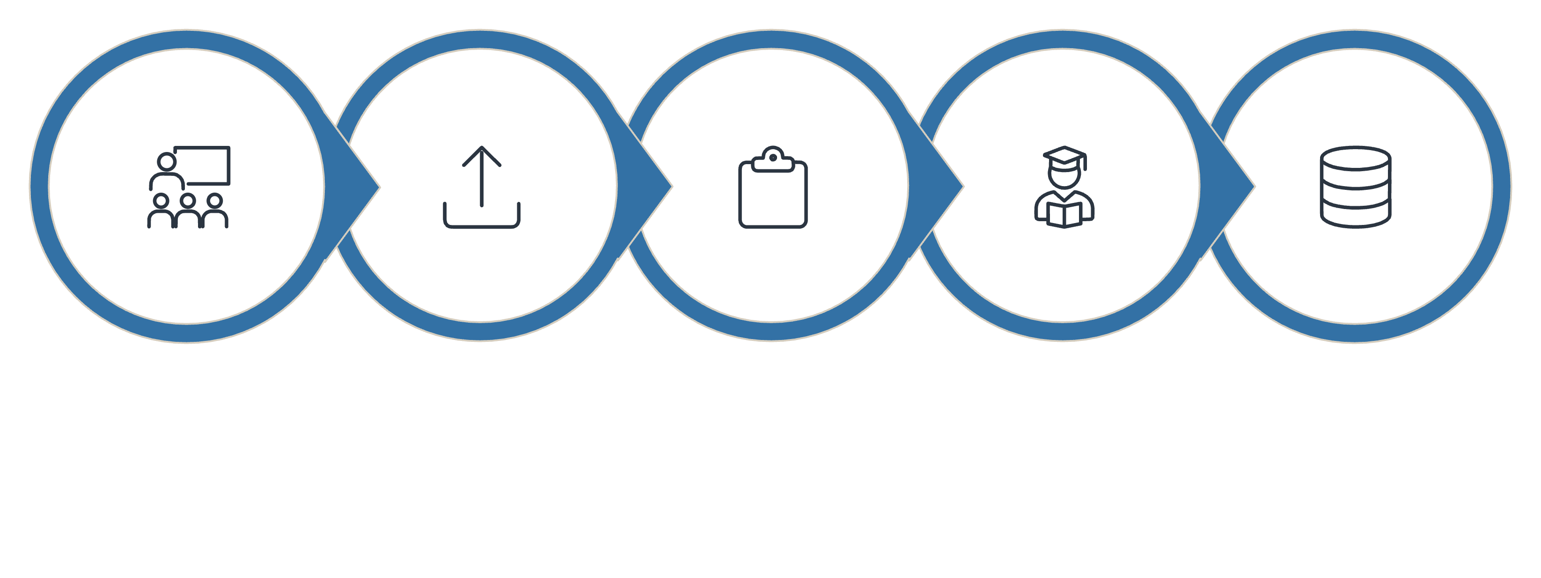
System Workflow
Upload Materials
Configure Assessments
Create Course
Student Activity
Store Data

Slide 8
Learning Analytics Calculations
👨‍🎓 Student Analytics
👨‍🏫 Teacher Analytics
Overall Course Progress %
Class Average Performance
Topic-Wise Progress Tracking
Student-Wise Performance Comparison
Quiz Average Scores
Topic-Wise Class Performance
Assignment Performance Metrics
Quiz & Assignment Completion Rates
Strong & Weak Topic Identification

Slide 9
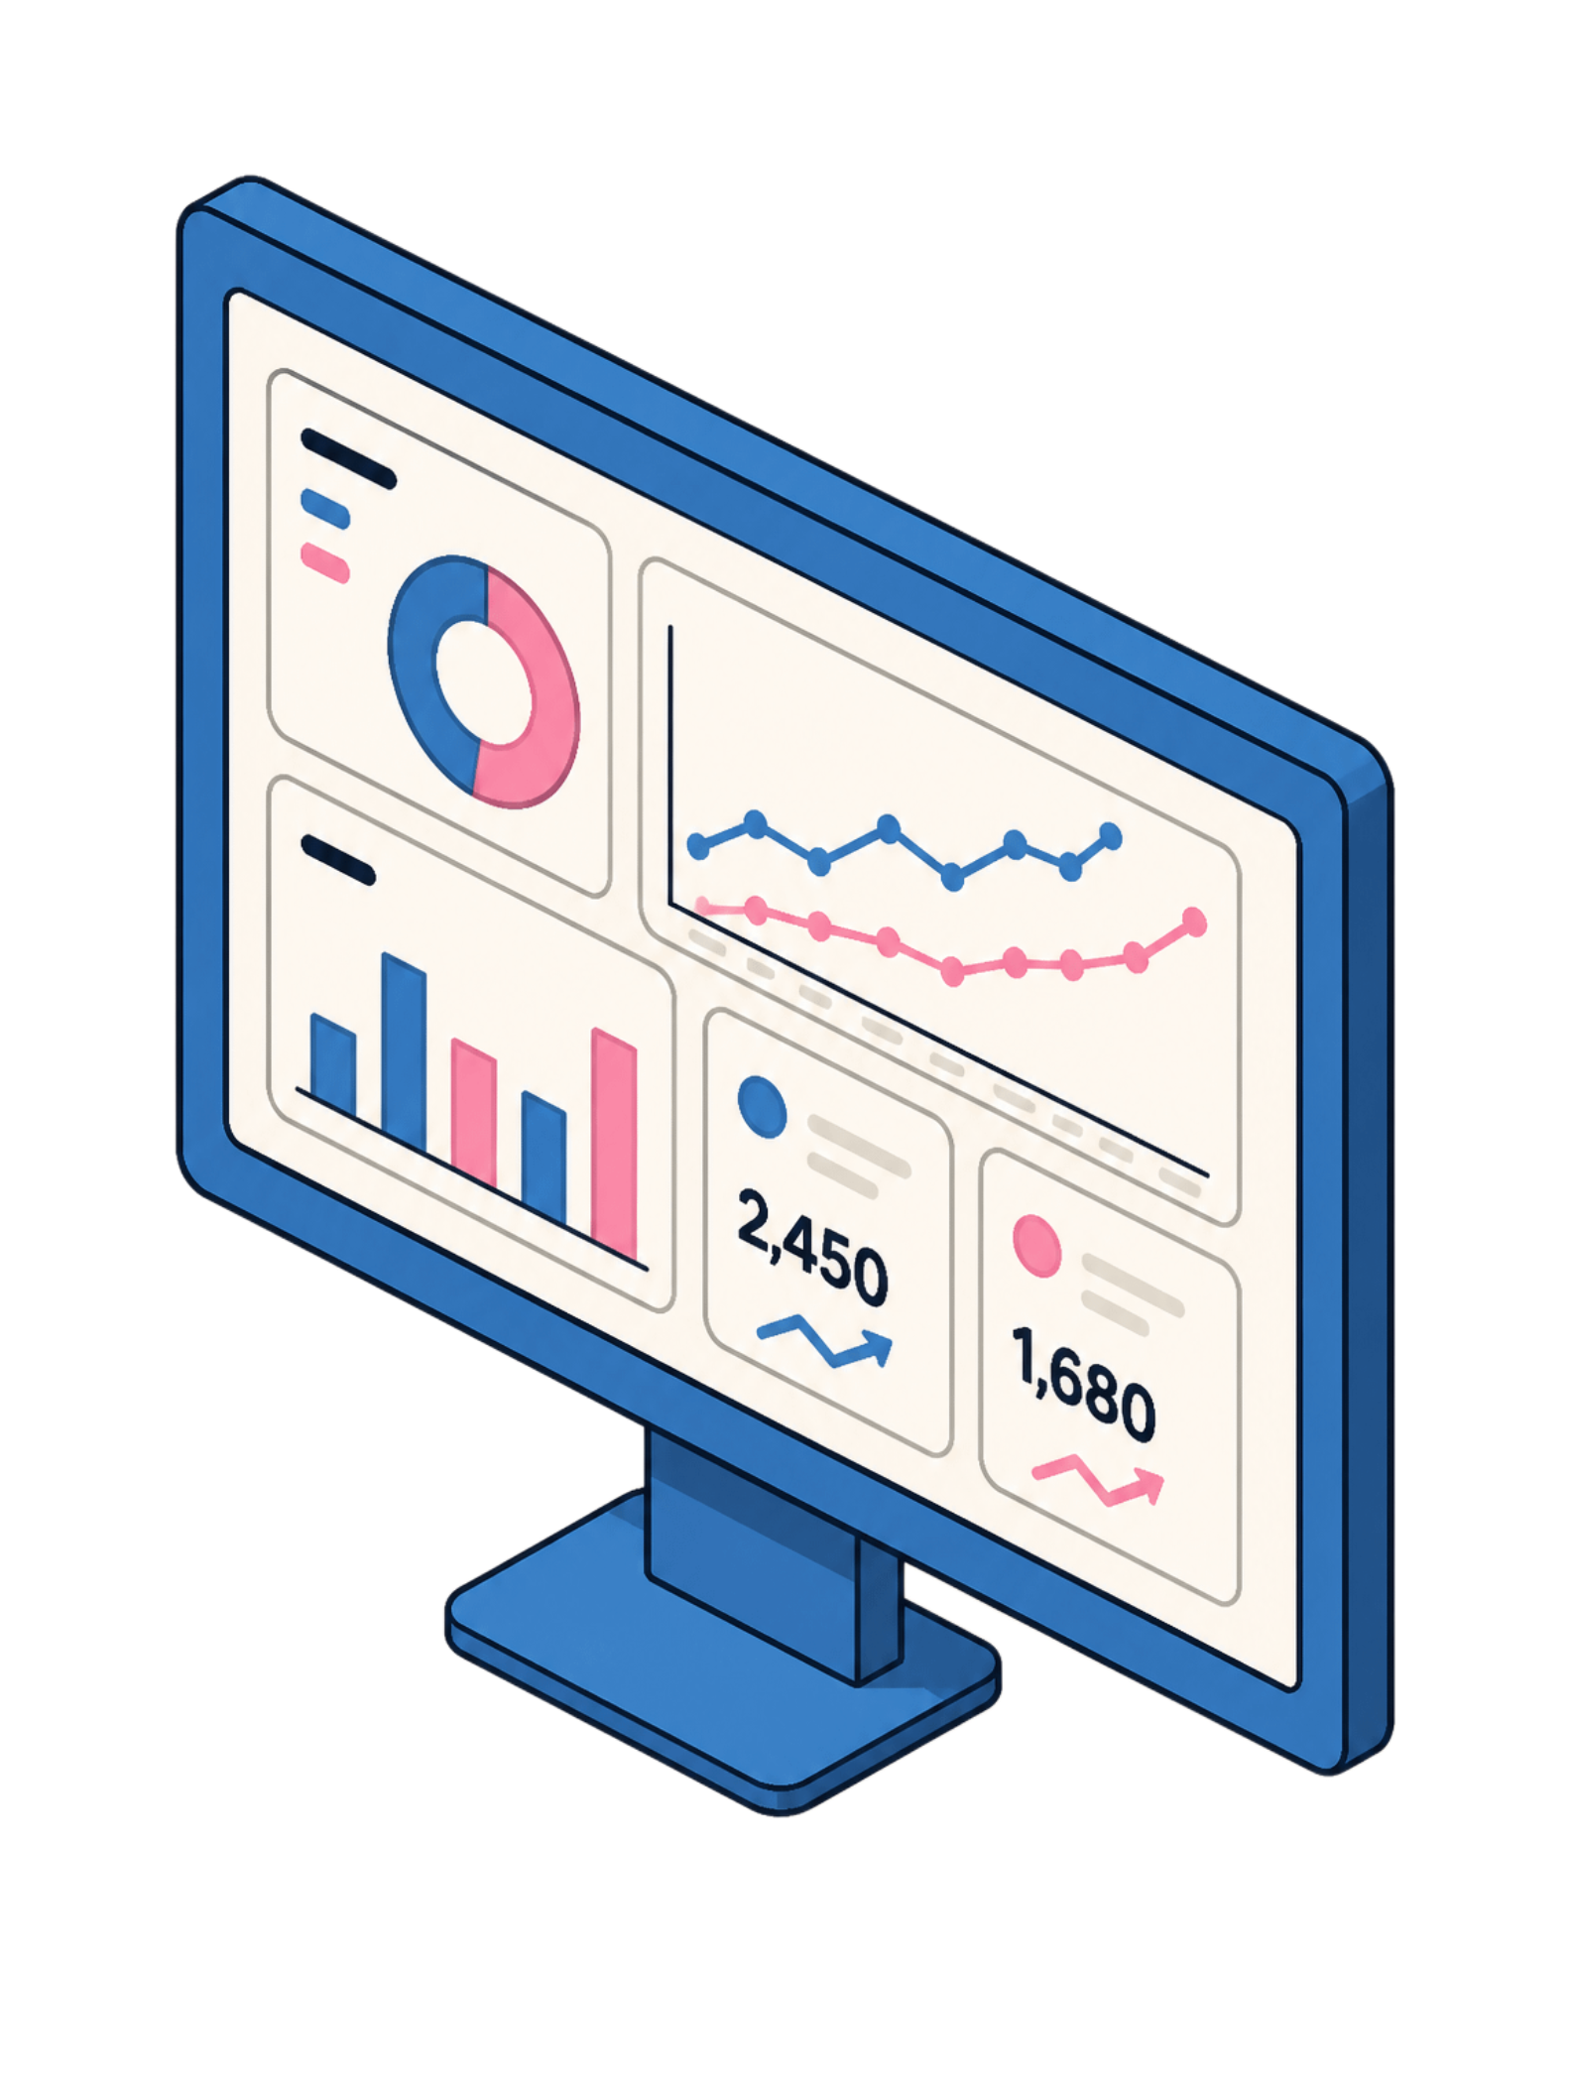
Dashboards
👨‍🎓 Student Dashboard
👨‍🏫 Teacher Dashboard
Overall course progress (progress bar)
Average score across all topics
Topic-wise performance (bar chart)
Quiz and assignment status
Weak topics with recommendations
Learning activity timeline
Class average and distribution
Student performance comparison
Topic-wise class performance
Quiz and assignment statistics
Weak topics across the class
Downloadable performance reports
📊 Progress Bars
📈 Bar & Pie Charts
📋 Performance Tables

Slide 10
Thank You

