Slide 1

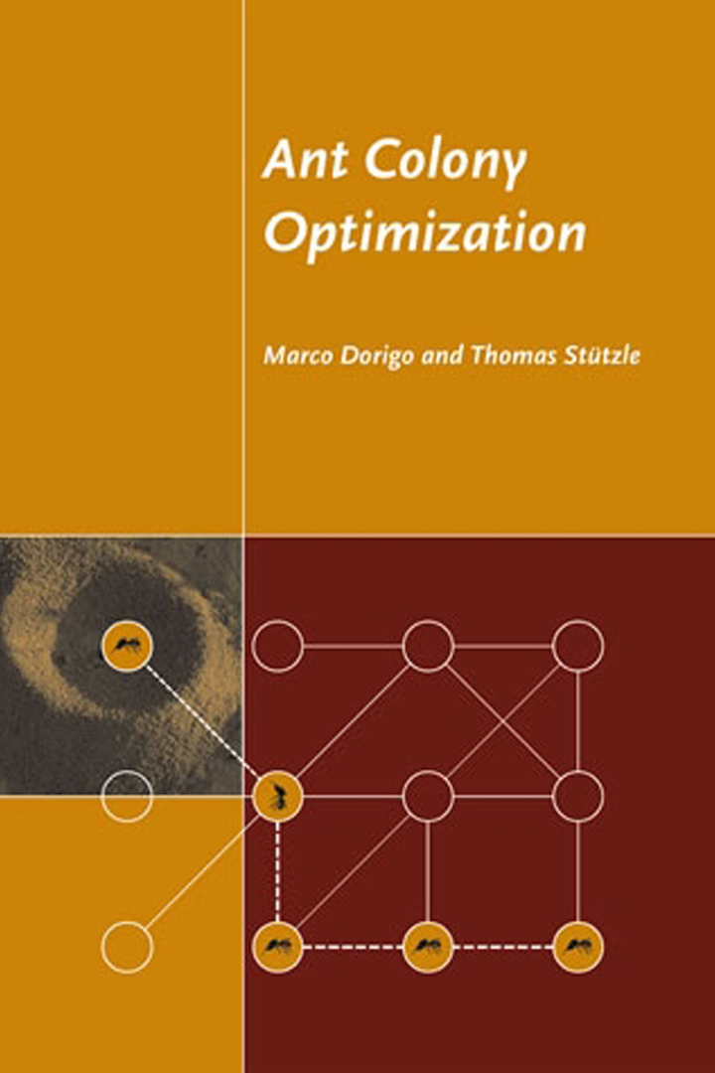

Ant Colony Optimization and Its Application in Load Balancing
Ant Colony Optimization (ACO) is a metaheuristic inspired by the foraging behavior of ants. In load balancing, ACO algorithms can be used to distribute network traffic efficiently among servers.
yk
by yashesh kopalli

Slide 2

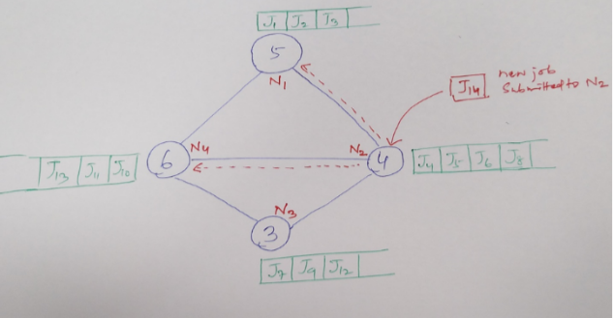
Problem Statement
Modern networks face congestion, leading to slow response times and decreased efficiency. Load balancing aims to evenly distribute traffic to improve performance and prevent bottlenecks.
Load balancing is applied in different types of network and each has its own way to solve. The network interconnections in fig, does not necessarly mean wired connections. we considered wireless decentralized network where every node is connected to every other node and the factor "distance" is taken into account while calculating the path for nodes which we need to migrate to.

Slide 3

Approach ? using what ?
Since we concluded with distance as our factor while calculating the path through which we are gonna send the job to other node, After exploring some alogorithms we have concluded to use Ant Colony Optimization. So why did we pick it ? The interesting Aspect of ACO is its flexibility to use in other problems. since its opimization problem dealing with Hueristics and Rewarding mechanism , it was easy to adapt it, to find the path that might lead to minimum number of migrations in our problem. We will how in later slides…

Slide 4

What is ACO ?
ACO is Nature-inspired optimization algorithm that is based on the foraging behavior of ants.computational technique that models the behavior of ants to solve optimization problems. It utilizes the collective intelligence of a colony to find the best solution. Instead of finding optimal path , small set of solutions collected by each ant at last converges to find the optimal path.

Slide 5
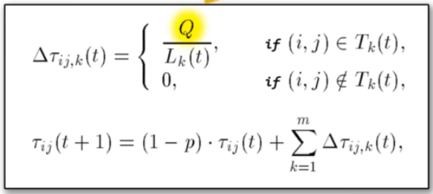
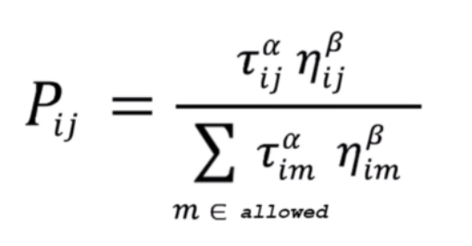
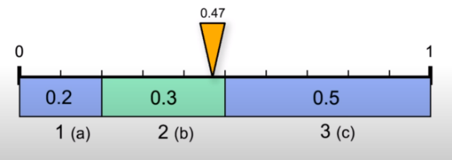
Formulas Used in This Approach
ACO algorithms utilize pheromone trails, heuristic information, and probabilities to guide the ants' search for optimal paths. These formulas ensure efficient load balancing and adaptability.

Slide 6


Slide 7
While Finding the path…
Change in Formula
Load updation at each iteration
Influence of this load in finding path
Static Performance measure

Slide 8

Challenges of Implementing Ant Colony Optimization in Load Balancing
Scalability
Optimization Parameters
System Heterogeneity
As network sizes increase, the computational complexity of ACO algorithms can become a challenge.
Choosing the right parameters for ACO algorithms requires careful tuning to achieve optimal load balancing.
Different servers may have varying capabilities, making load balancing more complex and challenging.b
Performance measure
Input Scaling
Choosing the Hueristic
One of the huge problem with the optimization technique is to scale the inputs accordingly so that all the factors such as distance , load availability and pheromone will have adequate contribution in find the optimal path
As we know for a given job to be performed in a given server , we never calculate how much time it may take unless we know its past records of performance of similiar type of job on that server. hence we performance measure cant be constant for real life applications.
To solve the problem, you need to know on which aspects of problem are you working on, and also we need to comeup with specific set of parameters which will give concise with the optimal solution

Slide 9



Conclusion and Key Takeaways
Efficient Load Balancing
Optimal Resource Utilization
Improved User Experience
Ant Colony Optimization offers an effective approach for load balancing, enhancing network performance and responsiveness.
ACO algorithms enable the efficient allocation of resources, maximizing server capacity and minimizing downtime.
By evenly distributing network traffic, ACO in load balancing ensures a seamless and responsive user experience.

