Slide 1
Movie Recommendation System using Apache Spark deployed on EMR Cluster

Slide 2
Recommendation System
A Recommendation System is an information filtering system that helps predict the rating based on the ratings given by other users to an item.
Two approaches:
Content-based filtering approach
Issues: Cold Start, Scalability, Sparsity
Model-based collaborative filtering approach
Alternate Least Squares algorithm uses a low-rank matrix approximation technique

Slide 3


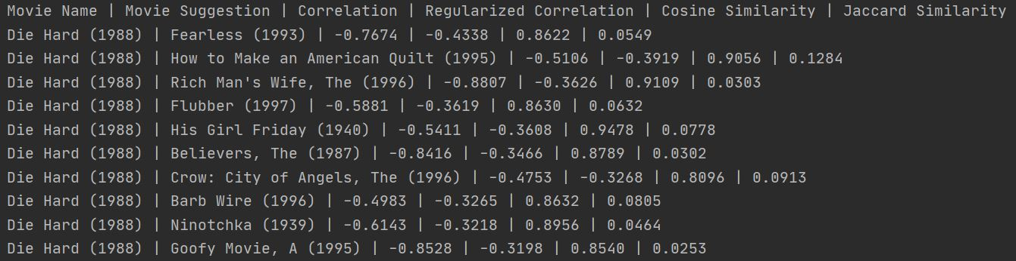
Item-based collaborative filtering for movie similarity
Two Similarity metrics:
Cosine Similarity: based on Euclidean distances.
Jaccard Similarity: based on Set theory.
Results:

Slide 4
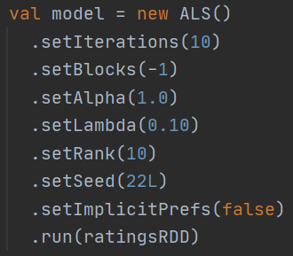
Model-based recommendation to find movies based on user preferences
Dataset:
MovieLens: Contains 25M+ ratings from 160K+ users on 60K+ movies
Algorithm:
Alternate Least Squares
Test Metric:
Root Mean Squared Error based on Matrix Factorization Model
Issue:
Spark executors fail at various levels while running simple SparkSQL commands
Solution:
Need of a distributed system -> AWS Elastic MapReduce Cluster

Slide 5
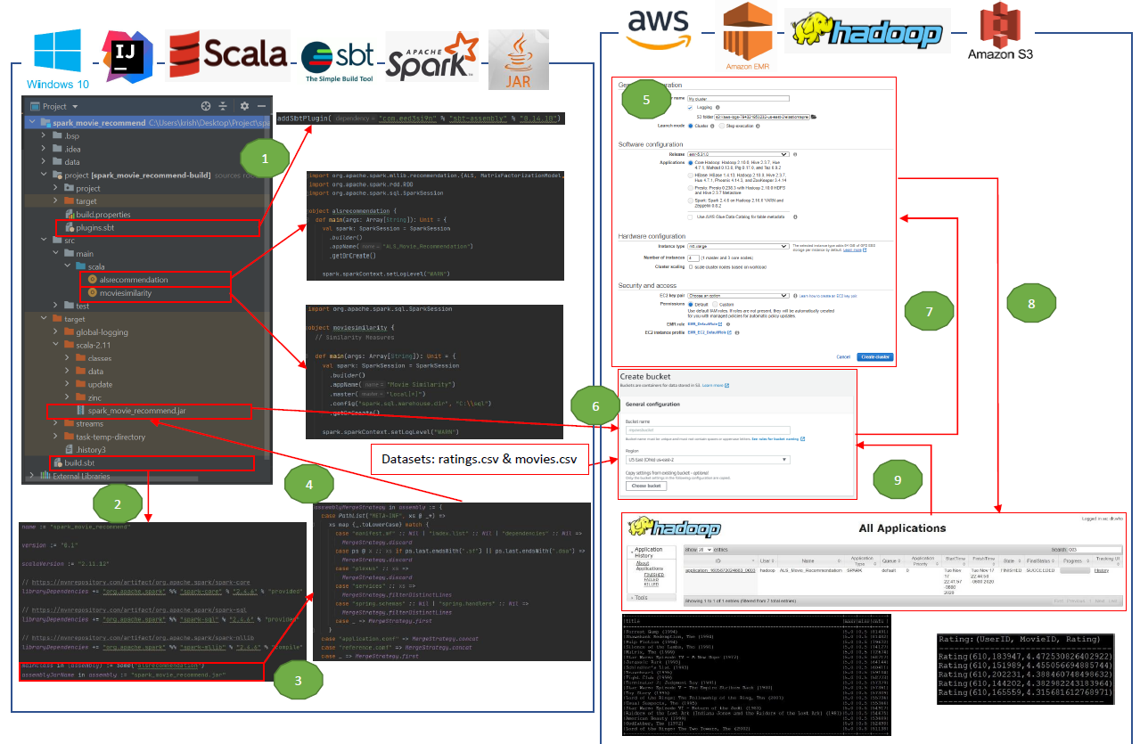

Slide 6
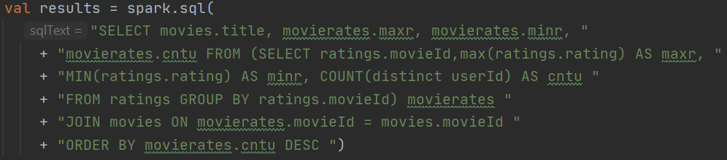
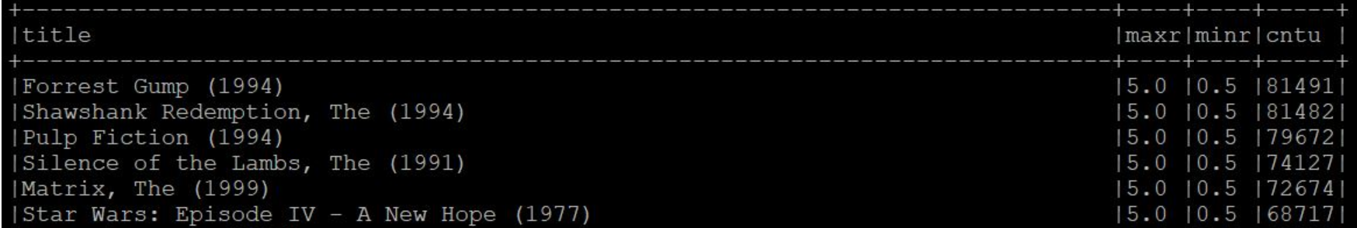
Results:
Difference:
Model Run locally:
With 100k records -> Time taken: 5 mins
With 25M records -> Compute Issues
Model Run on EMR Cluster (1 master and 3 core nodes):
With 25M records -> Time taken: 3 mins
SparkSQL Queries:
Maximum and minimum rating of movies with user counts

Slide 7
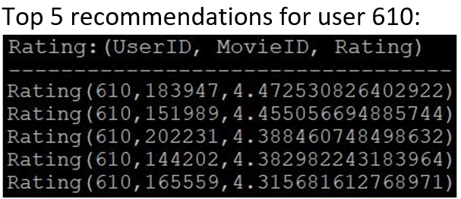
Model Performance
Test RMSE score: 0.81
Predictions
Alternate Approach:
Creating a Hadoop Cluster in AWS Cloud by spinning off free EC2 instances and installing and configuring required software instead of using EMR cluster.

