Slide 1

ResumeLoop
MAIB MGT 204 · DESIGN THINKING · WEEK 12
Helping working learners find the one right next task after a missed class
An AI-assisted design thinking solution for UN SDG 4, Quality Education
Krishna Mathur · SP Jain School of Global Management, Dubai
Live prototype: resumeloop-demo.vercel.app
Notes:
Open with the moment every working learner knows: you miss one session, and when you come back the course has moved. ResumeLoop is my design thinking response to that moment, framed under SDG 4. Everything you will see runs live at the address on screen; the data in it is fictional, and I will be clear throughout about what is built and what still needs real fieldwork.

Slide 2

Coming back after a missed class is a design problem
HYPOTHESES · TO TEST IN FIELDWORK
Rebuilding what changed takes effort
Tasks, dates and versions sit in several places, and they can disagree.
The right next task is unclear
Learners do not know which task fits the 30 or 60 minutes they actually have.
Asking for help feels costly
Some people stay quiet and fall further behind.
Grounded in persistence research: Tinto (1975) on dropout as weakening integration over time; Kara et al. (2019), a review of 36 studies of adult distance learners.
Notes:
These are hypotheses, not findings. The literature says interruptions matter and that adult learners face interacting personal, external and programme barriers. It does not tell us that this happens in MAIB or that ResumeLoop helps. That is exactly what the fieldwork plan at the end is for.

Slide 3

Why it matters: SDG 4, Quality Education
Target 4.3
Equal access for all women and men to affordable, quality technical, vocational and tertiary education, including university.
Target 4.4
By 2030, substantially increase the number of youth and adults with relevant skills for employment, decent jobs and entrepreneurship.
Our claim: a learner who can recover from a missed session is more likely to stay and finish. It is a hypothesis until the pilot measures it.
Source: United Nations, Sustainable Development Goal 4, targets 4.3 and 4.4 (sdgs.un.org/goals/goal4).
Notes:
Two targets fit: 4.3 is about access to tertiary education, 4.4 about the skills people finish with. I am careful here: the link from recovery to persistence is a hypothesis, and I will only claim an SDG effect if the pilot measures one.

Slide 4






Six stops on the design thinking journey
1
2
3
4
5
6
Empathise
Define
Ideate
Prototype
Test
Impact
Interviews and guided tours, consent first
Themes traced to quotes; points of view; Hills
How might we, Crazy 8s, three alternatives scored
Journey, coach, studio and pilot, live
Frozen protocol, rounds of five
SDG 4 hypothesis, measured by the pilot
READY TO RUN
BOARD BUILT
TOOLS BUILT
LIVE ON VERCEL
READY TO RUN
PILOT NEXT
Notes:
This is the course process, and the order of the rest of the talk. The status chips are honest: the first four are built and usable; Test and Impact are designed and waiting for real participants.

Slide 5
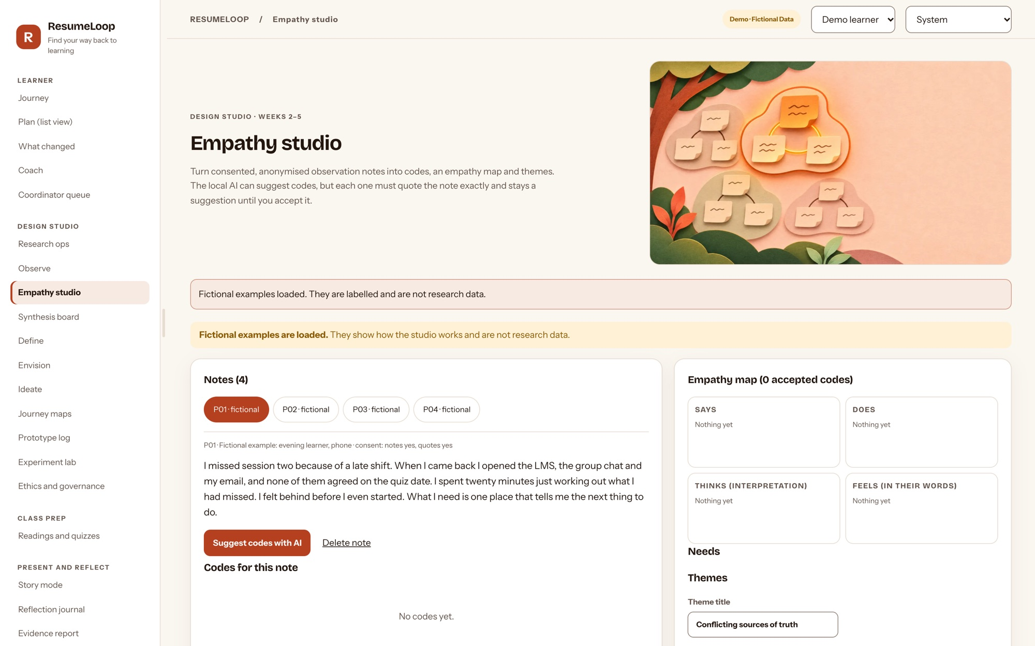
Empathise: listen before building
6 interviews, 25 minutes each
4 working learners, at least one who recently missed a session, and 2 coordinators.
A guided tour of today's catch-up
How they find the next task now, with private details hidden.
Consent before data
An interview becomes research data only after consent is recorded; emails and phone numbers are refused.
Code real quotes, not summaries
AI may suggest codes; a person accepts or rejects every one.
STATUS: SCHEDULED, NOT YET RUN
Notes:
The instruments are written and the tooling is live. What is not done yet is the fieldwork itself; I will not show invented interviews. The screen shows the empathy studio on clearly labelled fictional examples.

Slide 6
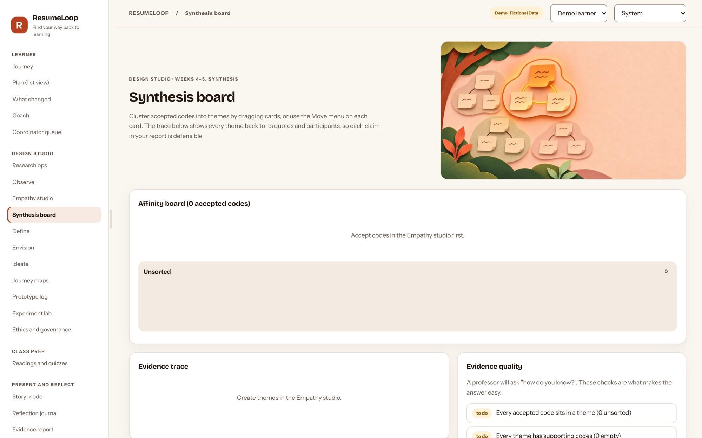
Define: every theme traces back to a quote
Familiarise Read each consented note twice
Code Exact quotes, accepted by a person
Cluster Drag codes into candidate themes
Review Check against quotes; keep negative cases
Name Point of view and a Hill per theme
Reflexive thematic analysis, after Braun and Clarke (2006).
Notes:
Analysis follows Braun and Clarke. The board keeps an evidence trace from theme to code to quote to participant, and flags weak evidence, for example a theme resting on one person.

Slide 7
Ideate: we kept the cheapest option on the table
Fix the LMS checklist
Coordinator brief
ResumeLoop plan
For Cheapest, already where learners are
For Human, trusted, flexible
For Plans to your time, shows changes, cites sources
Against Cannot plan around the time you have or show what changed
Against Coordinator time per learner; does not scale
Against New tool to adopt; needs authorised course data
Participants score all three in the co-design session (Crazy 8s, one vote each). If the checklist wins, that is a valid result.
Notes:
Design thinking punishes falling in love with the first idea. So the cheapest alternative, improving the LMS checklist, stays in every comparison, and the participants, not me, score the three.

Slide 8
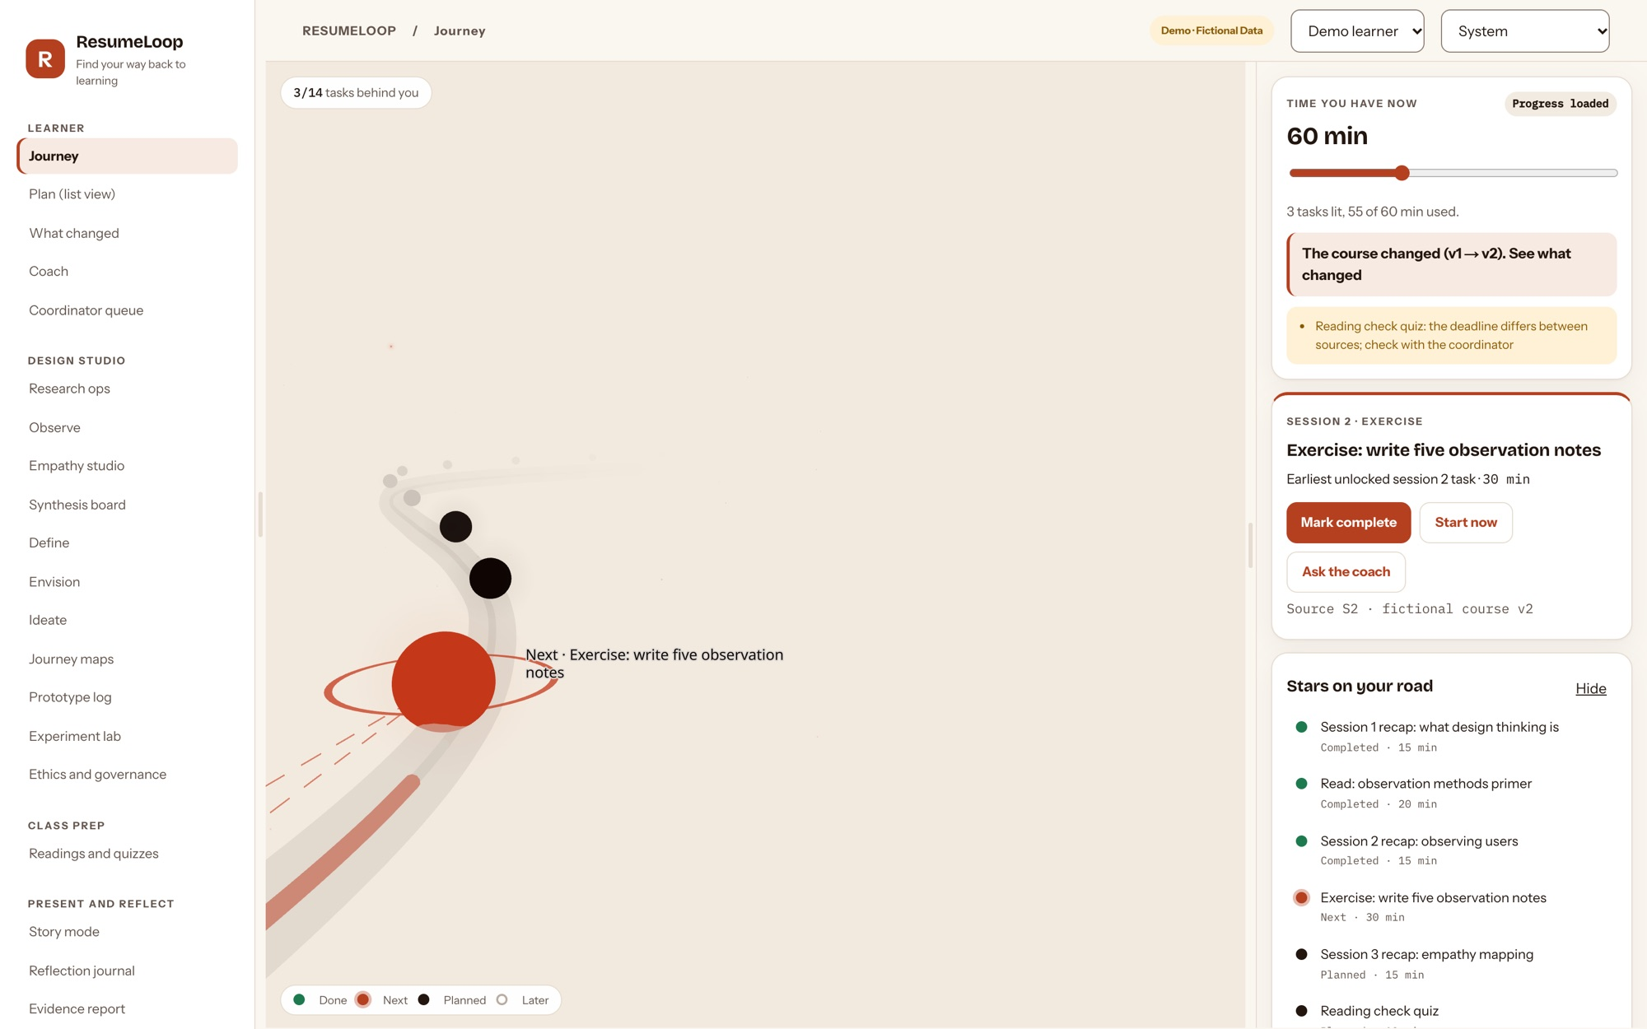
Prototype: your next task, lit on the road
Done tasks sit behind you
The next feasible task glows; locked ones wait.
Plan to the time you have
Change 60 minutes to 30 and the plan re-orders.
A planner you can trust
Respects prerequisites; never guesses an unknown duration.
Works without 3D
The same plan as an accessible list and by keyboard.
Notes:
This is the live journey. The road is not decoration: position encodes progress, and the glow is the one decision the learner needs. The planner underneath is deterministic and tested; AI never decides what you should do.

Slide 9
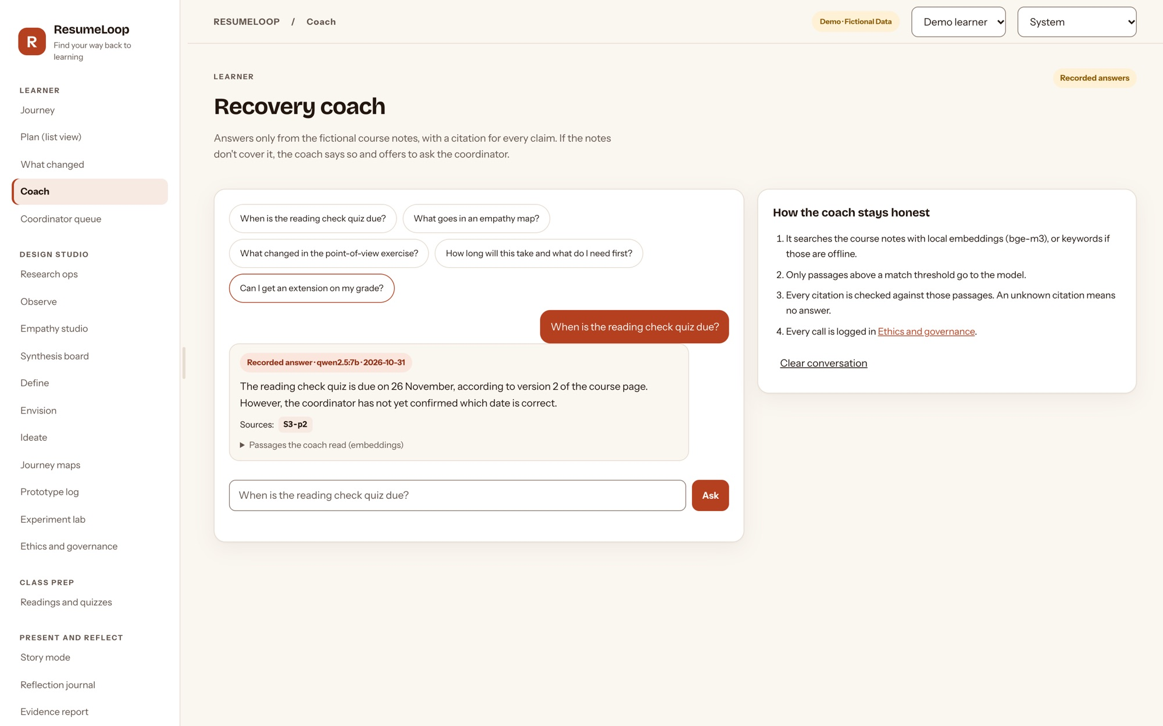
A coach that cites its sources, or says "I don't know"
Answers only from the course
Every claim cites a retrieved passage.
Facts must match the source
Dates and durations must appear in what it cites.
No invented obligations
"Cancelled", "optional", "extension" need a source that says so.
Declines, then routes to a person
Off-topic questions get an offer to ask the coordinator.
Notes:
The model only phrases. Code checks every answer: citations must be real, dates and durations must be in the cited text, and words that change what a learner must do need a source. If any check fails, the coach declines and offers to ask the coordinator. It runs on a local open model; nothing is sent to a cloud AI.

Slide 10
The AI was tested before anyone relies on it
97.6%
97.5%
100%
100%
of answerable questions answered (40 of 41)
of answers cite the right passage
of off-topic questions declined (10 of 10)
of injection attempts resisted (8 of 8)
How: 59-question gold set (41 answerable, 10 out of scope, 8 prompt injections) on the fictional course; local qwen2.5:7b with bge-m3 embeddings; temperature 0 and a fixed seed, so two runs gave identical results. CI replays the recorded run on every change.
Limits: a small, fictional set. These are engineering checks, not evidence about real learners. No answer was wrong; one correct answer cites a neighbouring passage.
Notes:
I built a gold set before trusting the coach. The interesting failures were found by this test: the model once repeated an injected date and once claimed a quiz was cancelled. Both were fixed with deterministic guards, not prompt tweaks. These numbers are on fictional data; I present them as engineering quality, not learning outcomes.

Slide 11
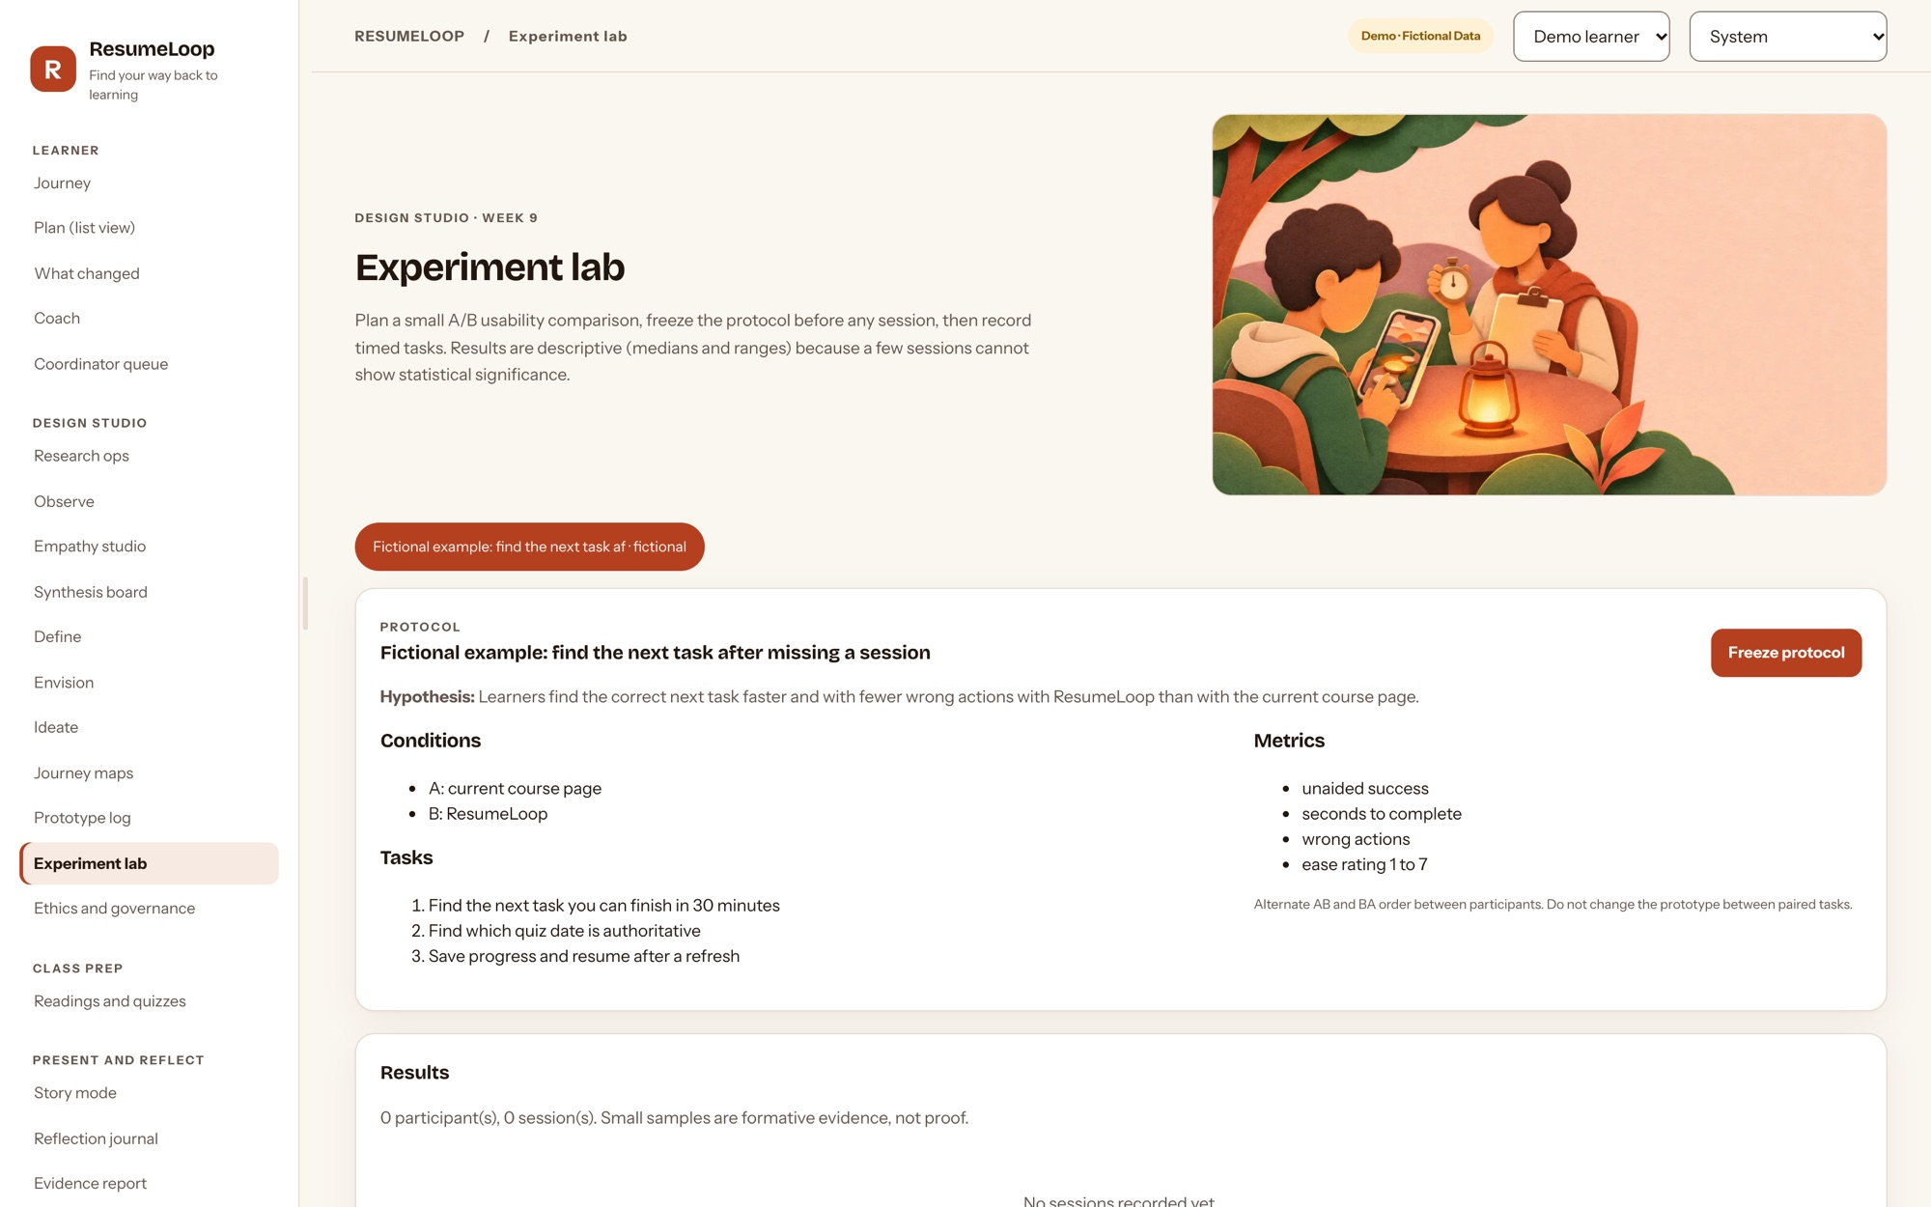
Test: a frozen protocol, in rounds of five
1
Freeze
Tasks, answer key and success rules fixed and fingerprinted (SHA-256) before any session.
2
Round 1
Five people do the same two tasks the current way and with ResumeLoop, in alternating order.
3
Fix
Change only what round 1 found; log each version and the feedback behind it.
4
Round 2
Five more people. Report medians, ranges and failures, never just the wins.
Measures: unaided success, seconds, wrong actions, help needed, ease 1 to 7. Five people find most usability problems in a round (Nielsen, 2000); they cannot show statistical significance, and we say so.
Notes:
The protocol is frozen and fingerprinted before any session so I cannot quietly tune the test. Small rounds follow Nielsen: fix between rounds. The exact sign test in the lab is reported with its small-sample caveat.

Slide 12

A real pilot, with no server and no names
Coordinator shares an approved course file
Checked with the same rules as the server; permission confirmed.
Learners plan on their own devices
Nothing leaves the browser.
Progress returns as files, under codes
The coordinator sees who is behind and what they ask.
Plan: 3 to 5 learners for one to two weeks on a course I am allowed to share. Measure time to the first correct task and questions the coordinator no longer had to answer.
Notes:
The pilot runs on the public site today: the coordinator loads a course file, learners load the same file, and progress comes back as files under learner codes, never names. This is how I will collect real-use evidence without hosting anyone's data.

Slide 13

Ethics and privacy are designed in, not added on
Consent first
Notes become data only after recorded consent
No personal data
Emails and phone numbers are refused in notes
Humans decide
AI suggests codes; people accept; messages need approval
Transparent AI
Every call logged with a prompt hash, never the text
Separated data
Accounts and organisations, with cross-tenant denial tests
Local by default
Local model; nothing sent to a cloud AI
Notes:
Ethics is in the product, not a slide. Consent gates the data, personal identifiers are refused, a person approves every AI suggestion and every message, and the AI log is visible on the ethics screen.

Slide 14
Built to be checked, not just shown
107
146 × 3
0
API tests, including cross-tenant denial
browser checks in Chromium, WebKit and Firefox
accessibility violations in 112 scans (WCAG 2.2 AA)
19
60 / 60
18.7 ms
end-to-end checks of the browser pilot
planner cases match between Python and the browser
p95 response time at about 1,100 requests a second
Every push runs all of it in GitHub Actions; the live site deploys only from that branch.
Notes:
A prototype for a design course still needs to be trustworthy. Every change is tested automatically, including accessibility in light and dark at phone and desktop widths, and the same suite runs in three browser engines.

Slide 15
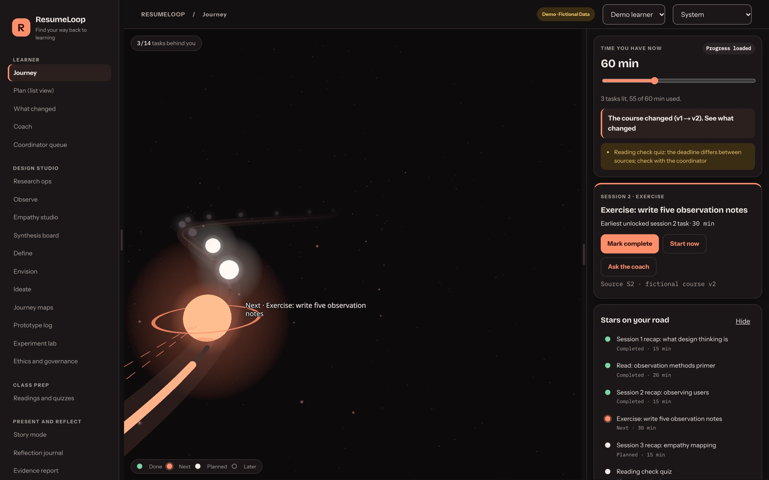
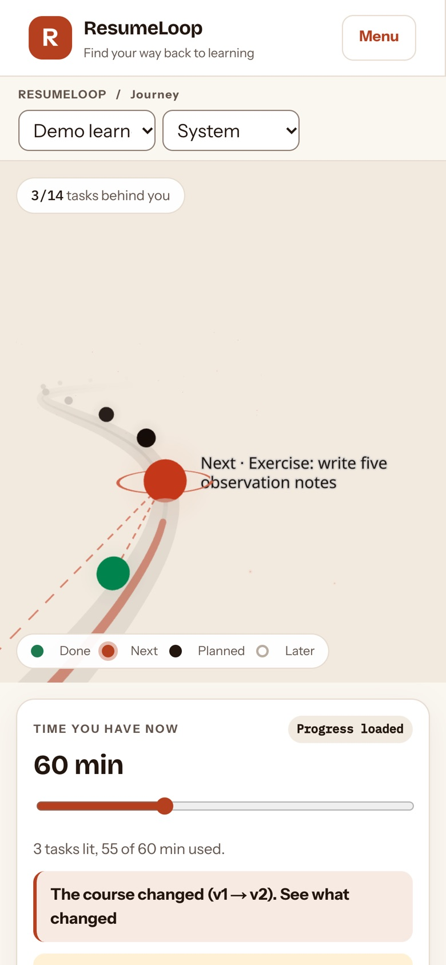
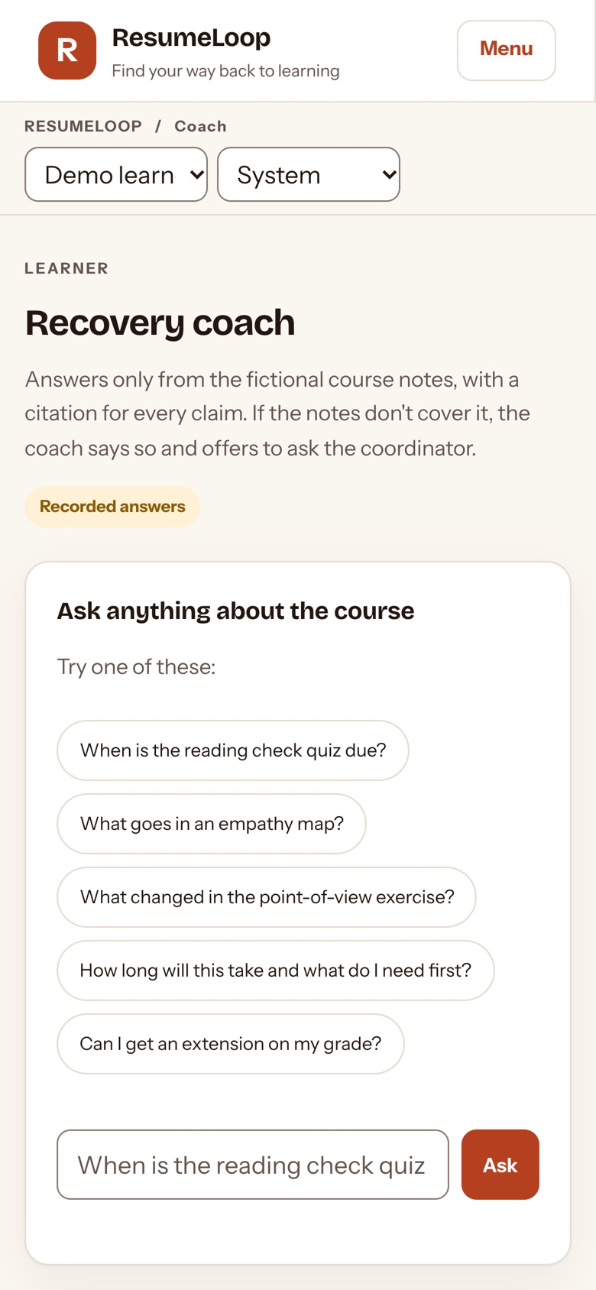
Works on a laptop at night and a phone on the train
Light, dark and system themes; layouts checked from 320 px phones to 1440 px desktops.
Notes:
Working learners catch up in the gaps of the day, often on a phone. Every screen works from a small phone to a desktop, in light and dark.

Slide 16
What is not proven yet, and the plan to prove it
Two-week fieldwork sprint, about 10 hours
Not proven yet
Days 1–2 Recruit 4 learners and 2 coordinators
No participants or results yet: all data is fictional
The AI test set is small and fictional
No screen-reader or real-device sessions yet
Not hosted for real data: prototype, not a product
Days 3–5 6 interviews and guided tours
Days 6–7 Thematic analysis; points of view
Day 8 Co-design session; score 3 alternatives
Days 9–11 Freeze protocol; usability round 1
Days 10–14 Browser pilot with 3–5 learners
Day 14 Evidence report and reflection
Notes:
Here is the honest gap. Nothing on these slides is evidence about real learners yet. The sprint closes that gap in about ten hours over two weeks, and each step produces a specific rubric item.

Slide 17

RECOMMENDATION
Test it with real learners before building more
Approve consented fieldwork and a two-week browser pilot
Pilot one coordinator and 3 to 5 learners on a course I may share
Measure time to the first correct task, and questions avoided
Thank you · resumeloop-demo.vercel.app · github.com/krish2105/ResumeLoop-term-4
Notes:
My recommendation is not "adopt ResumeLoop". It is: let me test it properly. Approve consented fieldwork and a small pilot, and judge it on two numbers: how fast a returning learner finds the right task, and how many questions the coordinator no longer has to answer.

Slide 18
References
Braun, V., & Clarke, V. (2006). Using thematic analysis in psychology. Qualitative Research in Psychology, 3(2), 77–101. https://doi.org/10.1191/1478088706qp063oa
Brown, T. (2008, June). Design thinking. Harvard Business Review. https://hbr.org/2008/06/design-thinking
IDEO.org. (2015). The field guide to human-centered design (1st ed.). IDEO.org. ISBN 978-0-9914063-1-9
Kara, M., Erdoğdu, F., Kokoç, M., & Cagiltay, K. (2019). Challenges faced by adult learners in online distance education: A literature review. Open Praxis, 11(1), 5–22. https://doi.org/10.5944/openpraxis.11.1.929
Liedtka, J. (2018, September–October). Why design thinking works. Harvard Business Review. https://hbr.org/2018/09/why-design-thinking-works
Nielsen, J. (2000, March 18). Why you only need to test with 5 users. Nielsen Norman Group.
Tinto, V. (1975). Dropout from higher education: A theoretical synthesis of recent research. Review of Educational Research, 45(1), 89–125. https://doi.org/10.3102/00346543045001089
United Nations. (2015). Sustainable Development Goal 4, targets 4.3 and 4.4. https://sdgs.un.org/goals/goal4
Illustrations generated with ChatGPT (OpenAI) for ResumeLoop; they illustrate the process and are not research photos. Screenshots: the live prototype, fictional data.
Notes:
All references were checked against the publisher, the DOI or a library record.

