Slide 1


RetentionLens
See which wholesale accounts are about to go quiet, what they are worth, and draft the call you approve.
Real data: UCI Online Retail II · 1,067,371 invoice lines · 5,852 accounts scored
MAIB AI 208 · AI in Marketing · Krishna Mathur
Live demo: krish2105.github.io/Retention-Lens-AI-in-Marketing-
Notes:
RetentionLens is a weekly account review for small wholesalers. Everything shown runs on a real, licensed dataset, and every number in this deck is read from saved result files.

Slide 2

THE PROBLEM
Most wholesale accounts quietly stop ordering, and nobody notices in time
65–67%
23%
£467k
of known accounts placed no order in the next 90 days (dev cutoffs)
of invoice lines have no customer ID: data quality is part of the job
usual 90-day spend at stake in high-risk accounts today
User: an owner or account manager at a small wholesaler with hundreds of trade accounts and no data team.
Today: spreadsheets and memory. Lapsing accounts are found after the revenue has gone.
Gap (research): DTC tools need Shopify events and 500+ buyers; distributor platforms are quote-only ERP projects.
Notes:
Lapse rates come from the model evaluation file; the missing-ID share comes from the data profile. Competitor facts are from the sourced research report.

Slide 3
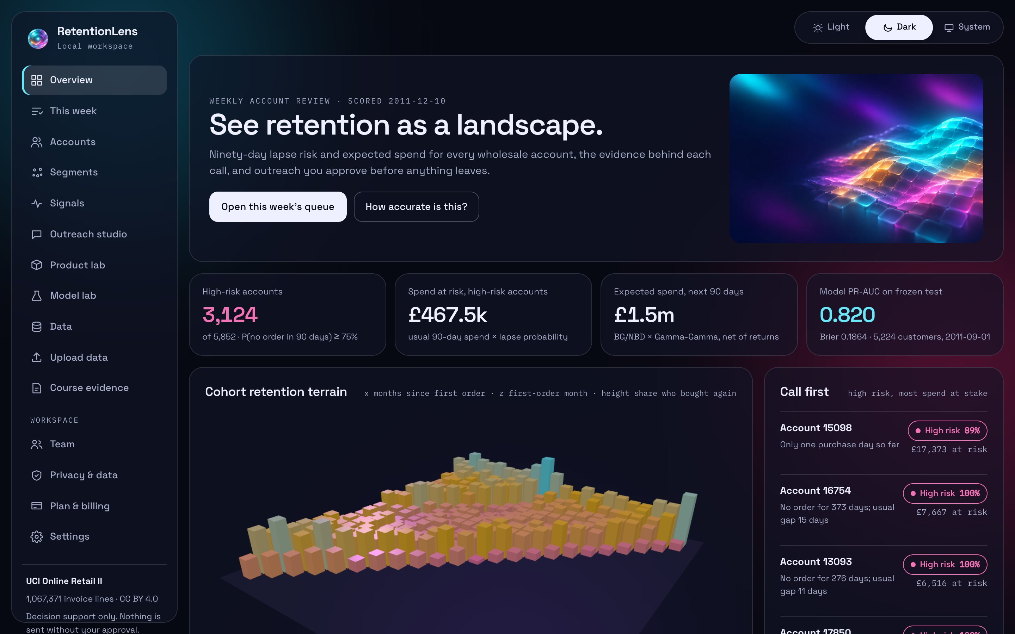
THE PRODUCT
One weekly loop: upload, score, review, draft, approve, measure
Upload
any invoice CSV or Excel export; columns matched, bad rows listed
Score
90-day lapse probability and expected spend with an 80% range
Review
this week's queue, most spend at risk first, with reasons
Draft
a local AI writes the check-in; checks run on every draft
Approve
a person approves with a consent basis; nothing is sent
Measure
a random holdout shows whether contacting accounts helps
Notes:
The public demo is read-only and runs on the real UCI data. The local install adds upload, the weekly queue, AI drafting with Ollama and the decision log.

Slide 4
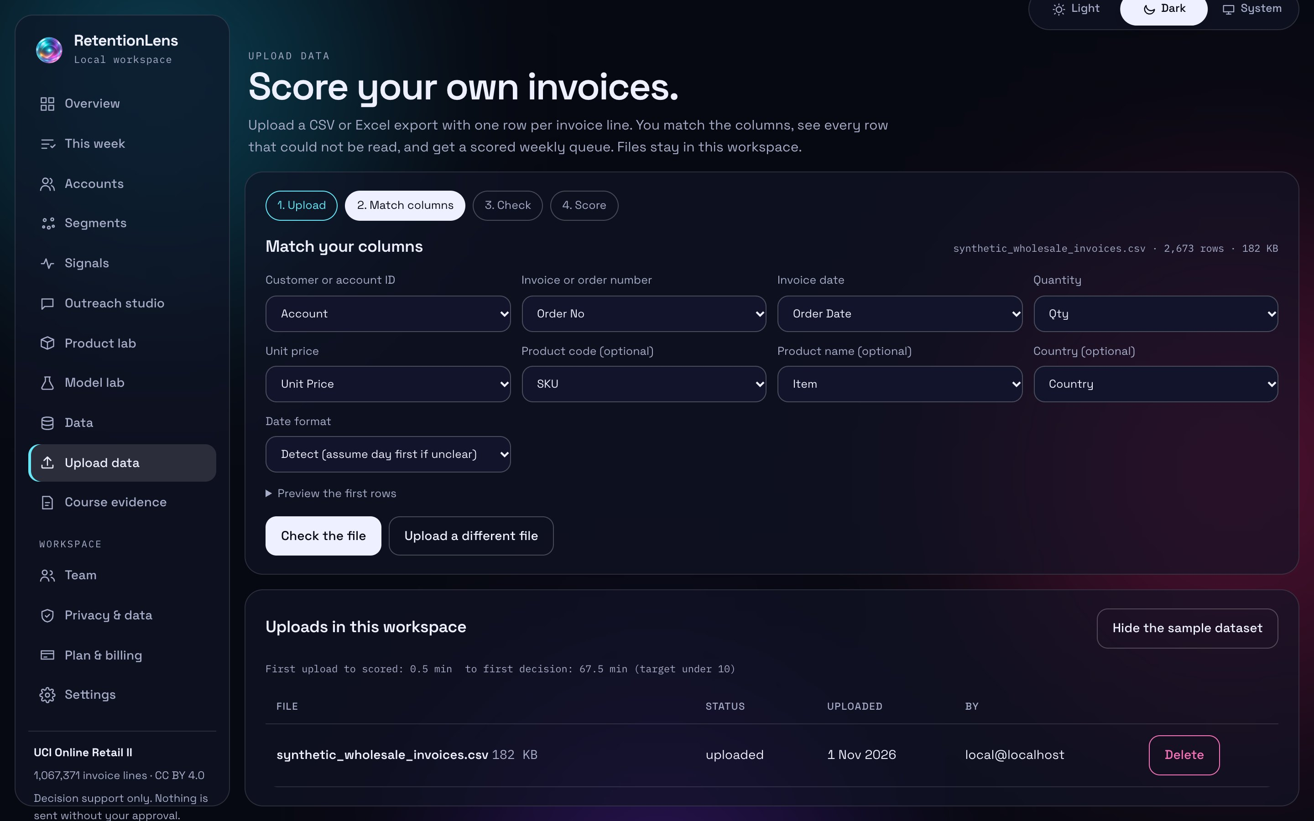
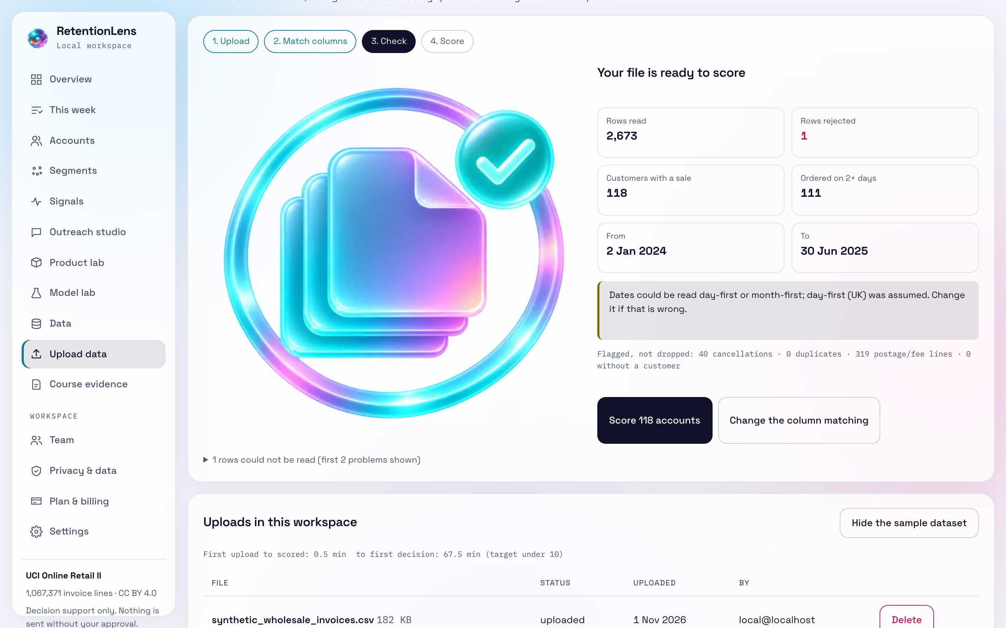
SELF-SERVE UPLOAD · R3
Bring your own invoices: match columns, see every rejected row
Four steps: upload, match columns (guessed, editable), check, score. Scoring runs in a background worker.
The check report counts rows read and rejected, cancellations, duplicates and date-format guesses. Nothing is silently filled in.
The same seasonal BG/NBD + Gamma-Gamma model and value ranges as the reference data.
SYNTHETIC sample file shown (apps/web/public/samples/synthetic_wholesale_invoices.csv). The upload was deleted after capture.
Notes:
Screens captured from the running app on 2026-11-01 using the synthetic sample file, which is labelled SYNTHETIC wherever it appears. The counts in the check report are for the synthetic file only. No real customer has uploaded data yet.

Slide 5
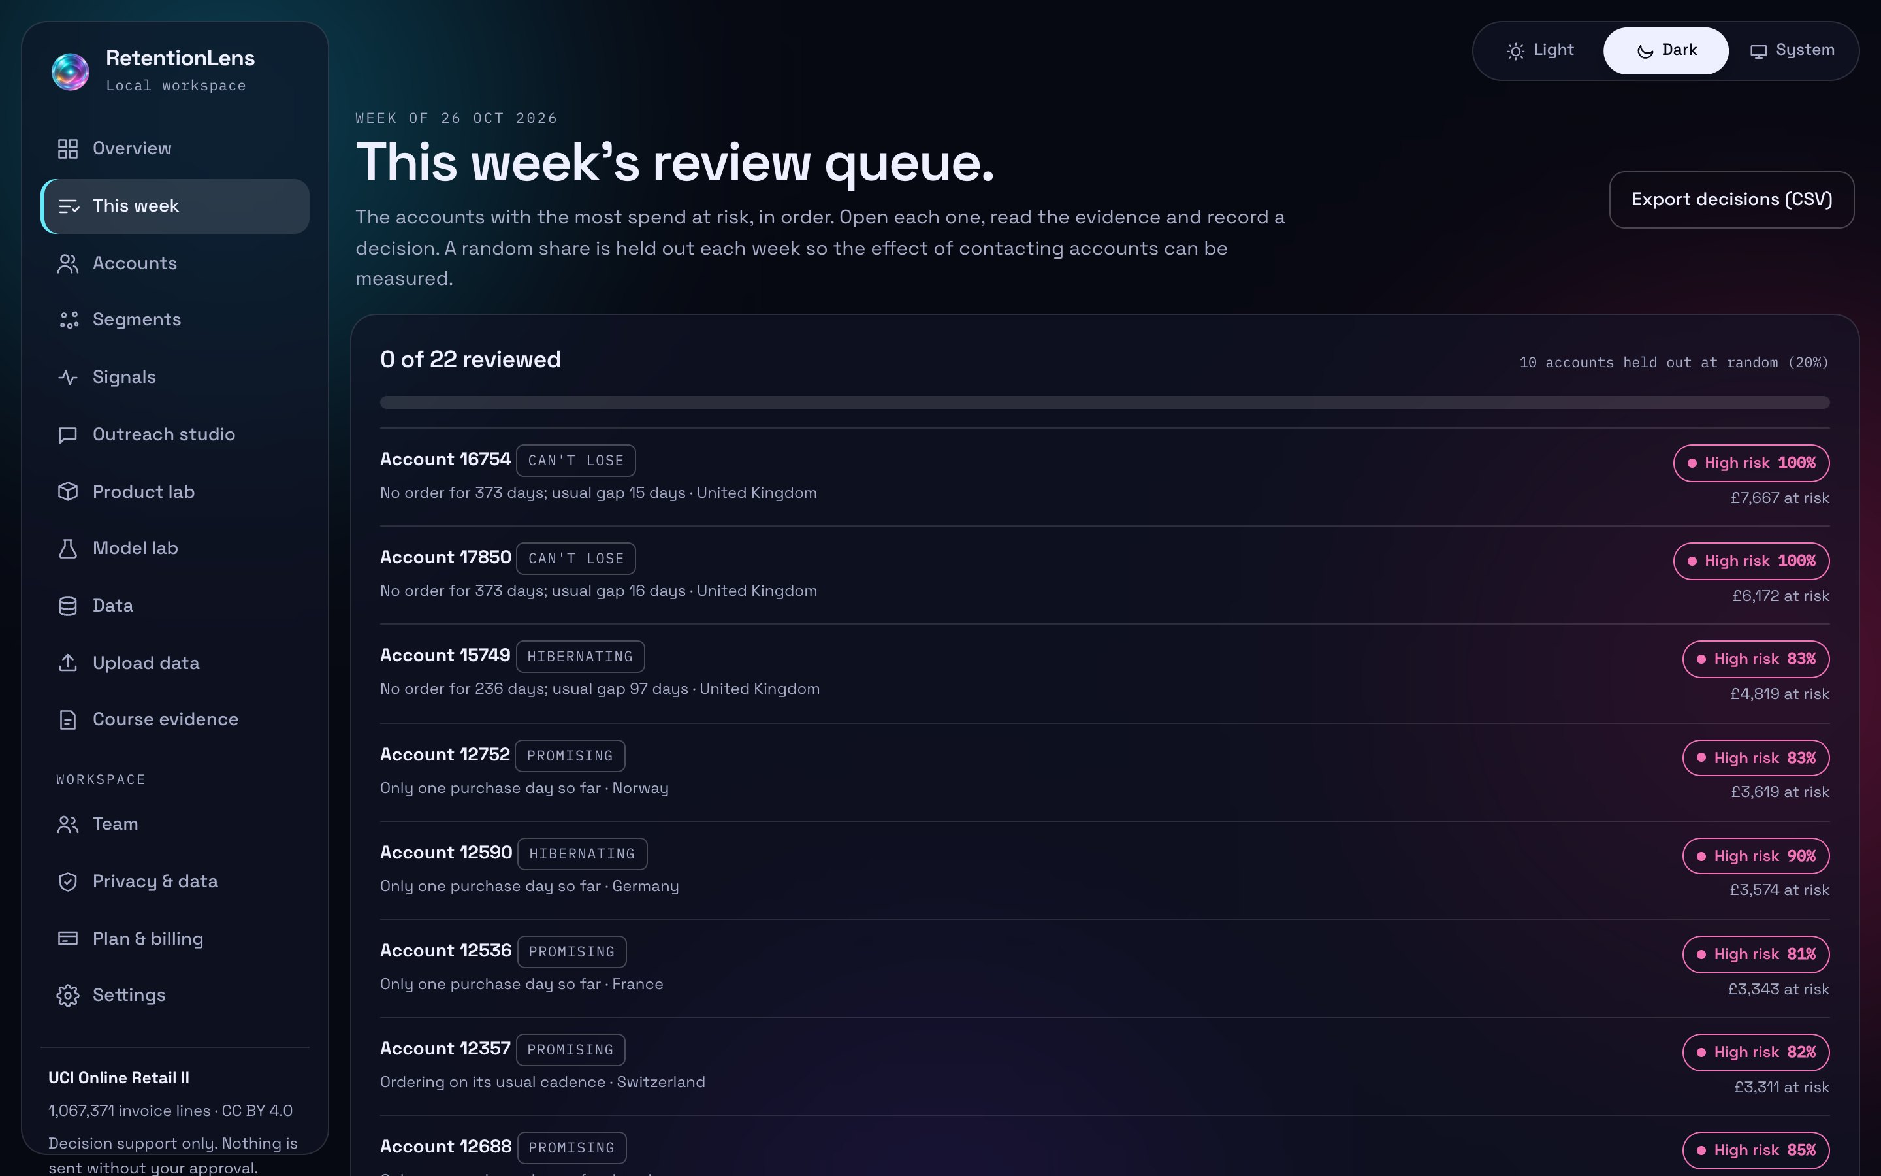
WEEKLY QUEUE AND HOLDOUT · R4
A short list each week, and a built-in test of whether outreach works
The queue lists the accounts with the most spend at risk, in order, with the reasons behind each call.
A random 20% of eligible accounts is held out each week (stable hash of workspace, account and week) and not shown.
After 28 days, reorder rates of contacted and held-out accounts are compared with a 95% interval.
Result so far: none. It needs several weekly queues and a later upload; an interval that crosses zero proves nothing.
Notes:
The holdout share is the RL_HOLDOUT_SHARE setting, default 20%. The uplift panel on this page shows 0 of 0 reorders today because no real outreach has happened. This is the mechanism for a future pilot to measure causal impact, not a result.

Slide 6

DATA · OUTCOME A
One licensed source, checksummed, with every problem row counted
Measure | Value
Invoice lines | 1,067,371
Date range | 2009-12-01 to 2011-12-09
Invoices · customers · countries | 53,628 · 5,942 · 43
No customer ID | 243,007 (22.8%)
Cancellations | 19,494
Repeated across the two workbook sheets | 22,202
Rows usable for customer models | 794,163 (74.4%)
Finding: the two sheets overlap on 1–9 December 2010, so the published row count includes a duplicated week. The pipeline flags it instead of dropping rows.
Notes:
Source: UCI Online Retail II, CC BY 4.0, DOI 10.24432/C5CG6D. Archive SHA-256 is recorded in the source register.

Slide 7
METHOD
Rolling cutoffs, fixed before any result, and one frozen test
2010-09-01
2010-12-01
2011-03-01
2011-06-01
2011-09-01
training only
dev evaluation
dev evaluation
dev evaluation
frozen test, scored once
Features use only data before the cutoff; labels come from the next 90 days. A unit test proves no leakage.
Label: lapse = no purchase day in the window. Value = net spend in the window, floored at £0.
Models: recency rule · logistic RFM · BG/NBD + Gamma-Gamma (PyMC-Marketing) · LightGBM.
Claim rule: a model wins only if it is better on at least 3 of 4 evaluation cutoffs. No tuning on dev or test.
Notes:
This protocol is in docs/superpowers/plans/2026-11-01-p2-models.md and was committed before the first run.

Slide 8
RESULTS · OUTCOMES A AND C
Simple models win: BG/NBD beats gradient boosting
Frozen test (5,224 customers): BG/NBD PR-AUC 0.820, Brier 0.1864; LightGBM 0.819, 0.1938.
Across 4 cutoffs LightGBM beats BG/NBD on 0 and logistic RFM on 1.
Spend ranking: BG/NBD + Gamma-Gamma normalised Gini 0.825 vs LightGBM 0.807.
Limit found here: the test window is the Christmas peak and spend was under-predicted. The next slide shows the fix.
Notes:
Read directly from reports/model_results.json. These are the P2 results on the frozen test, scored once.

Slide 9
SEASONALITY, RANGES AND A DEEP-LEARNING CHALLENGER · R5
A seasonal correction halves the spend bias; the neural model lost
32.9% → 16.8%
74.2% → 80.0%
0 of 3
mean total-spend bias on 3 dev cutoffs (49% less)
80% value-range coverage on the peak window (R5b)
dev cutoffs where the ZILN network beat BG/NBD on lapse PR-AUC
Adopted: a seasonal multiplier on BG/NBD + Gamma-Gamma. Better Brier and value MAE on 3 of 3 dev cutoffs; ranking cannot change because every account is rescaled equally.
Adopted (R5b): 80% split-conformal ranges calibrated on residuals pooled from the previous 90 days and the same window last year. Dev coverage 79.5%, 85.1%, 84.7%.
Disclosure: previous-90-days alone was best on dev but covered only 74.2% on the peak. The peak window had already been seen, so choosing the pooled version was informed by it.
Not adopted: ZILN network (value MAE wins 0 of 3). Kept as the documented deep-learning challenger; three versions disclosed.
Notes:
All numbers from reports/r5_results.json (seed 42). Model selection used only the dev cutoffs 2010-12-01, 2011-03-01, 2011-06-01. The 2011-09-01 window was scored once in P2; here it appears only as a labelled post-hoc look. Post hoc, 79% of the peak spend gap closed, which is optimistic for that reason.

Slide 10
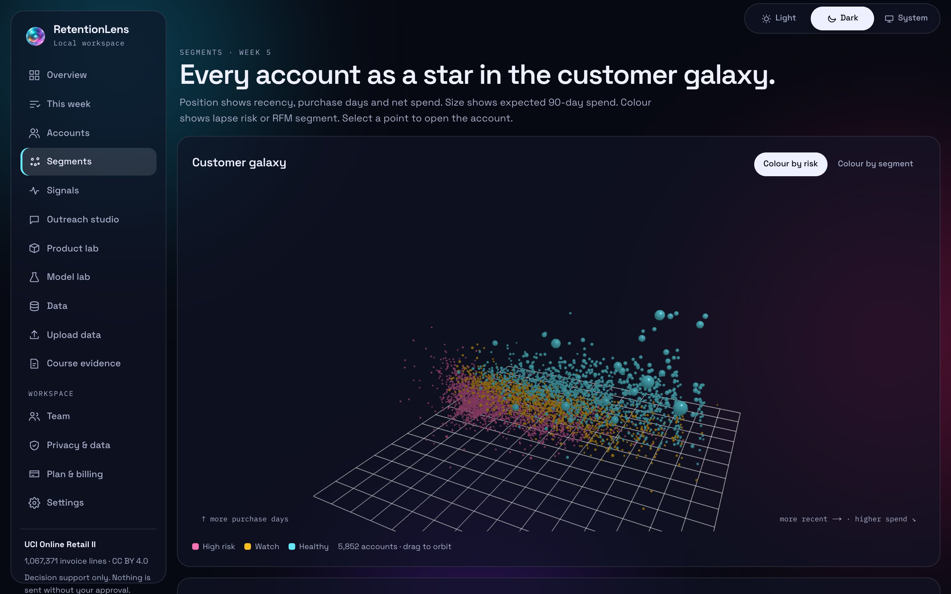
SEGMENTS · OUTCOME C · WEEK 5
Every account as a star in the customer galaxy
Segment | Accounts | Exp. 90-day £
Champions | 1,239 | 1,000,902
Loyal | 735 | 155,832
Needs attention | 631 | 112,284
Promising | 670 | 97,510
Hibernating | 1,435 | 53,126
Lookalike model finds new customers who look like future top-20% spenders: test AUC 0.821 on 1,285 later customers.
Notes:
k-means chose k=4 by silhouette. Each RFM segment carries a suggested play for a person to judge.

Slide 11
SIGNALS · OUTCOME B · WEEKS 9–10
Wholesale buying runs a month ahead of consumer interest
Christmas lines: correlation 0.34 in the same month, 0.90 with interest one month later (12 monthly points, exploratory).
Traditional: invoices. Web: Wikimedia pageviews (CC0). Network: co-purchase communities.
Social: 600 posts, SYNTHETIC and labelled, because licensed review data cannot be published.
Scraping demo: polite, robots-checked, on the toscrape.com sandbox.
Notes:
Wikipedia data covers 2016 to 2025 and invoices 2009 to 2011, so only seasonal shape is compared.

Slide 12
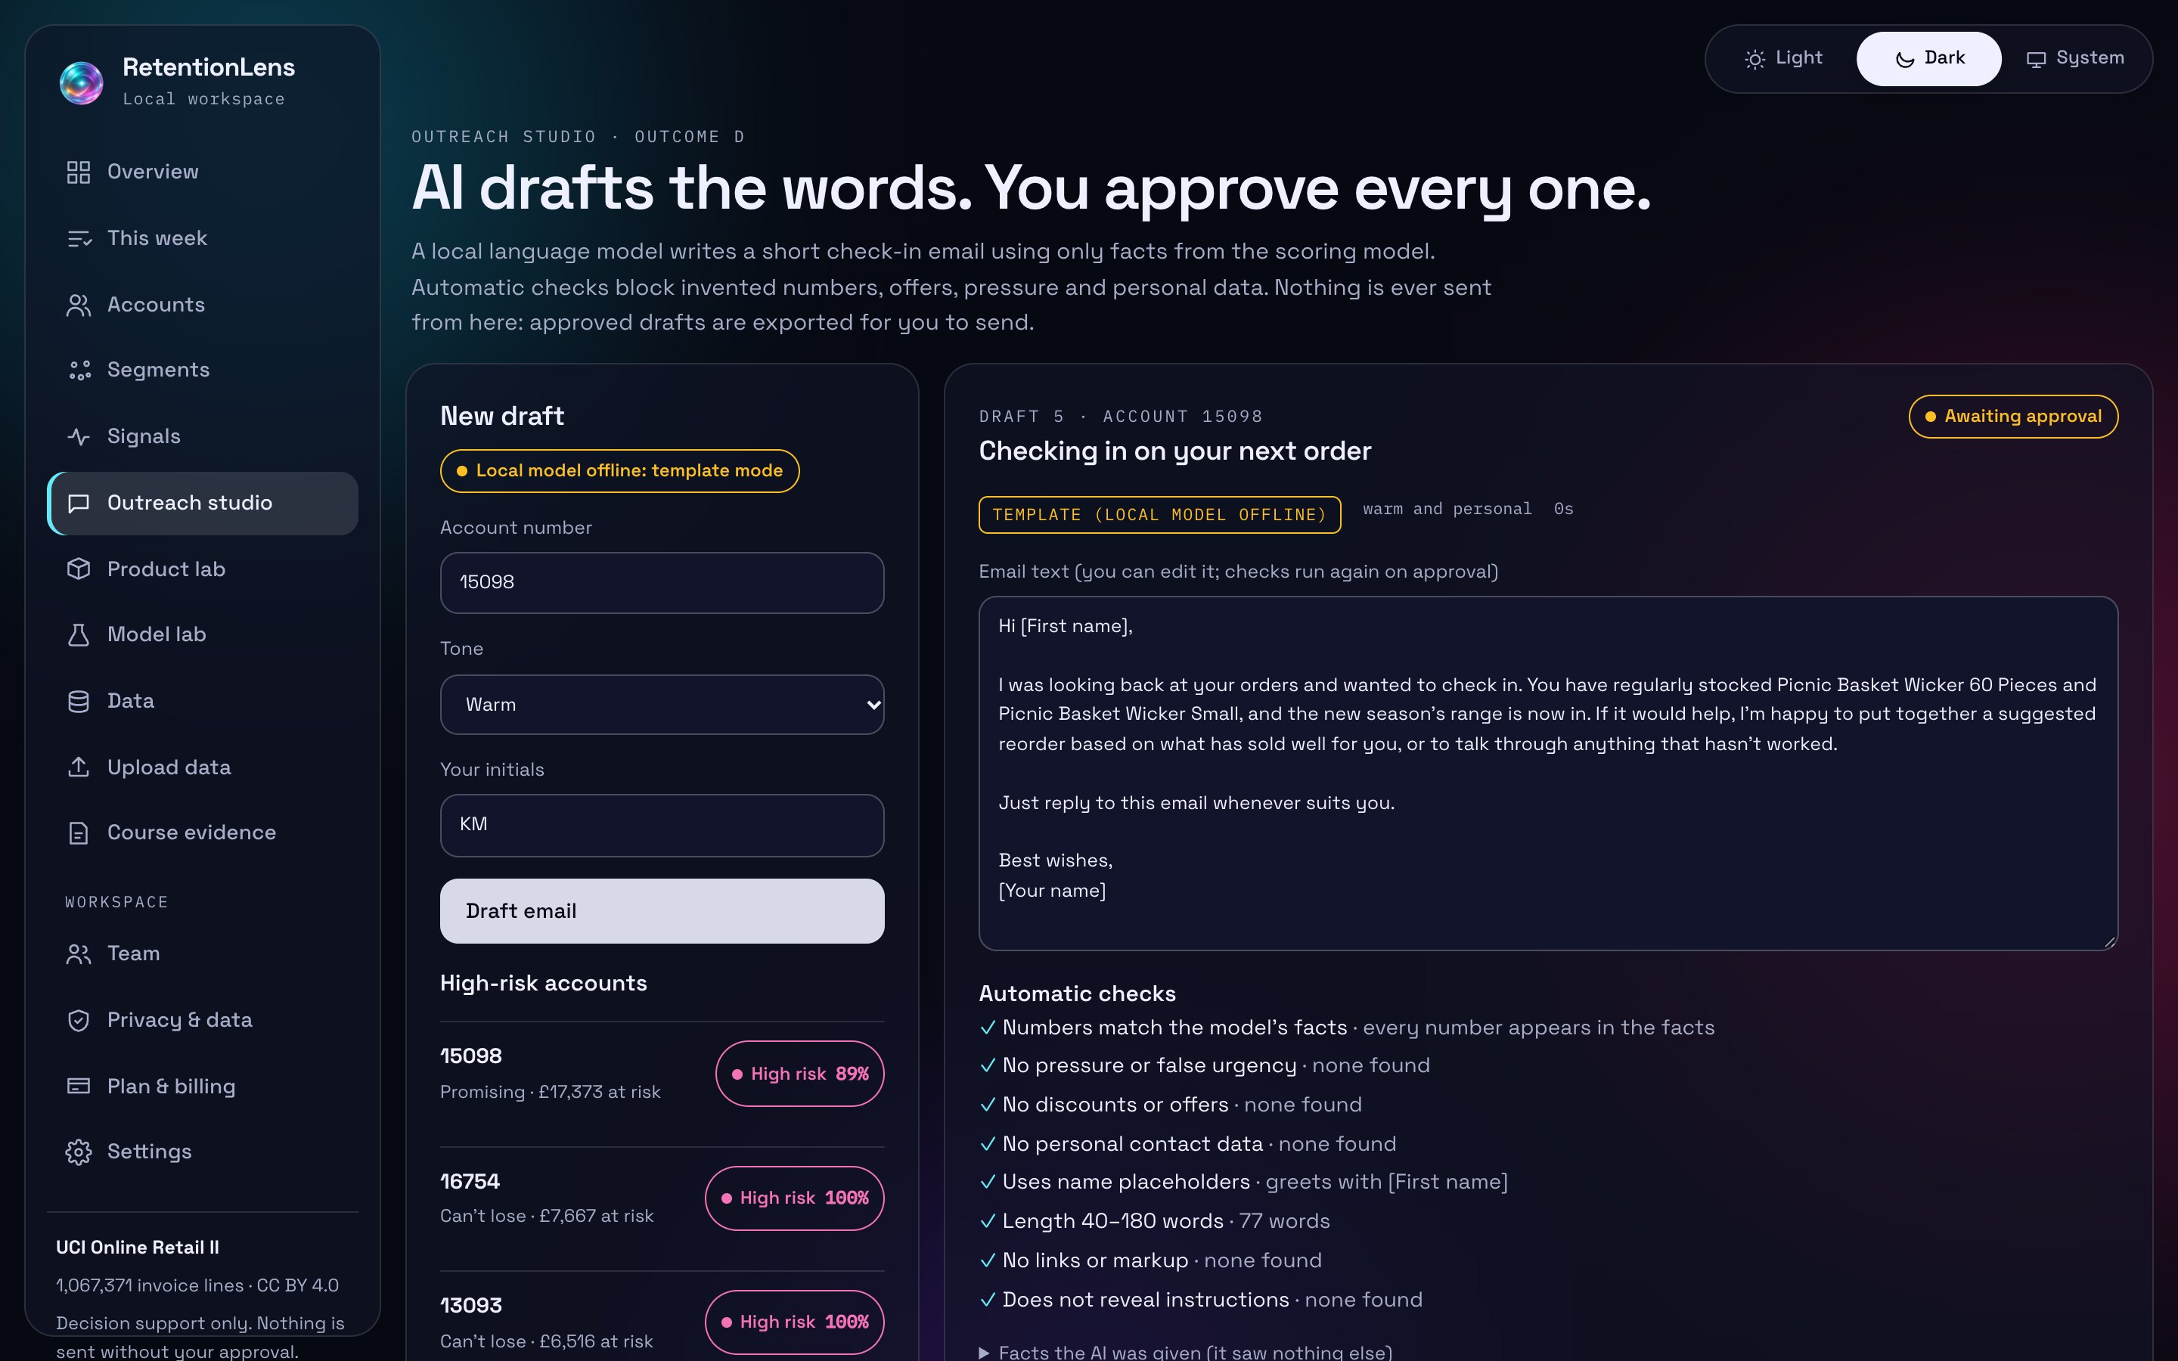
OUTREACH STUDIO · OUTCOME D
The AI writes the words; the model supplies the numbers; a person decides
1 Facts from the scoring model only
2 Local qwen2.5:7b drafts (JSON)
3 Checker: numbers, offers, pressure, contact data
4 Second-pass review of tone
5 Human approval + UK PECR basis
6 CSV export · no send tool
Live test, 16 drafts: numbers grounded 15/16; second-pass review passed 1/16. A person reviews every draft.
Notes:
The critic is strict and still needs calibration against human labels; the labelling sheet is in reports/critic_labels.csv.

Slide 13
RESPONSIBLE AI · CLO4
Built so it cannot email a customer by itself
Red-teamed
Every number grounded
Consent first
No free text in prompts; 23 OWASP LLM Top 10 cases run in CI on every push.
Any figure not in the model output blocks the draft.
Companies: legitimate interest. Sole traders: consent or soft opt-in. Otherwise approval is blocked.
Accountable
Honest data
Accessible
Idempotent approvals and an append-only audit log of who decided what.
Synthetic data labelled everywhere; licences in the source register.
axe-core WCAG 2.2 AA: 0 violations on 9 pages, both themes; works at 320 px.
Notes:
Mapped to the OWASP Top 10 for LLM applications (2025) in docs/security/LLM_RED_TEAM.md: prompt injection, sensitive information disclosure, improper output handling, excessive agency, system prompt leakage, misinformation and unbounded consumption.

Slide 14
SAAS FOUNDATIONS · R2, R6, R8
Built and tested locally; not yet hosted
Workspaces and roles
Row-level security in CI
One workspace per company; owner, reviewer and viewer roles; every query scoped to the workspace. Sign-in hardening: throttling, weak passwords refused.
The Supabase migration is applied to a local Postgres stack in CI and a two-tenant test fails the build on any read or write leak.
Load test: 20 users, 30 s
Restore drill: passed
10,261 requests, 342 per second, 0 errors. p95 270.9 ms against a 500 ms target.
Backup checksum and integrity check passed; row counts matched in all 14 tables. Run on a SYNTHETIC seeded database.
Tests collected on 2026-11-01: 61 ML · 66 API · 52 browser (static) + 1 live end-to-end flow.
Notes:
Sources: reports/load_test.json (local machine, not a hosted server), reports/restore_drill.md (small synthetic database), the rls job in .github/workflows/ci.yml, and test collection counts in design/test_counts.json. Render, Supabase and Stripe accounts do not exist yet, so none of this has run on hosted infrastructure.

Slide 15
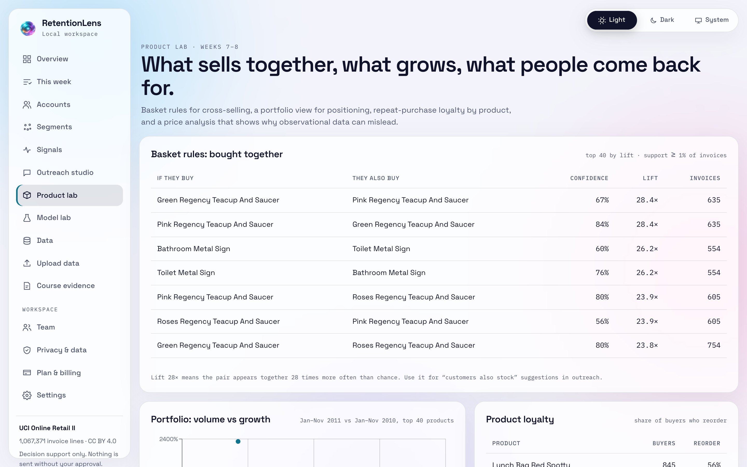
PRODUCT LAB · WEEKS 7–8
What sells together, and why price data can mislead
Strongest pair: Green Regency Teacup And Saucer → Pink Regency Teacup And Saucer, lift 28.4×, 635 invoices.
Portfolio matrix: stars, cash cows, question marks and dogs from 2011 vs 2010 sales.
Product loyalty: share of buyers who reorder an item, a simple brand signal.
Price elasticities come out near −15 to −20: wholesale price breaks, not price sensitivity. Shown as a confounding lesson.
Notes:
All product-lab results are associational; no price was randomised.

Slide 16
COURSE FIT
Every learning outcome has a working screen and a result file
Outcome | Evidence
A · research and predictive analytics | Data profile, rolling-cutoff lapse models, cohort terrain
B · traditional, web and social data | Wikipedia seasonality, co-purchase network, synthetic social, scraper
C · CLV, churn, retention, new customers | BG/NBD + Gamma-Gamma, segments, lookalikes
D · Generative AI for decisions | Outreach studio with checks, consent gate and live evaluation
Labs weeks 2, 4, 6, 8, 10 | Scaffolds and EVIDENCE.md in labs/ · [OWNER: lab reports to be written]
Week 12 final project | This deck, the report, and the live demo
Notes:
The Course evidence page in the app links each outcome to the screen and file that shows it.

Slide 17
WHAT IS STILL MISSING
The software exists; the market evidence does not yet
No customer interviews yet: buyer, workflow and price are hypotheses.
No usability sessions: the 10-minute first-run target is untested with real users.
No pilot and no customers: the holdout queue has produced no uplift result.
No hosting: Render, Supabase and Stripe test accounts are not created; everything ran locally or as a static demo.
The AI critic is uncalibrated: no human labels yet. One wholesaler, 2009–2011 data.
Next, in order
8–10 discovery interviews (kit ready in docs/research).
5 think-aloud sessions on upload → queue.
Label 16+ drafts to calibrate the critic.
Create hosting accounts; run the restore drill on real rows.
A four-week pilot with one wholesaler.
[OWNER: add your own reflection and learning narrative here or in the talk track]
Notes:
[OWNER: speaker narrative and reflection to be written by the student.] Facts only on this slide: none of the listed evidence exists yet; see project/NEXT_ACTIONS.md.

Slide 18

Thank you
Live demo · krish2105.github.io/Retention-Lens-AI-in-Marketing- · retentionlens-demo.vercel.app
Code · github.com/krish2105/Retention-Lens-AI-in-Marketing-
Illustrations generated by the author with ChatGPT Images. Data: Chen (2019), UCI Online Retail II, CC BY 4.0.

