Slide 1


Slide 2
Minor Project – I Geyser Eruption Analysis by the use of K-mean clustering algorithm
MEMBER’S NAME | ROLL NUMBER | SAP ID | BRANCH
Anushka Sharma | R2142201903 | 500085576 | Big Data
Garvita Adhikari | R1242201887 | 500087652 | Big Data
Krish Aggarwal | R214220624 | 500082524 | Big Data
Udbhav Singh | R2142201245 | 500082352 | Big Data
Under the guidance of
Bhagwant Singh Sir

Slide 3

Contents
Introduction
Software and Libraries to be used
Motivation
Problem Statement
Objective
Methodology
Result and Discussion
Conclusion
Application of project
References

Slide 4
Introduction
A geyser is a special form of hot spring that explodes under pressure, releasing steam and water jets into the air.
Geyser eruption is the conversion of thermal to kinetic energy during decompression.
The eruption will continue until all the water is forced out of the tube, or until the temperature inside the geyser drops below boiling point.

Slide 5
Software and Libraries to be used: C++ & Python
Vector
Math.h
Stdlib.h
Time.h
fstream
Matplotlib
Itertools

Slide 6

Motivation
To examine data of various time stretches at which geyser eruption occurs in order to compute and compare the mean time interval of eruption.
Geysers provide a natural laboratory to study multiphase eruptive processes.

Slide 7
Problem Statement
To comprehend geysers better and to anticipate parts of their way of behaving. This examination explores the spans at which explicit geyser erupts and submits numerical scatter plots for the time stretches by the utilization of K mean clustering calculation .

Slide 8
Objective
To examine data of various time stretches at which geyser eruption occurs in order to compute and compare the mean time interval of eruption.
To comprehend geysers better and to anticipate parts of their way of behaving.

Slide 9
Literature Review
In 2022, Reservoir computing, a form of machine learning, was used to characterize the collective behavior of 10 Yellowstone geysers. These improvements suggest that geysers are not independent and instead reflect the existence of a complex interconnected subsurface groundwater system.
In 2022, this paper is based on inspection paradox of renewal theory which states that, in expectation, the inspection interval is larger than a common renewal interval, in general. For a random inspection time, which includes the deterministic case, and a delayed renewal process, representations of the expected length of an inspection interval and related inequalities in terms of covariance are shown. Data sets of eruption times of Beehive Geyser and Riverside Geyser in Yellowstone National Park.
In 2019, a catalog of 73,466 eruptions of Strokkur geyser was created in Iceland, from a 1 year seismic data set. It was found that 50,135 single eruptions but only 1 sextuple eruption, while the mean waiting time increased from 3.7 min after single eruptions to 16.4 min after sextuple eruptions. Through this research it was found that the waiting time after an eruption can be predicted, while future eruption type or amplitude cannot.

Slide 10
Literature Review
In 2019, this paper focuses on three open questions about geysers in general and Steamboat in particular: (1) what initiates an active phase? (2) What controls the intervals between eruptions within active phases? (3) What controls the height of the eruption column? The coupled conduit and plume dynamics model suggests that a deeper reservoir produces a greater vapor mass fraction and therefore a greater exit velocity. More robust monitoring of geyser systems is needed to understand eruption variability and additional constraints on plumbing geometry would improve quantification of eruption dynamics.
In 2017, this paper mainly focuses on why do geysers exist? What determines eruption intervals, durations, and heights? What initiates eruptions? Eruptions are driven by the conversion of thermal to kinetic energy during decompression. Larger and deeper cavities permit larger eruptions and promote regularity by isolating water from weather variations.
In 2015, this paper tells that Geysers can be hydraulically connected through permeable pathways to other hot springs. The level of complexity of geyser eruptions may be controlled by the underground geometry. Over time geysers change periodicity, develop new thermal features, and shift interactions

Slide 11
Methodology
This implementation is performed using C++ & Python programming language with related libraries to achieve the task. For the K-means clustering algorithm, some specific values are assigned for K , and clusters have been created from the standardized data. Because the features could not be in the same measurement units, standardizing data involves including data with a zero mean and a one standard deviation. And the centroid calculated from the dataset are then plotted in the graph

Slide 12
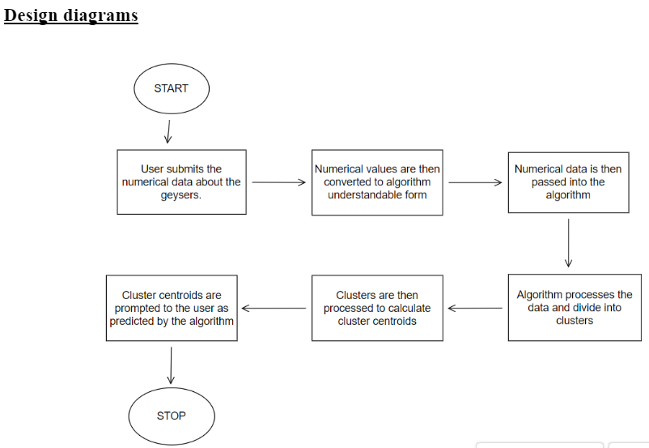
Fig 1: Plan of Work

Slide 13
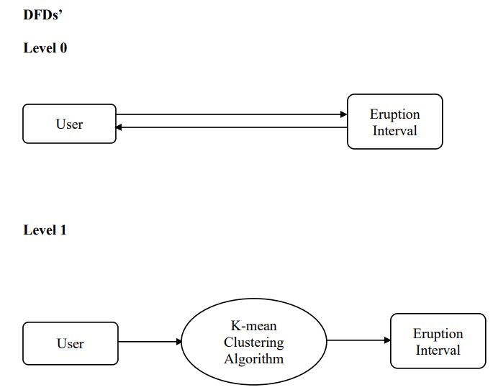
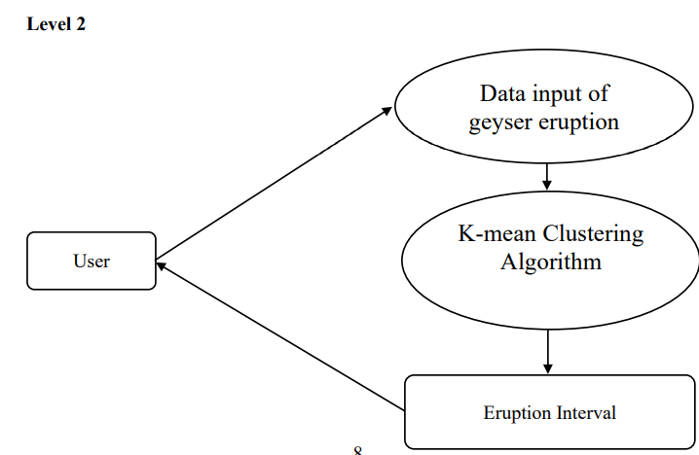

Slide 14
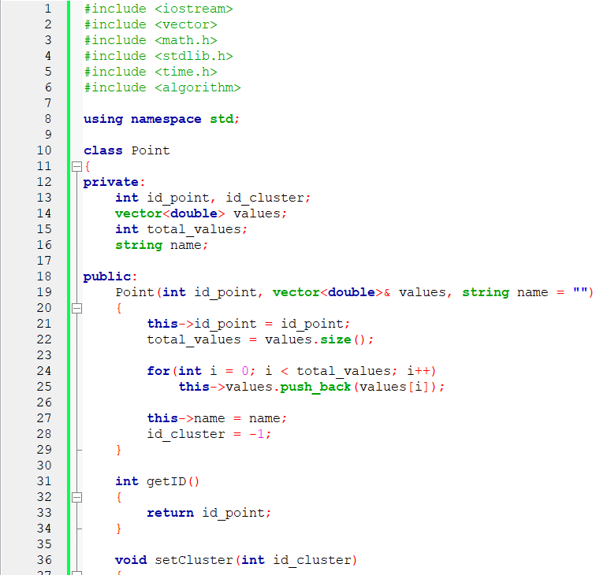
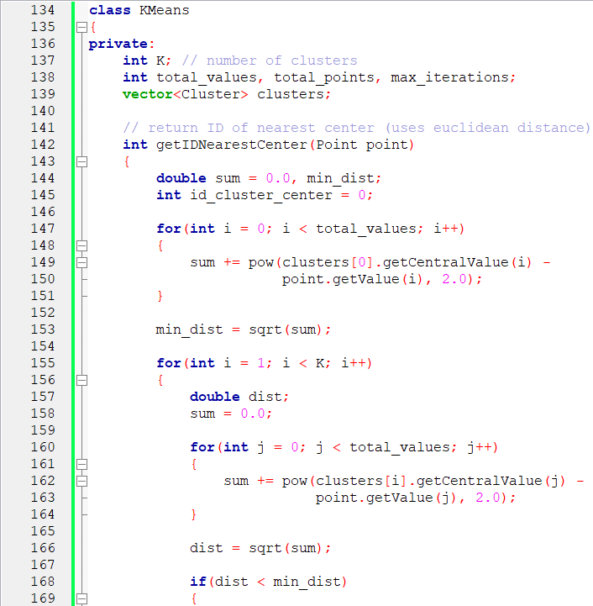
Input:

Slide 15
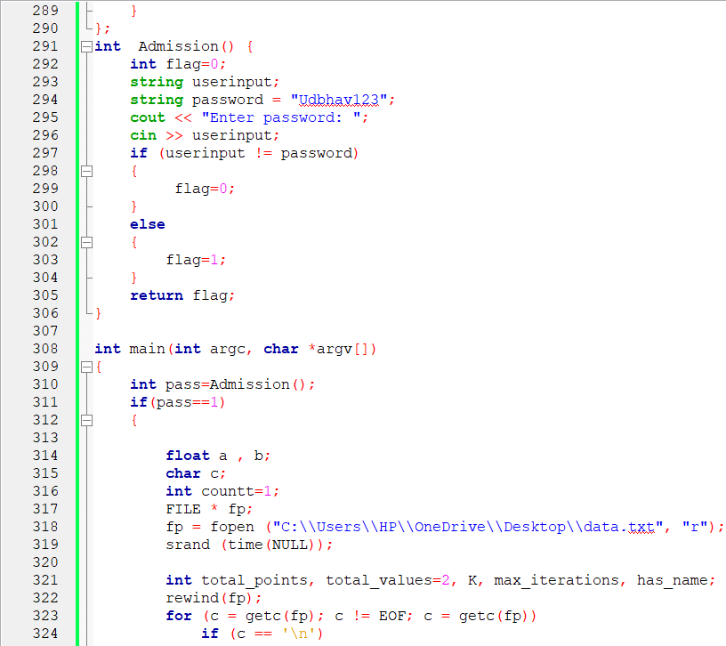
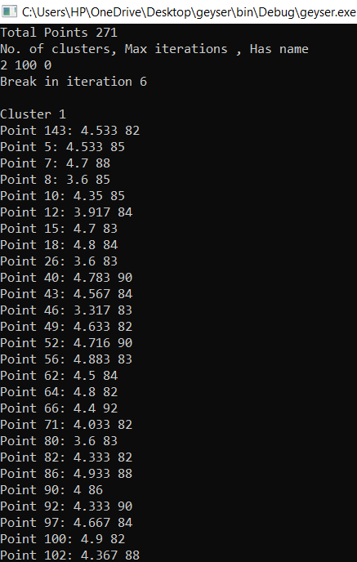
Output:

Slide 16
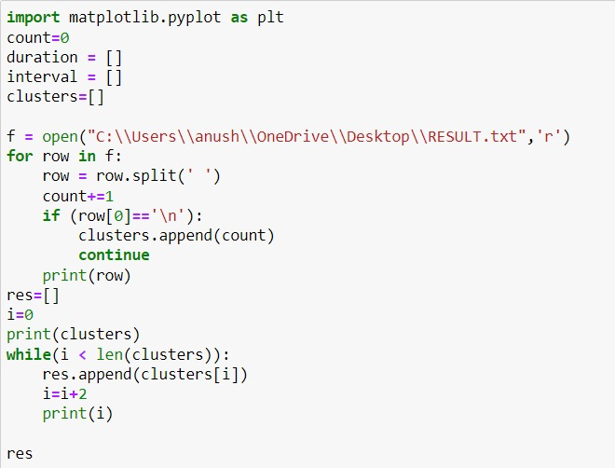
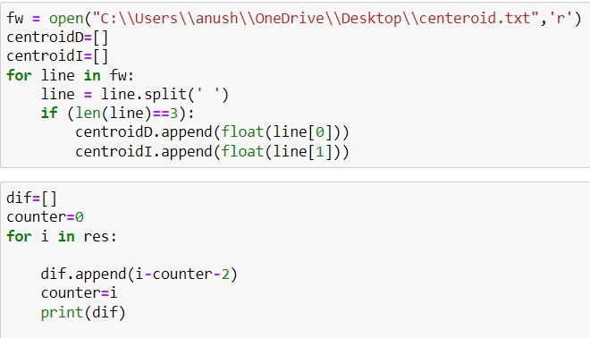
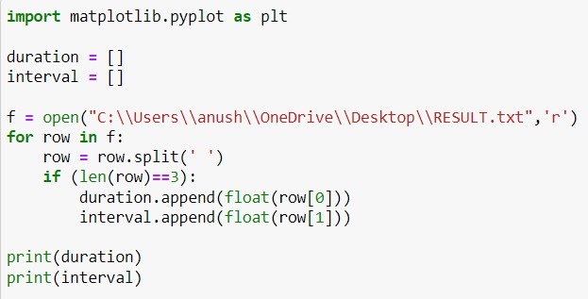
Input:

Slide 17
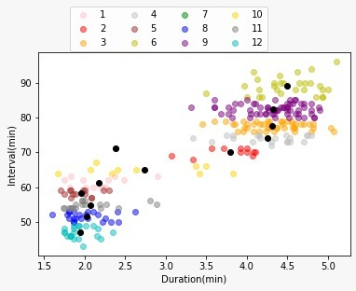
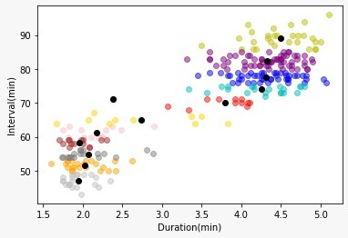
Scattered plots

Slide 18
Result and Discussion
To extract the dataset from web resource and gain insights.
To examine data of various time stretches at which geyser eruption occurs in order to compute and compare the mean time interval of eruption.

Slide 19
Conclusion
Analysing the extracted data from web source
Identified the dataset to be categorical data
Plotting a scattered graph from this categorical data.

Slide 20
Application of Project
To deliver services to the meteorological department

Slide 21
References
Quantifying Interdependencies in Geyser Eruptions at the Upper Geyser Basin, Yellowstone National ParkWilliam F. Fagan,Anshuman Swain,Amitava Banerjee,Hamir Ranade,Peter Thompson,Phillip P. A. Staniczenko,Barrett Flynn, JeffersonHungerford, Shaul Hurwitz
Quantifying the Inspection Paradox with Random Time, Diana Rauwolf, Udo KampsInstitute of Statistics, RWTH Aachen University.
Eruption Interval Monitoring at Strokkur Geyser, Iceland. Eva P. S. Eibl,Sebastian Hainzl,Nele I. K. Vesely,Thomas R. Walter,Philippe Jousset,Gylfi Páll Hersir,Torsten Dahm
Reed, M. H. ; Barth, A. ; Girona, T. ; Hajimirza, S. ; Hurwitz, S. ; Karlstrom, L. ; Karplus, M. S. ; Manga, M. ; Muñoz-Saez, C. ; Rashtbehesht, S. H. ; Wu, S. M. “Multiparameter Study of Eruptive Behavior at Steamboat Geyser, Yellowstone ”
Hurwitz, S., & Manga, M. (2017). The Fascinating and Complex Dynamics of Geyser Eruptions. Annual Review of Earth and Planetary Sciences, 45(1), 31-59.
Munoz-Saez, C., Namiki, A., & Manga, M. (2015). Geyser eruption intervals and interactions: Examples from El Tatio, Atacama, Chile. Journal of Geophysical Research: Solid Earth, 120(11), 7490-7507.

