Slide 1

AI-Based Hostel Room Allocation System
A web portal with an AI booking assistant
Presented by Krish · Lovely Professional University
·Course - AI Foundation (CSE276)
Krish Kumar 12523448; Puppala Uday Kiran 12505113; Wani Abdul Hanan 12525011; Bhavya Bishnoi 12525855

Slide 2



THE PROBLEM
Hostel allocation should not depend on a spreadsheet
AUDIENCE PROMPT
Two students click
the same bed.
Manual allocation creates double bookings
Long queues and poor visibility slow everyone down
One live web app gives admins control and students self-service
What should happen next?

Slide 3
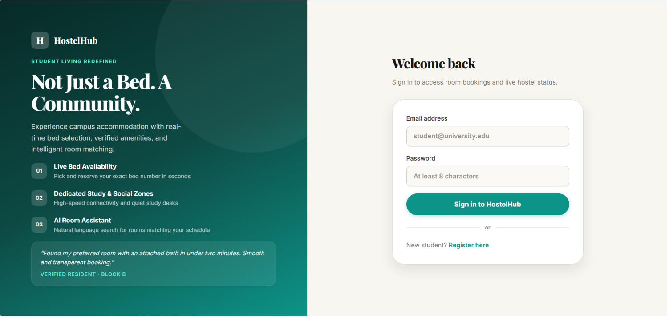
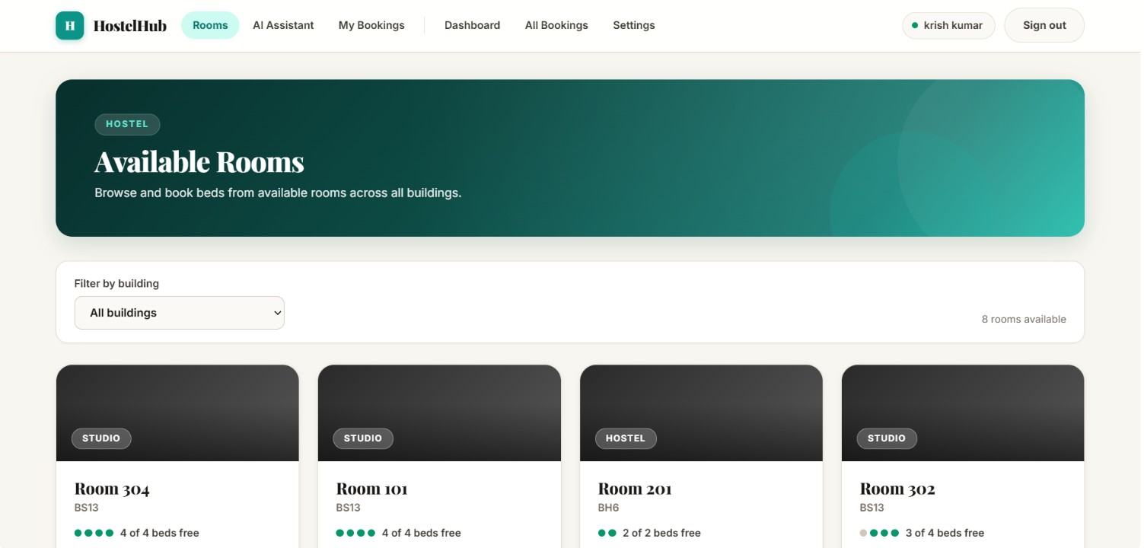
THE PRODUCT
One system, two portals, one source of truth
ADMIN PORTAL
STUDENT PORTAL
Control inventory
Book with confidence
Manage buildings, rooms, beds, and policies.
Browse, book, cancel, and ask the assistant for help.
AI assistant
Understands natural requests such as “a double room with a study desk.”
The student always confirms before a booking is created.

Slide 4




TRUST BOUNDARY
Database rules beat browser assumptions
Server functions and PostgreSQL
Unique indexes
Enforce availability, privacy, cancellation, and role rules.
Prevent two students from taking one bed.
AI boundary
Out of scope
The AI can search and propose, but it cannot book.
Payments, roommate matching, mobile apps, and autonomous booking.

Slide 5
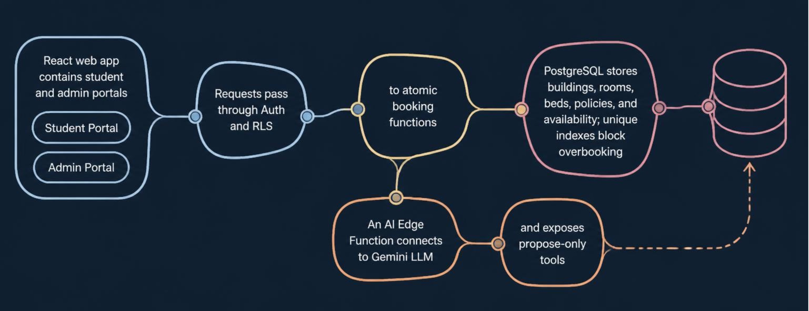
METHODOLOGY
Methodology: the AI stays behind the rules
The interface can be conversational. The system of record remains transactional.

Slide 6

BOOKING FLOW
Booking is a server-side atomic step
01
02
03
04
Select
Recheck
Save
Protect
Student selects a bed or accepts a proposed bed.
Server rechecks availability, identity, policy, and cutoff rules.
One atomic booking function saves the result.
The database prevents a race condition from becoming an overbooking.
Trace the recheck that protects the final step.

Slide 7
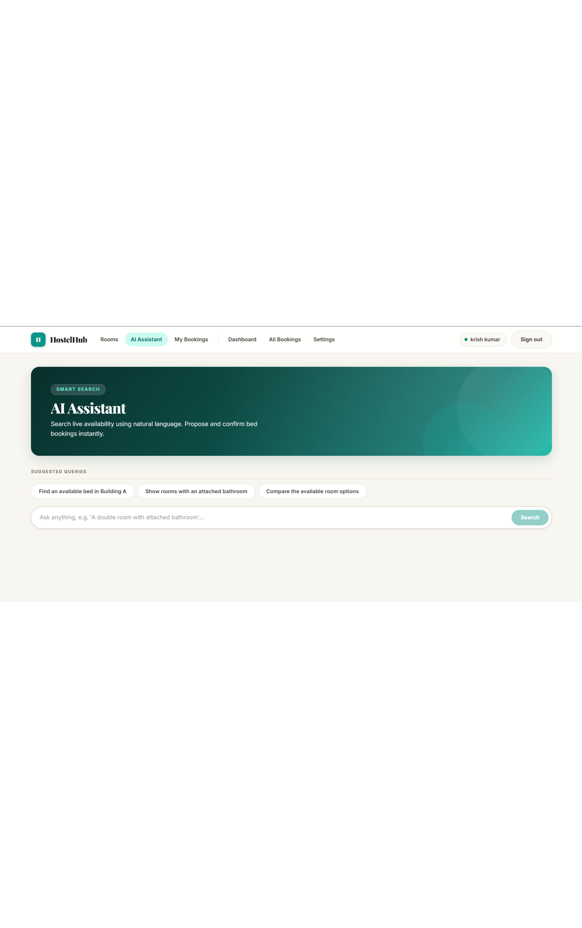
AI ASSISTANT
The AI assistant proposes; the student decides
01
02
03
04
Describe
Search
Propose
Confirm
Student describes the need in natural language.
Gemini calls only three allowed search tools.
Server returns real rooms and beds from live availability.
A five-minute proposal is rechecked before booking.
The database, not the AI, decides what exists.

Slide 8
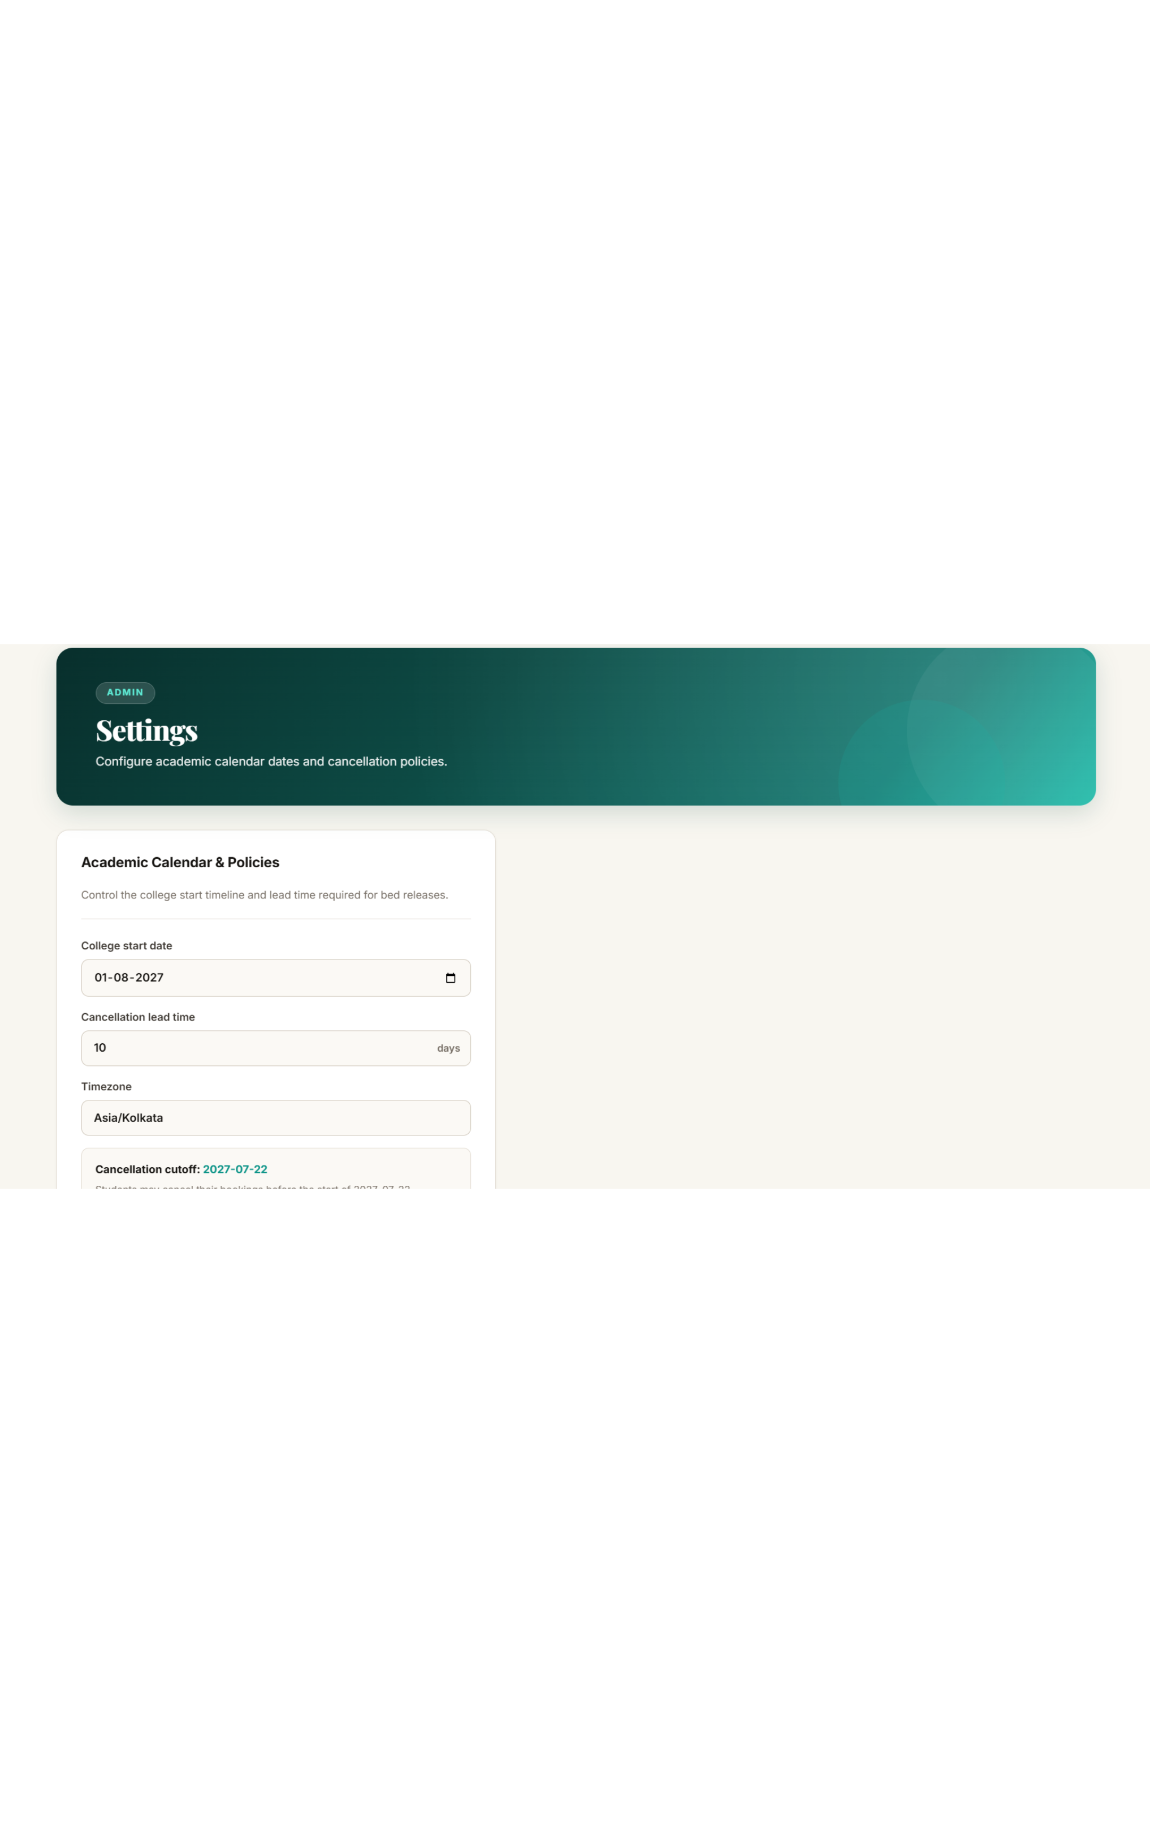




POLICY AND PRIVACY
Cancellation and privacy are policy, not suggestions
Each student can have one active booking.
Cancellation is allowed until 10 days before college starts.
The cutoff is calculated on the server in the college’s timezone.
Cancelled bookings remain in history, while student contact details stay private from other students.

Slide 9
RESULTS
Results: the critical paths held under test
10/10
3/3
Exactly one
automated integration tests passed
solver tests passed
Booking, cancellation, privacy, and admin rules.
Including an impossible case reported as infeasible.
student succeeded
Concurrent booking of one bed.
Before-cutoff cancellation freed the bed.
On/after-cutoff cancellation was rejected.
A proposal for a bed already taken was rejected at confirmation.
Transparency note: one live AI test was skipped; the missing-facility claim check was manual.

Slide 10
Links, resources, and next steps
GitHub repository: https://github.com/krish50507kumar/Hostel-allocation-system
Live demo: https://hostel-allocation-system-inky.vercel.app/
FUTURE WORK
Compare LLM providers, explain solver recommendations, add admin editing, roommate preferences, verified college email, stronger rate limits, notifications, waitlists, and payments.
Would you trust the AI more if every proposal remained database-verifiable?

Slide 11
Thank You
Questions and feedback are welcome.
GitHub: Hostel-allocation-system · Live demo: hostel-allocation-system-inky.vercel.app
Notes:
Thank the audience, invite questions, and point to the repository and live demo for follow-up.

