Slide 1
The Subtle Art of Accurate NLP for Radiology Report Mining
Krishna Chaitanya Kaluva, Suthirth Vaidya, Kiran Vaidhya, Abhijith Chunduru
Predible Health, Bangalore, India

Slide 2
Rise in AI is leading to huge demand in highly-accurate NLP tools
Most hospitals have dumps of radiology data but need good tools to extract the right specific datasets
Few different application where you may use NLP:
Extract an imaging dataset which meet specific diagnosis or range of diseases (such as cancer)
Extract an imaging dataset with specific findings such as pulmonary nodules
Extract highly-specific criteria-define datasets
Example: COPD patients with emphysematous bullae

Slide 3
Different approaches: Rule based vs Machine Learning based NLP
 | Rule based NLP | Machine learning based NLP
Debug Difficulty | Hard coded rules – easy | Black box – difficult
Flexibility | Easily updatable rules with new words or synonyms | Model needs to be trained on large amount new data
Quantity of data | Small report set is enough | Requires massive training corpus and annotations
Time needed | Less time consuming | More time consuming
Text Length | Can interpret sentences but not paragraphs, documents | Can interpret sentences, paragraphs and documents
Scalability | Difficult | Easy
Domain Expertise | Requires good clinical knowledge | Requires good technical experience

Slide 4
Rule based NLP is easy to code and less time to implement and test
Radiologist already have good clinical knowledge
Rule based NLP requires minimal amount of coding experience
Hence, radiologists can easily leverage the power of Rule based NLP to generate accurate classified reports
Requirements to implement a Rule based NLP
Reports
List of Key words
List of negations
1
2
3

Slide 5



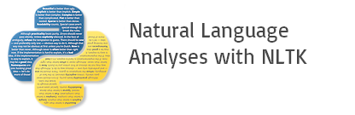
What software do you need for rule-based NLP?
Hardware requirements:
PC / Laptop
Software requirements:
Python 3.4 and above (anaconda environment if windows)
Jupyter notebook (available with anaconda on windows)
Libraries:
Numpy
Pandas
NLTK

Slide 6
Extract all the reports from PACS and collate them
In order parse the report texts and derive meaningful insights, following are the first steps to collate all the required report data dump
Extract relevant reports from PACS (say Chest CT reports) that meets your inclusion / exclusion criteria and write to an excel file
If a patient has more than one report, identify the report relevant to the problem statement
Eg : Early detection of Lung Cancer – Report with a nodule finding for the first time
The excel file should have 2 columns – “Patient ID” , “Report text”
Make sure the report text is not exported in html or xml format

Slide 7
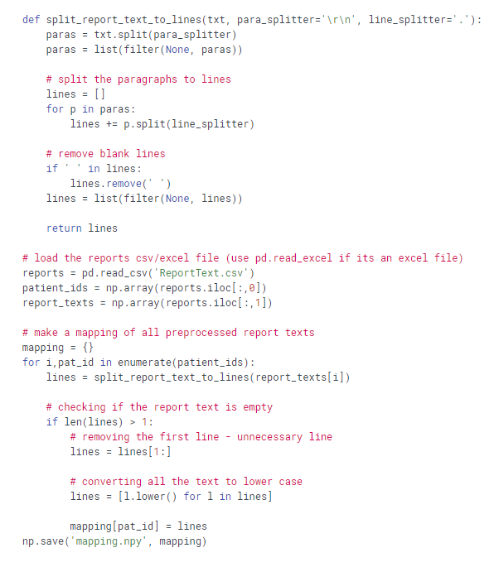
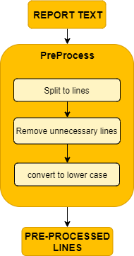
Process the extracted reports to use them in code
Given a report text,
Split text into lines
Remove blank lines
Load the excel / csv file and separate IDs and reports
Iterate on all patients
Get the lines in a report
Remove unnecessary lines if any
Convert all lines to lower case
create a mapping – [patient ➔ report lines]

Slide 8
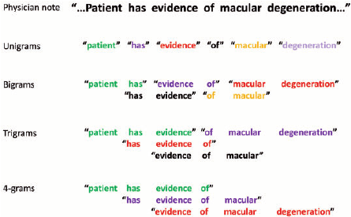
Use N-Gram analysis to understand most commonly occurring keywords (and pairs)
N-gram: A contiguous sequence of N words occurring together and their frequencies in a huge corpus of text data
It helps understand the reporting semantics followed by the hospital while reporting a case
Better understanding of how and what negations or adjectives were used for a specific scenario (such as unremarkable, likely)
Helps us identify various abbreviations or short forms used in reporting ( such as GG, UIP, ILD)
Can help identify clinically relevant and irrelevant terms (Eg: machine specifications in a report are irrelevant)

Slide 9
Steps to perform N-gram analysis on reports
N-gram analysis gives us a set of one, two, three, or four word combinations and their frequencies of occurrence in the reports
In order to perform this analysis
Collate lines from all reports into a single list of lines
Remove stop words from all the lines
Remove the phrases / sub headings that are commonly used while reporting
Eg: “CT Thorax / Chest - HRCT Plain of 01-JUN-2017”, “Volumetric Scanning was performed on a MDCT”, “Results”, “Conclusion”, “Impression”
Convert all the lines into list of words
Using the open source library NLTK (Natural Language Processing Kit), we perform n-gram analysis on each line and add up the frequencies of occurrence
Collate all lines
Remove stop words
Remove machine specifications
Split into words
NLTK

Slide 10
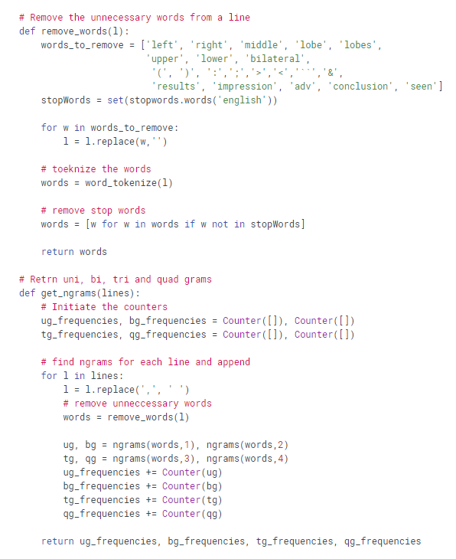
N-gram analysis – Code explanation
Given a line
Remove unnecessary words and characters
Remove stop words
Return the list of words remaining in a line
Given a set of lines
Remove unnecessary words and stop words from each line
Use ngrams module from nltk to get Uni, Bi, Tri and Quad grams
Iterate on each line and add the frequencies

Slide 11
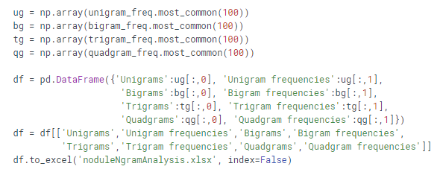
Ngram analysis – Code explanation
Save the most common 100 or 200 phenomes for each of Uni, Bi, Tri and Quad grams to an excel file
Example of how the saved excel file will look like
Unigram | Unigram frequency | Bigram | Bigram frequency | Trigram | Trigram frequency
('lesion') | 3348 | ('degenerative', 'changes') | 3352 | ('mild', 'pleural', 'effusion') | 2326
('infiltrates') | 674 | ('pleural', 'thickening') | 2452 | ('mediastinal', 'lymph', 'nodes') | 1833
('atelectasis’) | 3028 | ('pleuroparenchymal', 'interfaces') | 1502 | ('passive', 'collapse', 'consolidation') | 73
('emphysematous') | 2483 | ('emphysematous', 'changes') | 1859 | ('mediastinal', 'vascular', 'structures') | 794
('mass') | 1166 | ('ground', 'glass') | 4822 | ('hiatus', 'hernia', 'noted') | 106

Slide 12
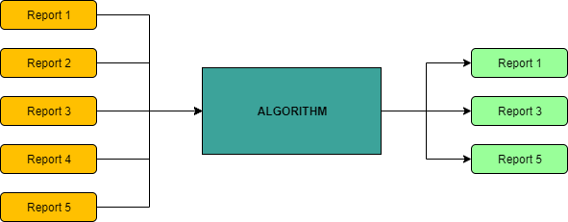
Example - Find all Chest CT scans with Pulmonary fibrosis in them
Objective – Find all Chest CT scans with Pulmonary fibrosis reported in them
Keywords – As mentioned in the table before
Negations – no, not, normal, absent, absence, unlikely, negative

Slide 13
Example lines of how pulmonary fibrosis is reported
Interstitial thickening with areas of fibrosis seen in bilateral lung fields
Multiple subpleural areas of honeycombing in bilateral lungs
Reticulations are seen in right middle lobe and left lingual
Bronchial dilatation with bronchial wall thickening is seen on both sides
Lung parenchyma shows few centrilobular nodules with septal thickening and GG haze in left lower lobe
Adjoining area of atelectasis and traction bronchiectasis is also seen
Areas of mosaic attenuation seen in both lung fields.
Patchy hypodense fibrotic area is seen in posterior basal segment of left lower lobe
Patchy areas of ground glassing seen scattered in both lungs
Fibrotic changes in the form of traction bronchiectasis and inter and intralobular septal thickening

Slide 14
Example list of most frequent N-grams for pulmonary fibrosis
Lets find all the cases with pulmonary fibrosis from Chest CT reports
Pulmonary fibrosis – majorly presents as Honeycombing, Reticulations, Ground glass haze, Traction Bronchiectasis
Keywords found from N-gram analysis of reports
Honeycombing | Reticulation | Ground glass haze | Traction Bronchiectasis | Other words
honey combing | reticular changes | ground glass haze | traction bronchietasis | fibrosis
hony combing | reticulations | ground glassing | bronchial dilation | fibrotic changes
 |  | GG haze |  | hypodense regions
 |  | patchy areas of ground glass |  | septal thickening
 |  | mosaic attenuation

Slide 15
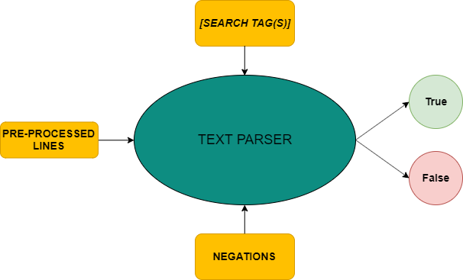
Steps to implement rule based NLP
For every report text, get the lines from it using the pre-processed mapping
Pass it to the text parsing algorithm with following attributes
1. Lines
2. Search tags or keywords
3. Negations
There are 2 types of search tags / keywords –
AND condition tags – is True when all tags are present
Eg: [‘honey’, ‘combing’] – both the words should be there for honeycombing to be true
OR condition tags – is True when any one tag is present
Eg: [‘fibrosis’, ‘fibrotic’] – True when at least one of them is present
The algorithm will return True or False for the respective search tag

Slide 16
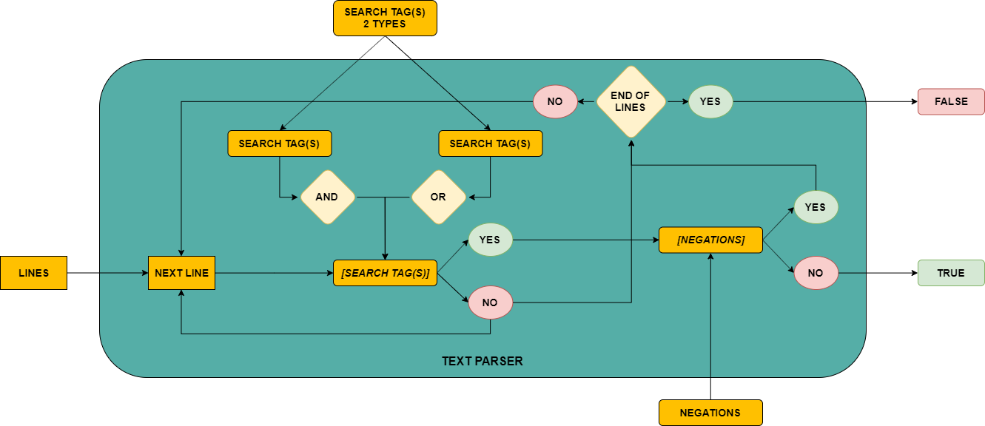
Flow chart showing the implementation of text parser algorithm

Slide 17
Explaining text parser algorithm using examples lines
Adjoining area of atelectasis and traction bronchiectasis is also seen
bronchi
AND
[SEARCH TAG(S)]
YES
[NEGATIONS]
NO
TRUE
traction, dilatation
OR
no, not, normal, ….
Bronchial dilatation with bronchial wall thickening is seen on both sides
bronchi
AND
[SEARCH TAG(S)]
YES
[NEGATIONS]
NO
TRUE
traction, dilatation
OR
no, not, normal, ….

Slide 18
Explaining text parser algorithm using examples lines
There are ill-defined centrilobular ground glass opacities scattered in bilateral lungs
ground glass
AND
[SEARCH TAG(S)]
YES
[NEGATIONS]
NO
TRUE
nodule, opaciti
OR
no, not, normal, ….
Patchy areas of ground glassing seen scattered in both lungs
ground glass
AND
[SEARCH TAG(S)]
NO
FALSE
nodule, opaciti
OR
False

Slide 19
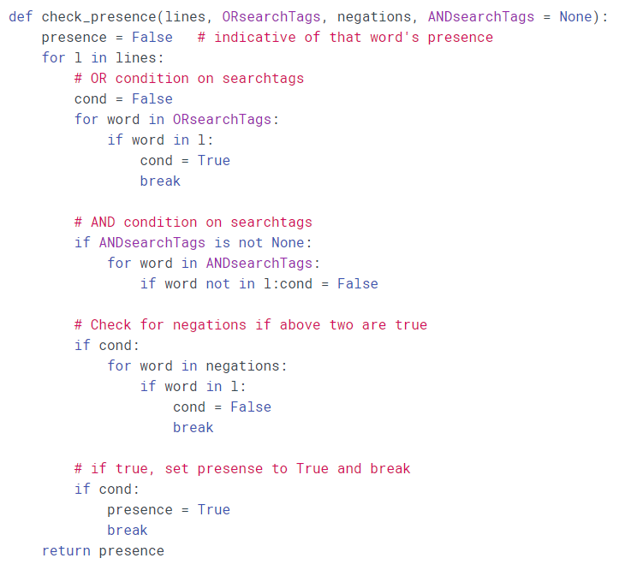
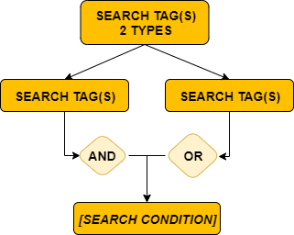
Text parser algorithm - code explanation
[NEGATIONS]

Slide 20
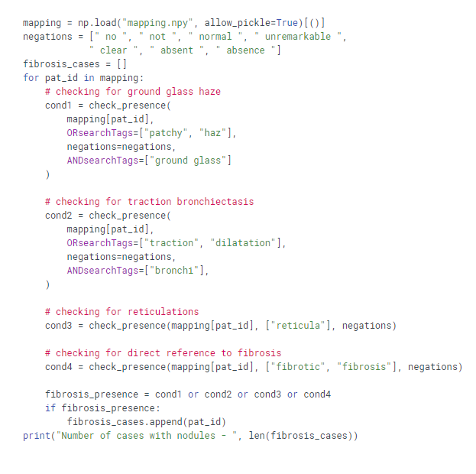
Text parser algorithm for fibrosis
Checking for ground glass haze or patchy areas of ground glassing
Checking for traction bronchiectasis or bronchial dilation
Checking for reticulations or reticular changes
Checking for fibrosis or fibrotic changes

Slide 21
Common pitfalls
Not knowing all kinds of negations used – unremarkable, ruled out, etc
Dealing with multiple negations in the same sentence – “Lung fields are not normal”
Occurrence of one word in an other word – mass and massive, no and normal, etc
Improper splitting of lines
Spelling mistakes in reports ➔ “esophagus”, “oesophagus”
Improper / No reporting standards
Presence of similar diseases in other organs

Slide 22
Spaces, Organ names, Lemmatization – Steps to improve accuracy
Use space before and after the word while giving input – helps solve the problem of one word being in another word – Example: “no” is found in “normal”, but “ no “(with space) is not found in “normal”
Some of the words which require spaces before and after – no, not, normal, likely, mass, etc.
Append organ name based negations – Helps avoid confusion with similar disease in a different organ
Example – When looking for cancer in lung, add the words liver, kidney, renal, adrenal, spleen, etc to negations to avoid picking cancer in them
Use lemmatized version of a word or part of the word in search tags to account for spelling mistakes
Example – “oesophagus”, “esophagus” are 2 words meaning similar – use the common phrase “ophagus” to avoid spelling mistakes

Slide 23
Further work
You can try a hybrid of rule based NLP and machine learning models to get meaningful insights on documents
Can extract parts of speech in each sentence using nltk to identify the severity of a disease/condition
A mildly-enlarged subcarinal lymph node is seen
Can use parts of speech in required sentences to get the characteristics of a disease/condition (texture, size, etc)
“Sub-centimetric calcified nodules are seen”
Write another function to deal with multiple negations in a line
Example – If “not” and “normal” are present, replace them with “abnormal”
Adjective
SEVERITY
Adjective
SIZE
Adjective
TEXTURE

Slide 24
We’ve open sourced the code to help you get started
https://github.com/predible/RSNA2019.git
Feel free to fork the repository and start developing
Contribute, raise issues and help the community

Slide 25
For further details contact
krishna@prediblehealth.com

