Slide 1
Healthcare Data Analysis
DINESHGOPI SUNKARA
BHOOKYA GOPI KRISHNA
KAKADIYA KRUNAL GORDHANBHAI
VEKARIYA URVISH BHAVINBHAI

Slide 2
Introduction
Healthcare data has become a crucial resource for improving healthcare delivery and understanding patient health.
This project analyzes healthcare data to support data-driven decisions, focusing on predicting patient outcomes.
Aim and objective: To provide actionable insights and improve healthcare management through data analysis.

Slide 3
Problem Statement
The healthcare industry faces challenges in predicting patient outcomes, optimizing treatments, and managing resources effectively. This project seeks to address these challenges by analyzing a healthcare dataset to uncover insights that can aid in predicting patient outcomes and understanding key health-related trends.

Slide 4
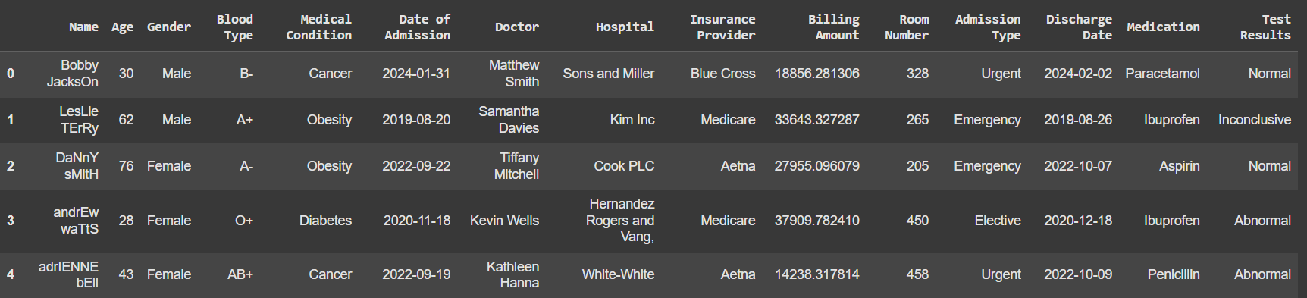
About Dataset

Slide 5
Technical Presentation

Slide 6
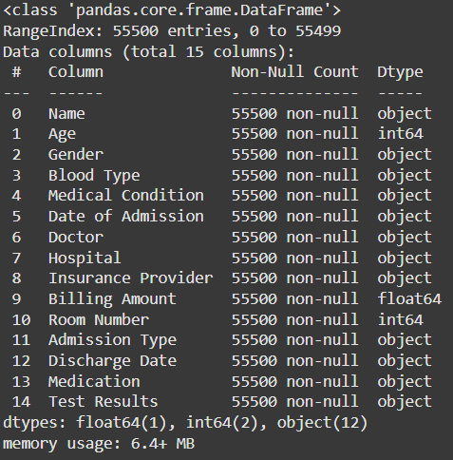
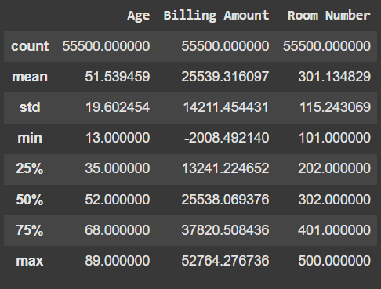
Data Distribution & Statistics

Slide 7
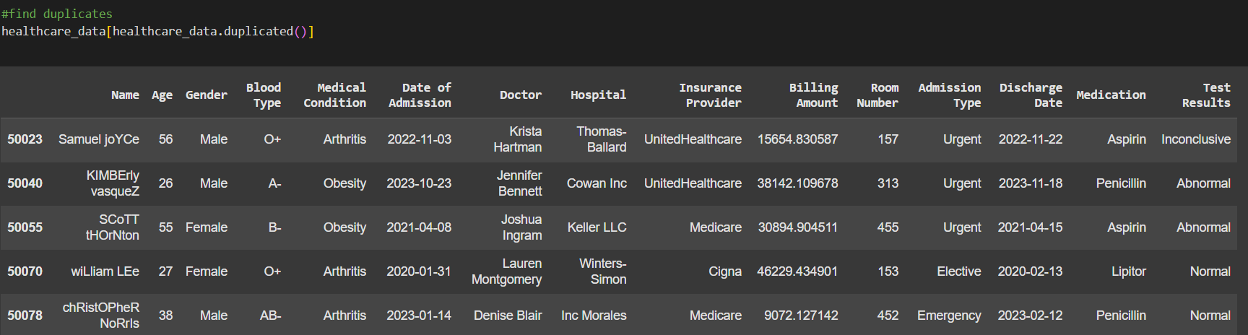
Duplicate Value Treatment

Slide 8
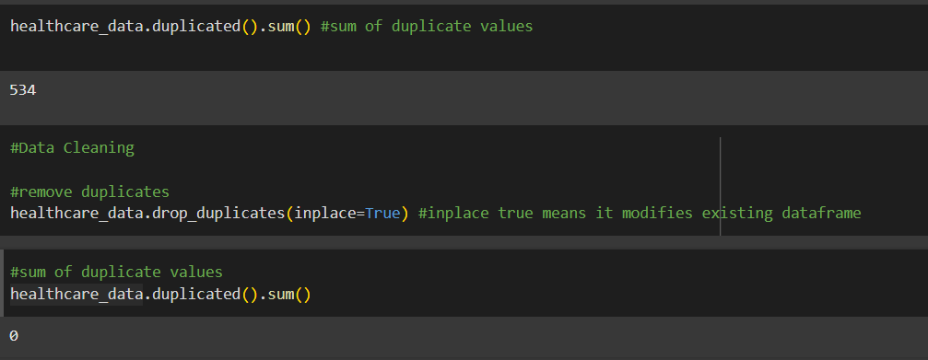
Duplicate Value Treatment

Slide 9
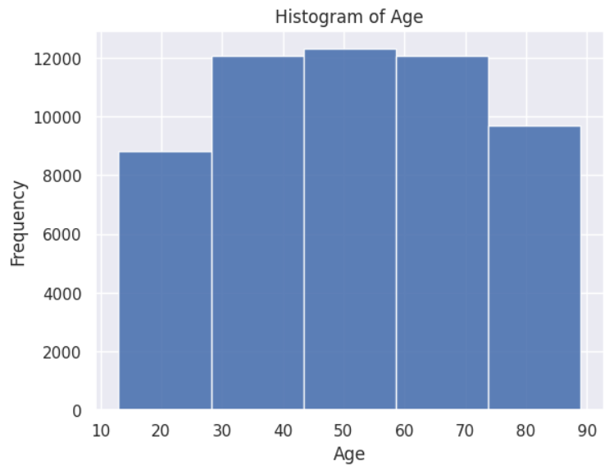
Visual Analysis
Number of patient by Age

Slide 10
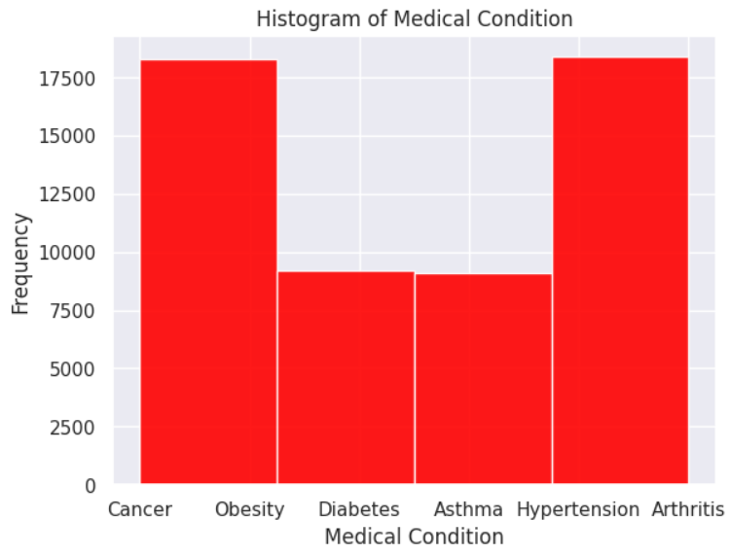
Visual Analysis
Medical Condition

Slide 11
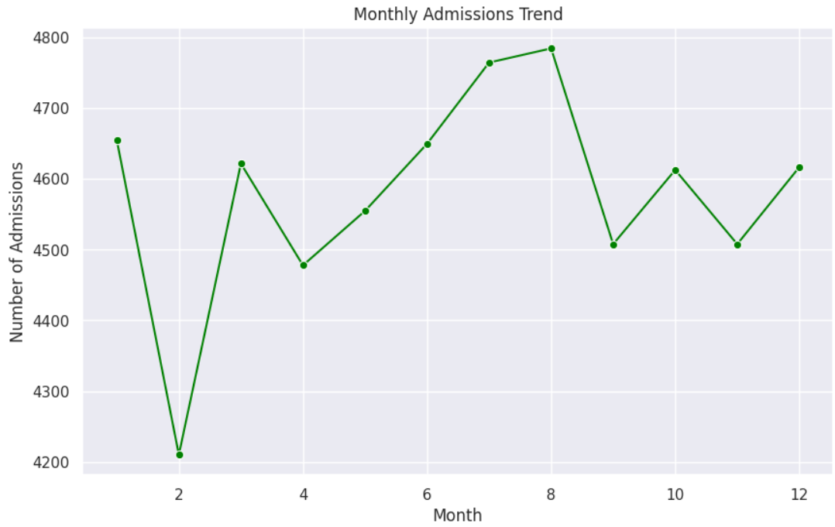
Visual Analysis
Monthly Admission Trend

Slide 12
Thank You

