Slide 1

VJ HACKATHON 2026
Victory and Joy in Smart Innovations | CSI SBC, Dept. of CSE, VNRVJIET, Telangana
PulseVault
ABHA-Linked, QR-Based Consent-Driven Health Vault
Team Name | Enthusiast
Team Leader Name | Krish Agrawal
Team Leader Mobile Number | [add before submission]
Team Leader Email | [add before submission]
No. of Team Members | 1 (solo)
Mentor Name (if any) | None
College Name | Dr. S. & S.S. Ghandhy Government Engineering College, Surat
Domain | HealthCare
Problem Statement | Problem Statement 3: Patient-Held Consent-Driven Health Record

Slide 2
02
Domain & Problem Statement
Problem Statement 3
Domain: HealthCare
Title: Patient-Held Consent-Driven Health Record
Event: VJ Hackathon 2026, VNRVJIET
Key Requirements
1. Patient-held record via QR code, ABHA linkage, or both.
2. Granular consent and instant revocation, demonstrated as a core feature.
3. Access in seconds via a simple point-of-care interface: no complex login, heavy hardware or training.
4. Instant critical history: prescriptions, diagnostic tests, allergies.
Problem Context
Patients visit PHCs, private clinics and district hospitals with no prior records reachable by the doctor.
Result: repeated tests, unknown current medicines, missed allergy warnings.
Small providers struggle to adopt complex digital health systems.
PULSEVAULT • Scan • Consent • Care
Team Enthusiast | VJ Hackathon 2026 | 3

Slide 3
03
Idea / Solution
PulseVault is a QR + ABHA (M1/M2) linked mobile/web app. The patient holds the record and any provider views it by scanning a dynamic, time-bound QR: no account, no login, no extra hardware.
Consent & Revocation Engine
Generate: pick scope (allergies, medicines, tests, full), duration (15 min-24 h), view-only.
Issue: signed single-purpose QR or 6-digit OTP.
Monitor: live "Dr. X viewing, 08:42 left" and audit trail.
Revoke: one tap kills the token; access ends on the next request.
Doctor Point-of-Care Flow
Scan: phone camera or light web scanner. No install, no login.
Critical Snapshot: allergies, current medicines, chronic conditions, last tests.
Expand: prescriptions and reports within granted scope.
Add: notes or prescriptions with patient approval.
Emergency Offline QR
Works without internet: signed blood group, allergies and chronic medicines.
Patient opt-in: enabled and edited only by the patient.
Hybrid identity: ABHA optional; phone-OTP onboarding, link ABHA later.
PULSEVAULT • Scan • Consent • Care
Team Enthusiast | VJ Hackathon 2026 | 4

Slide 4
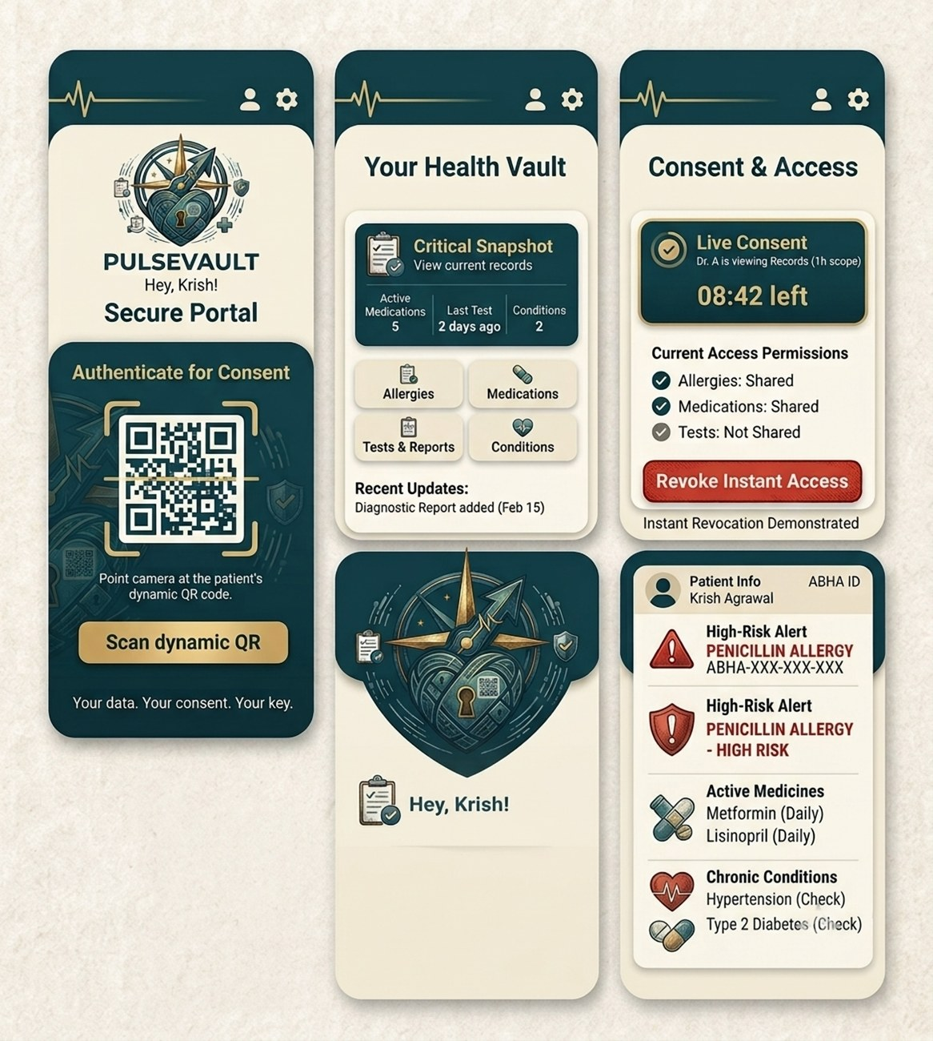
04
Product Preview
Planned App Screens (Concept UI)
Secure Portal: provider taps "Scan dynamic QR" and points the camera at the patient's code.
Your Health Vault: Critical Snapshot plus Allergies, Medications, Tests & Reports, Conditions and recent updates.
Consent & Access: live consent timer, per-category permissions and a red "Revoke Instant Access" button.
Provider Critical View: high-risk allergy alert, active medicines and chronic conditions at a glance.
Note: design mock-ups of the intended prototype; the sample patient data shown is illustrative.
PULSEVAULT • Scan • Consent • Care
Team Enthusiast | VJ Hackathon 2026 | 5

Slide 5
05
Existing vs Proposed System
Aspect | Existing System | PulseVault (Proposed)
Record ownership | Held by each provider; fragmented | Held by the patient, in one vault
Consent | Static, one-time checkbox | Scoped, time-bound, revocable in one tap
Provider access | Accounts, logins, EHR training | Scan a QR. No login, no install
Connectivity | Assumes stable internet | Low-bandwidth PWA + offline emergency QR
Critical history | Buried in paper or files | Allergies, medicines, tests at a glance
Transparency | Patient cannot see who viewed | Live access status and audit log
PULSEVAULT • Scan • Consent • Care
Team Enthusiast | VJ Hackathon 2026 | 6

Slide 6
06
Innovation & USP
Live Consent, Not a Checkbox
Scope + expiry baked into every signed token.
Verified on every request, so revocation is instant.
Zero-Login Provider Access
Any phone or PC with a camera works.
Removes the adoption barrier for small clinics.
Hybrid Identity
ABHA-linked or QR/phone-only.
Patients without ABHA are not excluded.
Trust Built on Security, Not Buzzwords
Core value comes from E2EE, signed tokens and audit logs, not from "using AI".
ZKP selective disclosure and AI summaries are roadmap items.
PULSEVAULT • Scan • Consent • Care
Team Enthusiast | VJ Hackathon 2026 | 7

Slide 7
07
Objective & Scope of Solution
Objectives
Give patients ownership of their health record.
Let providers see critical history in under 3 seconds.
Make consent granular, visible and instantly revocable.
Reduce repeat tests and allergy or drug errors.
Fit small clinics: no training or hardware.
In Scope: 24-Hour Prototype
Patient app: vault, consent generator, live revoke
Provider web scan + Critical Snapshot
Signed tokens, audit log, emergency QR
ABHA sandbox or mock linkage
Future Scope
Full ABDM HIP/HIU certification, lab/pharmacy feeds, regional languages, caregiver delegation.
PULSEVAULT • Scan • Consent • Care
Team Enthusiast | VJ Hackathon 2026 | 8

Slide 8
08
System Architecture
PATIENT & DATA LAYER
Patient App
Flutter / RN: records, consent
Encryption & Vault
E2EE, FHIR-structured data
ABHA Gateway
M1/M2 linkage (ABDM sandbox)
→
→
CONSENT & ACCESS LAYER
Consent Engine
scope, TTL, revoke, audit
Token Service (FastAPI)
signed short-lived tokens
Provider Light Dashboard
scan → Critical Snapshot
→
→
Data Flow: Consent → Access → Revoke
1. Patient selects scope + duration; Consent Engine issues a signed token as QR/OTP.
2. Doctor scans; Token Service verifies the token on every request.
3. Scoped FHIR data is decrypted for a view-only session.
4. Patient taps Revoke; the token is blacklisted and the session ends. Every event is audit-logged.
PULSEVAULT • Scan • Consent • Care
Team Enthusiast | VJ Hackathon 2026 | 9

Slide 9
09
Resources Required
Technologies
Frontend: Flutter / React Native; provider PWA
Backend: Python FastAPI (or Node.js)
Data: PostgreSQL, Redis for revoke list
Security: AES-256, E2EE, signed JWT tokens, dynamic QR
Standard: FHIR R4
Data & Standards
Datasets: synthetic FHIR patients (e.g. Synthea), no real patient data
FHIR resources: AllergyIntolerance, MedicationRequest, DiagnosticReport, Condition, Patient
ABDM: sandbox for ABHA M1/M2 flows
Tools & Infrastructure
Devices: any smartphone or tablet with a camera
Hosting: free-tier cloud + HTTPS
Dev tools: Git, Postman, Figma
Team: Krish Agrawal (solo build)
PULSEVAULT • Scan • Consent • Care
Team Enthusiast | VJ Hackathon 2026 | 10

Slide 10
10
Feasibility & 24-Hour Roadmap
Hours | Milestone
0-3 | Scope, FHIR model, wireframes, repo
3-9 | Backend: APIs, consent engine, token + revoke
9-15 | Patient app: vault, consent, live access, revoke
15-19 | Provider web view: scan, snapshot
19-21 | Encryption, audit log, emergency QR, ABHA sandbox/mock
21-23 | End-to-end test, seeded data, latency check
23-24 | Demo script and pitch rehearsal
Why It Is Feasible
Proven, open-source stack.
Runs on phones clinics already own.
Low bandwidth: compressed FHIR, cached PWA.
Offline fallback via emergency QR.
Scales with stateless services; aligned to ABDM and DPDP principles.
Production ABDM needs sandbox registration and certification.
PULSEVAULT • Scan • Consent • Care
Team Enthusiast | VJ Hackathon 2026 | 11

Slide 11
11
Impact, Metrics & Future Scope
Outcome | Design Target
Scan-to-record access | < 3 s on 4G
Provider onboarding | Zero login
Unauthorised exposure | Zero: valid, unrevoked token needed
Revocation | Effective on next request
Repeat tests | Fewer duplicates (pilot-measured)
Post-Hackathon Vision
Pilot at a PHC and nearby clinics.
Full ABDM HIP/HIU integration.
ZKP selective disclosure.
Regional-language voice UI (Hindi, Telugu, Gujarati).
Lab and pharmacy auto-capture.
Family and caregiver delegation.
Assistive AI record summaries.
Targets are design goals, to be validated in the demo and pilot.
Impact on PHC Care
Safer prescribing, less cost and travel for rural patients, real patient agency.
PULSEVAULT • Scan • Consent • Care
Team Enthusiast | VJ Hackathon 2026 | 12

Slide 12
Thank You!
Your records. Your consent. Your key.
Team Enthusiast | Krish Agrawal
Dr. S. & S.S. Ghandhy Government Engineering College, Surat
VJ Hackathon 2026 | Healthcare PS 3

