Slide 1
DELTA CODE 2026 | ROUND 2 | PROBABILITY & STATISTICS
k-Way Collision Probabilities
High-dimensional vectorized Monte Carlo vs. Poisson analysis
Team Enthusiast
Krish Agrawal
krishagrawal222@gmail.com
Technozion 2026 | The Mathematical Society, NIT Warangal

Slide 2
The problem
Generalized birthday: when does some bucket get k or more keys?
P(Collision ≥ k) ≈ 1 − exp( − C(n,k) / C^(k−1) )
n keys drawn uniformly from C buckets | k = 2 is the classic birthday problem | λ = C(n,k) / C^(k−1)
Why it matters
The hard part
Our approach
Hash collisions (SHA-256), salts and database sharding rely on collision resistance over huge key spaces, up to C = 2³².
For k ≥ 3 the events are rare (p < 10⁻⁶). Brute-force Monte Carlo breaks down and analysis must take over.
Derive the Poisson bound, simulate with vectorized NumPy, then quantify exactly where each method works.
Team Enthusiast | Delta Code 2026 | 2

Slide 3
Why Poisson works
Derivation: count colliding k-subsets
1. Exact reformulation
2. Mean of X
Let X be the number of k-subsets of keys that all share a bucket. Then {max load ≥ k} = {X ≥ 1} exactly.
Each subset collides with probability C^−(k−1), so E[X] = C(n,k) / C^(k−1) = λ.
3. Poisson limit (Chen-Stein)
4. Where it is biased
Only overlapping subsets are dependent. The error is bounded by min(1, 1/λ)·(b₁+b₂), with b₂ ≈ λ·k·n/C, so it vanishes when n ≪ C.
k = 2: Poisson slightly under-estimates (≈ n/3C). k ≥ 3: it over-counts buckets with load > k, so it over-estimates as λ grows.
Team Enthusiast | Delta Code 2026 | 3

Slide 4
Vectorized Monte Carlo engine
No Python loop over trials; memory independent of T
Detect
Chunk
Verify
Sort each row in place, then test S[:, k−1:] == S[:, :n−k+1]. In a sorted row, a value occurs ≥ k times iff keys i and i+k−1 match. np.diff and bincount versions cross-check it.
Full T×n matrix is 4 GB at n = 1000. Block size comes from a memory budget (256 MB default), keys are uint32 for C ≤ 2³², rows are C-contiguous, and results are bit-identical for any chunk size.
15 self-tests pass, including exact enumeration. Clopper-Pearson and Wilson 95% CIs via scipy.stats. NumPy beat a numba kernel about 7× on 1 core, so NumPy is the default.
Team Enthusiast | Delta Code 2026 | 4

Slide 5
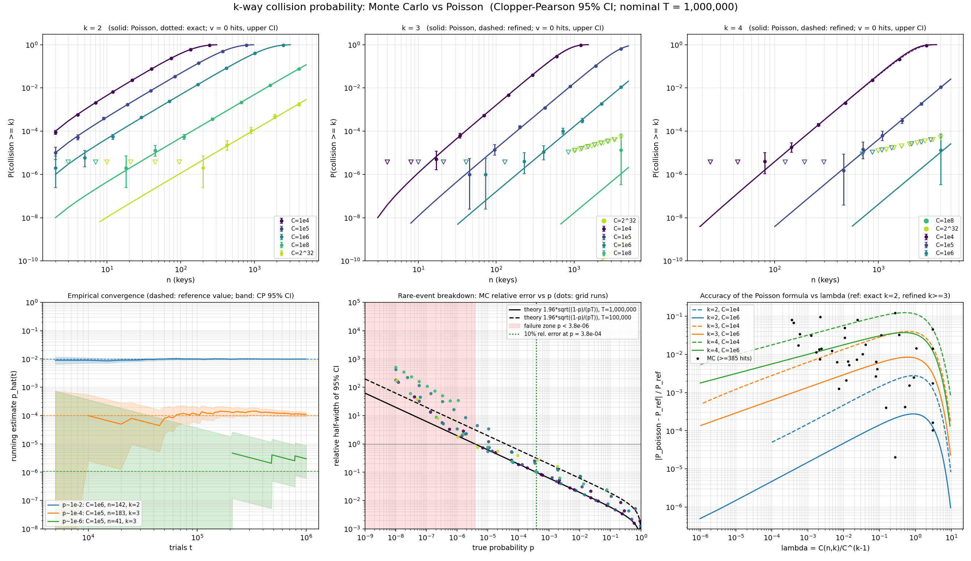
Results
135 parameter points: C from 10⁴ to 2³², k = 2, 3, 4
135
grid points with 95% CP and Wilson CIs
2.8·10¹⁰
random keys simulated in 277 s
15 / 15
self-tests pass
Team Enthusiast | Delta Code 2026 | 5

Slide 6
Where Monte Carlo breaks down
Relative error ≈ 1.96 / √(p·T); with T = 10⁶:
3.8·10⁻⁴
3.8·10⁻⁶
60 / 135
below this p, estimates are worse than ±10%
CI as wide as the estimate itself (failure zone)
grid points returned exactly zero hits
Empirical confirmation
Hand-over to analysis
39 points reliable (≥ 385 hits), 22 noisy, 74 failed (< 10 hits). At p ≈ 10⁻⁶ the running estimate used 3 hits and was off by 2.8×.
For C up to 2³² and k ≥ 3, every feasible n has p below the failure zone. Only the Poisson formula can answer there, with relative error ≈ 10⁻⁶.
Team Enthusiast | Delta Code 2026 | 6

Slide 7
Findings and takeaways
Poisson accuracy
Complementary regimes
Excellent for k = 2 at large C. For k ≥ 3 it over-estimates: 0.950 vs 0.908 at λ = 3, k = 4, C = 10⁴ (MC CI excludes Poisson).
Monte Carlo covers p ≳ 10⁻⁴; Poisson covers p ≲ 10⁻⁵. A refined bucket-occupancy formula matched the MC at 129 / 135 points.
Deliverables
Team Enthusiast
birthday.py, results.csv, plot_grid.png, report.md, requirements.txt, README.md, public GitHub repo.
Krish Agrawal
krishagrawal222@gmail.com
Thank you!
Team Enthusiast | Delta Code 2026 | 7

