Slide 1
Employee salary prediction using Machine Learning algorithms
CAPSTONE PROJECT
Presented By:
Krishan Jakhar
Bikaner Technical University, Bikaner
Electronics and Communication Engineering Department
AICTE Internship Student Registration ID :
STU66e3162a4d6bd1726158378

Slide 2
OUTLINE
Problem Statement (Should not include solution)
System Development Approach (Technology Used)
Algorithm & Deployment (Step by Step Procedure)
Result
Conclusion
References

Slide 3
Problem Statement
Many organizations need to predict whether an employee earns more than ₹50K or not for HR and compensation analysis.
This project uses machine learning to classify categories ( <=50k or >50k ) based on employee attributes.
Features include age, gender, education, occupation, work hours, capital gain/loss, and native country.
The model is trained on real-world data and integrated into an interactive streamlit web application
User can input data manually and automated salary class predictions.

Slide 4




System Approach
This section outlines the overall methodology, tools, and environment used to build and deploy the salary classification model.
✅ 1. System Requirements
Hardware:
Processor: Intel i5 or higher
RAM: Minimum 8 GB
Storage: 1 GB free space
Software:
OS: Windows 10 / Linux / macOS
Python 3.8 or higher
Jupyter Notebook / VS Code / Any IDE
Web browser for running the Streamlit app

Slide 5







System Approach
✅ 2. Libraries Required
The following Python libraries were used for data preprocessing, model training, and deployment:
Pandas – for data manipulation and analysis
NumPy – for numerical operations
Scikit-learn – for preprocessing, model building, and evaluation
Joblib – for saving/loading the model and encoders
Matplotlib / Seaborn – for data visualization (optional, during EDA)
Streamlit – for building the interactive web app
OS / Pickle – for file handling and object serialization (optional)

Slide 6
Algorithm & Deployment
Problem Understanding
- Define the goal: predict whether an employee earns >50k or <=50k.
- Understand the features (age, education, occupation, etc.) and target variable.
Data Collection
- Use the UCI Adult dataset (adult.csv) as the primary data source.
- Load the data using pandas and inspect for missing values, duplicates, and data types.
Data Preprocessing
- Handle missing or unknown values (e.g., replace ? With NaN and drop or impute)..
- Encode categorical columns using LabelEncoder or OneHotEncode.
- Scale numerical columns using StandardScalar.
- Split the dataset into training and testing sets (e.g, 80/20 split).

Slide 7
Model Building
- Train different classification models such as:
- Random Forest Classifier, Logistic Regression, Support Vector Machine , etc
- Evaluate using metrics: Accuracy, precision, Recall, F1-Score
- Choose the best-performing model.
Model Saving
- Save the trained model using joblib or pickle.
- Also save the encoders and scaler used during preprocessing.
Web Application with streamlit
- Build a user interface using Streamlit to:
- collect user inputs via sliders, dropdowns, etc.
-preprocess the input using saved encoders and scaler.
-predict and display the salary class.

Slide 8
Testing and Debugging
- Test the app thoroughly with different inputs.
- Handle errors like missing columns or invalid types.
Deployment
- Deploy the Streamlit app on platforms like Streamlit Cloud, Heroku, or Hugging Face Spaces.

Slide 9
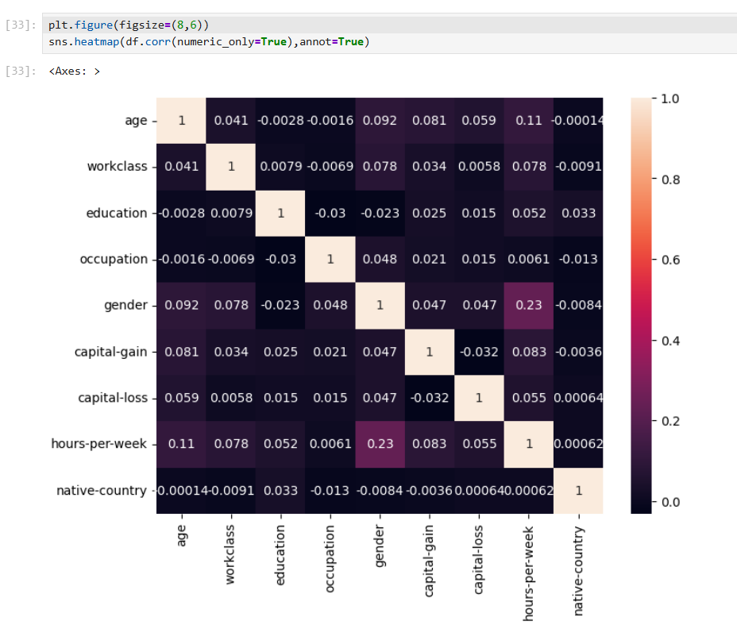
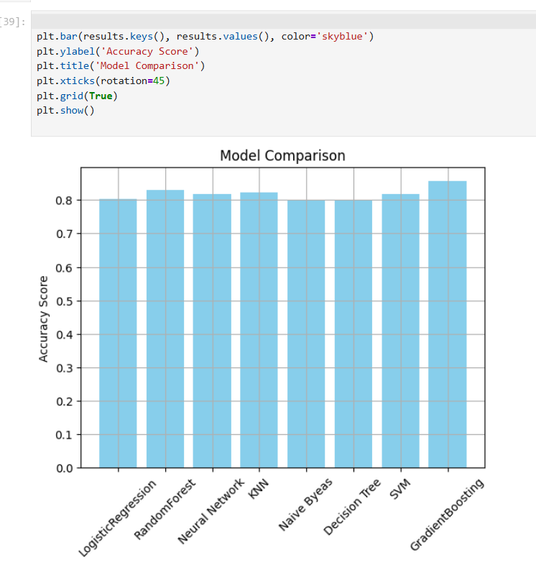
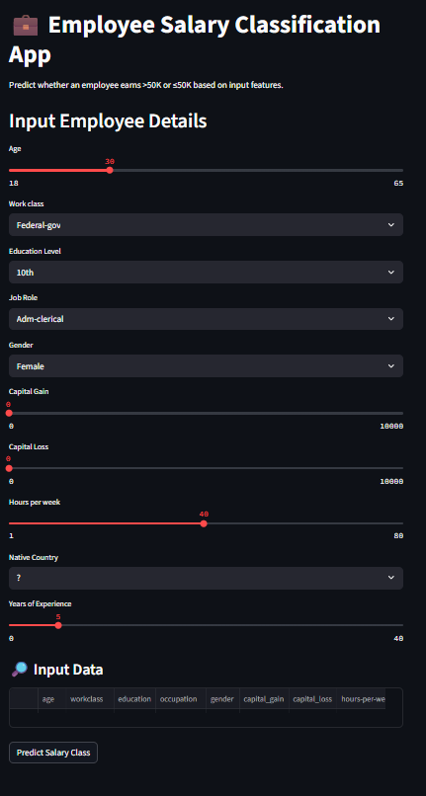
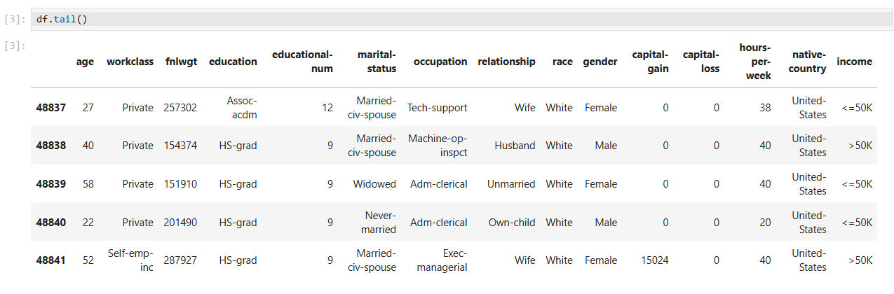
Result
Attach your Github link
https://github.com/krishan2607/Employee-salary-prediction-using-Machine-Learning-algorithms#

Slide 10
Conclusion
This project successfully demonstrates the application of machine learning for classifying employees based on salary levels.
By analyzing key features like age, education, occupation, and work hours, the system predicts whether an employee earns more than ₹50K or not.
The Random Forest Classifier provided the best accuracy (~86%) and proved effective for real-world classification tasks.
An interactive web application built with Streamlit allows seamless user interaction and real-time prediction.
The project showcases the complete pipeline from data preprocessing to model deployment, offering a practical solution for HR and compensation analysis.

Slide 11
References
UCI Machine Learning Repository - Adult Dataset Source of real-world census income data used for model training. 🔗 https://archive.ics.uci.edu/ml/datasets/adult
Scikit-learn Documentation Used for data preprocessing, model training, evaluation metrics, and model persistence. 🔗 https://scikit-learn.org/stable/
Streamlit Documentation Used to build and deploy the interactive web application. 🔗 https://docs.streamlit.io/
Pandas & NumPy Documentation Utilized for data handling, transformation, and numerical operations in ModelTraining.ipynb. 🔗 https://pandas.pydata.org/ 🔗 https://numpy.org/
Joblib Documentation Used for saving and loading the trained machine learning model, encoders, and scaler. 🔗 https://joblib.readthedocs.io/
Python Official Documentation Core language used to develop the model and web app. 🔗 https://docs.python.org/3/

Slide 12
THANK YOU

