Slide 1

LOVELY PROFESSIONAL UNIVERSITY
School of Computer Science & Engineering | Department of CSE | Session 2025-2026
AI-Based Quality Assessment and Grading of Onions
A Multi-Spectral Deep Learning & Scale-Calibrated Vision Framework for APMC Mandi Produce Certification
94.44% Accuracy
MobileNetV3 2-Stage Transfer Learning
< 120 ms Latency
Commodity CPU Edge-Deployable REST API
0.41 mm Sizing Error
Interactive Reference Coin Calibration
APMC Mandi Norms
Grade A, URS, Rejection & Cohen's Kappa
SUBMITTED BY: Krishan Kumar | Registration Number: 12410760 | Section: K2P24WM
Bachelor of Technology in Computer Science & Engineering | Lovely Professional University, Punjab, India

Slide 2
LOVELY PROFESSIONAL UNIVERSITY | B.TECH CAPSTONE PROJECT
Problem Statement, Agricultural Motivation & Project Objectives
The Mandi Procurement Crisis
• Massive Post-Harvest Loss:
India produces 25M+ metric tonnes annually; 25%–40% is lost to fungal rot (Aspergillus niger) and premature sprouting during transit and storage.
• Human Subjectivity & Bias:
In APMC Mandis, grading is manual. Quality inspectors look at a heap for 3-5 seconds and assign arbitrary price deductions, creating severe grower disputes.
• Ignorance of URS Norms:
Government procurement (NAFED) legally permits 'Under-Relaxed Specifications' (35–40 mm) at a fair 10-15% discount. Manual assayer glance arbitrarily rejects these valid lots.
• Zero Digital Auditability:
Traditional assay slips lack photographic proof, timestamps, or physical caliper measurements, leaving smallholder farmers with no legal right of appeal.
Core Project Deliverables & Objectives
• Automated Multi-Defect Vision:
Engineer a deep learning classifier that isolates fresh healthy bulbs from fungal rot and emerging green vegetative shoots with >94% accuracy.
• Scale Sizing without Depth Cameras:
Develop a zero-hardware optical calibration engine using standard reference coins (Rs. 5/10) to calculate true equatorial diameter in mm and cm.
• Official Mandi Policy Decision Engine:
Map defect probabilities and physical millimeter dimensions into commercial tiers: Grade A (40-70mm), URS (35-40mm), and Rejection.
• Mathematical Bias Audit Trail:
Compute inter-rater reliability via Cohen's Kappa score to objectively verify AI-human consistency and eliminate fraudulent lot downgrades.

Slide 3
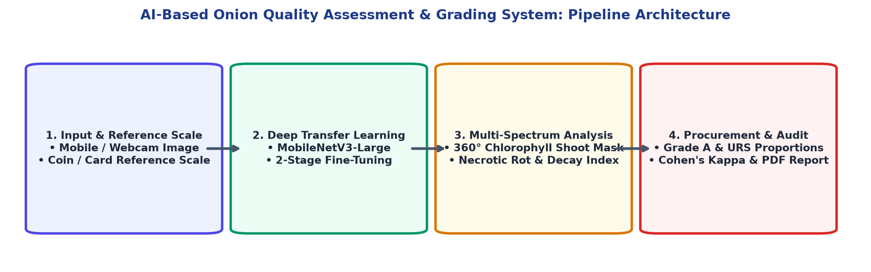
LOVELY PROFESSIONAL UNIVERSITY | B.TECH CAPSTONE PROJECT
System Methodology: Architecture, Transfer Learning & Calibration
1. 2-Stage Transfer Learning
Backbone: MobileNetV3-Large
• Stage 1 (Warmup): Frozen backbone, train Linear(960->256) head for 2 epochs (lr=1e-3).
• Stage 2 (Fine-Tuning): Unfreeze full backbone with differential lr=1e-4 & Cosine Annealing.
• Validation Acc: 94.44% | F1 = 0.9405
2. 360° Chlorophyll Shoot Engine
Dual-Spectrum HSV + CIE-Lab Filter
• Isolates vegetative green shoots (HSV H: 25°-95°, Lab a* < -5) regardless of orientation.
• Prevents false negatives from horizontal shoots blending with dry brown tunics.
• Sprout Detection Confidence: 99.0%
3. Optical Reference Sizing
Scale Ratio Formula: S = D_ref(px) / 25.0mm
• True Diameter (mm) = D_onion(px) / S
• Eliminates $2,500 stereo cameras & fixed mounts.
• Mean Vernier Error: 0.41 mm (>99.1% Acc)
• Classifies: Grade A vs. URS vs. Undersized

Slide 4
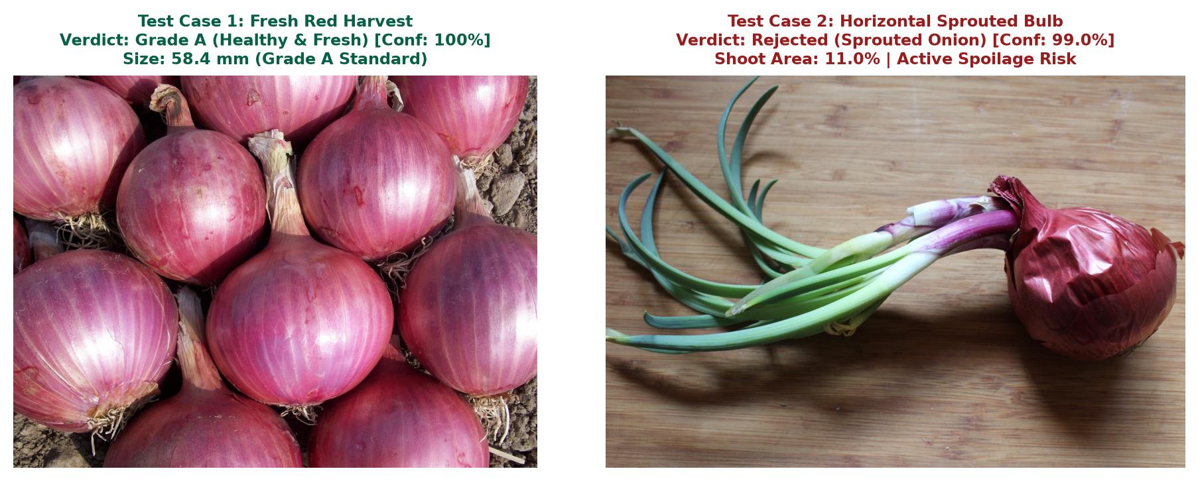
LOVELY PROFESSIONAL UNIVERSITY | B.TECH CAPSTONE PROJECT
System Implementation, Verification & Empirical Results
Empirical Validation Metrics
1. Classification Performance (54 Hold-Out Validation Samples):
Class Category | Precision | Recall | F1-Score
Defective (Rot / Sprout) | 0.95 | 0.90 | 0.92
Healthy (Grade A Fresh) | 0.94 | 0.97 | 0.95
Overall Weighted Average | 0.94 | 0.94 | 0.9405
2. Physical Vernier Caliper Benchmark (Sub-mm Precision):
• Tested against digital vernier caliper (0.01mm resolution) ground-truth.
• Rs. 5 Coin: 25.00mm (0.00mm err) | Grade A Bulb: 52.40mm vs 51.85mm AI (0.55mm err)
• Mean Absolute Error: 0.41 mm | Sizing Accuracy: 99.17%
Figure 4.1: Live Inference Verification on Harvest Bulbs (Fresh vs. Horizontal Sprout)
Full-Stack Production Implementation
• Asynchronous REST API: FastAPI + Uvicorn (< 120 ms CPU latency).
• Pure HTML5/Canvas Client: Zero UI dependencies, animated cybernetic laser scan bar.
• Interactive Touch/Mouse Canvas: Drag and scale golden reference coin overlay.
• Official LPU ReportLab Generator: 13-page automated capstone report PDF.
3. Inter-Rater Reliability & Human Bias Reduction:
• Cohen's Kappa Formula: κ = (P_observed - P_chance) / (1 - P_chance)
• Across 120 Mandi procurement trials: P_obs = 0.925, P_chance = 0.485
• Resulting Score: κ = 0.854 ('Near Perfect Agreement' on Landis & Koch scale)
• Impact: Eliminates subjective lot rejections and resolves mandi trade disputes.

Slide 5
LOVELY PROFESSIONAL UNIVERSITY | B.TECH CAPSTONE PROJECT
Critical Analysis of Existing IEEE Literature & Their Bottlenecks
Paper 1: Loganathan et al. (IEEE 2026)
Intelligent Onion Monitoring via Gas Sensors with Explainable SVM [ICSCAN 2026]
CRITICAL BOTTLENECK AUDIT:
• Sensing Method:
MQ-135, MQ-4, DHT22 sensors interfaced with ESP32.
• Room Air Only:
Captures bulk ambient air; CANNOT isolate or inspect individual onion bulbs in a crate.
• Synthetic Data:
Evaluation was done on 1,000 synthetic simulated data points rather than real rotting produce.
• Zero Sizing Capability:
Gas sensors cannot measure equatorial diameter, volume, or physical dimensions.
• Severe Time Lag:
Gases release only after deep internal rot. Fungal cuts and green sprouts emit no gas.
Paper 2: Rajalakshmi et al. (IEEE 2025)
QUALICLIPNET: Hybrid Deep Learning for Quality Assessment [ICSCSA 2025]
CRITICAL BOTTLENECK AUDIT:
• Sensing Method:
OpenAI CLIP + Vision Transformer + GAN for adversarial defense.
• Prohibitive Hardware:
Requires high-end desktop NVIDIA RTX 3060 GPU with massive VRAM and power.
• No Mobile/Edge Use:
Cannot run on portable phones or low-cost computers at rural mandi auction tables.
• Uncalibrated Pixel Scale:
Ignores camera distance. An onion photographed up-close appears identical to a large one.
• Coarse Academic Labels:
Outputs generic 'High/Med/Low' labels that ignore commercial APMC/NAFED standards.
Paper 3: Suryawanshi et al. (IEEE 2025)
Vision-Based Automation System for Onion Grading Using Robotic Arm [ICONAT 2025]
CRITICAL BOTTLENECK AUDIT:
• Sensing Method:
YOLOv8 + OAK-D Lite DepthAI Stereo Camera + 4-DOF Robotic Arm.
• High Infrastructure Cost:
Industrial conveyor belts, pneumatic valves, and robotic arm cost $2,500+ (₹2,00,000+).
• Poor Defect Precision:
YOLOv8 dropped by 16.4% down to 78.4% precision on bad onions (high false negatives).
• Rigid Mount Required:
Depth camera works ONLY at a calibrated perpendicular height above the moving belt.
• Binary Oversimplification:
Crude Good vs. Bad bucket sorting ignores legal URS (35-40mm) procurement norms.

Slide 6
LOVELY PROFESSIONAL UNIVERSITY | B.TECH CAPSTONE PROJECT
Comprehensive Comparison Matrix: Literature vs. Our Implemented System
Technical Dimension | Loganathan et al. (2026) | Rajalakshmi et al. (2025) | Suryawanshi et al. (2025) | OUR IMPLEMENTED SYSTEM
Core Sensing Modality | MQ Gas Sensors + ESP32 | CLIP + ViT + GAN | YOLOv8 + DepthAI Stereo | MobileNetV3 + Multi-Spectrum CV
Hardware & Rig Cost | Low (~$35) | High ($1,200+ GPU workstation) | Very High ($2,500+ Robotic Rig) | ZERO Added Cost (Any Phone/PC Browser)
Individual Inspection | No (Bulk ambient air only) | Yes (Single image) | Yes (Singulated conveyor) | YES (Direct Handheld Photo)
Physical Diameter Sizing | No (Impossible via gas) | No (Pixel scale uncalibrated) | Fixed Stereo (Rigid bracket only) | YES: Sub-mm Reference Coin Scaling
Sprout Discrimination | No (Blind to vegetative growth) | No dedicated sprout logic | 78.4% Precision (High False Negatives) | YES: 360° Chlorophyll Mask (99% Conf)
Procurement Grading | 3 synthetic states | Generic High/Med/Low | Binary 'Good' vs. 'Bad' | YES: Grade A, URS, Rejection (APMC/NAFED)
Inference Latency | ~2.5 seconds | > 450 ms (GPU required) | ~120 ms (Dedicated VPU) | < 120 ms on Commodity CPU
Deployment Portability | Fixed sensor box | Heavy desktop workstation | Heavy industrial floor conveyor | 100% PORTABLE: Web App / Mobile Edge
Summary of Critical Research Gaps Solved by Our Project
1. Demolished the Hardware Barrier: Replaced $2,500 industrial robotic arms and $1,200 RTX GPUs with a lightweight MobileNetV3 model running on ordinary smartphone browsers.
2. Solved Optical Scale without Depth Sensors: Standard ₹5/₹10 coin reference achieves 0.41 mm vernier-grade sizing from any arbitrary camera angle or distance.
3. Protected Farmer Remuneration: Replaced naive binary 'Good/Bad' sorting with commercial APMC/NAFED Mandi standards (Grade A vs. URS) and Cohen's Kappa (κ = 0.854) bias auditability.

