Slide 1

How to prepare for the exam
( or at least how did I :))
26/5/2016
Gavrail Kubatev

Slide 2
Introduction
Certification general info
Exam details
Before the Exam
During the Exam
After the Exam
Study resources and Tools
Additional resources
Learning/Exam tips
Code Examples

Slide 3
Certification general info
Associate(OCA)
Oracle Certified Associate, Java SE 8 Programmer
Oracle Certified Associate, Java SE 7 Programmer
Professional(OCP)
Oracle Certified Professional, Java SE 8 Programmer
Oracle Certified Professional, Java SE 7 Programmer
Master(OCM)
Oracle Certified Master, Java SE 6 Programmer

Slide 4
Before the Exam
Create your account in the Pearson Vue system
Create your account in the Oracle CertView system
Link/Authenticate the accounts (should be done at least 1 hour after account creation)
Identify the Test center you want to take the Exam in.
Book your Exam
At least a week earlier
Two ways of booking
Via the Pearson Vue site( Wednesdays and Thursdays)
Directly with the test center( Monday, Tuesday and Friday)

Slide 5
During the Exam
Test center tour
Security is tight , no cheating ☺
Video surveillance
Pc with sub 20 inch display
You cant bring anything inside except for your personal ID(even water)
Test center will provide you with pens, laminated sheet for writing and ear plugs
Notes:
https://www.youtube.com/watch?v=ly3QqlES_4w

Slide 6
During the Exam
You can not pause the exam , once started
Exam software is easy to use
The exam consists of 77 questions. 12 of them are not graded, you are not aware which ones.
2.5 hours, 65 % correct answers required
There are no drag and drop questions
You are told how many correct answers there are
You are able to strike out answers

Slide 7
After the Exam
Results are available online in your CertView account,30 minutes after finishing
Your passing result is not listed on your certificate
Certificate is provided for you to download and print
Your mistakes are listed as “objectives”
Ex. “Differentiate among checked exceptions, unchecked exceptions, and Errors”

Slide 8
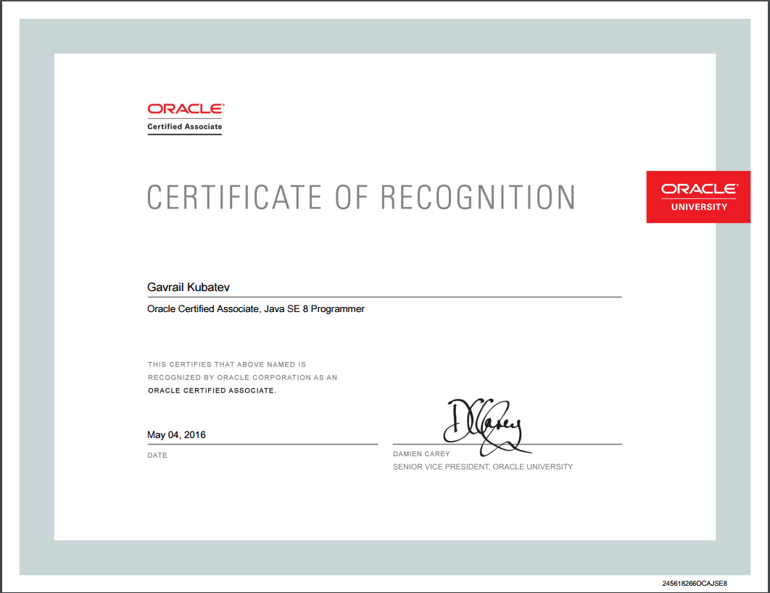

Slide 9
Study resources and Tools
OCA Study guide – Boyarski & Selikoff
Enthuware practice exams
Thinking in Java by Bruce Eckel
Java Language Specs
codingBat
Notepad(++)
Flashcard Machine

Slide 10
Additional resources
OCA Java SE 8 Programmer I Certification Guide by Mala Gupta
OCA/OCP Java SE 7 Programmer I & II Study Guide (Exams 1Z0-803 & 1Z0-804) by Kathy Sierra and Bert Bates
OCA Java SE 8 Programmer I (1Z0-808) Complete Video Course
MyExamCloud practice tests
WhizLabs practice tests
Notes:
http://www.informit.com/store/oca-java-se-8-programmer-i-1z0-808-complete-video-course-9780134498287
http://www.myexamcloud.com/onlineexam/viewStudyPlan.html?s=KFx2lAszxQI=
http://www.whizlabs.com/oracle-certified-associate-java-se-8-programmer/ocajp8-practice-tests/

Slide 11
Learning/Exam tips
Be comfortable with distinguishing between compile errors and exceptions
Learn which exceptions are thrown by the programmer and which by the JVM
Learn all core classes’ APIs
Use the language specification

Slide 12
Learning/Exam tips
Read all answers
Subvocalization while reading code
Separate and analyze your mock exam wrong answers
Pay attention for “unreachable code”

Slide 13
Code examples
1)
final int a = 5;
final int b = 10;
for(;b<a;){ System.out.println("Dreamix");
}
2)
for(int i=0;i<10;)
{ i=i++;
System.out.println("Dreamix"); }
3)
for(int i=0;i<10;new String("Dreamix"))
{ i++;
System.out.println("Dreamix"); }

Slide 14
Code examples
4)
int f= 011;
float a=0x1.1p0f;
float g=0x612f;
float b=01101f;
float d=0b101;
5)
HRISTO:for(int i=0;i<10;i++){
GEORGI:System.out.println("Dreamix");
if(i>3)break HRISTO;
}

Slide 15
Code examples
6) True or false
"String".replace('g','g')=="String“;
7)
interface A{ int TEST =5; }
interface B{ int TEST =5; }
class FatherOfAll implements A,B{ int a = 5;
}

Slide 16
Code examples
9)
LocalDateTime timer= LocalDateTime.parse("2016-01-02"); System.out.println(timer);

Slide 17
Code examples
10) Java Exceptions is a mechanism ..
for dealing with unexpected user inputs.
that you can use to determine what to do when something unexpected happens.
for logging unexpected behavior.
to ensure that the program runs even if something unexpected happens.
that the VM uses to exit the program when something unexpected happens.
Notes:
B &C

Slide 18

Thank you and Good Luck!

