Slide 1
CROSS-BORDER EXCEPTION OPERATIONS
CorridorProof
Shared evidence for
uncertain payment outcomes
Sender and receiver teams agree a safe resolution
from an attributable case record.
Live Drunix dashboard / Synthetic payment rails
CorridorProof / Drunix hackathon prototype
01
Notes:
Synthetic prototype. No real funds or institutional identities. Live dashboard connected to the local two-organization Drunix test network. API scenario checks, actual MVCC conflict, unauthorized MSP rejection and restart persistence passed. All payment execution remains synthetic. Team identity and portal PS wording require confirmation.

Slide 2
PROBLEM EVIDENCE
Manual exceptions remain a documented requirement
Nexus documentation describes manual handling of
investigations, recalls and disputes in its first release.
Our narrow question
Can two operations teams share the evidence and
approvals needed to resolve uncertain payouts safely?
Documentation supports the problem. Partner demand and savings remain unvalidated.
CorridorProof / Drunix hackathon prototype
02
Notes:
Primary sources checked 30 September 2026. Nexus https://docs.nexusglobalpayments.org/payment-processing/key-points describes first-release manual investigations, recalls and disputes and possible future automation. This is documentation, not proof of present deployed release status. Swift https://www.swift.com/products/case-management proves an established competitive category, not our savings.

Slide 3
CORE SAFEGUARD
Unknown payout outcomes need reconciliation
Missing response
Status stays unknown
A timeout records an exception.
It cannot approve a refund.
Receiver evidence determines
the next resolution step.
Late credit
Both parties acknowledge closure. No refund occurs.
CorridorProof / Drunix hackathon prototype
03
Notes:
Nexus payment-priority handling https://docs.nexusglobalpayments.org/payment-processing/time-critical-vs-non-time-critical-payments distinguishes scheme-specific status and cancellation behavior. Our rule is a conservative prototype policy, not a universal Nexus cancellation implementation. Node/Go shared conformance tests and browser flow implement the illustrated sequence.

Slide 4
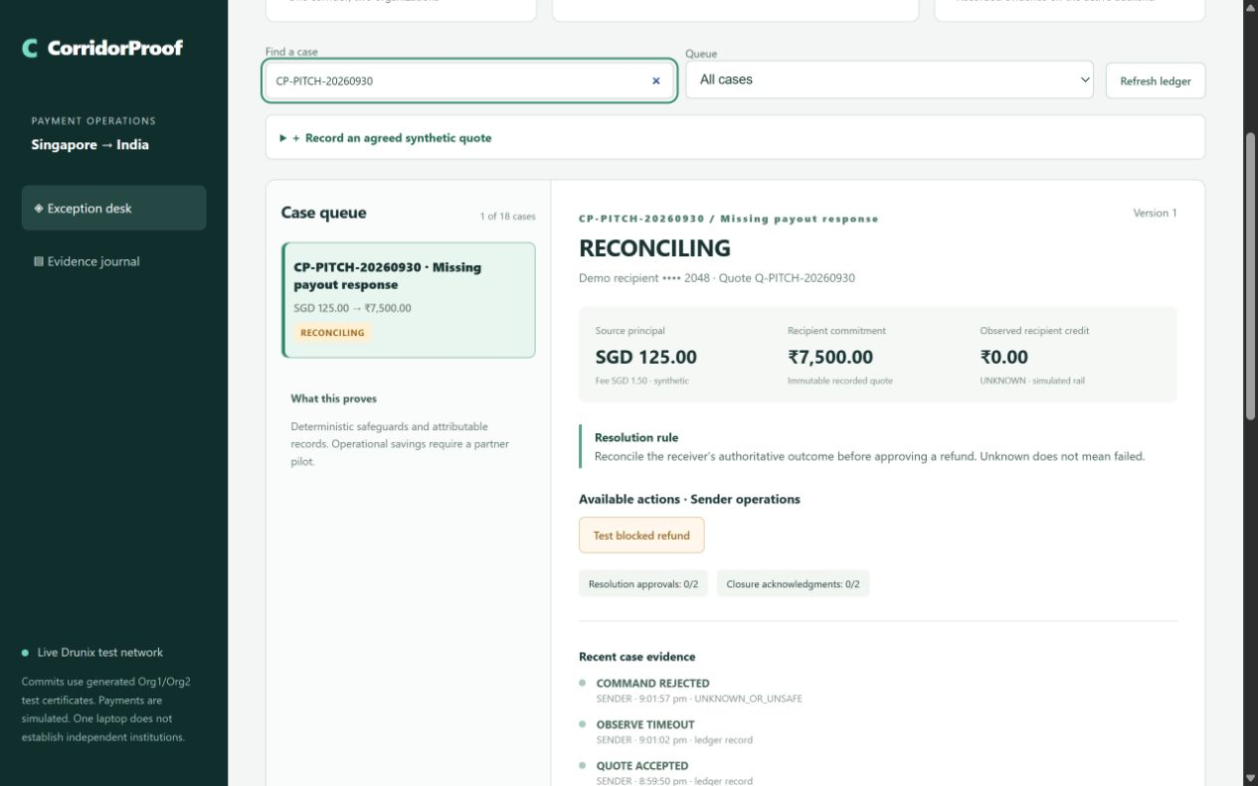
PROTOTYPE DEMONSTRATION
Live exception workspace
Visible safeguards
Refund denied while
outcome is unknown
Two organizations
approve corrections
VALID commit receipts
for accepted and
denied decisions
CorridorProof / Drunix hackathon prototype
04
Notes:
Actual live dashboard screenshot: custom accepted SGD125 quote, INR7500 recipient commitment, timeout and denied refund. Full API check: 36 VALID transactions across five scenarios. Browser late credit and both closure acknowledgments also verified. No real payments. Receipts in submission/drunix-dashboard-evidence.json and drunix-browser-evidence.json.

Slide 5
VERIFIED IMPLEMENTATION
Evidence and recovery controls
Live ledger comparison
Detect altered or missing exported records by comparing
with the current certificate-authenticated workspace.
Safe request recovery
Save the exact request before submission. An uncertain
commit blocks replacement actions until reconciliation.
Verified: real concurrent-update conflict, rejected untrusted MSP and restart persistence.
CorridorProof / Drunix hackathon prototype
05
Notes:
Live exports are compared with the current authenticated Drunix workspace. Altered and truncated exports were rejected. This is an online comparison, not offline cryptographic block verification. Persisted exact request identities support safe reconciliation of uncertain commits. Actual same-version proposals produced one VALID and one MVCC_READ_CONFLICT commit. Both lite peers restarted with identical state: 17 cases and 122 events at the checkpoint. See submission/drunix-dashboard-evidence.json and drunix-resilience-evidence.json.

Slide 6
TECHNICAL IMPLEMENTATION
Live dashboard architecture
APPLICATION REQUEST PATH
Browser
dashboard
Node HTTP API
Requests + operations
Go gateway
TLS + commit check
calls
submits
POLICY AND LEDGER
Go chaincode
MSP + policy
Drunix network
Org1 AND Org2
YugabyteDB
State stores
endorsed by
persists
Local test network includes documented SQL bookmark fixes. Payments are simulated.
CorridorProof / Drunix hackathon prototype
06
Notes:
Browser to Node24 HTTP API to TLS certificate-bound Go gateway to chaincode on a two-organization Drunix test network, AND endorsement. YugabyteDB state stores. Source pinned ddc0eae778158d3f8a96605cfeda383ae5eafcfc with two documented SQL bookmark patches needed for the expanded range-query workload. Node server holds generated test credentials for both organizations. Independent institutional custody is not demonstrated. Default npm start remains a separately labelled SQLite signed fallback. Official network https://github.com/npci/drunix/blob/main/drunix-network/test-network/README.md. See docs/LIVE-DASHBOARD.md.

Slide 7
ADAPTER AND DECISION SAFEGUARDS
Structured status intake
Bind the report to its commitment
Validate case, quote, currency, amount and message identity.
Credited, rejected and blocked reports enter existing policy.
Hold uncertainty and contradictions
Pending and unposted reports cannot prove beneficiary credit.
Save the original request; replay exactly and reject changed contents.
Synthetic JSON adapter. No bank connection or ISO 20022 certification claimed.
CorridorProof / Drunix hackathon prototype
07
Notes:
Nexus status semantics: https://docs.nexusglobalpayments.org/messaging-and-translation/message-pacs.002-payment-status-report and https://docs.nexusglobalpayments.org/payment-processing/time-critical-vs-non-time-critical-payments. Implemented src/operations.js and src/status-inbox.js normalize explicitly synthetic JSON. This is not ISO 20022 XML parsing, certified compatibility or authenticated rail evidence. Live test held pending without state mutation, committed partial credit, replayed exactly once, rejected changed message contents and held contradictory rejection. Inbox metadata is local; accepted observations go through the existing ledger contract. See submission/drunix-operations-evidence.json.

Slide 8
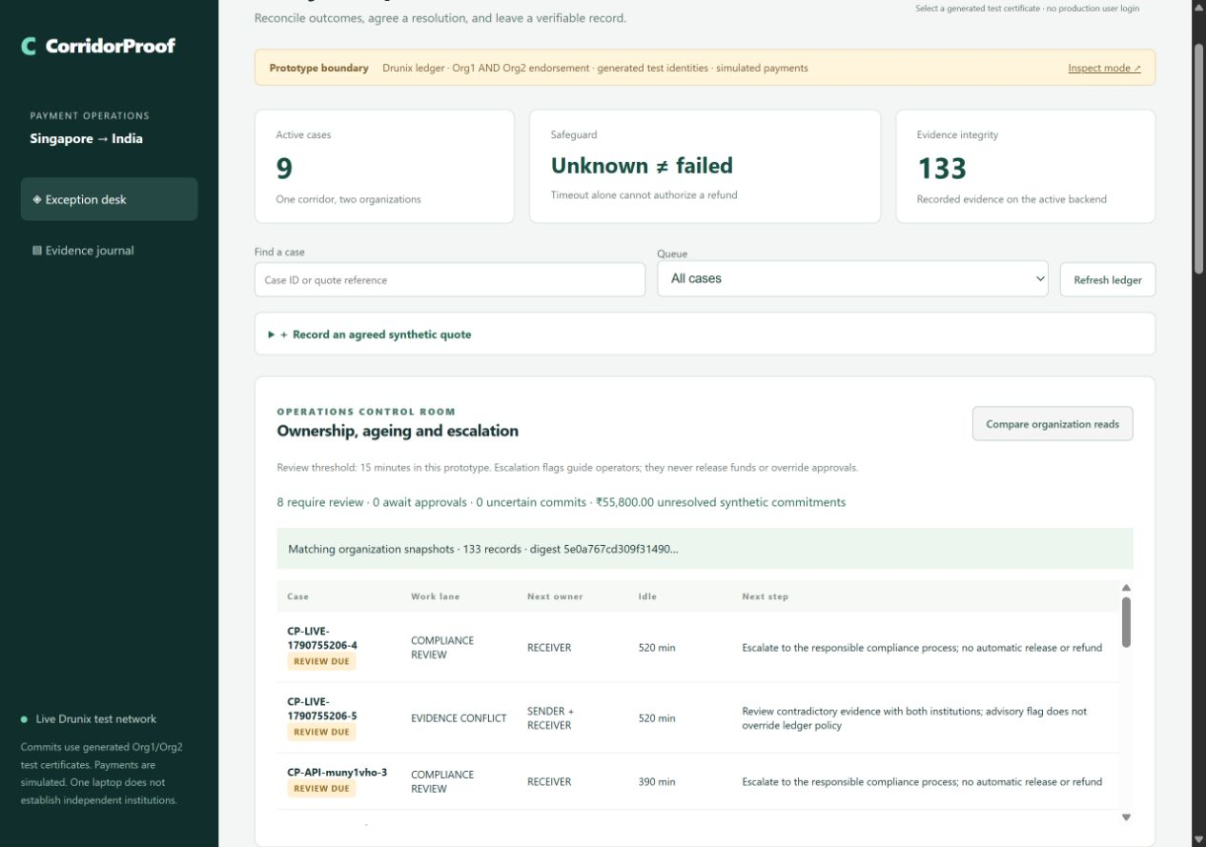
OWNERSHIP AND INSPECTION
Operations control room
Who acts next?
Missing approvals
Next organization
Idle time and review
Case dossier with full
verification context
Fresh Org1 / Org2
snapshot comparison
CorridorProof / Drunix hackathon prototype
08
Notes:
Actual screenshot of live local Drunix dashboard. Implemented operations read model derives missing owners/approvals, idle age, conflict/compliance/uncertain review flags and synthetic commitment totals. Fifteen-minute threshold is prototype operational configuration, not a Nexus SLA. Case dossier includes full workspace context and local adapter dispositions; packet digest alone is not provenance or block inclusion. Fresh Org1 and Org2 queries matched 133 events at the pictured checkpoint. Sequential queries can differ during a commit. See docs/OPERATIONS.md and submission/drunix-operations-browser-evidence.json.

Slide 9
MARKET POSITION
Existing products and the governance hypothesis
Swift / Nexus service desk
Established investigation workflows. We must validate
what a specific corridor partner still needs.
CorridorProof hypothesis
Independent operators jointly govern accepted evidence
and resolution changes without unilateral edit authority.
A trusted shared database remains a valid option when independent governance is unnecessary.
CorridorProof / Drunix hackathon prototype
09
Notes:
Nexus investigation service desk and possible future ISO20022 automation: https://docs.nexusglobalpayments.org/payment-processing/key-points. Swift Case Management and network-agnostic E&I: https://www.swift.com/products/case-management and https://www.swift.com/news-events/news/transforming-exceptions-and-investigations. Trusted database alternative is our architecture inference. No feature superiority or unmet buyer need is established.

Slide 10
PILOT AND BUSINESS MODEL
A corridor pilot is the next commercial gate
Candidate buyer
Sender and receiver PSP operations teams
Shadow pilot
Replay de-identified exceptions against the current workflow.
Measure operator effort and unsafe-decision prevention.
Subscription plus integration is a pricing hypothesis.
No customer adoption or operational savings claimed.
CorridorProof / Drunix hackathon prototype
10
Notes:
Hypotheses, not validated outcomes. Candidate buyers: PSP operations teams or corridor operator. Shadow pilot should compare existing workflows and trusted-database baseline with Drunix. Measure staff minutes, counterparty contacts, evidence rework and resolution time excluding rail waiting. No partners, savings percentage, market size or pricing validated.

