Slide 1
CROSS-BORDER EXCEPTION OPERATIONS
CorridorProof
Shared evidence for
uncertain payment outcomes
Sender and receiver teams agree a safe resolution
from an attributable case record.
Local dashboard / Drunix CLI: 46 VALID transactions
CorridorProof / Drunix hackathon prototype
01
Notes:
Synthetic prototype. No real funds or institutional identities. Separate local Drunix test network verified with 46 VALID transactions across five scenarios; dashboard remains local. Team identity and portal PS wording require confirmation.

Slide 2
PROBLEM EVIDENCE
Manual exceptions remain a documented requirement
Nexus documentation describes manual handling of
investigations, recalls and disputes in its first release.
Our narrow question
Can two operations teams share the evidence and
approvals needed to resolve uncertain payouts safely?
Documentation supports the problem. Partner demand and savings remain unvalidated.
CorridorProof / Drunix hackathon prototype
02
Notes:
Primary sources checked 30 September 2026. Nexus https://docs.nexusglobalpayments.org/payment-processing/key-points describes first-release manual investigations, recalls and disputes and possible future automation. This is documentation, not proof of present deployed release status. FSB Deputy Secretary General remarks, 8 July 2026 https://www.fsb.org/2026/07/cross-border-payments-towards-the-next-chapter/ identify data quality/operational integration frictions, with disclaimer that views do not necessarily represent FSB/members. Swift https://www.swift.com/products/case-management proves an established competitive category, not our savings.

Slide 3
CORE SAFEGUARD
Unknown payout outcomes need reconciliation
Missing response
Status stays unknown
A timeout records an exception.
It cannot approve a refund.
Receiver evidence determines
the next resolution step.
Late credit
Both parties acknowledge closure. No refund occurs.
CorridorProof / Drunix hackathon prototype
03
Notes:
Nexus payment-priority handling https://docs.nexusglobalpayments.org/payment-processing/time-critical-vs-non-time-critical-payments distinguishes scheme-specific status and cancellation behavior. Our rule is a conservative prototype policy, not a universal Nexus cancellation implementation. Node/Go shared conformance tests and browser flow implement the illustrated sequence.

Slide 4
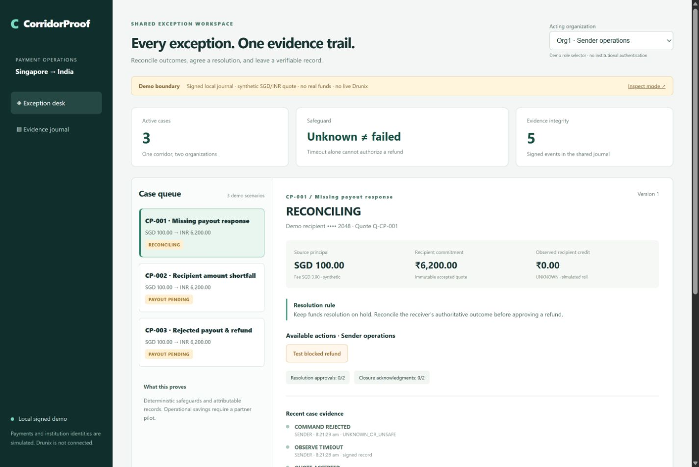
PROTOTYPE DEMONSTRATION
A working exception desk
Visible safeguards
Refund denied while
outcome is unknown
Two organizations
approve corrections
Signed evidence
exports for inspection
CorridorProof / Drunix hackathon prototype
04
Notes:
Screenshot of the locally implemented app, synthetic data. Browser-tested timeout/blocked-refund, late credit/joint closure, shortfall dual approval/correction and evidence alteration. Payments never leave the local application. Separate Drunix CLI passed five scenarios with 46 VALID commits. Dashboard remains local.

Slide 5
IMPLEMENTED CONTROLS
Evidence can be checked independently
Attributed events
Organization signatures and linked hashes
protect event contents from unnoticed alteration.
Reconstructed case state
The verifier replays signed events and checks
the exported case summary against the result.
Trust boundary: local demo keys simulate roles. Independent identity and external truth require more.
CorridorProof / Drunix hackathon prototype
05
Notes:
Implementation sources src/integrity.js, src/store.js, src/policy.js. Tests check quote-event alteration, removed/truncated events, mismatched snapshots, replay and restart. Completeness and institutional identity need independently pinned public keys and witnessed heads. Local server holds every demo private key. Signatures do not establish truth of external rail evidence.

Slide 6
TECHNICAL PLAN
Architecture and deployment boundary
EXECUTABLE LOCAL DEMO
Browser
dashboard
Node API
Policy + SQLite
Signed evidence
Export + replay
calls
records
LIVE DRUNIX CLI / 46 VALID COMMITS / DASHBOARD SEPARATE
Certificate-bound
Go Gateway CLI
Go chaincode
MSP + policy
Drunix network
Two orgs + AND
submits
deploys to
CorridorProof / Drunix hackathon prototype
06
Notes:
See docs/ARCHITECTURE.md and DECISIONS.md. Node.js24 HTTP/SQLite/Ed25519 signed local journal, browser-native dashboard. Separate Go chaincode and TLS certificate-bound Gateway CLI passed five live local test-network scenarios with 46 VALID transactions. Both orgs read matching state; replay and sequential stale-version denial passed. Dashboard-to-live integration pending. Receipts: https://github.com/krishang-1/corridorproof/blob/main/submission/drunix-live-evidence.json. Official repository pinned ddc0eae778158d3f8a96605cfeda383ae5eafcfc. https://github.com/npci/drunix/blob/main/drunix-network/test-network/README.md. Native editable architecture nodes describe required implementation evidence, not decorative graphics.

Slide 7
MARKET POSITION
Existing products and the governance hypothesis
Swift / Nexus service desk
Established investigation workflows. We must validate
what a specific corridor partner still needs.
CorridorProof hypothesis
Independent operators jointly govern accepted evidence
and resolution changes without unilateral edit authority.
A trusted shared database remains a valid option when independent governance is unnecessary.
CorridorProof / Drunix hackathon prototype
07
Notes:
Nexus investigation service desk and possible future ISO20022 automation: https://docs.nexusglobalpayments.org/payment-processing/key-points. Swift Case Management and network-agnostic E&I: https://www.swift.com/products/case-management and https://www.swift.com/news-events/news/transforming-exceptions-and-investigations. Trusted database alternative is our architecture inference. No feature superiority or unmet buyer need is established.

Slide 8
PILOT AND BUSINESS MODEL
A corridor pilot is the next commercial gate
Candidate buyer
Sender and receiver PSP operations teams
Shadow pilot
Replay de-identified exceptions against the current workflow.
Measure operator effort and unsafe-decision prevention.
Subscription plus integration is a pricing hypothesis.
No customer adoption or operational savings claimed.
CorridorProof / Drunix hackathon prototype
08
Notes:
Hypotheses, not validated outcomes. Candidate buyers: PSP operations teams or corridor operator. Shadow pilot should compare existing workflows and trusted-database baseline with Drunix. Measure staff minutes, counterparty contacts, evidence rework and resolution time excluding rail waiting. No partners, savings percentage, market size or pricing validated.

