Slide 1



Utility Domain understanding demonstration

Slide 2
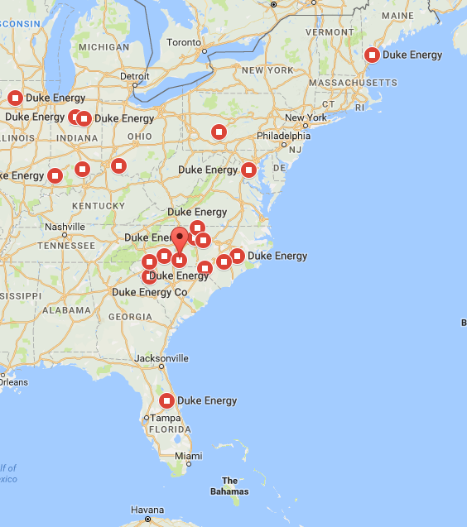



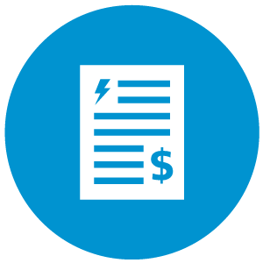
About Duke Energy
Duke Energy Service Territories & Subsidiaries
One of the Largest electric power holding company in United States
$23.56 B
Revenue in FY 2017
Subsidiaries:
Duke Energy Carolinas
Duke Energy Ohio
Duke Energy Kentucky
Duke Energy Indiana
Duke Energy Florida
Duke Energy Progress
Duke Energy Renewables
Duke Energy Retail
Duke Energy International
Operations in 6 states in US with assets also in Canada & Latin America
7.6 Million
Electric Customers
2nd largest Utility in US by Market Cap
1.6 Million
Gas
Customers
Recent Developments at Duke Energy
29,060
Employees
Black Enterprise 40 Best Companies for Diversity
$25 Billion Investments in Grid Modernization
$11 Billion Investments in Clean Generation
Expansion in Natural Gas Infrastructure (15%)
Top quartile CSAT scores
Power/Forward Carolinas: $16 Billion to be invested in North & South Carolina
$1.1 Billion Florida Grid Investments through 2021
185 MW battery storage projects proposed or in-service
$4.55-$4.85 2018 EPS guidance range
8-10% attractive risk adjusted total shareholder returns
4-6% highly achievable EPS growth through 2022
125
Fortune 500 List
Dow Jones Sustainability Index (DJSI) for North America for the 11th consecutive year
United Way North Carolina's Power of Commitment Award

Slide 3
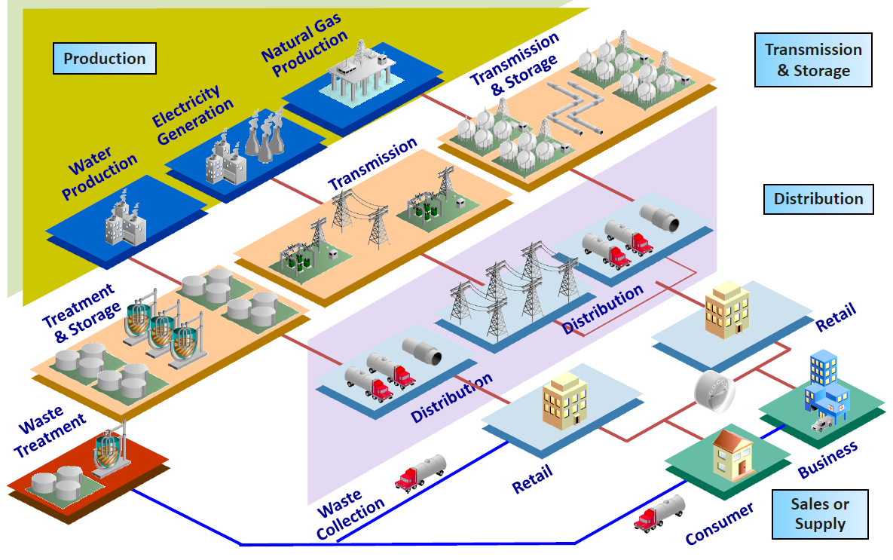
Utilities Value Chain

Slide 4

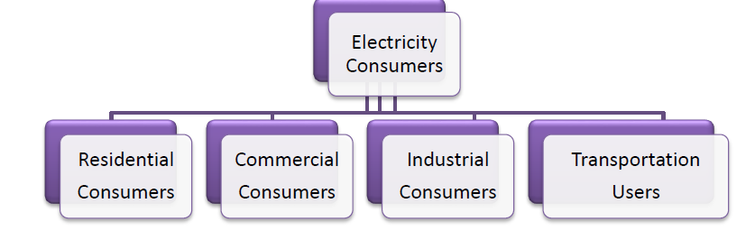
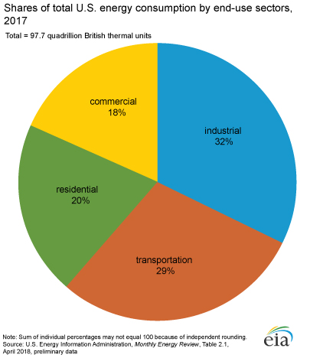
Who are electricity consumers?

Slide 5
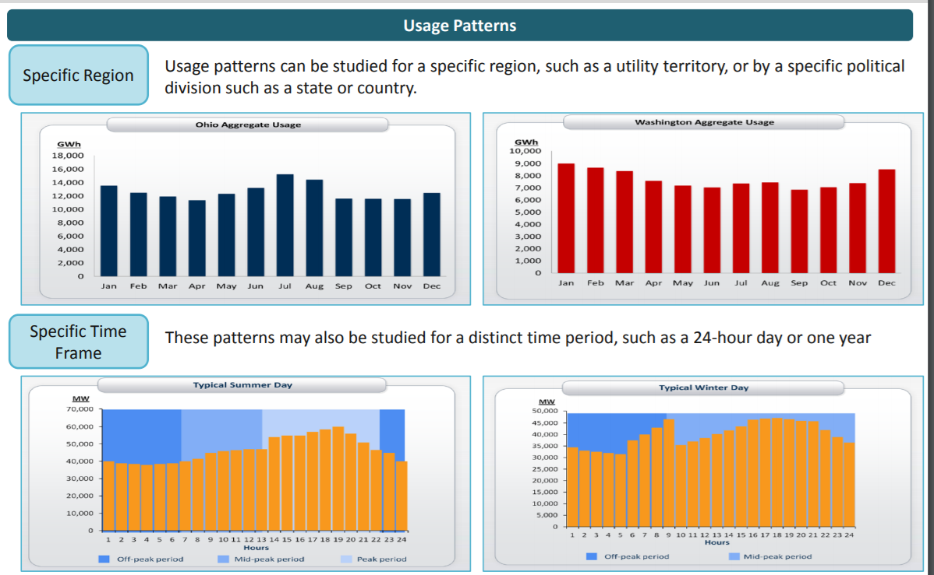

Slide 6
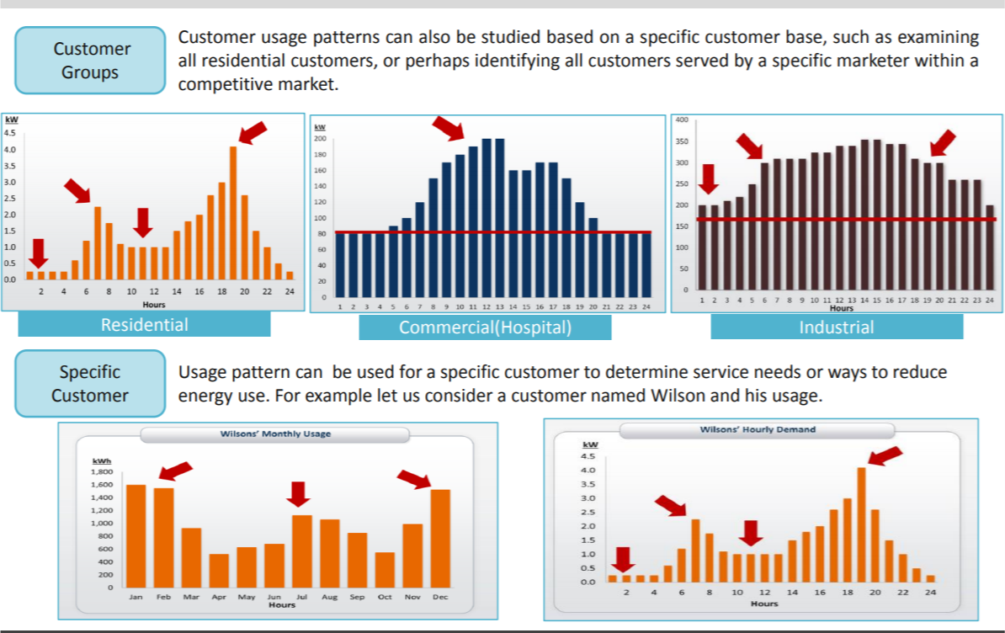

Slide 7
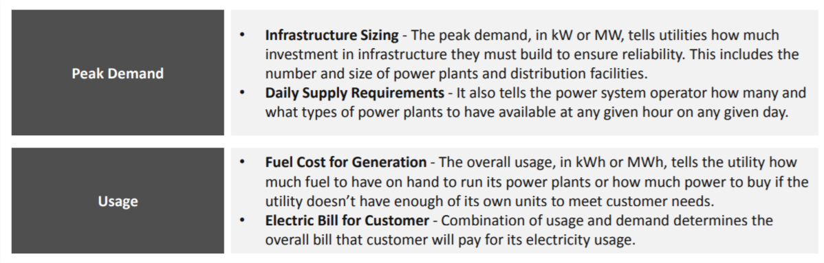

Slide 8
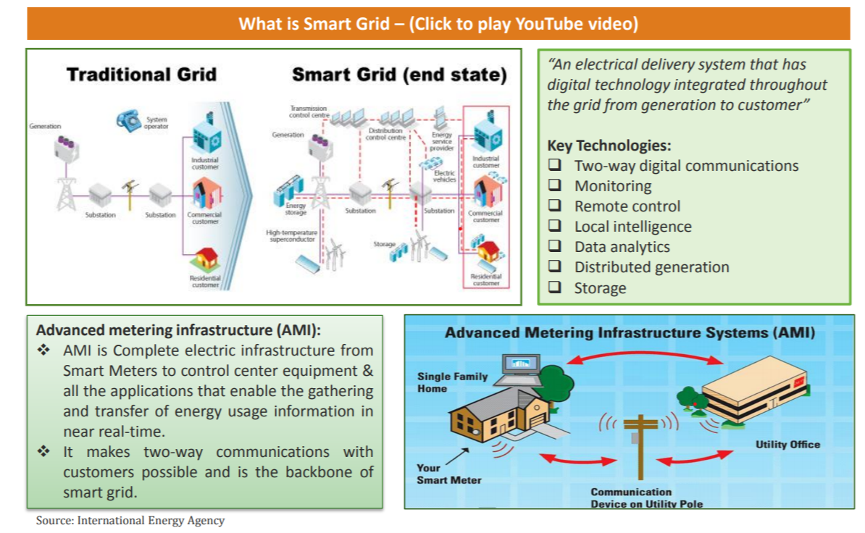

Slide 9

Contact details
Bhawesh.gupta@cognizant.com

