Slide 1
Duke Energy

Slide 2
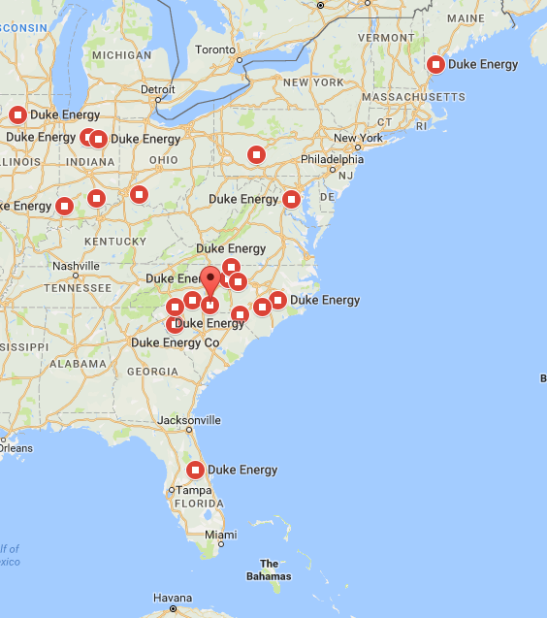




About Duke Energy
Duke Energy Service Territories & Subsidiaries
One of the Largest electric power holding company in United States
$23.56 B
Revenue in FY 2017
Subsidiaries:
Duke Energy Carolinas
Duke Energy Ohio
Duke Energy Kentucky
Duke Energy Indiana
Duke Energy Florida
Duke Energy Progress
Duke Energy Renewables
Duke Energy Retail
Duke Energy International
Operations in 6 states in US with assets also in Canada & Latin America
7.6 Million
Electric Customers
2nd largest Utility in US by Market Cap
1.6 Million
Gas
Customers
Recent Developments at Duke Energy
29,060
Employees
Black Enterprise 40 Best Companies for Diversity
$25 Billion Investments in Grid Modernization
$11 Billion Investments in Clean Generation
Expansion in Natural Gas Infrastructure (15%)
Top quartile CSAT scores
Power/Forward Carolinas: $16 Billion to be invested in North & South Carolina
$1.1 Billion Florida Grid Investments through 2021
185 MW battery storage projects proposed or in-service
$4.55-$4.85 2018 EPS guidance range
8-10% attractive risk adjusted total shareholder returns
4-6% highly achievable EPS growth through 2022
125
Fortune 500 List
Dow Jones Sustainability Index (DJSI) for North America for the 11th consecutive year
United Way North Carolina's Power of Commitment Award
Notes:
1

Slide 3
Duke Energy Business Outlook – Key Imperatives
Grid Modernization
Focus on Cleaner Energy
Operational Excellence
Stakeholder
Engagement
Customer Experience
Transformation
Grid Modernization including storm hardening, to ensure the system is better prepared for severe weather and to improve the system’s reliability and flexibility
Invest $25 billion in modernizing energy delivery system.
Generation of cleaner energy through an increased amount of natural gas, renewables generation and the continued safe and reliable operation of nuclear plants.
Invest $25 billion in modernizing energy delivery system.
Operational excellence through engagement with employees and being an industry leader in safety performance and efficient operations
Stakeholder engagement to ensure the regulatory rules in the states in which Duke Energy operates benefit customers and allow Duke Energy to recover its significant investments in a timely manner
Transformation of the customer experience to meet changing customer expectations through enhanced convenience, control and choice in energy supply and usage.

Slide 4
THANK YOU

