Slide 1
NMIMS MPSTME · B.TECH COMPUTER ENGINEERING
Digital Image
Watermarking
A hybrid DWT–DCT–SVD approach — extended evaluation on 100 images, controls, technology comparison and a video feasibility test
CLASSICAL SIGNAL PROCESSING — NO MACHINE LEARNING / DEEP LEARNING
Krishang Vikram Singh
Roll No. B106 · Batch C1
Subject: Image and Video Processing (IVP) · First submission July 2026 · extended edition October 2026
NMIMS MPSTME · Image & Video Processing
Notes:
Opening. This is the extended version of my watermarking project. The first submission tested a hybrid DWT-DCT-SVD scheme on two images. Since then I audited the code, rebuilt the evaluation on 100 unique images, added control experiments, compared the scheme with existing technology, and tried it on real video. I will show what held up, what did not, and what I corrected.

Slide 2
02
INTRODUCTION · MOTIVATION
Copying an image takes a second — proving who owns it is the hard part
Imperceptible
Robust
Explainable
The watermark must not visibly change the image. Measured with PSNR and SSIM against the unwatermarked original.
It must survive compression, noise, filtering and geometric change. Measured with NC / ZNCC / BER of the recovered logo.
DWT, DCT and SVD are closed-form and verifiable by hand — no black-box model. A deliberate scope choice, not a claim of superiority.
WHAT THIS EXTENDED WORK ADDS
▪ 100 unique images instead of two, with seeded attacks, status logging and 43 unit tests
▪ Controls that ask whether a high NC really proves the watermark is present
▪ Technology comparison (libraries and an existing watermarking package) and an exploratory video test
NMIMS MPSTME · Image & Video Processing
02
Notes:
Motivation: images are copied in one click. An invisible watermark carries an ownership signal inside the pixels. Three constraints must hold at once: imperceptible, robust, explainable. The project's third constraint is explainability: every step is a closed-form linear-algebra operation, no learned component. In this extended work I test whether the first two constraints hold at scale.

Slide 3
03
OBJECTIVES AND SCOPE
Six objectives — three inherited from the first submission, three new
# | Objective | Status
1 | Implement the hybrid DWT–DCT–SVD embed/extract pipeline | inherited
2 | Quantify imperceptibility (PSNR, SSIM) | inherited · now 100 images
3 | Quantify robustness (NC, BER + ZNCC) under 14 attacks and a no-attack reference | inherited · now 100 images
4 | Characterise the α trade-off | re-done, 4 attacks
5 | Find failure modes — including false positives (controls) | new
6 | Compare with libraries and an existing package; test video | new
Scope boundaries
▪ 8-bit grey-scale images (colour only via luminance)
▪ No machine / deep learning
▪ Scheme is non-blind: needs a key with the original singular values
▪ Video = exploratory (2 clips × 60 frames)
▪ Only operations that exist in the code are documented
Honesty rule: every number in this deck comes from a recorded experiment file; limits, unverified claims and corrections to the first submission are stated explicitly.
NMIMS MPSTME · Image & Video Processing
03
Notes:
Objectives one to three are from the first submission: implement, measure imperceptibility, measure robustness. The new ones are: characterise alpha, find and explain failure modes including false positives, and compare with existing technology and video. Scope boundaries matter: grey-scale only, no machine learning, non-blind scheme, video exploratory.

Slide 4
04
EXISTING TECHNOLOGY · LITERATURE
From LSB to hybrids — and an old warning about SVD schemes
1994
1997
2002–04
2010–22
2005
LSB marking
Spread spectrum
SVD & DWT-SVD
Hybrid DWT-DCT-SVD
False-positive critique
▪ van Schyndel et al. [10]
▪ high capacity, fragile
▪ Cox et al. [1]
▪ significant spectral coefficients
▪ Liu & Tan [2]; Ganic & Eskicioglu [3]
▪ singular-value embedding
▪ [7] [8] [9]
▪ reported gains; not re-tested here
▪ Zhang & Li [4]; Ting [5]
▪ key owner's mark can be 'found' anywhere
▪ Gap 1 — identity binding: SVD schemes can report the key owner's logo whatever was embedded (measured on slide 15)
▪ Gap 2 — geometry: global embedding breaks under cropping/rotation, the standard remedy being invariant or block-based domains [22]
▪ Gap 3 — evaluation breadth: published hybrids are typically shown on a few standard images; here 100
Bibliographic details verified against publisher / secondary records; status flags in research/REFERENCES.md.
NMIMS MPSTME · Image & Video Processing
04
Notes:
A short timeline. Spatial LSB marks by van Schyndel et al. 1994 are fragile. Cox et al. 1997 put a spread-spectrum watermark into significant spectral coefficients. Liu and Tan 2002 introduced SVD ownership watermarking; Ganic and Eskicioglu 2004 combined DWT and SVD. Later hybrids cascade DWT, DCT and SVD. The important warning: comments by Zhang and Li in 2005 and Ting in 2005 concern false positives and ambiguity attacks on this family. I verified the bibliographic details of each reference; I did not re-run those papers' experiments. The claim in my first report that hybrids always beat single transforms is a literature trend, not something I tested.

Slide 5
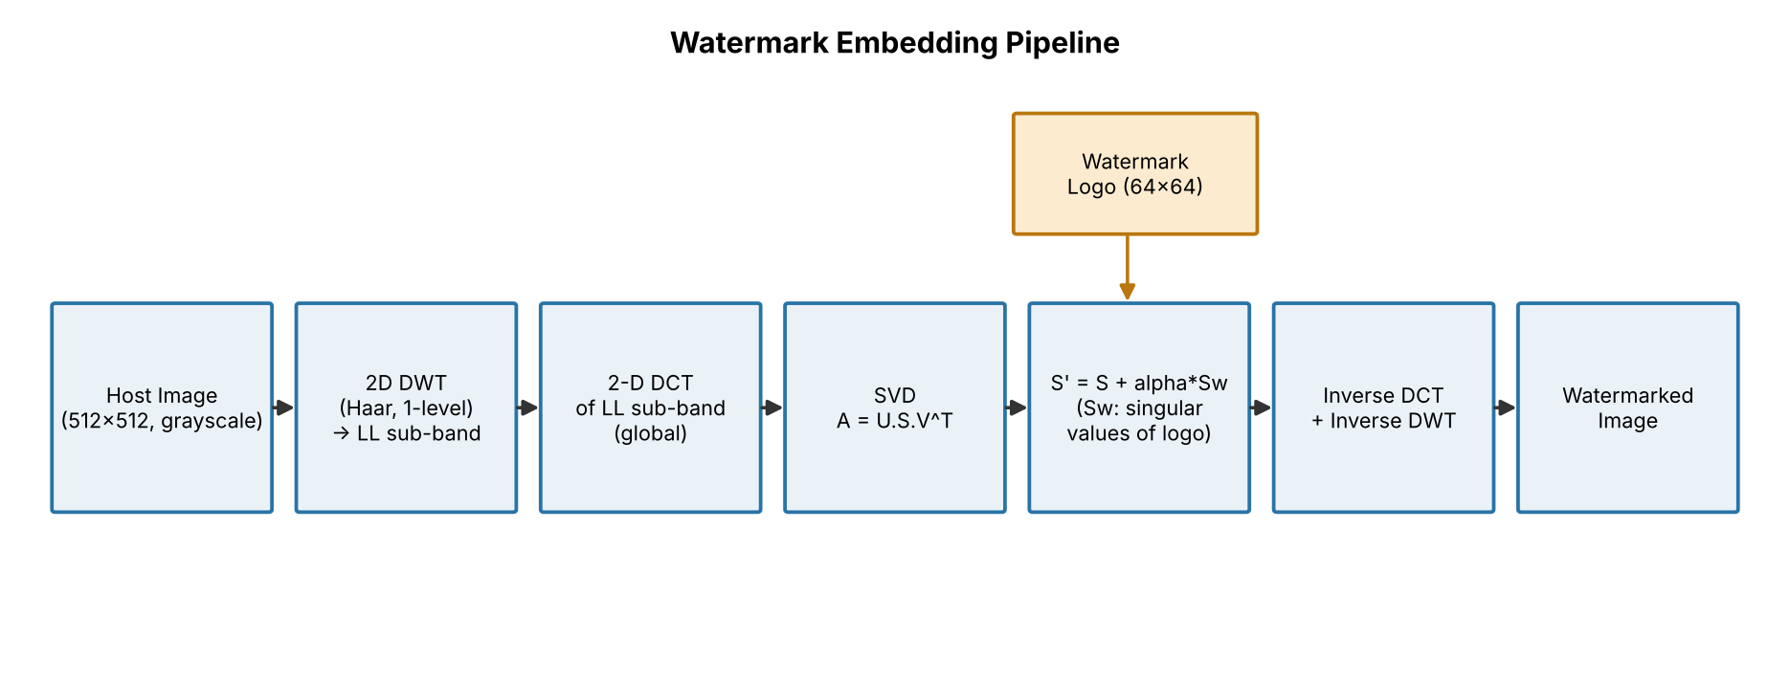
05
SYSTEM ARCHITECTURE · EMBEDDING
Embedding: add the logo's singular values to the host's — once, by the owner
Correction vs first submission: the DCT is applied to the whole LL band (not 8×8 blocks). Alpha = 0.10 in the main experiment.
NMIMS MPSTME · Image & Video Processing
05
Notes:
The embedding pipeline: host image, one-level Haar DWT, take the LL band, apply a 2-D DCT to the whole band, take the SVD, add alpha times the singular values of the logo, and invert the transforms. Two corrections to the first submission are visible here: the DCT is global, not block-wise. The result is an 8-bit image that looks like the original; the owner keeps a key.

Slide 6
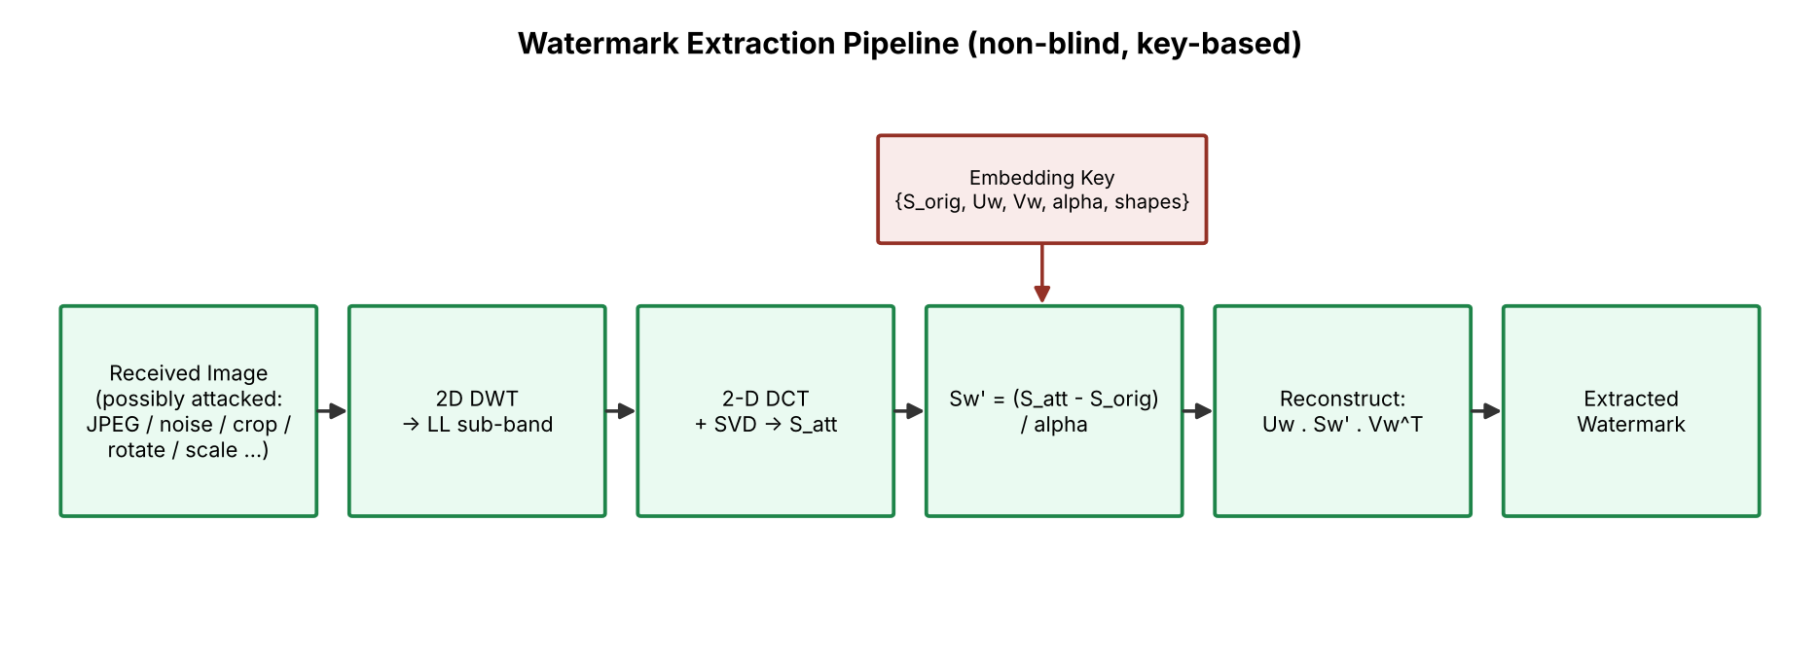
06
SYSTEM ARCHITECTURE · VERIFICATION
Extraction needs the owner's key — and rebuilds the owner's logo from it
Correction vs first submission: extraction is non-blind (needs S_orig of the unmarked host); the key holds U_w and V_w, i.e. the logo's identity.
NMIMS MPSTME · Image & Video Processing
06
Notes:
Extraction repeats DWT, DCT and SVD on the received, possibly attacked image and subtracts the stored original singular values, divides by alpha and rebuilds the logo from the key's singular vectors. Second correction: the scheme is non-blind, not semi-blind, because the key contains the original singular values. And note the consequence we will measure later: because the logo's singular vectors are in the key, the extractor returns the key owner's logo whatever singular values it finds.

Slide 7
07
MATHEMATICAL FOUNDATIONS
One tunable parameter: add α times the logo's singular values
DWT (HAAR, LL)
What follows from the maths
LL = (a + b + c + d) / 2 for each 2×2 block
▪ Non-blind: needs S_orig of the unmarked host
▪ Global DCT: not tied to JPEG's 8×8 blocks — JPEG robustness comes from SVD
▪ Identity in the key: U_w, V_w rebuild *the owner's* logo from any singular values
▪ Metric caution: a blank white image already scores NC = 0.36 against this logo
DCT-II (GLOBAL, ORTHONORMAL)
F(u,v) = α(u)α(v) ΣΣ f(x,y) cos[(2x+1)uπ/2M] cos[(2y+1)vπ/2N]
SVD
A = U·diag(S)·Vᵀ W = U_w·diag(S_w)·V_wᵀ
EMBEDDING
S′ = S + α·S_w , A′ = U·diag(S′)·Vᵀ → IDCT → IDWT → clip
EXTRACTION (KEY: S_ORIG, U_W, V_W, Α)
S_w′ = (S_att − S_orig) / α , W′ = U_w·diag(S_w′)·V_wᵀ
Equations (1)–(5) of the report; numerics unchanged from the first submission (re-run reproduces its table within 0.004 NC).
NMIMS MPSTME · Image & Video Processing
07
Notes:
The mathematics in five lines. Haar DWT gives the approximation band. A global orthonormal DCT-II moves it to a frequency domain. SVD factors the DCT matrix and the logo. The embedding rule adds alpha times the logo's singular values to the host's singular values. Extraction subtracts the stored original singular values and divides by alpha, then rebuilds the logo from the key's singular vectors. Important consequence: the identity of the logo lives in the key, not in the image.

Slide 8
08
TRANSFORMATIONS IMPLEMENTED
Twenty documented operations — only those that exist in the code
# | Transformation | Library | # | Transformation
T1 | Grey conversion, centre-crop, Lanczos resize | Pillow | T11–T12 | Median 3×3, Gaussian blur σ=1.5
T2 | 1-level Haar DWT / inverse | PyWavelets | T13–T15 | Rotation 5°/15°, border cropping, 0.5× scaling
T3 | 2-D DCT-II / inverse (global) | SciPy | T16–T17 | Histogram equalisation, unsharp mask
T4 | SVD of host sub-band and logo | NumPy | T18 | PSNR, SSIM, MSE
T5 | Singular-value embedding and extraction | NumPy | T19 | NC, ZNCC (new), BER
T6–T7 | Anti-aliased resize; procedural logo | scikit-image, Pillow | T20 | Frame I/O, per-frame embed, codec round trip (new)
T8 | JPEG Q=90/50/20 | Pillow | T9–T10 | Gaussian σ²=0.005/0.02; salt-and-pepper 2 %
Pipeline order matters: DWT → DCT → SVD → embed → round to 8 bit → attack → DWT → DCT → SVD → extract. The first submission attacked the float image; the 8-bit protocol is primary here (difference < 0.001 mean NC except histogram equalisation).
NMIMS MPSTME · Image & Video Processing
08
Notes:
Every operation in the code is documented in TRANSFORMATIONS_REFERENCE with its mathematics, parameters, limitations and complexity. The core is T2 to T5. T8 to T17 are the attacks used for testing. T20, video, is new and exploratory. Generic operations such as Sobel, CLAHE or morphology are not in this project and are not claimed.

Slide 9
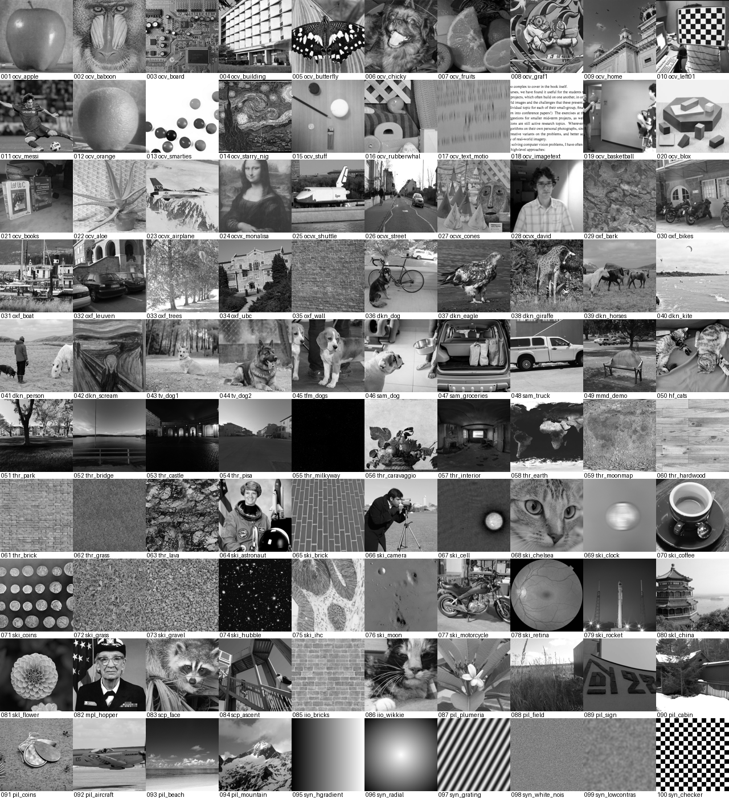
09
DATASET DESIGN
100 unique images: 94 real, 6 labelled synthetic — rights and provenance recorded
94
6
18
real images
synthetic controls
categories
Provenance, diversity, limits
▪ Sources: OpenCV (+extra), scikit-image, darknet, torchvision, three.js, Pillow tests, …
▪ Brightness: mid 87, dark 7, bright 6; contrast: medium 62, low 19, high 19
▪ SHA-256, URL, licence and rights note per image in metadata.csv
▪ Convenience sample — not a benchmark; colour removed; 1–4 images in several categories
NMIMS MPSTME · Image & Video Processing
09
Notes:
The dataset: 94 real images from open sample collections hosted on GitHub — OpenCV, scikit-image, torchvision, three.js textures and others — plus six synthetic controls. They are grey-standardised, square-cropped and resized to 512. Near duplicates were rejected by a hash, and a test asserts uniqueness. Important caveat: only raw GitHub and PyPI were reachable, so this is a convenience sample, not a benchmark, and rights for most photographs are not documented upstream — I record exactly what upstream says.

Slide 10
10
QUANTITATIVE EVALUATION METHODOLOGY
Seven experiments, 14 attacks plus a reference, four metrics — all seeded and logged
ID | What | Size
E1 | embed α = 0.10, save 8-bit PNG, verify | 100 images
E2 | 15 conditions × 2 protocols | 3000 trials
E3 | α sweep × 4 attacks | 4000 rows
E4 | false-positive controls (a–d) | 1600 rows
S1/S2 | scheme / component benchmarks | 30 imgs / 10 ops
V1 | video: 2 clips × 60 frames × 6 codecs | 720 frames
Metrics
▪ PSNR / SSIM vs the unwatermarked original
▪ NC, ZNCC (mean-centred), BER vs the logo
▪ Recognised if NC ≥ 0.75 (project convention)
▪ 95 % bootstrap CIs; Wilson intervals for pass rates
100/100 images · 3000/3000 attack trials · 4000/4000 sweep rows — 0 failures
Two full runs gave identical metrics (max |Δ| = 0.0) · 43 tests pass · ≈ 80 s on 4 cores
NMIMS MPSTME · Image & Video Processing
10
Notes:
E1 imperceptibility, E2 robustness with fifteen conditions — fourteen attacks plus the unattacked reference, which the first report counted as an attack — under two protocols, E3 an alpha sweep with four attacks, E4 false-positive controls. S1 and S2 are the technology comparisons and V1 is the video test. Metrics: PSNR and SSIM for imperceptibility; NC, ZNCC and BER for the recovered logo. The 0.75 threshold is the project's convention; I could not find a primary literature source for it, and I measure its false-alarm rate in E4.

Slide 11
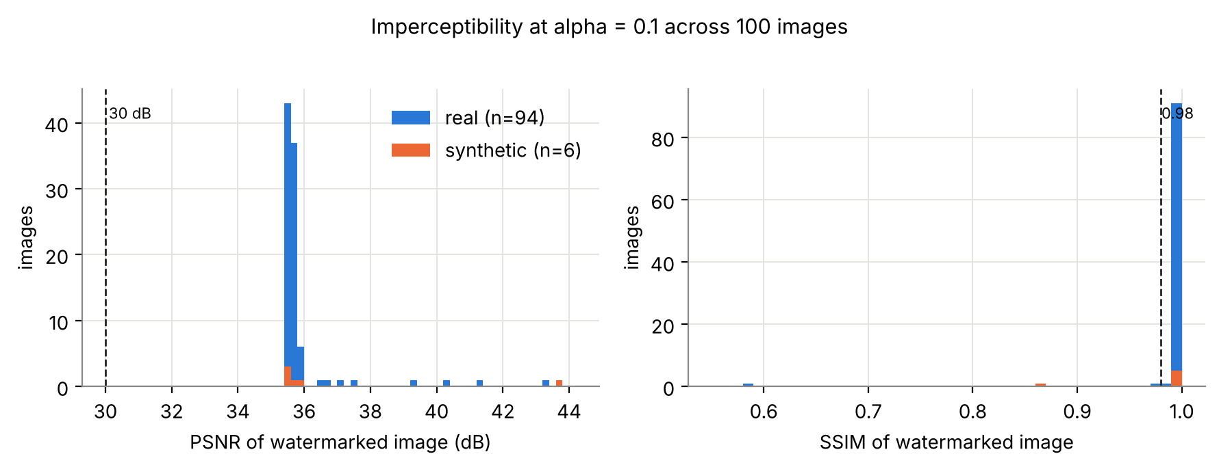
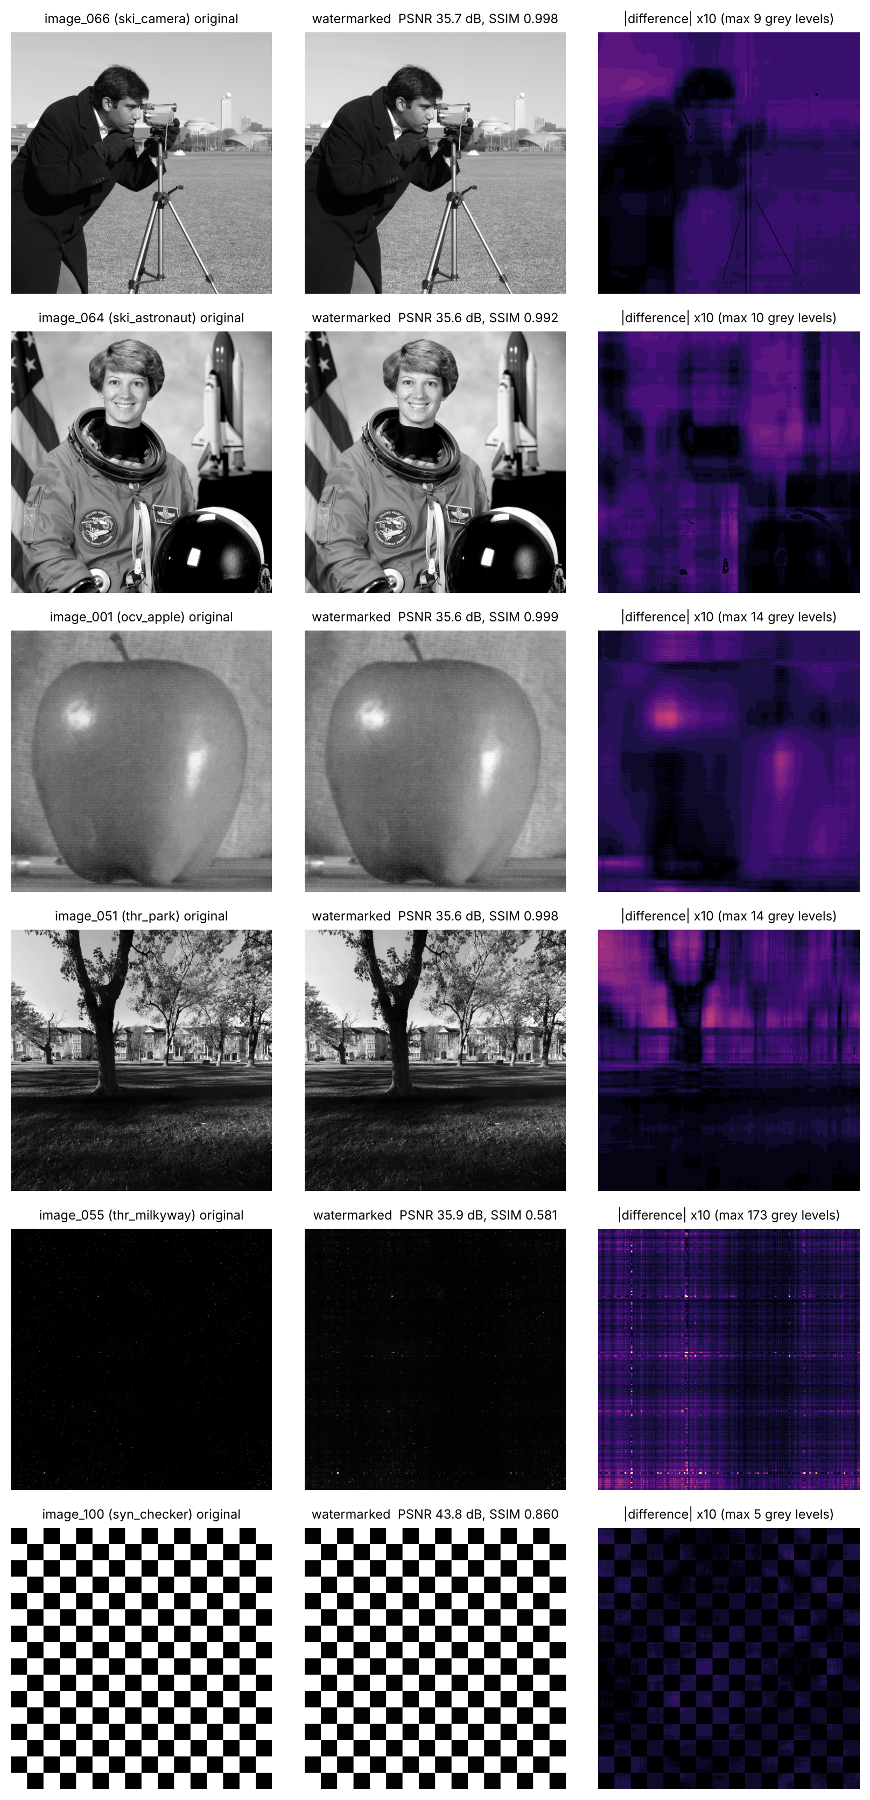
11
RESULTS · IMPERCEPTIBILITY
Invisible on typical images — but PSNR alone hides some failures
36.0 dB
mean PSNR (min 35.5)
0.992
mean SSIM · 3 images < 0.98
▪ PSNR ≈ 35.6 dB for 82 of 100 images — set by the logo, not the host
▪ Near-black sky (image_055): PSNR 35.9 dB but SSIM 0.58 — clipping dominates
▪ Checkerboard: SSIM 0.86; synthetic images reach 43.8 dB
0
images below 30 dB
Right: original · watermarked · |difference|×10 for typical images and two failure cases (E1, 100 images).
NMIMS MPSTME · Image & Video Processing
11
Notes:
Across 100 images the mean PSNR is 36.0 dB and mean SSIM 0.992. Notice that PSNR is almost the same for most images, about 35.6 dB, because the added energy is set by the logo's singular values, not by the host. SSIM exposes exceptions: the near-black Milky Way image has PSNR 35.9 but SSIM 0.58, and the checkerboard 0.86. So PSNR alone would have hidden these failures.

Slide 12
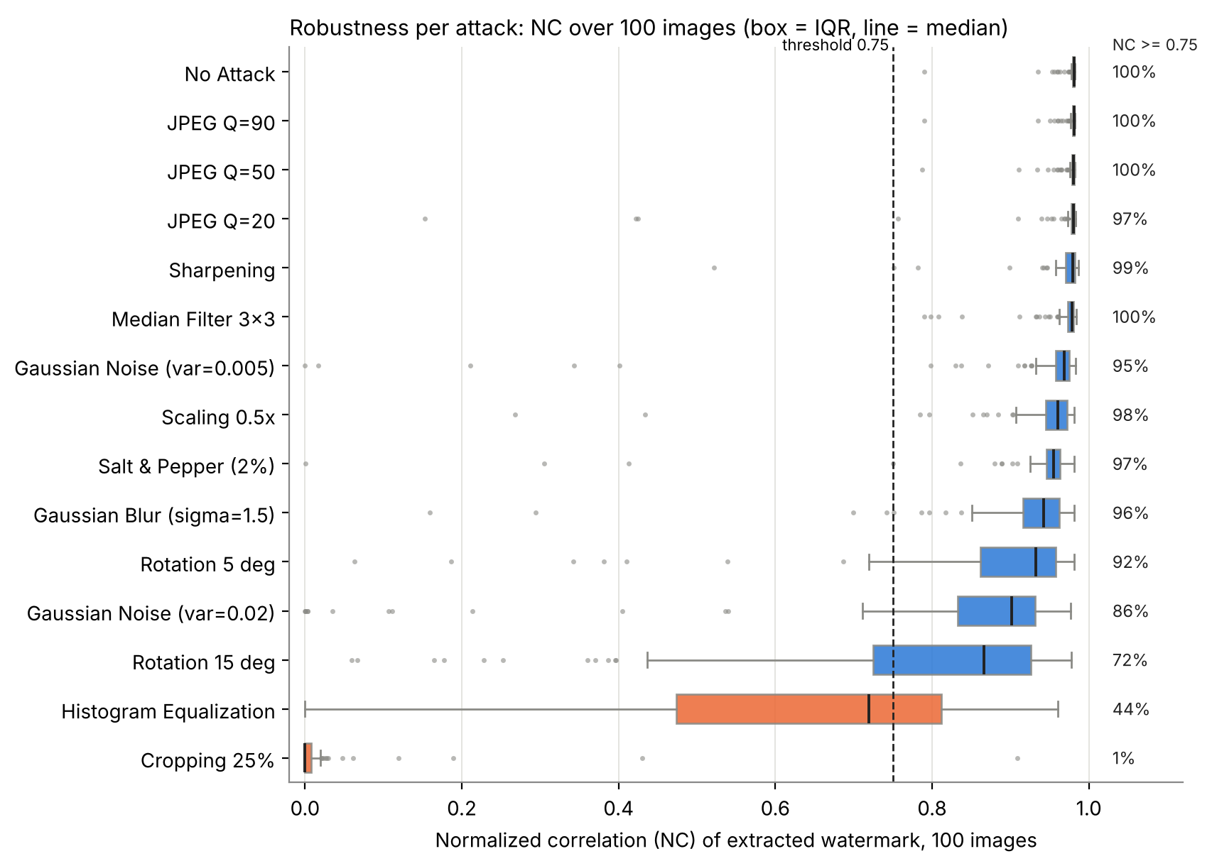
12
RESULTS · ROBUSTNESS UNDER ATTACK
85.1 % of trials recovered — strong for compression and filtering, weak for cropping and equalisation
Attack | mean NC | NC ≥ 0.75
JPEG Q=50 | 0.975 | 100 %
Median 3×3 | 0.967 | 100 %
Scaling 0.5× | 0.938 | 98 %
Noise σ²=0.02 | 0.806 | 86 %
Rotation 15° | 0.776 | 72 %
Hist. equalisation | 0.644 | 44 %
Border cropping | 0.022 | 1 %
First submission: "rotation/scaling NC > 0.93". At n = 100: scaling 0.938 ✓, 5° rotation 0.880 ✗.
1500 trials = 100 images × 15 conditions (14 attacks + reference); attacks only: 1177/1400 = 84.1 %.
NMIMS MPSTME · Image & Video Processing
12
Notes:
Headline: 1277 of 1500 trials reach NC at least 0.75 when the unattacked reference is included, as in the first submission, and 1177 of 1400 counting only the 14 attacks. Very robust: JPEG, median filter, sharpening, scaling, salt and pepper, blur, mild noise. Moderate: five and fifteen degree rotation, strong noise. Weak: histogram equalisation, 44 percent, and border cropping, 1 percent. The first submission said moderate rotation and scaling had mean NC above 0.93; with 100 images that holds for scaling, 0.938, but not for 5 degree rotation, 0.880.

Slide 13
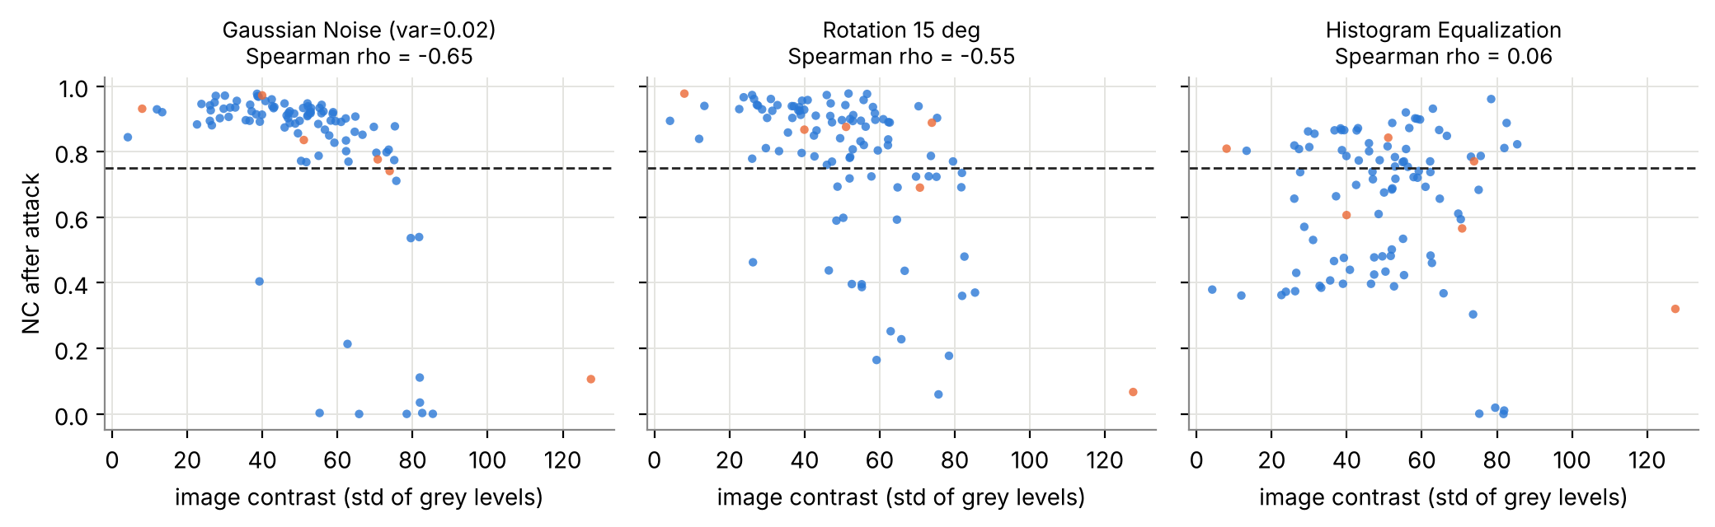
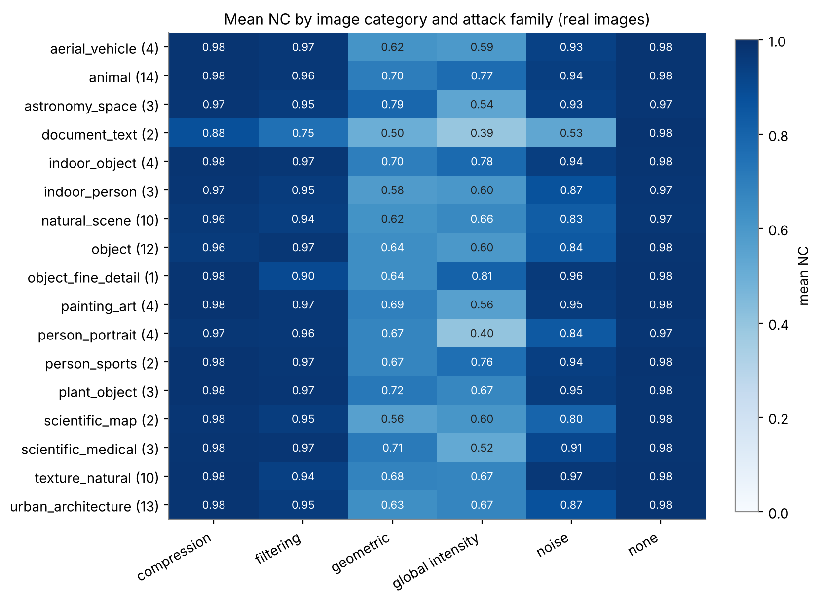
13
RESULTS · WHICH IMAGES FAIL?
Robustness depends on the image: higher-contrast images lose more under noise and rotation
▪ Noise σ²=0.02: ρ(contrast) = -0.65; salt-and-pepper -0.68; 15° rotation -0.55
▪ Hist. equalisation tracks mean brightness (ρ = -0.31), not contrast
▪ Weakest categories: document text (noise 0.53) and portraits under equalisation (0.40)
▪ n = 100, uncorrected p-values — associations, not causes
NMIMS MPSTME · Image & Video Processing
13
Notes:
Across the 100 images, NC after noise and rotation is negatively correlated with image contrast — Spearman rho about minus 0.65 for strong Gaussian noise, minus 0.68 for salt and pepper and minus 0.55 for 15 degree rotation. Histogram equalisation instead correlates with mean brightness. These are associations, with uncorrected p-values and n of 100, not demonstrated causes. By category, the two document-text images are the weakest, portraits and documents are most sensitive to equalisation; several categories have only one to four images so I treat them as descriptive.

Slide 14
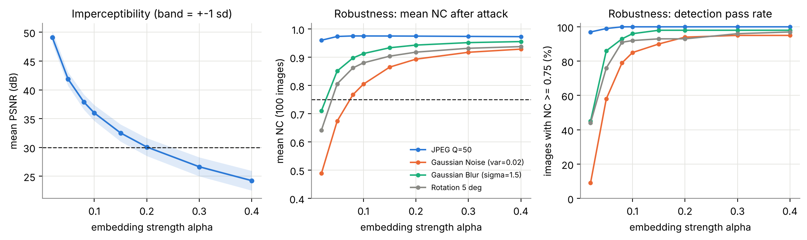
14
RESULTS · EMBEDDING STRENGTH
The α trade-off is real for noise and rotation — but flat for JPEG, so the earlier figure misled
9 % → 85 %
36.0 → 30.1 dB
0.96 → 0.97
Old figure: axis 0.93–0.99 + float truncation before JPEG → artefact (exp_jpeg_truncation.py)
noise pass rate, α 0.02 → 0.10
PSNR, α 0.10 → 0.20
mean NC after JPEG Q=50, α 0.02 → 0.40
NMIMS MPSTME · Image & Video Processing
14
Notes:
This slide corrects the first submission. Its trade-off figure used two y-axes with the NC axis zoomed to 0.93 to 0.99, and its JPEG simulation truncated floats, which lowered NC only at alpha 0.02. I re-created its conditions exactly and got the same numbers, then showed that rounding removes the dip. With 100 images and four attacks the picture is clear: after JPEG the NC is flat, but under noise, blur and rotation robustness grows with alpha while PSNR falls. For Gaussian noise the pass rate goes from 9 percent at alpha 0.02 to 85 percent at 0.10 and 95 percent at 0.40, while PSNR falls below 30 dB from alpha 0.20.

Slide 15
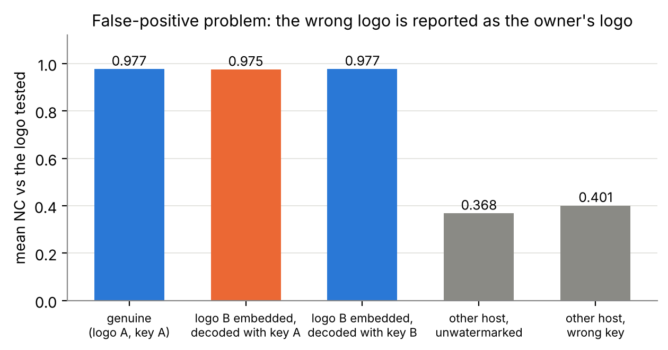
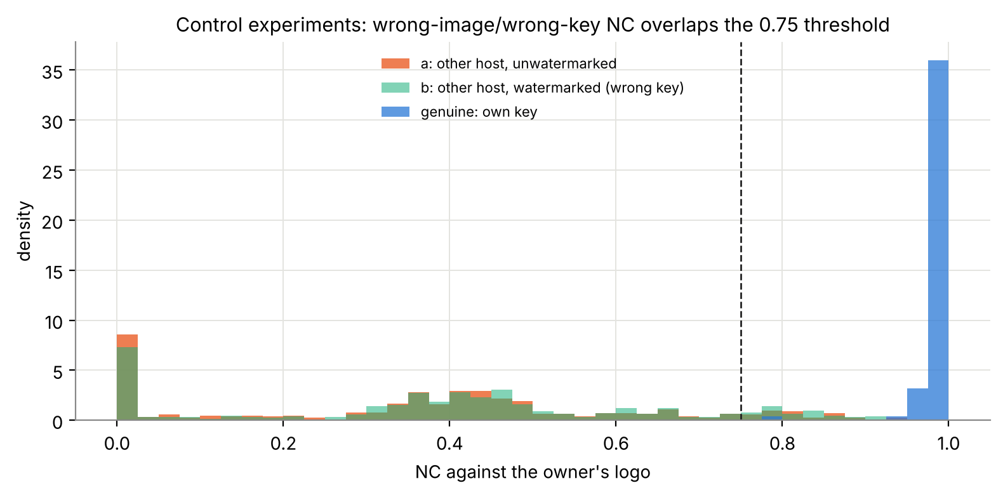
15
RESULTS · FALSE-POSITIVE CONTROLS
A different logo decoded with the owner's key still scores NC 0.98 — NC does not prove ownership
0.975
9.8 % / 12.6 %
0.82
Needed: an image-bound signature — not implemented; the principal-component variant was worse (NC 0.98 on an unmarked image)
wrong logo, owner's key (genuine 0.977)
unrelated-image controls above NC 0.75
95th percentile NC of unrelated images
NMIMS MPSTME · Image & Video Processing
15
Notes:
This is the most important finding. Control C: embed a different logo in the same host and decode with the key of logo A. The extractor returns the key owner's logo, NC 0.975 against 0.977 for the genuine pair. That is the false-positive problem described for SVD schemes in the literature, now measured for this implementation. Controls A and B: unrelated images decoded with a wrong key score 0.37 to 0.40 on average, and about 10 to 13 percent exceed the 0.75 threshold. A claim of ownership therefore needs an additional safeguard such as an image-bound signature; I did not implement one. I also tried embedding the principal component instead; that made things worse, the unwatermarked image still decoded at 0.98.

Slide 16
16
RESULTS · FAILURE CASE ANALYSIS
Four failure modes — explained from the data, not hidden
Border cropping
Histogram equalisation
Rotation > 5°
Near-constant images
▪ mean NC 0.022, pass 1 %
▪ 43.75 % of the *area* zeroed (25 % per dimension)
▪ all singular values change; logo extracts as black (BER 0.14 ≈ white fraction)
▪ mean NC 0.644, pass 44 %
▪ remaps the whole intensity distribution
▪ varies by image (first report: 0.10 vs 0.66)
▪ tracks mean brightness (ρ −0.31)
▪ 5°: 92 %, 15°: 72 %
▪ no re-registration attempted
▪ consistent with RST theory [22]
▪ block-based schemes break too (blind-watermark BER 0.21)
▪ near-black sky: PSNR 35.9 dB, SSIM 0.58
▪ checkerboard: lowest clean NC (0.79)
▪ PSNR alone would have hidden both
By contrast: JPEG Q ≥ 20, median 3×3, sharpening, 0.5× scaling, blur, salt-and-pepper and mild noise all reach ≥ 95 % pass rate.
NMIMS MPSTME · Image & Video Processing
16
Notes:
Border cropping: mean NC 0.02; with 43.75 percent of the area zeroed every singular value changes. The first report called this 25 percent cropping; 25 percent of each dimension is 43.75 percent of the area. Histogram equalisation: 44 percent pass; it varies between images, 0.10 for the cameraman and 0.66 for the astronaut in the first submission. Near-constant images: SSIM collapses though PSNR is fine. Rotation: 72 percent pass at 15 degrees; there is no re-registration.

Slide 17
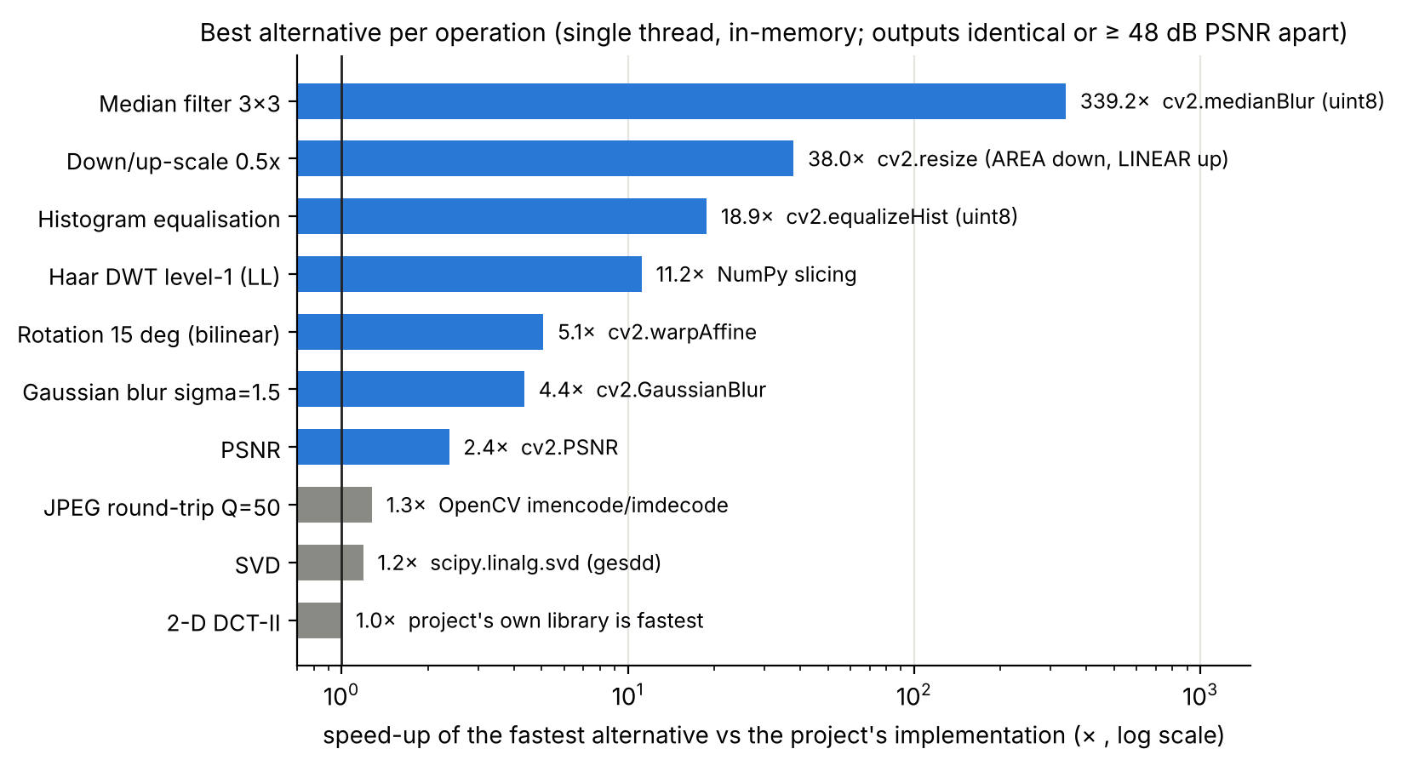
17
COMPARISON WITH EXISTING TECHNOLOGIES · COMPONENTS
Same operation, different libraries: numerically equal, speed rarely matters here
What the measurements say
▪ DCT / SVD / Haar agree to ≤ 1.5e-16 (DWT 1e-13); Pillow ≡ OpenCV JPEG
▪ SVD dominates embedding (≈ 23 of 37 ms); scipy.linalg.svd is 1.19× NumPy's
▪ OpenCV: median ≈ 340×, blur 4.4×, rotation 5.1×, rescale 38×, equalise 19× (partly uint8 vs float64)
▪ PyWavelets Haar is 11× slower than four lines of NumPy — still the right general tool
▪ ImageMagick CLI ≈ 49 ms per JPEG (process + disk)
▪ Whole experiment ≈ 80 s on 4 cores → no performance case for switching
Documentation-based capability matrix (not benchmarked) is in the report, Table 3.1.
NMIMS MPSTME · Image & Video Processing
17
Notes:
Component benchmark: the same operation on the same input in different libraries, one thread, in memory, warm-up and repeats. Results agree numerically: DCT and SVD to ten to the minus sixteen, Pillow and OpenCV JPEG bit-identical. OpenCV is much faster for the attack operations — about 340 times for the 3 by 3 median — partly because it works on uint8. But the whole 100-image experiment takes about 80 seconds, so changing libraries is not justified on speed. ImageMagick as a command line tool costs about 49 milliseconds per call, dominated by process start-up.

Slide 18
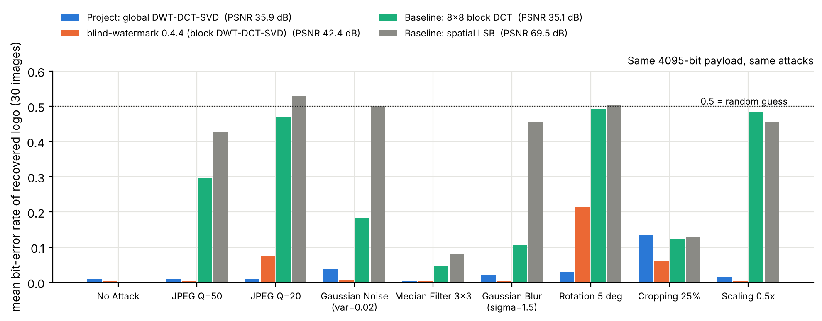
18
COMPARISON WITH EXISTING TECHNOLOGIES · SCHEMES
Beats LSB and block-DCT at equal PSNR — but not an existing blind block-based hybrid
Reading the comparison
▪ Project ≫ LSB and block-DCT under JPEG, scaling, rotation
▪ blind-watermark: lower BER under JPEG Q=50 (0.004 vs 0.010), noise, blur, cropping; higher PSNR (42.4 dB)
▪ …but 13× slower and worse under rotation (0.214 vs 0.029) and JPEG Q=20
▪ Its colour/YUV design and channel-wise attacks may favour it
▪ No claim of superiority — contribution = explainable reference implementation + measured weaknesses
 | Project | blind-watermark | block DCT | LSB
PSNR (dB) | 35.9 | 42.4 | 35.1 | 69.5
JPEG Q=50 BER | 0.010 | 0.004 | 0.296 | 0.426
Rotation 5° BER | 0.029 | 0.214 | 0.493 | 0.504
Cropping BER | 0.135 | 0.060 | 0.124 | 0.128
embed / extract ms | 32 / 17 | 420 / 315 | 26 / 12 | 2 / 1
blind? | no (key) | yes | yes | yes
NMIMS MPSTME · Image & Video Processing
18
Notes:
Scheme-level comparison with the same 4095-bit payload and the same attacks on 30 images. The block-DCT baseline was tuned to match the project's PSNR. LSB is imperceptible but destroyed by any processing. The open-source blind-watermark package, which is also DWT-DCT-SVD but block-based and blind, has lower bit-error rates under most attacks at higher PSNR, 42 against 36 dB. But it is 13 times slower to embed, 18 times slower to extract, and worse under rotation and strong JPEG. Caveat: its YUV design and my channel-wise attacks may favour it. So the project is a simple, explainable, key-based alternative, not a better algorithm.

Slide 19
19
EXPLORATORY VIDEO TEST
Per-frame embedding survives H.264 and MJPEG re-encoding — feasibility, not a video benchmark
Codec setting | PSNR (dB) | mean NC | min NC | size (kB)
lossless (FFV1) | 35.6 | 0.980 | 0.977 | 5289
H.264 CRF 18 | 35.0 | 0.980 | 0.977 | 381
H.264 CRF 23 | 34.6 | 0.980 | 0.976 | 181
H.264 CRF 28 | 33.9 | 0.979 | 0.974 | 88
MJPEG q=5 | 34.3 | 0.979 | 0.975 | 1244
MJPEG q=15 | 32.3 | 0.977 | 0.972 | 595
720
≥ 0.97
decoded frames, 0 failed
NC in every frame
Caveats
▪ 2 clips × 60 frames — small
▪ one key per frame (≈ 2 MB)
▪ no frame dropping, re-timing, colour or hardware codecs
▪ naive frame-drop still NC 0.97 (similar neighbours)
Embedding ≈ 32–41 ms per 512² frame on one core (≈ 24–31 frames/s) · clips: vtest.avi (768×576), Megamind.avi (720×528) from the OpenCV sample data
NMIMS MPSTME · Image & Video Processing
19
Notes:
Because the project's future-scope slide mentioned video, I tested it: 60 frames from each of two real clips, read with OpenCV, watermarked frame by frame, each with its own key, re-encoded with FFmpeg as lossless FFV1, H.264 at three quality levels, and MJPEG at two. All 720 decoded frames gave NC at least 0.972. So lossy codecs are not the difficulty. The caveats are important: keys are per frame, about 2 megabytes each; temporal attacks such as frame dropping or re-timing were not tested; and a naive misaligned frame-drop test still gave NC 0.97, presumably because neighbouring frames are similar — another sign that NC does not bind a mark to a frame.

Slide 20
20
CLAIMS VERSUS EVIDENCE
What held up and what did not: ten claims of the first submission checked at n = 100
First submission | This evaluation (100 images) | Verdict
PSNR 35.6 dB / SSIM 0.996 (2 images) | 36.0 dB / 0.992; 3 images < 0.98 | ✓ with exceptions
25 / 30 trials ≥ 0.75 | 1277 / 1500 (85.1 %); attacks only 84.1 % | ✓
JPEG: NC > 0.97 | 0.977 / 0.975 / 0.956 (Q 90/50/20) | ✓ (Q ≥ 50)
Rotation/scaling NC > 0.93 | scaling 0.938; rotation 5° 0.880 | scaling ✓ · rotation ✗
Cropping fails; hist-eq 0.10 / 0.66 | pass 1 %; hist-eq mean 0.644 (44 % pass) | ✓ (hist-eq varies)
Robustness rises with α (JPEG) | flat 0.960 → 0.973 | ✗ artefact
"Block DCT", "semi-blind" | global DCT, non-blind | corrected
"Fifteen attacks" | 14 attacks + the unattacked reference | corrected
Extraction proves ownership | wrong logo decoded at NC 0.975 | ✗ not supported
Hybrids beat single transforms | not tested; blind-watermark beats the project | unverified
NMIMS MPSTME · Image & Video Processing
20
Notes:
A direct comparison of the first submission's claims with the 100-image evidence. The headline numbers are reproducible and mostly hold. What changed: moderate rotation is weaker than claimed, the alpha trade-off figure was an artefact for JPEG, the block-DCT and semi-blind labels were wrong, the suite is fourteen attacks plus a reference, and — most importantly — extraction does not prove ownership.

Slide 21
21
IMPLEMENTATION · QUALITY · REPRODUCIBILITY
Tested, seeded and logged: 43 tests, zero failures, identical re-runs
Engineering
Verification
Traceability
▪ numerics of embed/extract_watermark unchanged
▪ validation: 2-D, finite, size, α > 0
▪ image_io: alpha, 16-bit, corrupt/empty files
▪ config-driven batch runner, 4 workers
▪ 43 tests pass (functions, edge cases, loaders, completeness)
▪ legacy re-run reproduces the first report (≤ 0.004 NC)
▪ two full runs: identical metrics
▪ all 100 output PNGs re-opened and validated
▪ originals preserved in original_backup/
▪ CHANGELOG lists every change and why
▪ negative results saved: principal-component variant; JPEG truncation
▪ PROJECT_AUDIT: 15 findings, F1–F15
REPRODUCE
python build_dataset.py → run_batch_experiment.py → analysis.py → benchmark_tech.py → video_demo.py
python -m pytest tests -q · Python 3.13, NumPy 2.5, SciPy 1.18, scikit-image 0.26, Pillow 12.3, OpenCV 5.0, FFmpeg 6.1
NMIMS MPSTME · Image & Video Processing
21
Notes:
Implementation: the embed and extract numerics are unchanged, so the first submission's numbers remain reproducible — I re-ran its experiment and got the same table within 0.004. Added: input validation, a safe image loader, a dataset builder, a multiprocessing batch runner that records status and time per operation and re-opens every output, seeded attacks, and 43 tests. Bug found during development, for transparency: a debug flag overwrote the metadata file; fixed, with a regression test.

Slide 22
22
LIMITATIONS · FUTURE SCOPE
Known limits — and the next steps the evidence supports
Limitations (measured)
Future scope (in priority order)
▪ False-positive problem — not fixed
▪ Non-blind: ≈ 2.1 MB key per image
▪ Cropping 1 %, rotation 15° 72 %, hist-eq 44 %
▪ Grey-scale only; clean BER ≈ 0.9 % (logo resampling)
▪ Dataset: convenience sample, rights mostly undocumented
▪ Only one existing package compared; no GPU; ±5–10 % timing noise
▪ Video: exploratory, per-frame keys, no temporal attacks
▪ 1 · Image-bound signature to remove false positives — verify with the E4 controls
▪ 2 · Block-based redundant embedding for cropping; use blind-watermark as the new baseline
▪ 3 · Geometric re-synchronisation (log-polar / template) [22]
▪ 4 · Colour: embed in the Y channel of YCbCr
▪ 5 · Video: index-aware keys, temporal redundancy, frame-drop and re-timing tests; real-time port (≈ 27 fps single-core as is)
▪ 6 · Learned watermarkers [29][30] as a comparison, if the no-ML rule is relaxed
NMIMS MPSTME · Image & Video Processing
22
Notes:
Limitations: false positives, non-blind key, cropping and rotation, histogram equalisation, grey-scale only, a lossy clean extraction of about 1 percent BER, and a dataset that is a convenience sample. Future work is ordered by evidence: first bind the logo to the image; then block-based redundant embedding for cropping; then geometric re-synchronisation; colour via luminance; and a proper video design with shared or index-aware keys.

Slide 23
23
CONCLUSION
A transparent scheme that survives everyday processing — but NC alone is not proof of ownership
36.0 dB / 0.992
85.1 %
NC 0.98
mean PSNR / SSIM over 100 images
of 1500 trials with NC ≥ 0.75
for a DIFFERENT logo with the owner's key
KEY TAKEAWAYS
▪ Works: JPEG Q ≥ 20, median, sharpening, scaling, blur, mild noise — ≥ 95 % pass rate; per-frame video re-encoding too
▪ Does not: border cropping (1 %), histogram equalisation (44 %), rotation 15° (72 %); first report's α-trade-off figure was an artefact for JPEG
▪ Cannot claim: ownership from NC alone (false-positive problem) or superiority over existing technology
▪ Next: bind the logo to the image, block-based redundancy, geometric re-synchronisation
NMIMS MPSTME · Image & Video Processing
23
Notes:
Conclusion. The scheme is transparent and survives re-compression and filtering well: 85 percent of all trials, 84 percent of attack trials. Imperceptibility is good on typical images with exceptions. The extension changed the story in four ways: the alpha trade-off exists only for harsher attacks, rotation and equalisation are weaker than claimed, a high NC does not prove ownership, and an existing package beats the project on most attacks. What I would do next is bind the logo to the image. Thank you; questions welcome.

Slide 24
24
REFERENCES
Verified sources (IEEE style) — status flags in research/REFERENCES.md
[1] I. J. Cox et al., “Secure spread spectrum watermarking for multimedia,” IEEE Trans. Image Process., 6(12):1673–1687, 1997.
[2] R. Liu and T. Tan, “An SVD-based watermarking scheme for protecting rightful ownership,” IEEE Trans. Multimedia, 4:121–128, 2002.
[3] E. Ganic and A. M. Eskicioglu, “Robust DWT-SVD domain image watermarking: embedding data in all frequencies,” Proc. MM&Sec ’04, ACM, pp. 166–174, 2004.
[4] X.-P. Zhang and K. Li, “Comments on ‘An SVD-based watermarking scheme…’,” IEEE Trans. Multimedia, 7:593–594, 2005.
[5] G. C.-W. Ting, “Ambiguity attacks on the Ganic–Eskicioglu DWT-SVD scheme,” Proc. ICISC, pp. 378–388, 2005.
[7] C.-C. Lai and C.-C. Tsai, “Digital image watermarking using DWT and SVD,” IEEE Trans. Instrum. Meas., 59(11):3060–3063, 2010.
[8] S. Bekkouch and K. M. Faraoun, “…combined DCT-DWT-SVD transforms,” J. Inf. Process. Syst., 11(3):406–420, 2015.
[9] M. Begum, J. Ferdush, M. S. Uddin, “A hybrid robust watermarking system based on DCT, DWT and SVD,” J. King Saud Univ. CIS, 34(8):5856–5867, 2022.
[10] R. G. van Schyndel et al., “A digital watermark,” Proc. ICIP, vol. 2, pp. 86–90, 1994. [11] E. Koch and J. Zhao, Proc. IEEE NSIP Workshop, pp. 452–455, 1995.
[12] S. G. Mallat, IEEE Trans. PAMI, 11(7):674–693, 1989. [13] N. Ahmed, T. Natarajan, K. R. Rao, IEEE Trans. Comput., C-23(1):90–93, 1974.
[16] Z. Wang et al., “Image quality assessment: from error visibility to structural similarity,” IEEE Trans. Image Process., 13(4):600–612, 2004.
[17] F. Hartung and M. Kutter, “Multimedia watermarking techniques,” Proc. IEEE, 87(7):1079–1107, 1999.
[22] C.-Y. Lin et al., “Rotation, scale, and translation resilient watermarking for images,” IEEE Trans. Image Process., 10(5):767–782, 2001.
[23] F. Hartung and B. Girod, “Watermarking of uncompressed and compressed video,” Signal Process., 66(3):283–301, 1998.
[28] blind-watermark 0.4.4, github.com/guofei9987/blind_watermark · [29] J. Zhu et al., HiDDeN, ECCV 2018 · [30] M. Tancik et al., StegaStamp, CVPR 2020
Software: NumPy [19], SciPy [20], scikit-image [21], PyWavelets [18], Pillow, OpenCV, FFmpeg, ImageMagick. Dataset sources and attributions: data/README.md.
NMIMS MPSTME · Image & Video Processing
24
Notes:
References. All bibliographic details were checked against publisher or secondary records; entries that could not be verified were not cited. The full list with verification status is in research/REFERENCES.md. Thank you.

