Slide 1
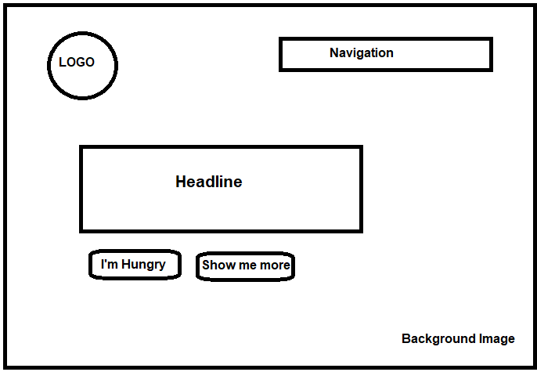
Section-1 Header

Slide 2
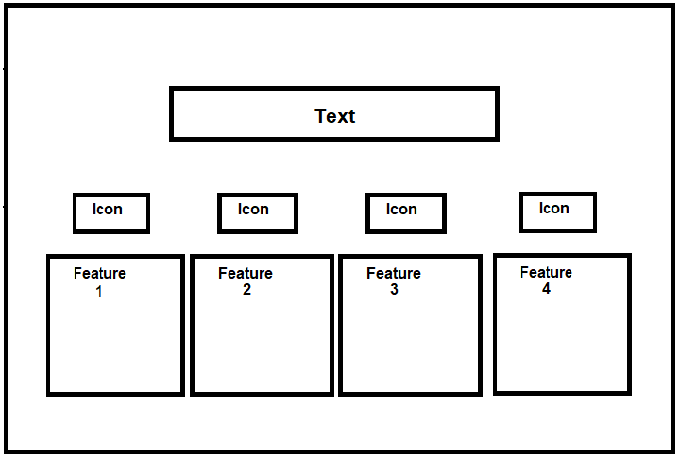
Section-2 features

Slide 3
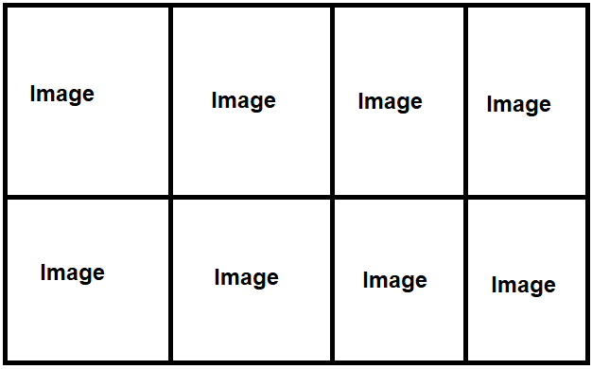
Section-3 favourite meals

Slide 4
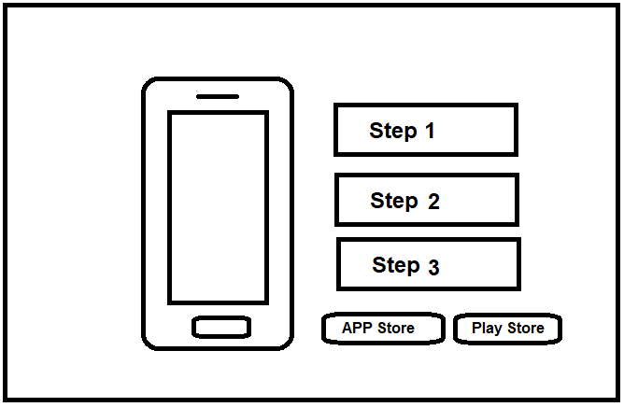
Section-4 how it works

Slide 5
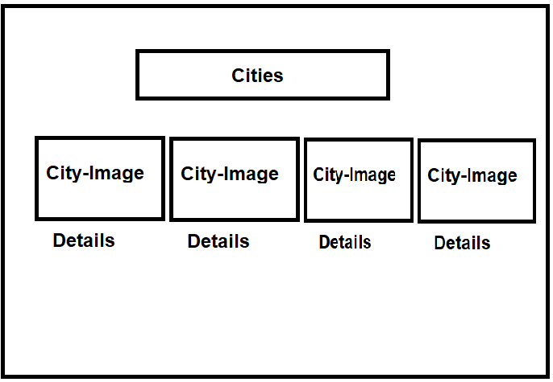
Section-5 cities

Slide 6
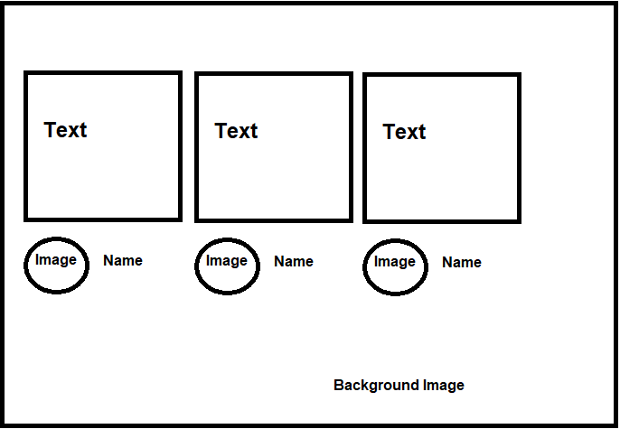
Section-6 customer testimonials

Slide 7
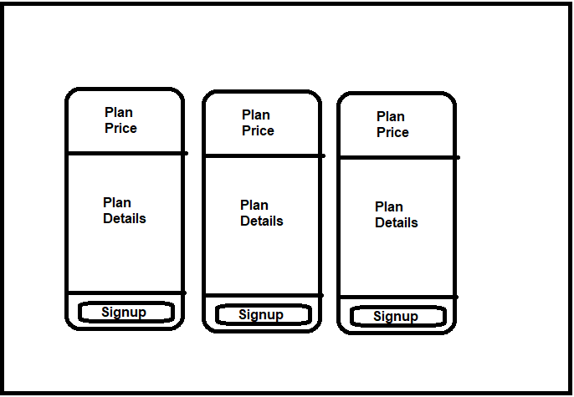
Section-7 signup and plan pricing

Slide 8
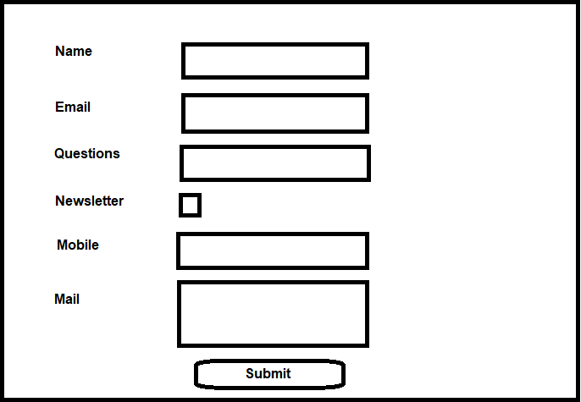
Section-8 contact form

Slide 9
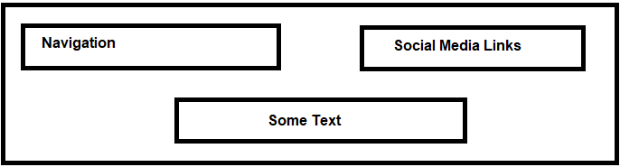
Section-9 Footer

