Slide 1
Inheritance in Java
Inheritance in Java is a mechanism in which one object acquires all the properties and behaviors of a parent object. It is an important part of OOPs (Object Oriented programming system).
The idea behind inheritance in Java is that you can create new classes that are built upon existing classes. When you inherit from an existing class, you can reuse methods and fields of the parent class. Moreover, you can add new methods and fields in your current class also.

Slide 2
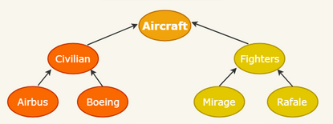
Inheritance in Java

Slide 3
Terms used in Inheritance
Class: A class is a group of objects which have common properties. It is a template or blueprint from which objects are created.
Sub Class/Child Class: Subclass is a class which inherits the other class. It is also called a derived class, extended class, or child class.
Super Class/Parent Class: Superclass is the class from where a subclass inherits the features. It is also called a base class or a parent class.
Reusability: As the name specifies, reusability is a mechanism which facilitates you to reuse the fields and methods of the existing class when you create a new class. You can use the same fields and methods already defined in the previous class.

Slide 4
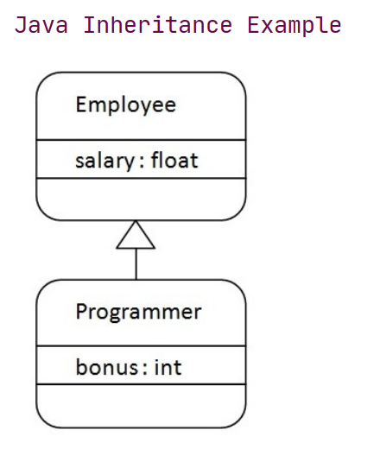
Inheritance in Java

Slide 5
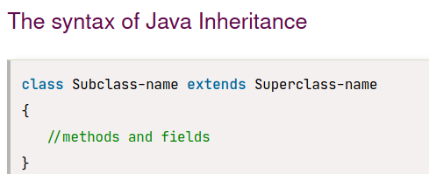
Inheritance in Java

Slide 6
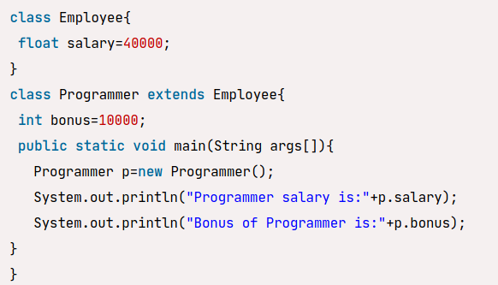
Inheritance in Java

Slide 7
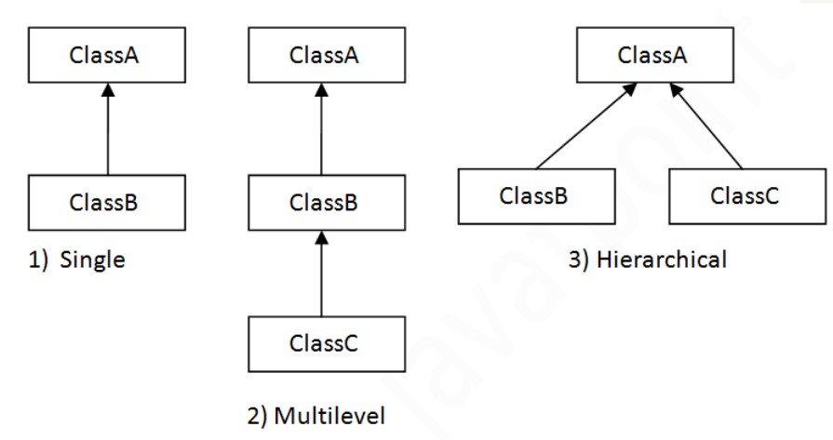
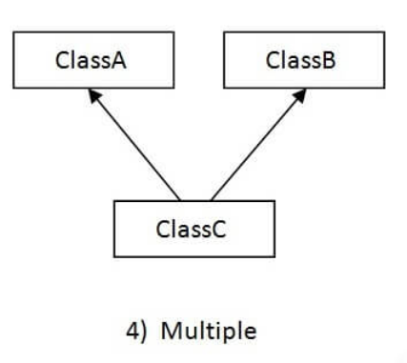
Types of inheritance in java
On the basis of class, there can be three types of inheritance in java: single, multilevel and hierarchical.

Slide 8
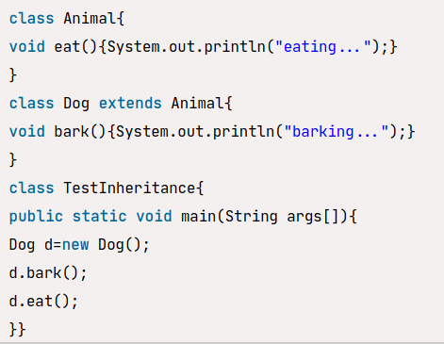
Single Inheritance Example
When a class inherits another class, it is known as a single inheritance. In the example given below, Dog class inherits the Animal class, so there is the single inheritance.

Slide 9
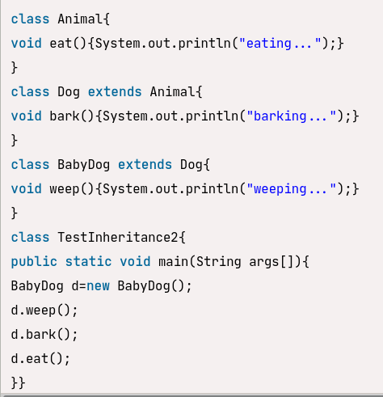
Multilevel Inheritance Example

Slide 10
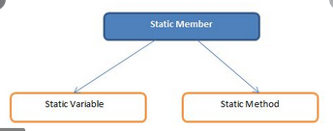
Java static keyword
The static keyword belongs to the class than an instance of the class.
The static can be:
Variable (also known as a class variable)
Method (also known as a class method)

Slide 11
Java static variable
The static variable gets memory only once in the class area at the time of class loading.
The static variable can be used to refer to the common property of all objects (which is not unique for each object), for example, the company name of employees, college name of students, etc.

