Slide 1

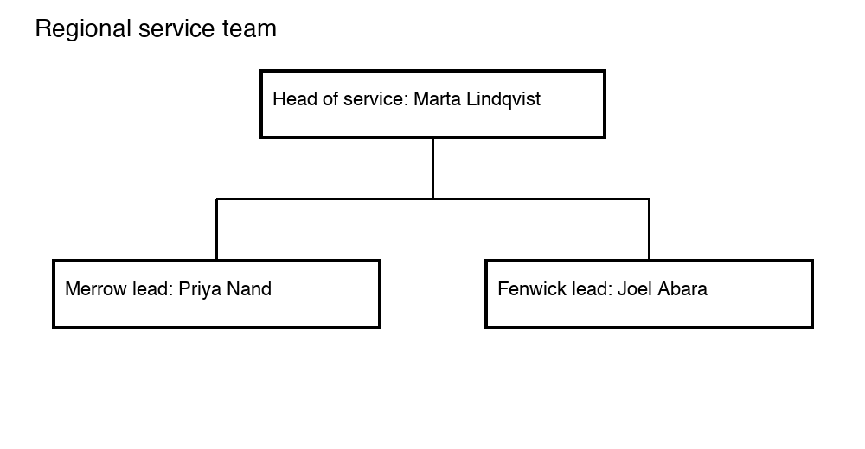
Our regional team

Slide 2
Questions?

